Slide 1
THE NEUROSURGEON’S DILEMMA: Patient Safety v Our Role As The Court Of Last Appeal
Hunt Batjer, MD

Slide 5
Hippocrates of Cos 5th Century BC

Slide 6
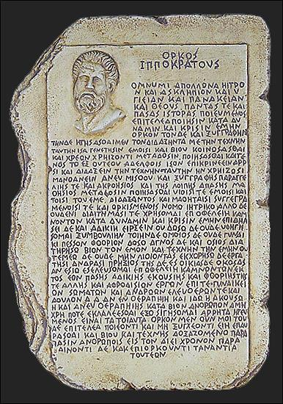

Slide 7
Newer Versions “I will prescribe regimens for the good of my patients according to my ability and my judgement and never do harm to anyone….”

Slide 8
Hippocratic Oath OUT of DATE??

Slide 9
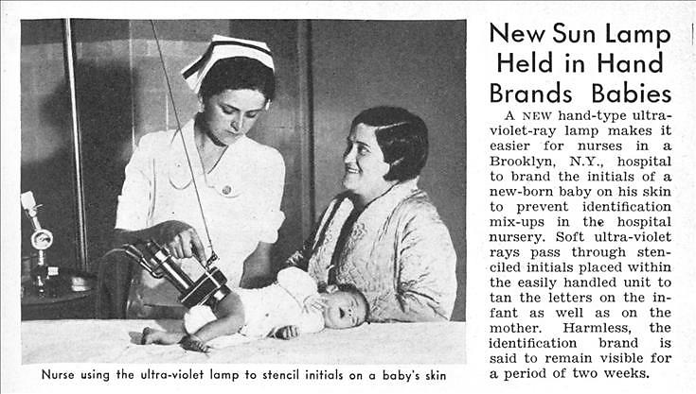

Slide 10
Modern Patient Safety Milestones
JCAH - 1950s
Accreditation Process and Standards for Hospitals
JCAHO - 1990s
Accreditation Integrated with Outcomes and Performance Standards for Healthcare Organizations
IOM Nat’l Roundtable on Healthcare Quality - 1990s
IOM- late 1990s
To Err is Human
Crossing the Quality Chasm

Slide 11
Patient Safety Milestones
Institute for Healthcare Improvement (IHI) - 2004
100,000 Lives Campaign
AHRQ
ACGME
Duty Hours Restrictions - 2003
Milestones – 2013
CCCs
Case Minimums - 2013
SNS
Matrix Curriculum
Boot Camps
NCAST
ABMS Surgical Boards Requirement for Case Minimums for Board Eligibility

Slide 12
IOM Quality Principles
Safe, Free from Harm
Patient Centered
Effective, Evidence Based
Efficient
Equitable
Timely

Slide 13
Impact in Surgical Practice
Multidisciplinary Screening
Risk Factor Assessment
Second Opinions, Conferences (Indications)
Marking the Site with Patient Aware
Time- Outs
Checklists
Chain of Command
NCC Training Standards
“Foam in, foam out”

Slide 14
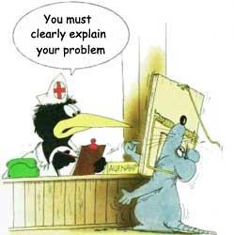

Slide 15
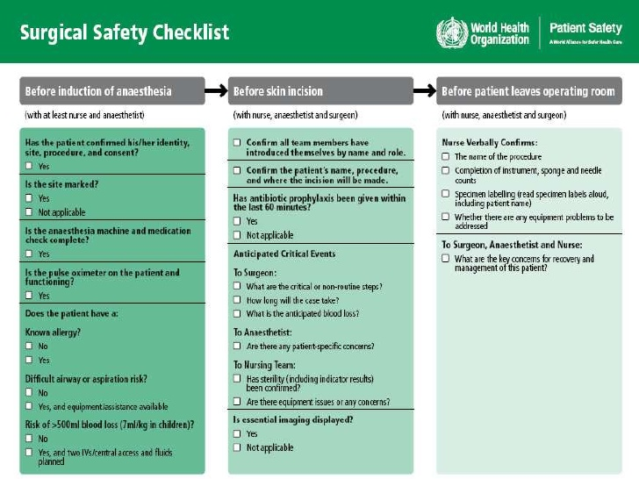

Slide 19
Unintended Consequences of Safety Initiatives
Development of perverse incentives
Avoidance of health care and rationing
Re-defining harm…time of treatment? Long term?
Durable strategies v lower risk temporizing ones
Selective memory loss re natural history
Volume and quantity of messaging deafens the audience
Silliness of messaging belittles the importance of the message
Culture of fear amongst providers and the public
Management of blame
Expectation of perfection

Slide 20
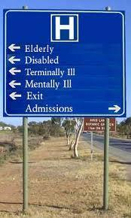

Slide 21
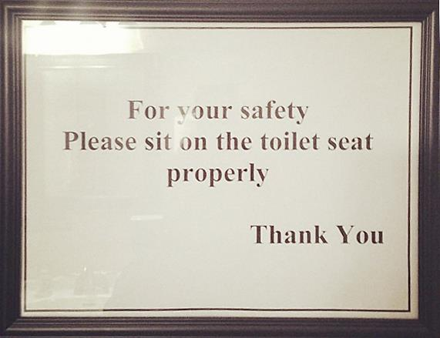

Slide 22
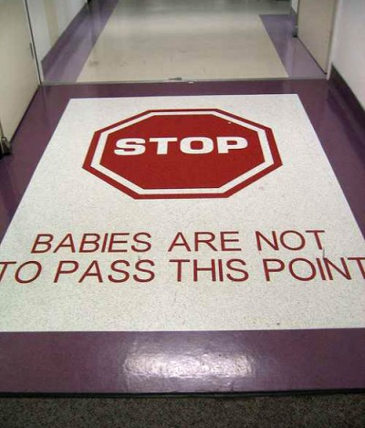

Slide 24
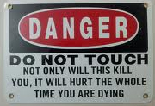
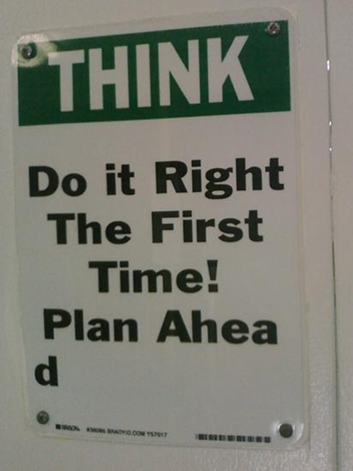
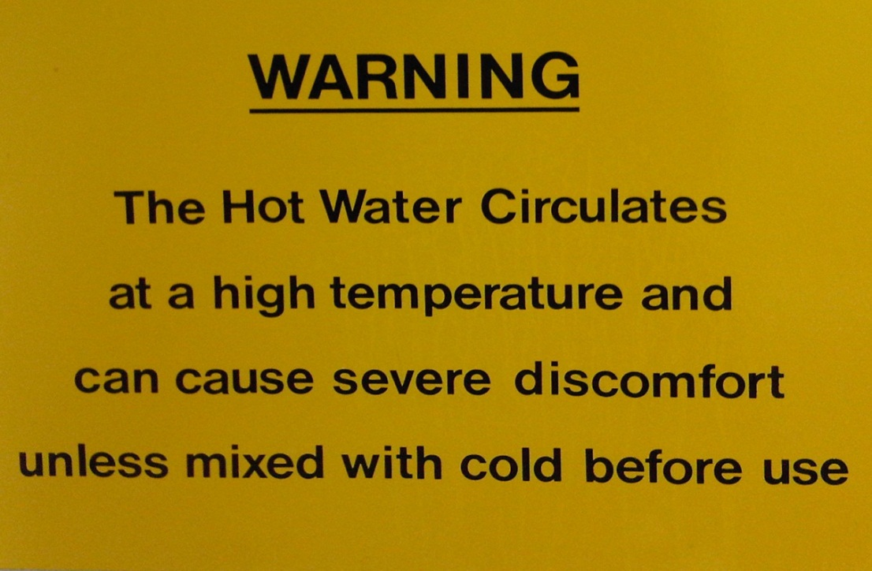

Slide 25
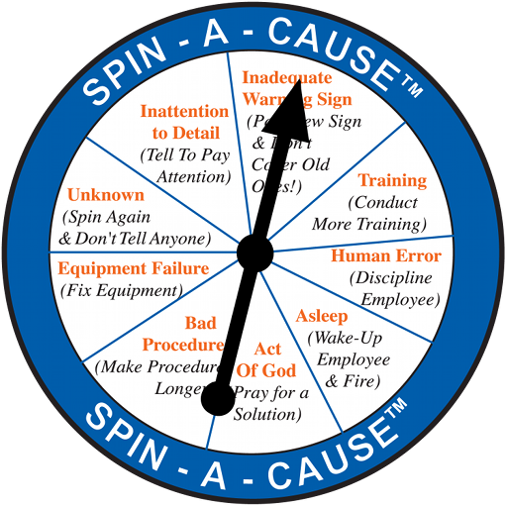

Slide 26
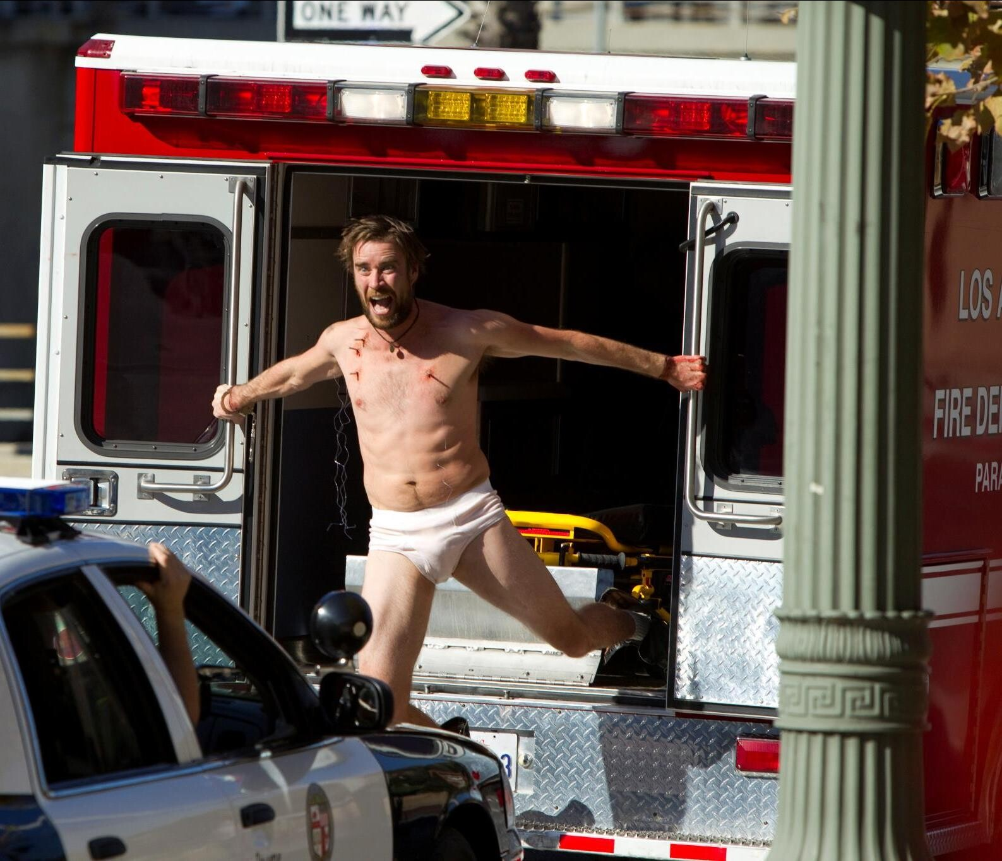

Slide 27
Dilemmas Unique to Neurosurgical Practice
Our diseases are life-threatening
Our complications are too
Refusal to intervene or delays may condemn patient to death or lasting disability
Entering the OR places the patient in harms way
How can we navigate the interface between risk avoidance and our role as the court of last appeal?

Slide 28
SAFE?

Slide 29
2011 (31 y/o)
Chronic HA (10 y) that became worse 2 mo prior to presentation
Assoc with nausea and vomiting
MRI and angio showed:
Complex rt occipital AVM fed by MCA and PCA
Started on topamax
Notes:
Aug 2004

Slide 30
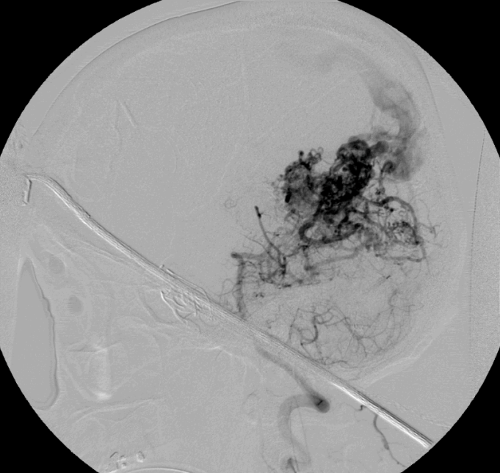
2012 (32 y/o)
Notes:
Aug 2004

Slide 31
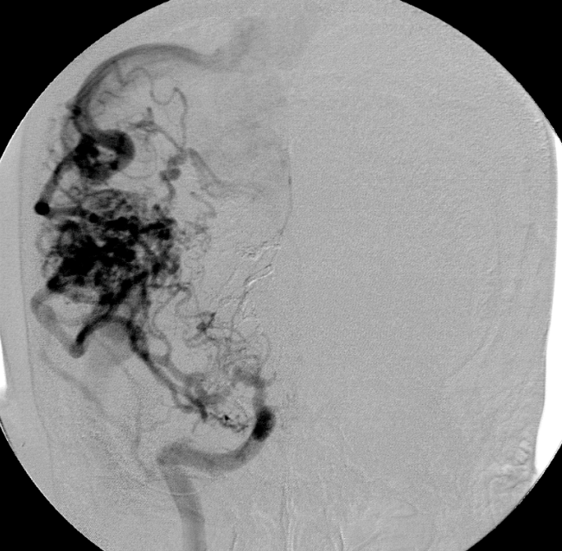
2012 (32 y/o)
Notes:
Aug 2004

Slide 32
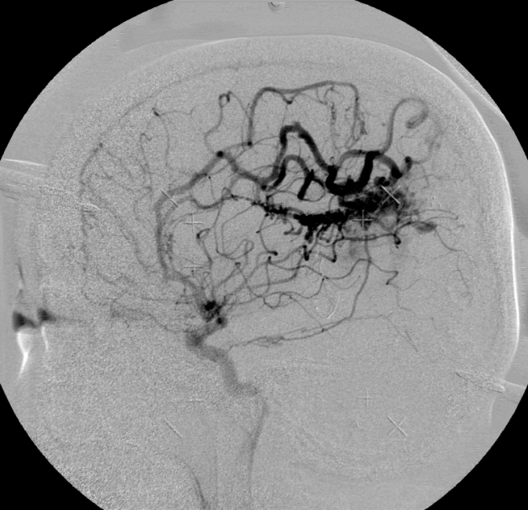
2005 (32 yo)
Notes:
Aug 2004

Slide 33
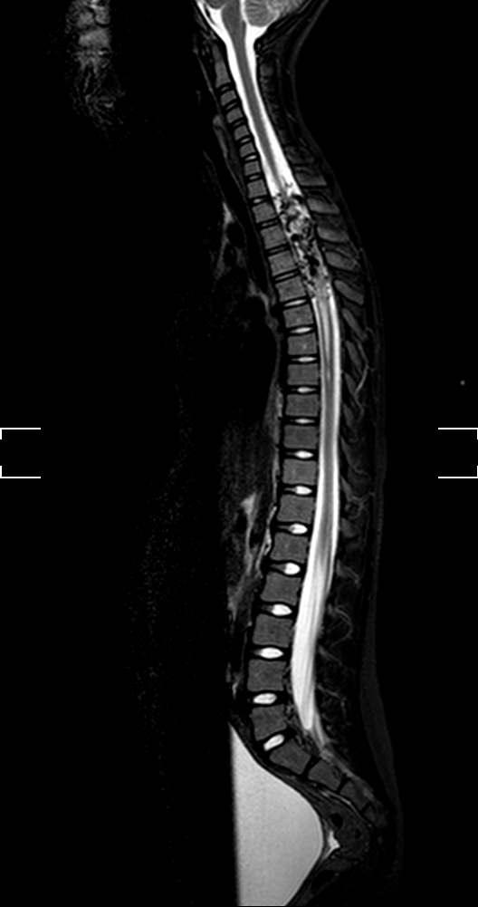
Safe?

Slide 35
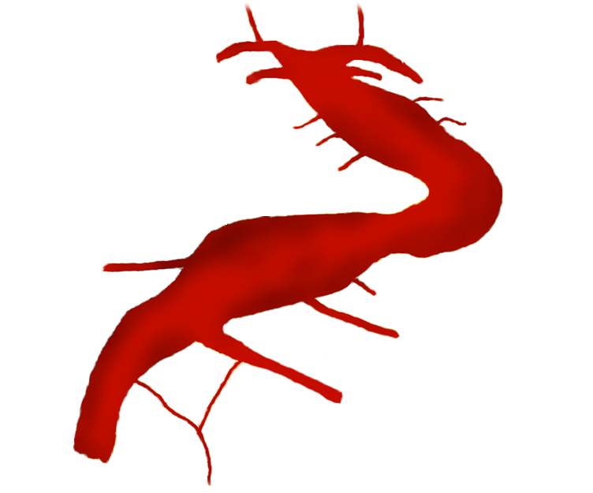
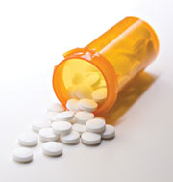
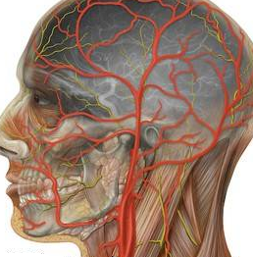
Treatment Options for Vertebro-basilar Dolichoectasia
1- Blood Pressure
Control
PCA
PCA
2- Antiplatelet
Therapy
SCA
SCA
3- Ipsilateral
Hunterian Ligation
Perforators
4-Bilateral
Hunterian Ligation
Dural Fixation
BA
Laminar Flow
5- Distal Bypass
AICA
BA
6- Surgical
Reconstruction
AICA
7- Enterprise Stent
with Coiling
VA
VA
8- Flow Diversion
9- Macrovascular
Decompression
ASA
ECA

Slide 36
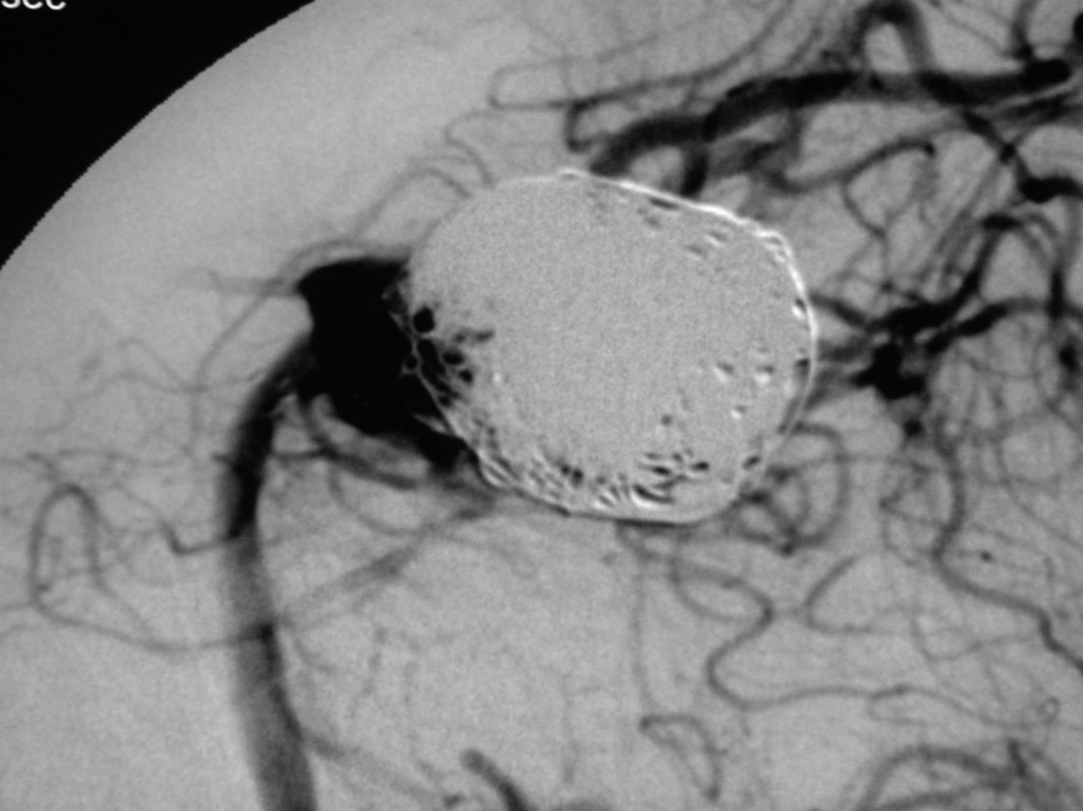
SAFE??

Slide 37
66 Y/O Man With HA, Confusion, Spastic HP

Slide 40
Errors May Be Caused By Placing Patient Safety Above All Else
Reluctance, refusal to intervene
Selection of unwise (“safer?”) treatment modalities
Forcing medical management to avoid OR
Avoiding (denying Rx to) high risk patients
Avoiding necessary intervention due to medico-legal or public disclosure concerns
Complicity with hospital priorities which puts patients at risk (LOS)
Complicity with dangerous safety protocols

Slide 41
Reluctance/ Refusal to Intervene

Slide 42
Conclusions:
Among patients without a prior SAH and with aneurysms <10mm, the rupture rate was 0.05%/yr
Aneurysms <10mm in Group II had 11x as likely a rupture
Size and location predicted likelihood of rupture in Group I, only basilar apex and not size in Group II
ISUIA
International Study of Unruptured Intracranial Aneurysms
November 24th, 2008

Slide 43
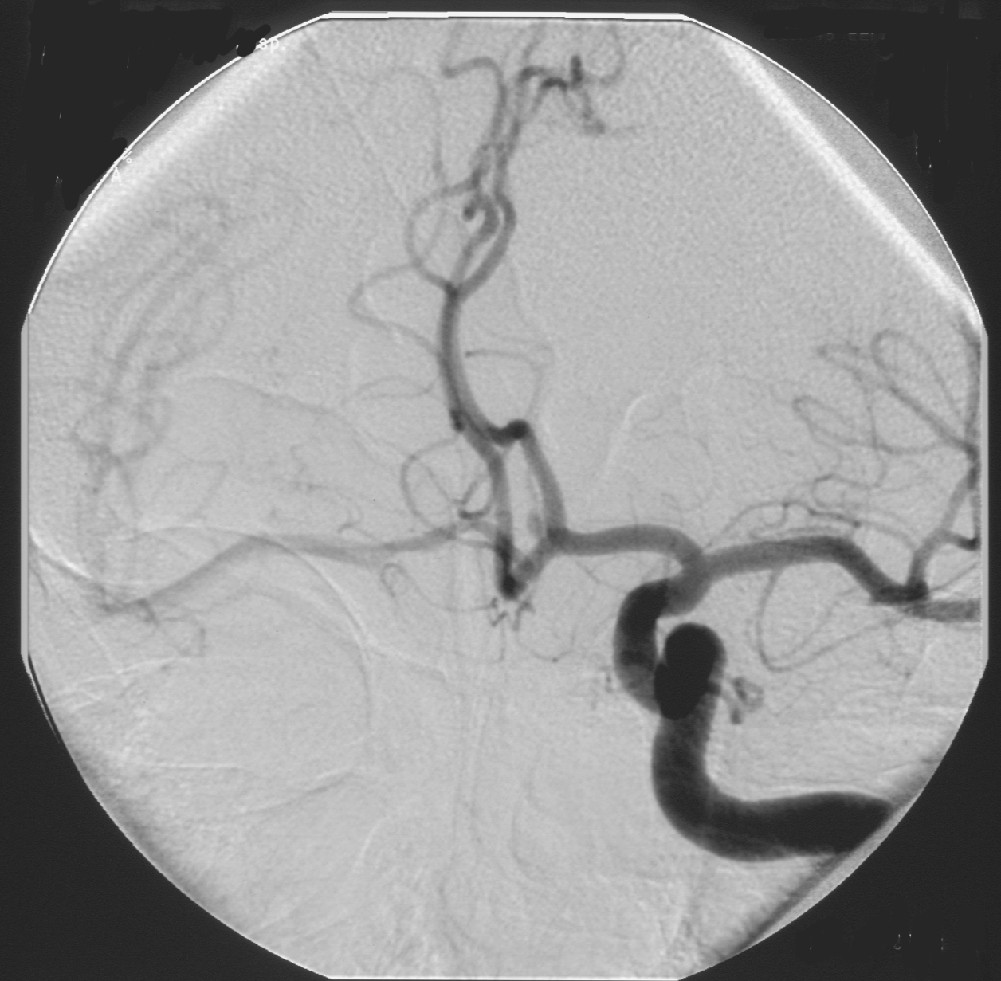

Slide 44
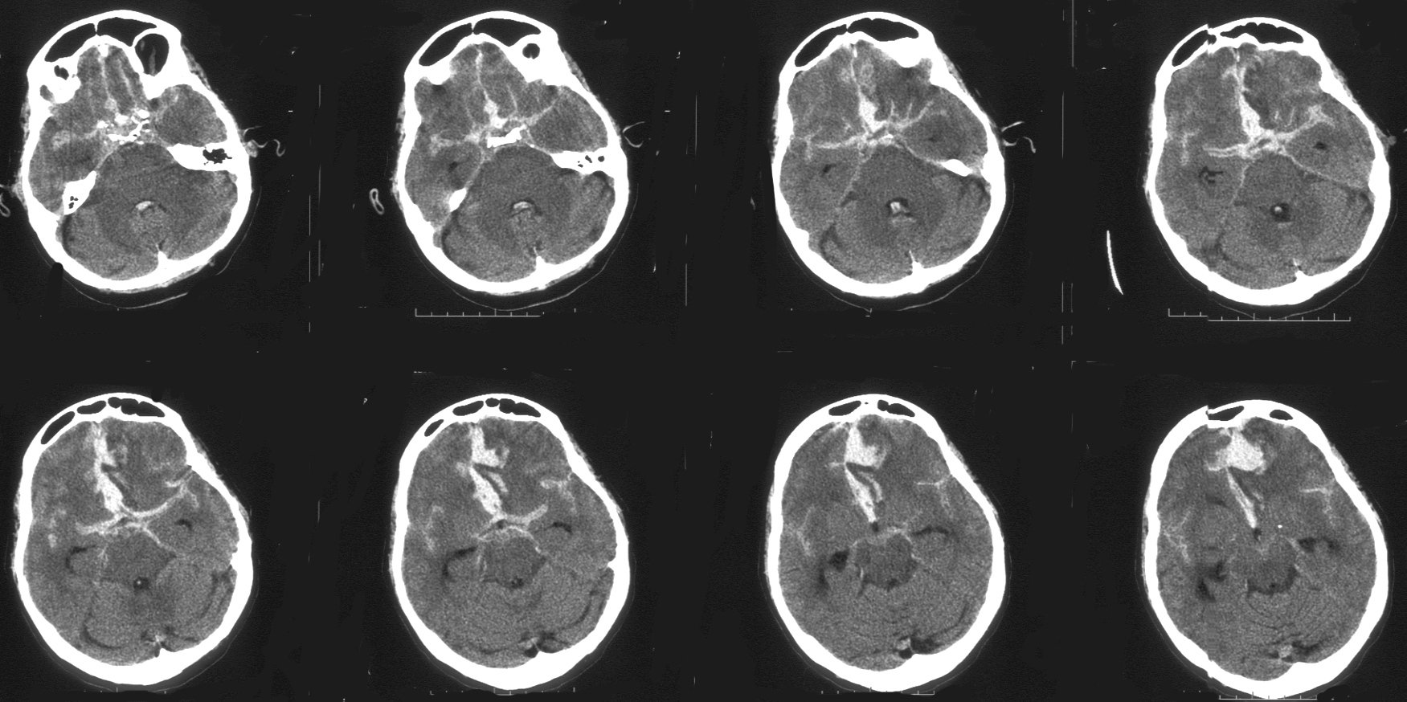

Slide 45
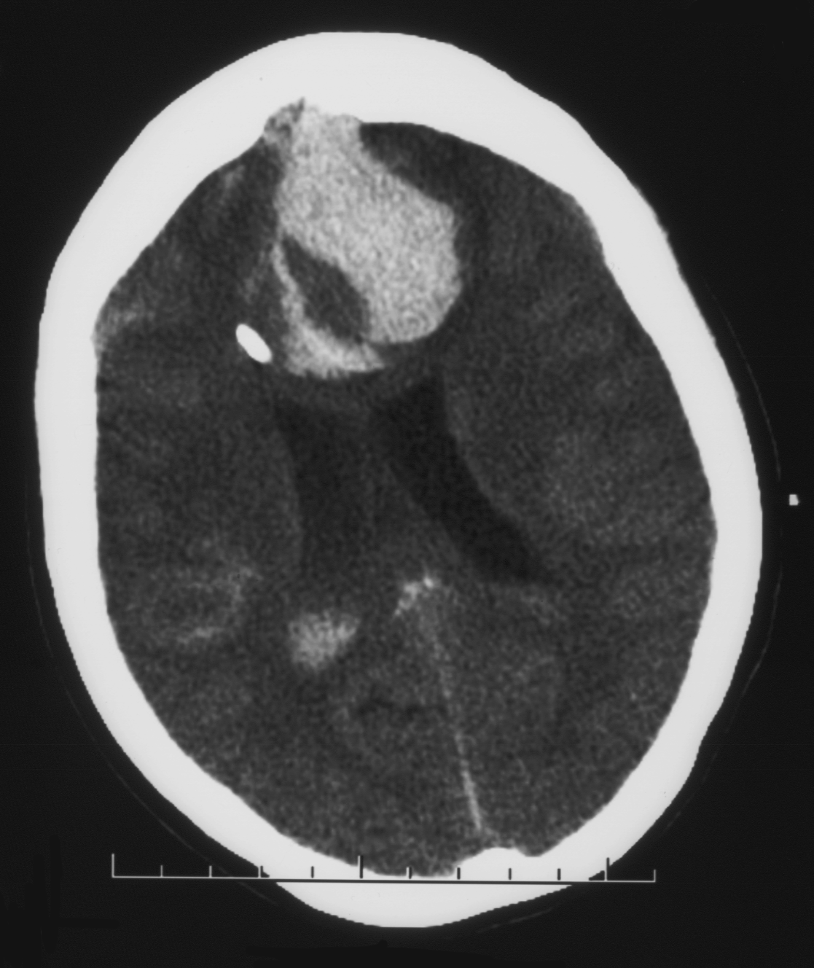

Slide 46
Aruba??

Slide 47
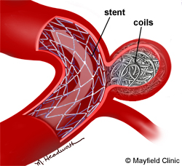
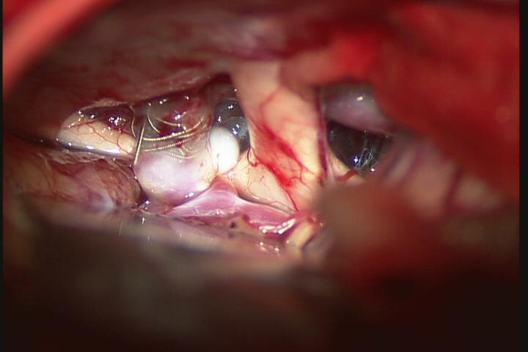
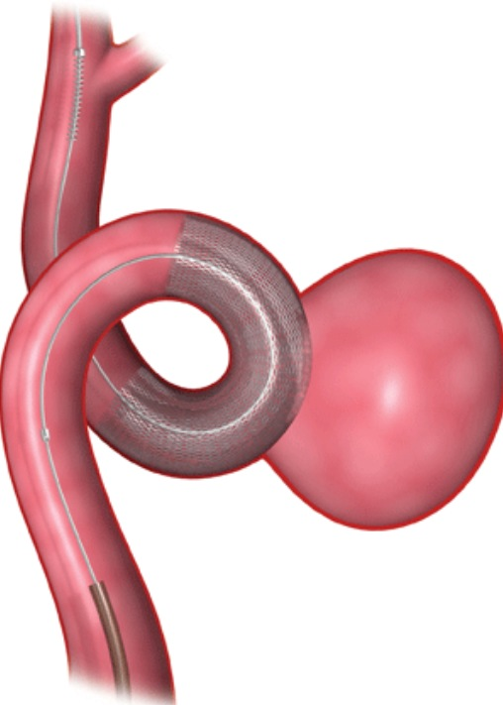
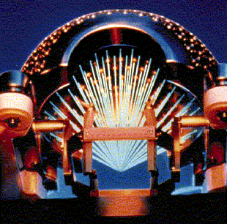
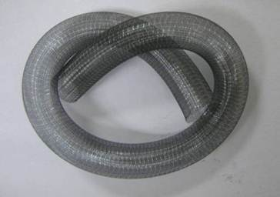
Selection of an Unwise (“Safer?”) Treatment Option

Slide 52
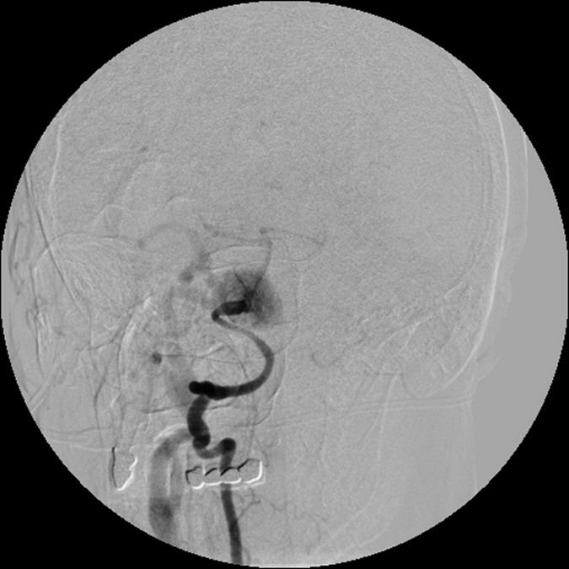

Slide 53
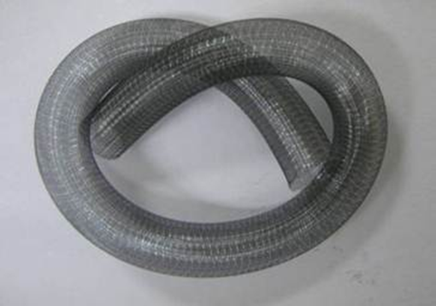

Slide 54
B.B.
73 yo F
PMH: RHF, PVD, CAD, CABG, HTN, aFib, COPD, Colon cancer s/p resection
Left M1/M2 aneurysm rupture s/p stent coiling in 2008
Recanalization
Now presents with stroke with expressive aphasia

Slide 55
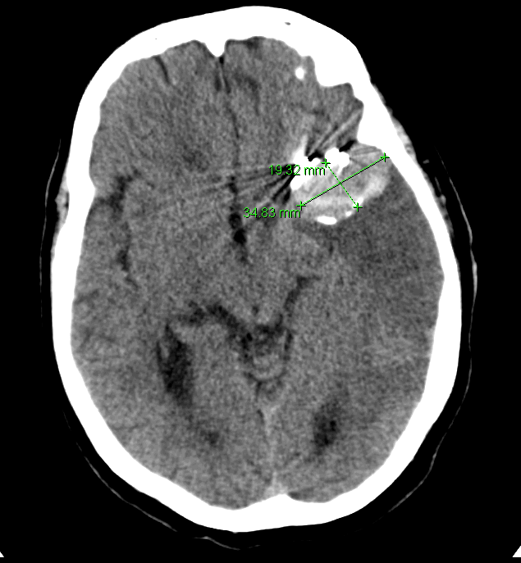

Slide 56
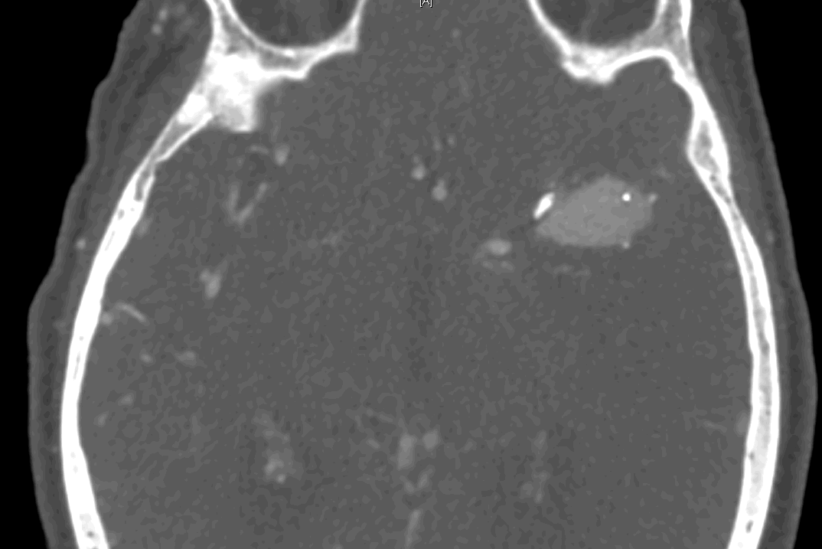

Slide 57
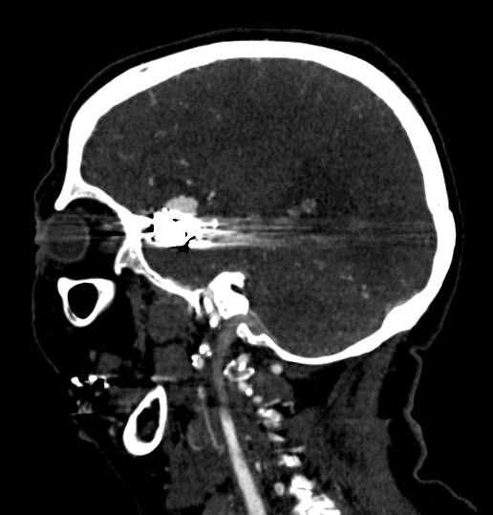

Slide 58
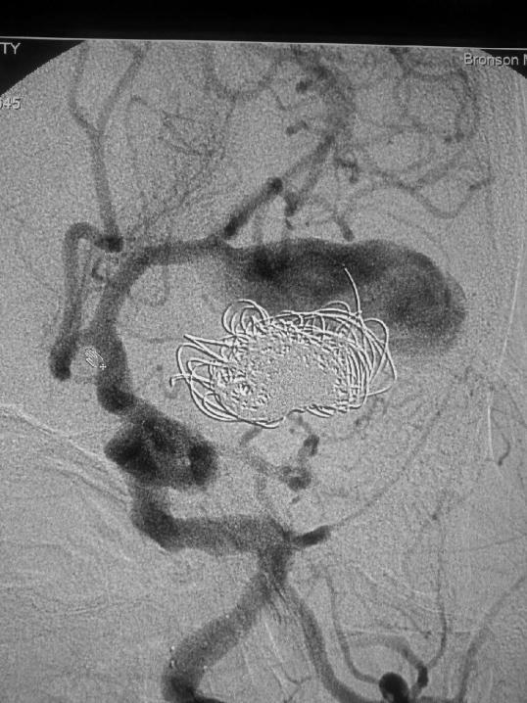

Slide 59
MF, 59Y/O Woman
Stent/ coiled R SCA in 2007
11/20/2011 SAH,stent- coiling of L P1/P2 An
5/1/2013 - HA, slurred speech, R hemiparesis, L CN III

Slide 60
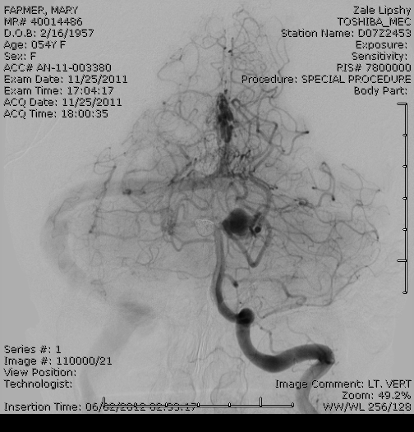
11/25/2011

Slide 61
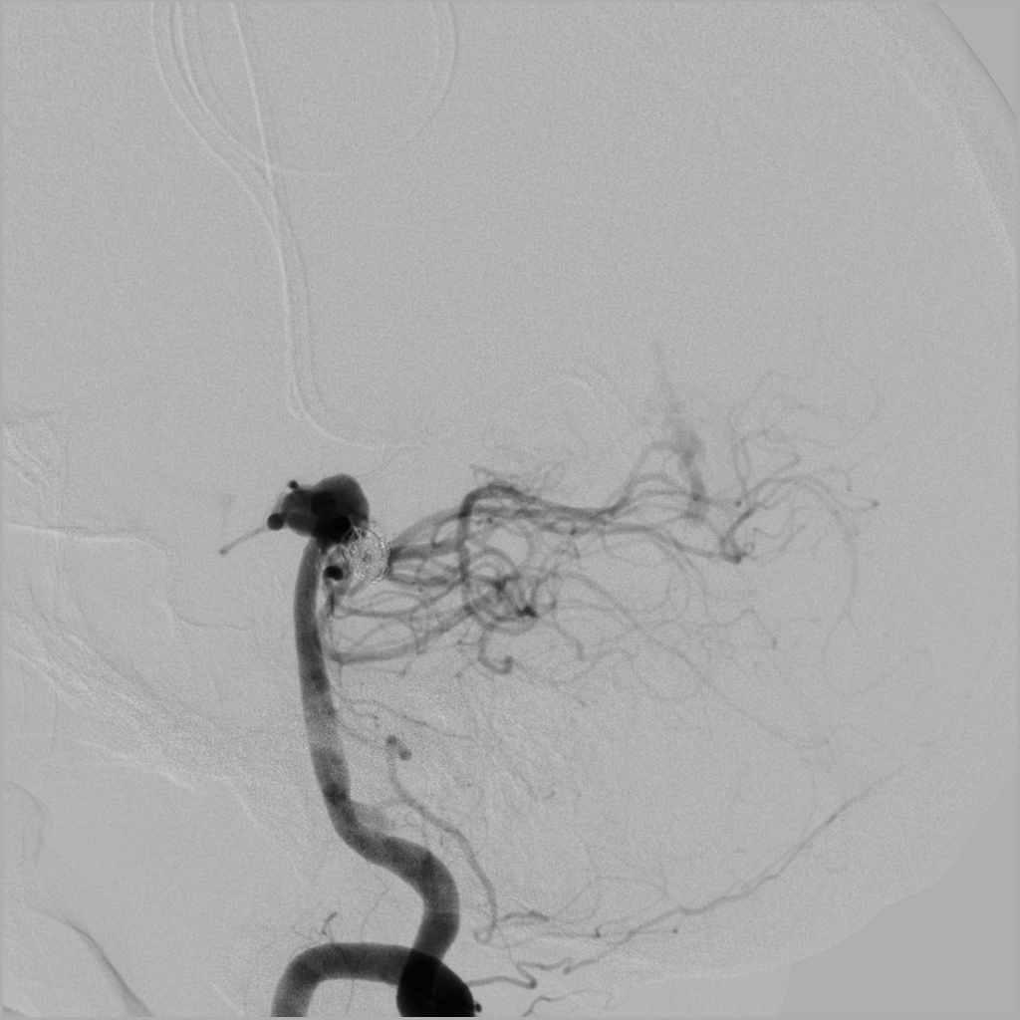
11/25/11

Slide 62
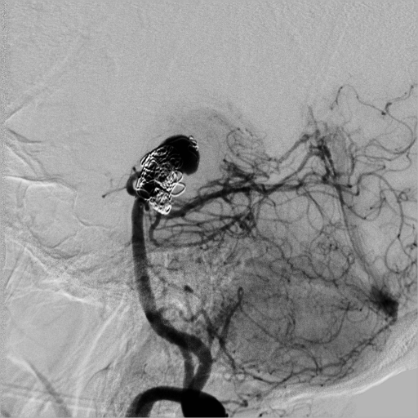
5/1/2013

Slide 63
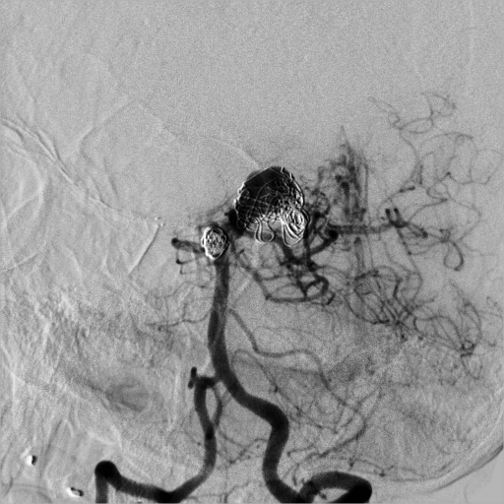
5/1/2013

Slide 64
K.P. - Radiosurgery 8 Y Prior

Slide 65
K.P.

Slide 66
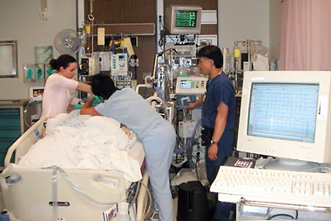
Forcing Medical Management to Avoid Surgery

Slide 67
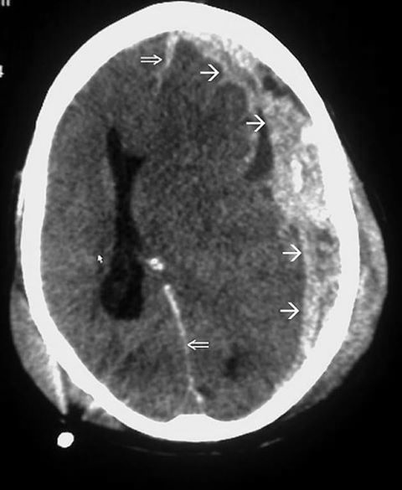

Slide 68
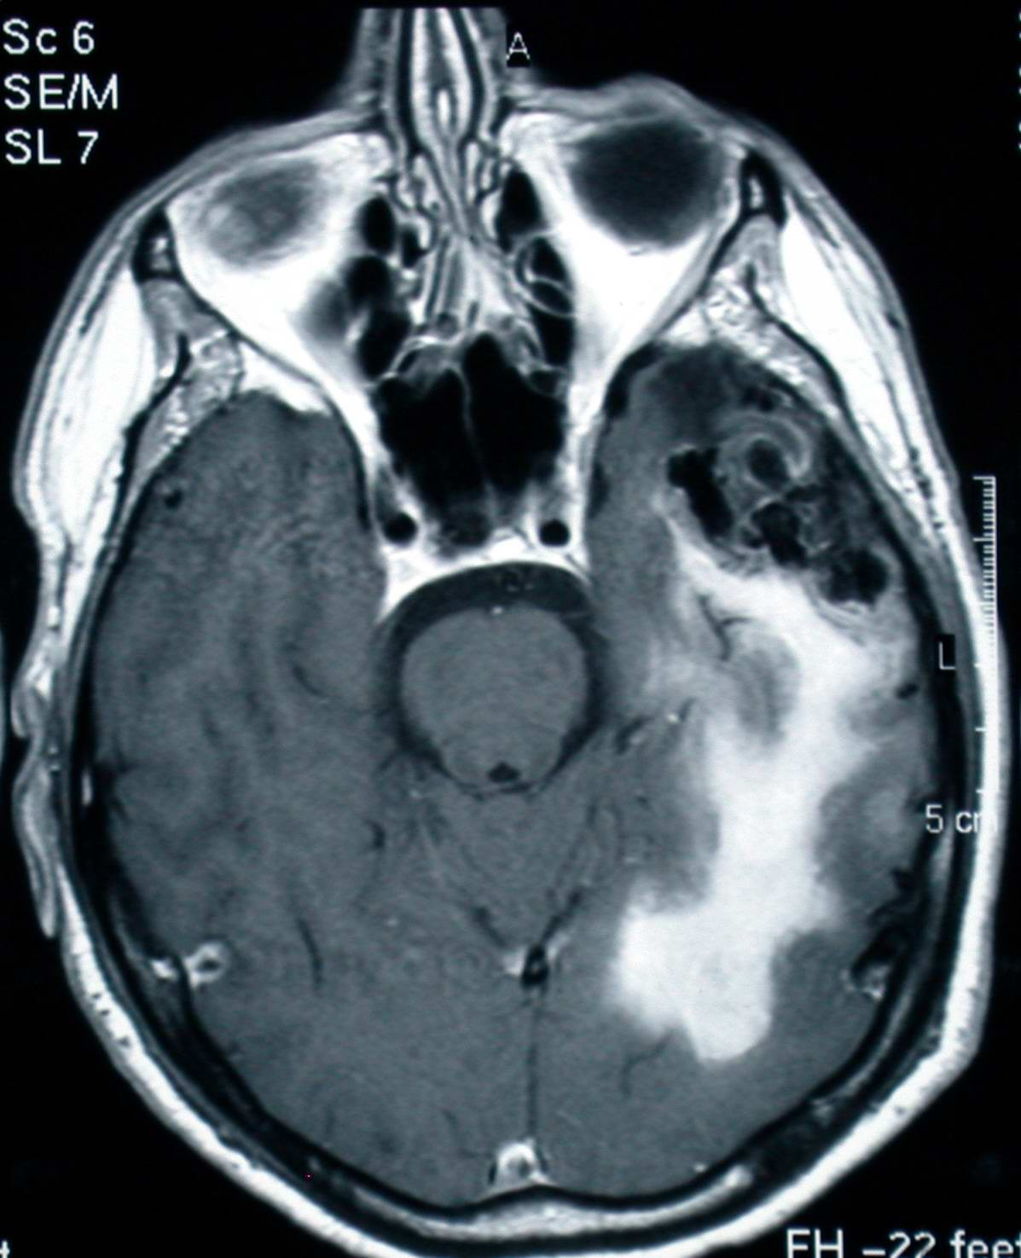
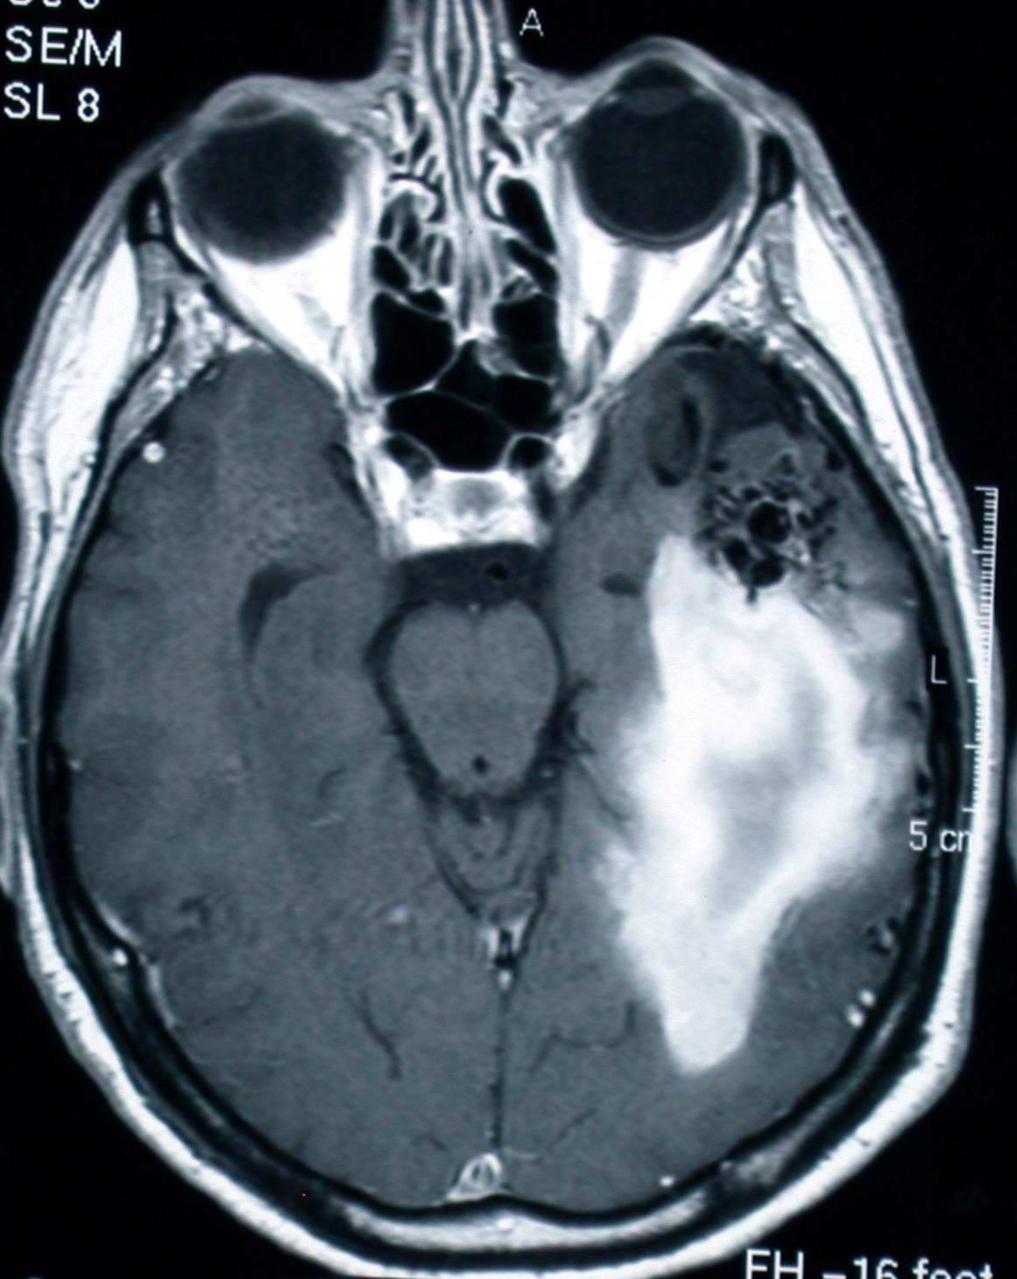

Slide 69
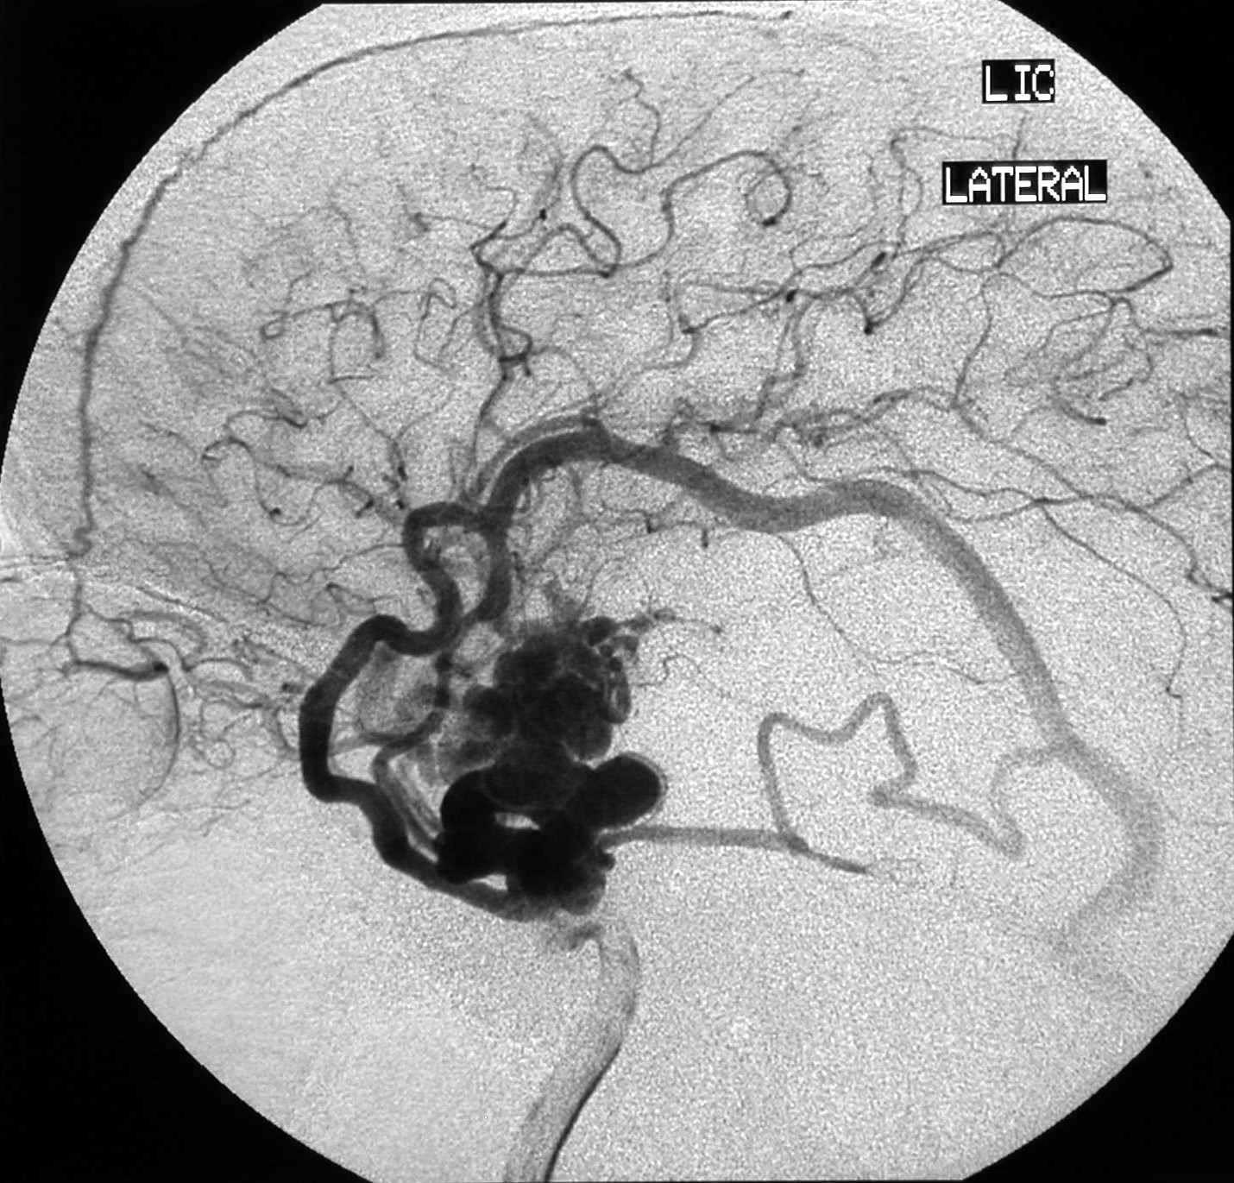

Slide 71
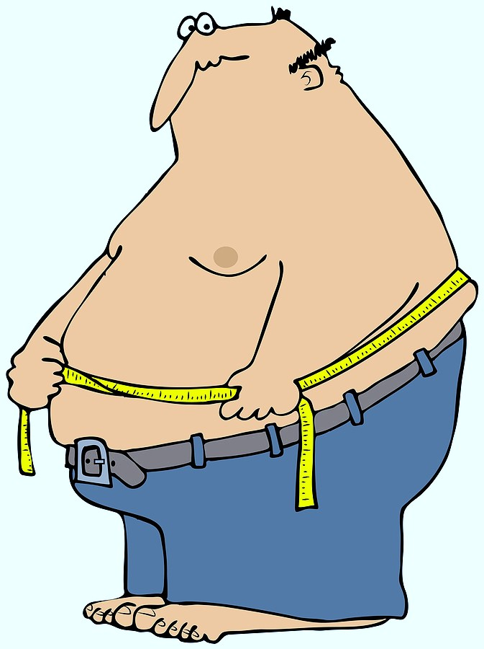
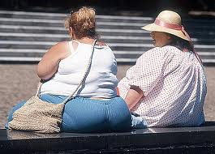
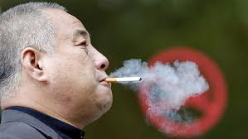
Avoiding High Risk Patients

Slide 72
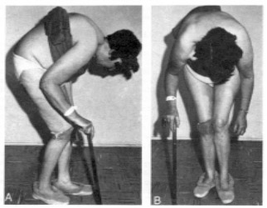
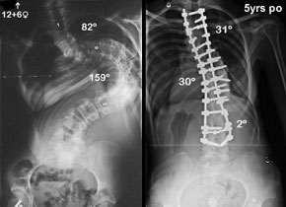
Spinal Deformity

Slide 73
High Risk

Slide 74
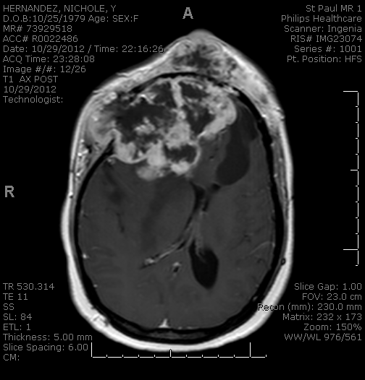
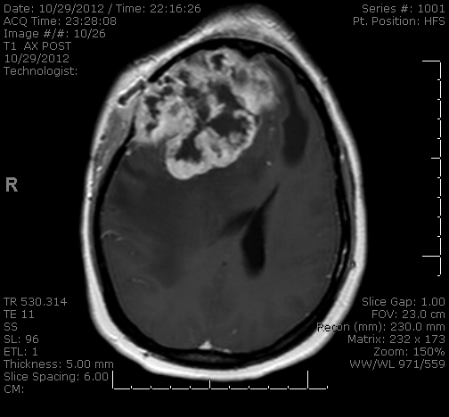

Slide 75
12/13

Slide 76
High Risk
12/17
12/19
12/21

Slide 77
12/13
12/20
1/03

Slide 79
2007 Non-Operative Rx- GK

Slide 80
2008-2009 FLAIR and Small Hemorrhage

Slide 81
3-6/2010 Aneurysm Clip and Coil

Slide 82
Endovascular Embolization
Pre 9/2010
Post 9/2010
Post 6/2011

Slide 83
Post Embolization Hemorrhages
6/2011
10/2012
10/2012

Slide 84
Large Hemorrhage Leading to Decompression 11/2012

Slide 85
Surgical Resection 12/2012

Slide 86
Post Shunting and Cranioplasty 1/2013- Disabled

Slide 87
MR Thoracic Spine 12/1/2012- Medical Management?
Progressive paraparesis in a patient with renal failure, CHF, advanced breast cancer, advanced liver dz, coagulopathic
T2
T1
STIR

Slide 88
MR Lumbar spine 12/1/2012
T2
T1
STIR

Slide 89
12/4/2012

Slide 90
MR Thoracic Spine 12/10/2012- Paraplegic
T2
STIR

Slide 91
Complicity With Dangerous Hospital Priorities- LOS

Slide 92
RO
53 Y/O man with progressive spastic paraparesis
Severe Chiari and cervical syrinx
T7-8 intramedullary tumor- Sensory Level
3/09 - T7-8 laminectomy for resection of pilocytic astrocytoma
To rehab hospital day 3
3/16 (day 7 post-op) - DVT, SQ heparin converted to coumadin
3/18 (day 9 post op) - sudden paraplegia
12 hour delay in Dx

Slide 93
Pre - Op

Slide 94
1 Day Post- Op

Slide 95
3/18- 9 Days Post- Op

Slide 96
Complicity With Dangerous Safety Protocols - DVT

Slide 97
AJ
4/16- rt suboccip crani for post fossa DAVF and SAH
ICU Protocol- DVT prophyllaxis starting at 48 hrs changed from BID to TID SQ heparin. Surgeons NOT notified.
Developed hydrocephalus- EVD
4/26 - EVD electively withdrawn
2 hrs later - obtunded

Slide 99
Pre-Pull

Slide 100
Post- Pull

Slide 101
Post-Pull

Slide 102
Neurosurgery is a High Risk Field

Slide 103
Conclusions
We have to be ready to treat high complexity, high morbidity, high risk cases
Their management is inherently UNSAFE
Mother Nature’s Plans?
They will have surgical complications and prolonged LOS
They are costly to care for
They have no other options
Their care represents a critical role of our academic centers and our raison d’etre
Medical/ Surgical decisions must be individualized and patient centered

