Slide 1
Harborview Neurotrauma Service

Slide 2
SWOT Analysis
Dedication to top quality trauma care
State, institution, and involved departments
Ability of UW NSG Dept to attract top staff & trainees
Extremely high volume of very ill patients
Limited resources
Rooms, beds, bricks & mortar, informatics
Tenuous funding
Mandate for efficiency
Mandate for meticulousness
S
Strengths
W
Weaknesses
C
Challenges
Programmes
Protocols
Treatments
O
Opportunities
Innovation
T
Threats

Slide 3
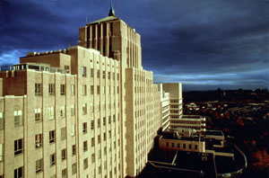
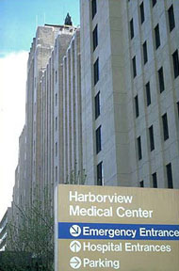
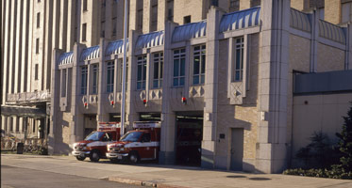

Slide 4
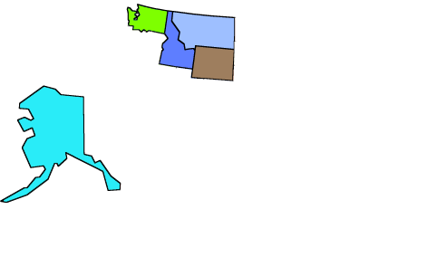
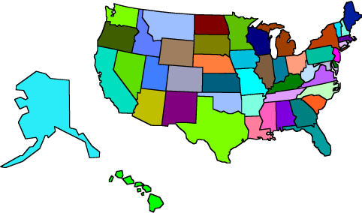
27% of the US Land Mass
WA
MO
ID
WY
W W A M I
Washington
Wyoming
Alaska
Montana
Idaho
AK

Slide 5
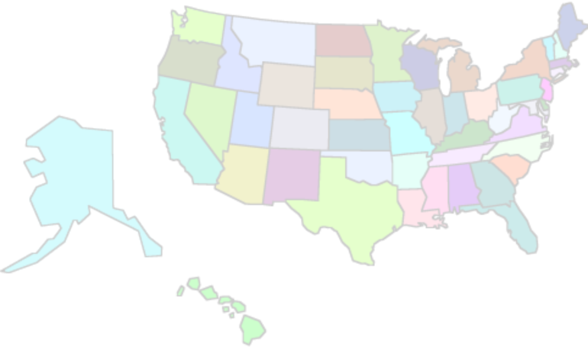
27% of the US Land Mass
Mean = 6170
Mean = 5312
Adult – 20% = GCS ≤ 8
Paediatric – 16% = GCS ≤ 8
Mean = 850
* Trauma Registry Entries

Slide 6
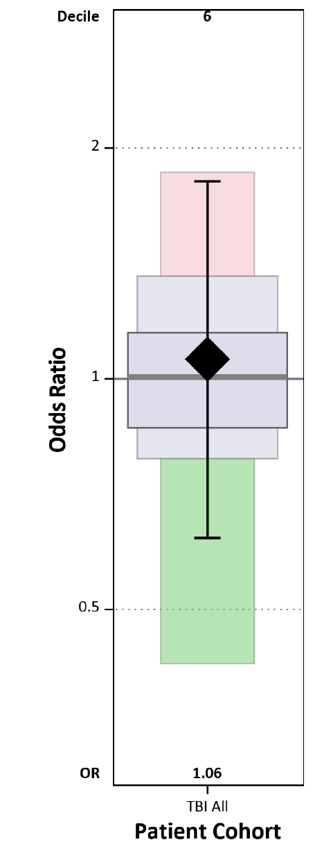
27% of the US Land Mass
HMC Neurotrauma Service in 2018
Involved in the management of 1538 TBI patients
418 admitted to the Neurotrauma Service
346 directly to NICU
1120 managed as consultants on other services
356 craniotomies for TBI
116 reconstruction procedures for TBI
e.g. Cranioplasties
Adults
Paediatrics
(0 – 18)
179 ICP monitors inserted
118 P_{bt}O₂ monitors inserted
* Trauma Registry Entries

Slide 7
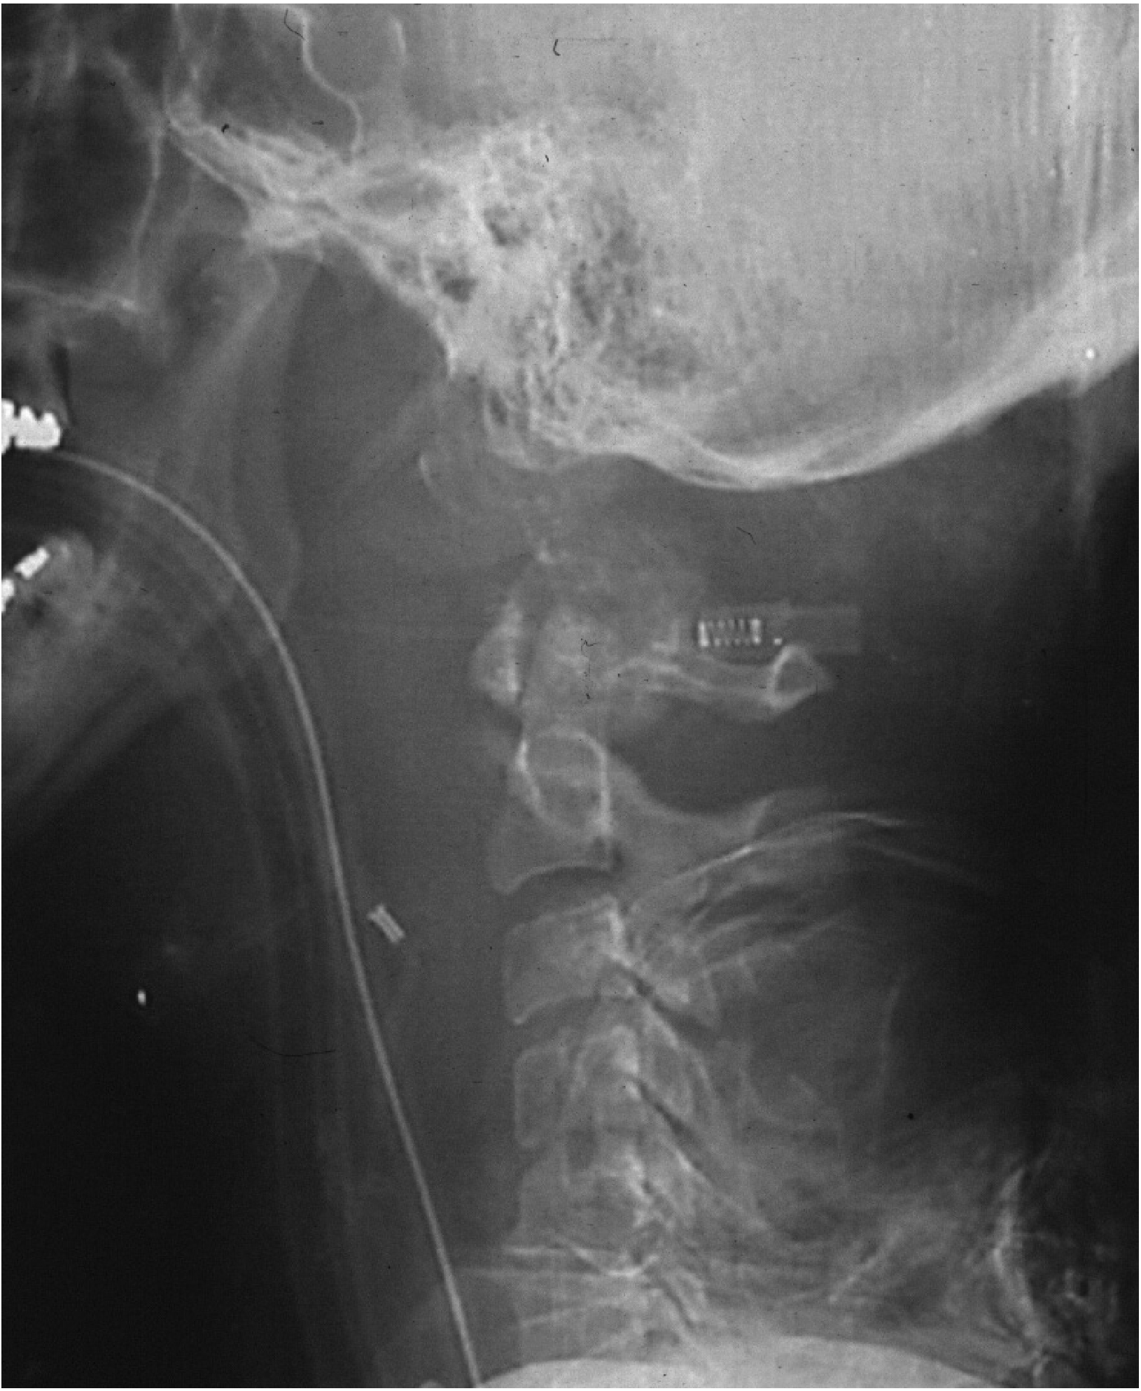
27% of the US Land Mass
HMC Neurotrauma Service in 2018
Spinal Trauma management*
1300 - 1500 spine trauma admissions per year
350 - 400 spine trauma surgeries per year by Neurotrauma Spine Service
39% Cervical
38% Thoracic
23% Lumbar
* Trauma Registry Entries

Slide 8
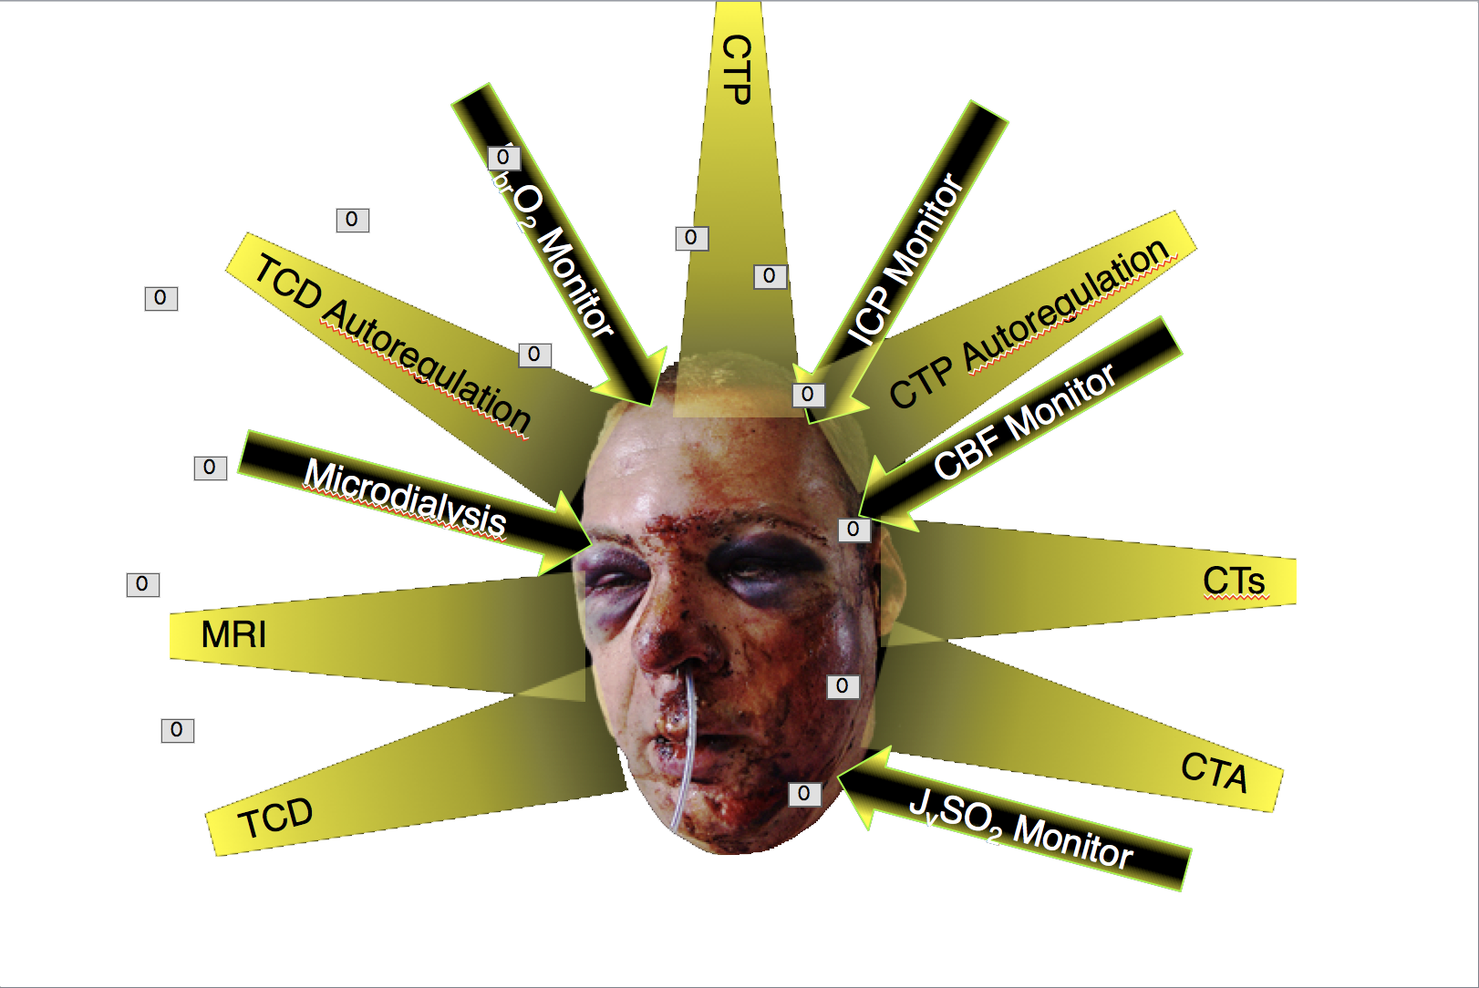
How We Do It
HMC NSG
Protocols
Attending-supervised “Hybrid” service
Responsibility + Volume + Mentorship = Success

Slide 9
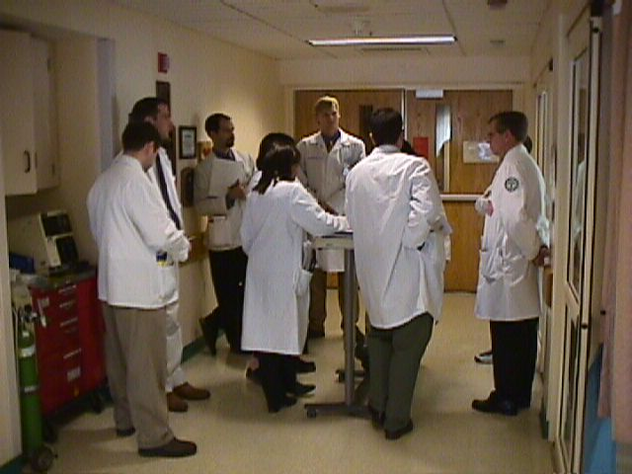
Tactical Neurotrauma Management
The Neurotrauma Service is often a rate-limiting step:
Clearing patients for non-emergent surgeries
Actual
Plan
Medical Student
0600
Attending-level Neurotrauma Rounds
Intern
Junior Resident
Chief Resident
Attending

Slide 10
Tactical Neurotrauma Management
The Neurotrauma Service is often a rate-limiting step:
Clearing patients for non-emergent surgeries
Actual
Plan
Chief NT Resident leads 0600 rounds
0600
Attending-level Neurotrauma Rounds
Intern
NT Team suggests decisions and plan
Immediately finalised by Attending
Junior Resident
NT plans codified before team leaves
Chief Resident
NSG Daily Plan/Coördination of
care done by 0730
Attending

Slide 11
Tactical Neurotrauma Management
Advantages of dedicated Neurotrauma Service directed by a specialist Neurotrauma Neurological Surgeon
Efficiency (vide supra)
Minimising variability in Neurosurgical care
“Predictable errors better than errors-du-jour”
Neurotrauma attending takes ALL daytime TBI cases
Also takes all patients admitted the previous evening
Spine/Skull base/Vascular colleagues ≠ interrupted
Economy of scale allows a Neurotrauma Service to exist

Slide 12
How We Do It
HMC NSG
Protocols

Slide 13
Trauma Resuscitation
Golden hour
Patient = packaged with no loose ends

Slide 14
Neurosurgery Derailing the Trauma Train
Time is Brain

Slide 15
Yes
Unequal pupils?
Clot thickness
> 10 mm
Yes
Type A if:
• EDH
• SDH
No
Type A if:
• EDH
• SDH
• ICH
• Diffuse Injury
• Penetrating Injury
No
Yes
Midline Shift ≥ 5 mm?
Bilateral pupil
Dilation?
Type A
Patients
Type A
Yes
No
No
GCS ≤ 8?
Yes
Type A if:
• EDH
Neurological
Deterioration?
Yes
No
Type A if:
• Penetrating Injury
Yes
GCS ≤ 12?
Decrease GCS Score by ≥ 2 points) NOT explained by non-neurologic causes
No
No
What does the
CT show?
Not Type A
No
Post Fossa
Injury?
Yes
Type A if:
• ICH
• Penetrating Injury

Slide 16
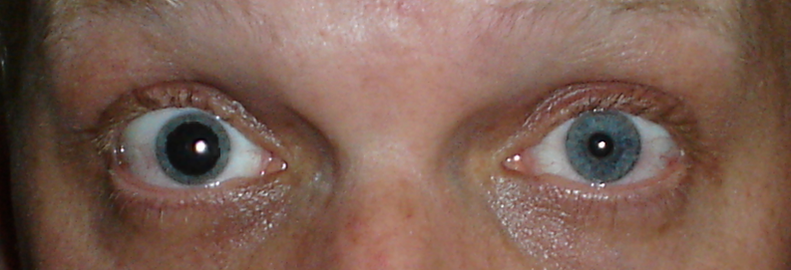
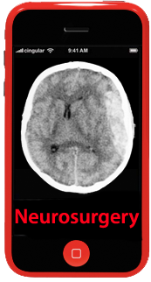
Yes
Unequal pupils?
Clot thickness
> 10 mm
Yes
Type A if:
• EDH
• SDH
No
Type A if:
• EDH
• SDH
• ICH
• Diffuse Injury
• Penetrating Injury
No
Yes
Midline Shift ≥ 5 mm?
Bilateral pupil
Dilation?
Type A
Yes
No
No
GCS ≤ 8?
Yes
Type A if:
• EDH
Neurological
Deterioration?
Yes
No
Type A if:
• Penetrating Injury
Yes
GCS ≤ 12?
Decrease GCS Score by ≥ 2 points) NOT explained by non-neurologic causes
No
No
What does the
CT show?
Post Fossa
Injury?
Type A if:
• ICH
• Penetrating Injury
The “Herniation Phone”
Not Type A
No
Yes

Slide 17
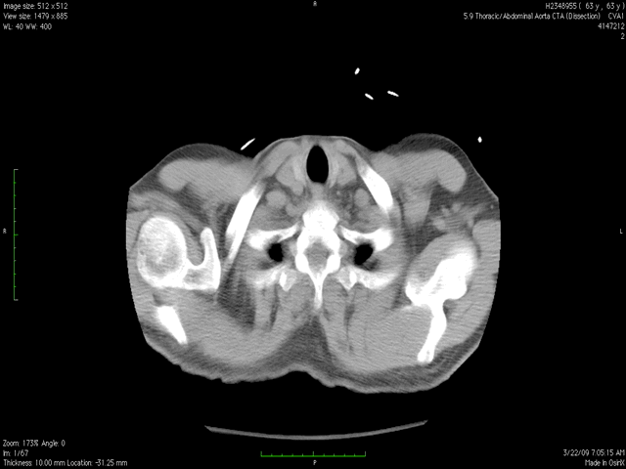
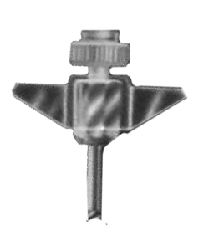
< 2 min
The “Herniation Phone”

Slide 18
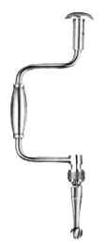
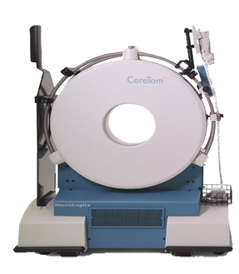
Direct to OR – No Head CT

Slide 19
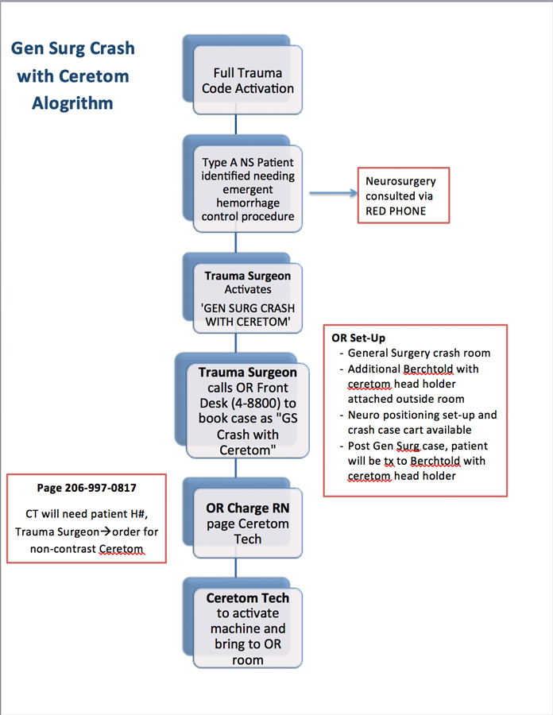
Direct to OR – No Head CT

Slide 20
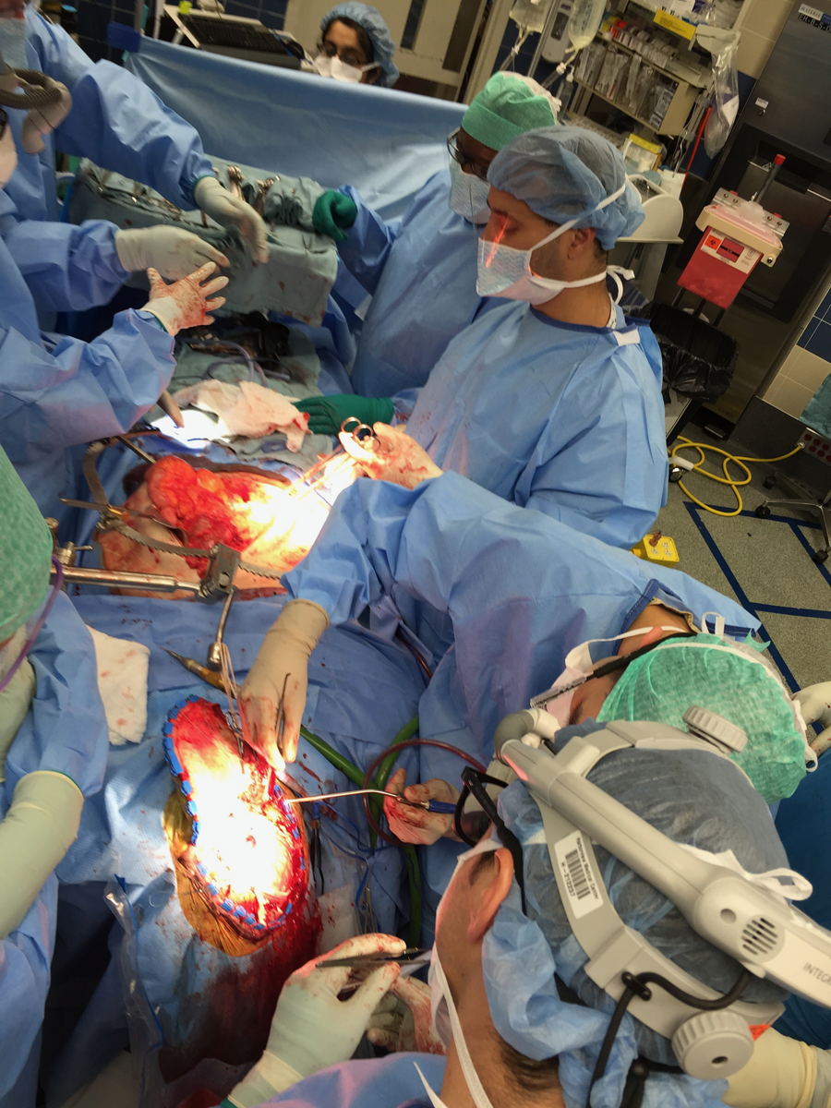
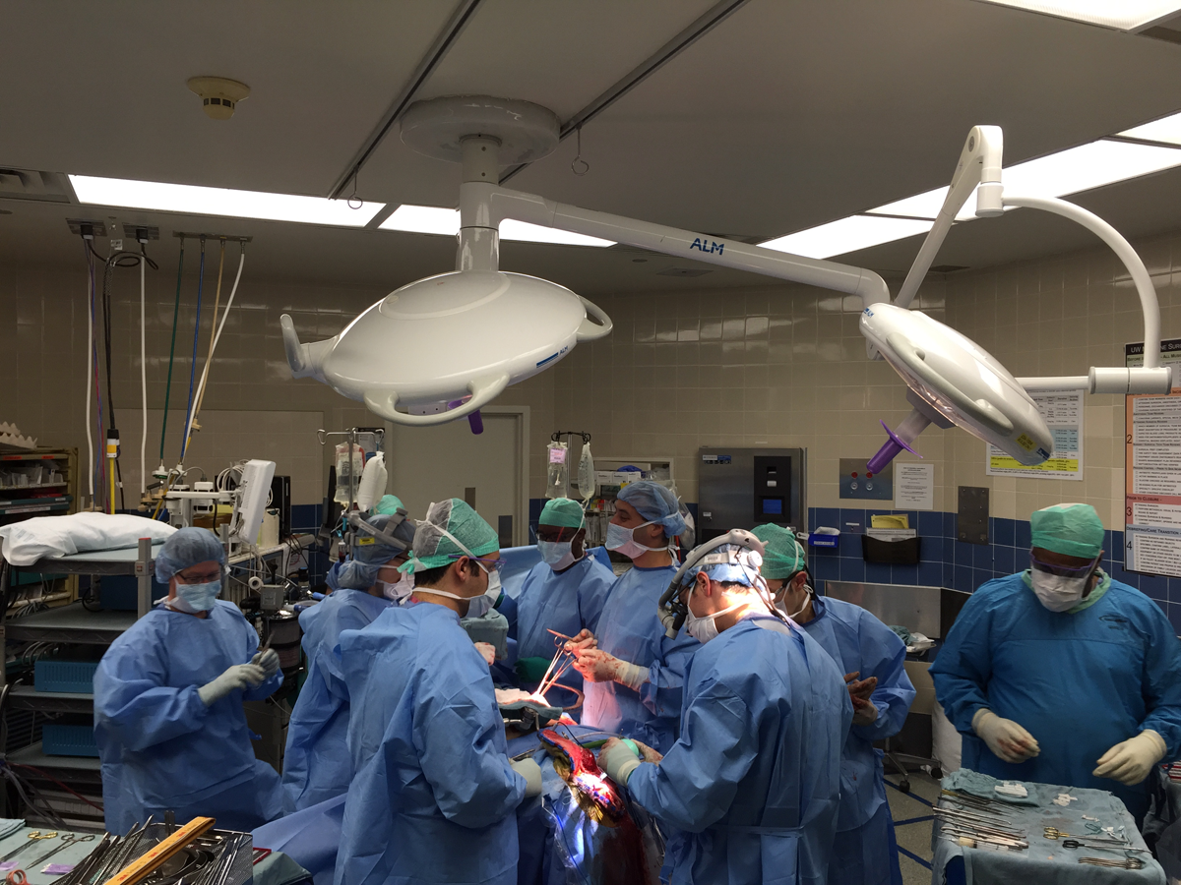
Simultaneous Surgery

Slide 21
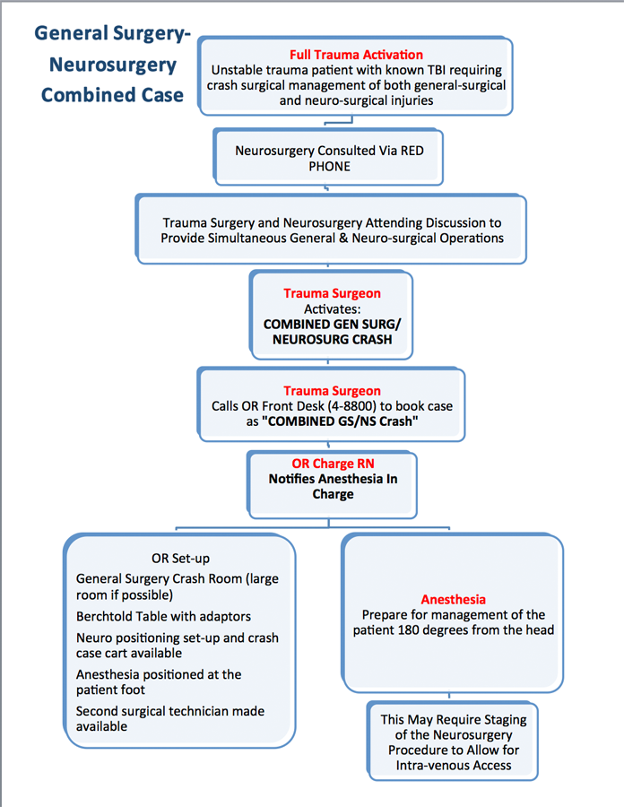
Simultaneous Surgery

Slide 22
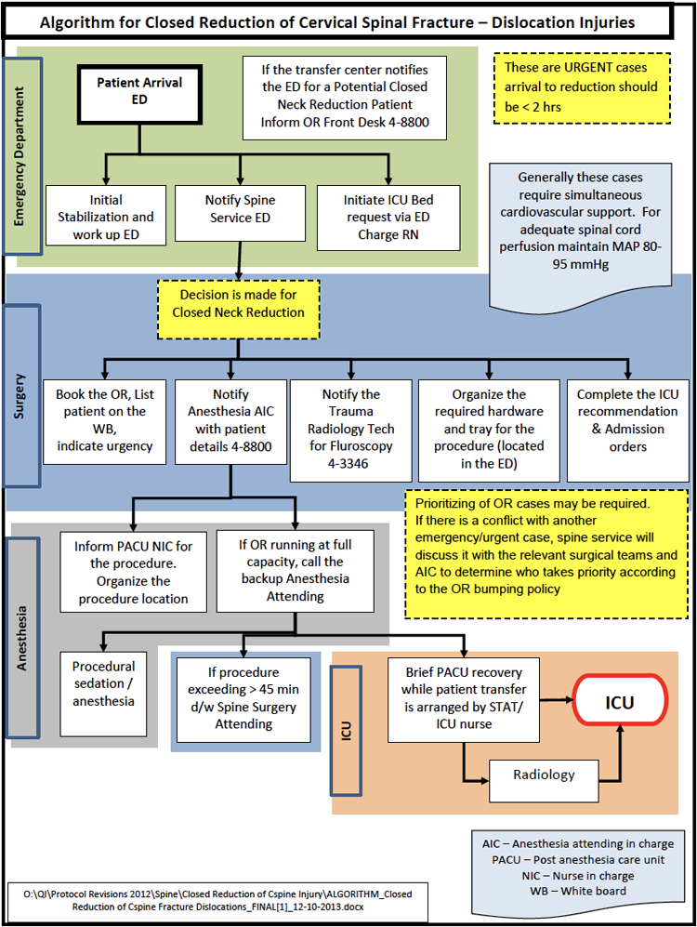
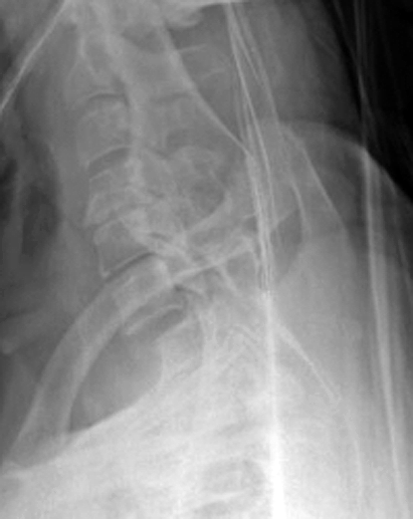
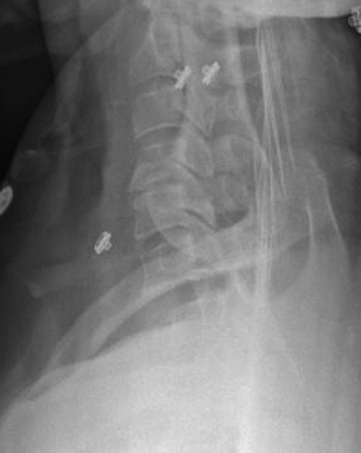
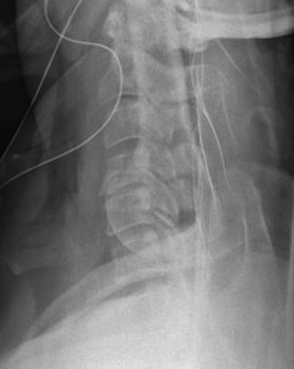
Manual Reduction of Jumped Facets
< 10 minutes

Slide 23
HMC Coördination of Critical Care and Neurotrauma Service
Harborview is too busy to have ONE Neurosurgeon doing BOTH Critical Care and running the Neurotrauma Service
Two Neurocritical Services
Patients in Trauma, Paediatrics, ± Medicine ICUs
¡Neurosurgery needs to manage the brain care!
All final brain-related treatments must be finalised by the Neurotrauma Service
ICU team is at bedside and may (¡should!) make suggestions
No “suggestions” become orders unless OK’d by us

Slide 24
How We Do It
Optimised TBI care through targeted treatment based on multimodality monitoring
Treating patient-specific physiology instead of “chasing numbers”
Adjusting MAP and CPP targets
Based on autoregulation, CBF, P_{bt}O₂, EEG, J_{v}sO₂ monitoring
Adjusting ICP target
Based on compliance, pupillometry, and imaging
Avoid Undertreatment AND Overtreatment

Slide 25
The Future
• Improve existing protocols (QA loops)
• Innovate new protocols
• Educate Neurotrauma Fellows
• Educate CAST/UCNS NCC Fellows
• Develop an effective informatics system

Slide 26
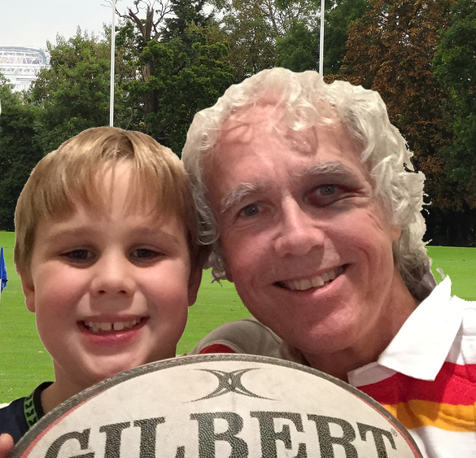
Thank You!

