Slide 1
INFRASTRUCTURE
AND APP/NEUROSURGEON HOSPITALISTS

Slide 2
OVERVIEW OF SUBJECT
PERFECT STORM OF
PATIENT SATISFACTION SURVEYS,
PATIENT SAFETY EMPHASIS,
RESIDENT EDUCATION HOURS,
ACGME MILESTONES, RESIDENT CASE MINIMUMS AND SATISFACTION SURVEYS

Slide 3
PRECISION MEDICINE: FOUR DISPARATE HOSPITALS, FOUR MODELS
SCH: 8 FTE
12 HOURS A DAY/7 DAYS A WEEK
ED, ICU, INPATIENT/OUTPATIENT
HMC: 18-20+ FTE
12 HOURS A DAY 7 DAYS A WEEK AND 3 DAYS 24/7; INPATIENT/OUTPATIENT
UWMC: 6FTE: 12 HOURS A DAY/5 DAYS WEEK: FACULTY STATUS:INPATIENT/FACULTY
CLINIC
VA: 2FTE: 12 HOURS/DAYS/24 CALL
INPATIENT/OUTPATIENT/OR

Slide 4
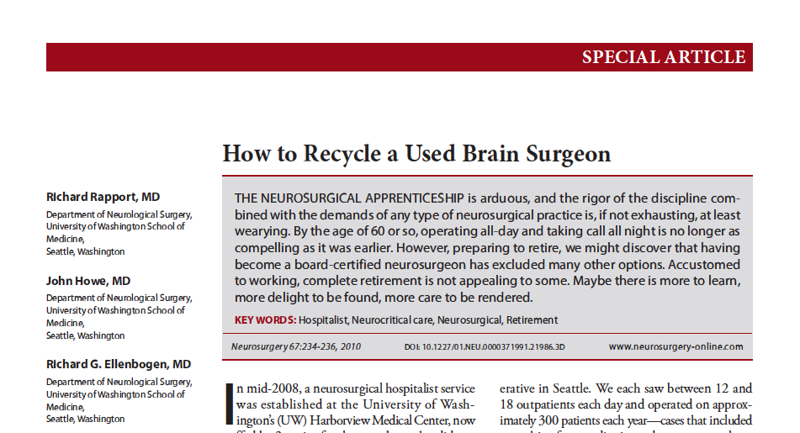
NEUROSURGEON HOSPITALIST MODEL

Slide 5
Swot aNALYSIS
ALL HOSPITALS “ALL IN”
TAILORED, HOSPITAL SPECIFIC EXPERTISE
NEED MORE FTE BECAUSE SPREAD OVER MULTIPLE HOSPITALS
LIMIT AT 10 PATIENTS PER APP
MARKEDLY IMPROVED OUR SAFETY, PATIENT SATISFACTION, AND RESIDENT EXPERIENCE
VERY EXPENSIVE
TRAINING
VERY MOBILE, EXTREMELY WELL TRAINED AND DESIRABLE
S
W
O
T
Strengths
Weaknesses
Opportunities
Threats

Slide 6
LEARNING POINTS FROM SWOT
IT IS PART OF OUR CULTURE
IDEAL: ED, ICU, INPATIENT/OUTPATIENT, FACULTY CLINICS
TAILORED HOSPITAL AND PRACTICE SPECIFIC APPROACH
ENGAGE THEM, PAY THEM BUT EASY TO LOOSE THEM
FACULTY STATUS IS BEST MODEL

Slide 7
Key initiatives next 1-3 years
APP SATISFACTION: INVEST IN EDUCATION AND TRAVEL
CONSIDER PA’s WHO WANT TO GO TO THE OR NEED THEM ALL TO GO TO THE ED, ICU BUT CREDENTIALLING IS A CHALLENGE

Slide 8
Summary/Conclusions
APP AND NEUROSURGEON
HOSPITALIST IS ESSENTIAL FOR SURVIVAL OF OUR PATIENT CARE MODEL, SAFETY PROFILE, DEPARTMENT SUCCESS, RESIDENCY SATISFACTION

Slide 9
Uw neurological surgery
DEPARTMENT CULTURE AND MISSION MATTER: NOAH’S ARC PRINCIPLES
DETAILS OF INFRASTRUCTURE ESSENTIAL
IT IS ALL ABOUT THE PEOPLE. NEED DISRUPTIVE THINKERS WHO BELIEVE IN TEAM SACRIFICE

