Slide 1
SNS Resident Course Update
Gregory J. Zipfel, MD

Slide 2
Committee on Resident Education (CoRE)
Chair – Rich Byrne
Subcommittees
Curriculum
Chair – Tim Mapstone
Portal
Chair – Warren Selman
Vice-Chair – Nicholas Bambakidis
Resident Courses
Chair – Greg Zipfel

Slide 3
Resident Course Subcommittee Members
Dan Barrow
Bernard Bendok
Rich Byrne
Joseph Ciacci
Aaron Cohen-Gadol
E. Sander Connolly
William T. Couldwell
Aclan Dogen
Bruce Ehni
Richard Ellenbogen
Isabella Germano
M. Sean Grady
Costas Hadjipanayis
Michael Haglund
Carl Heilman
Michael Kaplitt
Alexander Khalessi
Ricardo Komotar
Paul Larson
David Limbrick
Thomas Origitano
Ali Ozturk
Vikram C. Prabhu
Gustavo Pradilla
Ganesh Rao
Scott Shapiro
Philip Stieg
Chris Winfree
Julian Wu
Greg Zipfel (Chair)

Slide 4
2016 – Sustainability issue raised
2016
SNS
PGY1
PGY2
PGY4-5
PGY6-7
PGY1 $320,000
PGY2 $458,000
PGY4/5 $45,000
PGY6/7 $27,000
Total $850,000

Slide 5
2016 – Approved Changes
Administration costs reduced
SNS meeting coordinator (Joni Shulman)
Programs cover resident travel costs
Intern boot camp and Junior resident course
Junior Resident Course restructured
Course length reduced to 1.5 days
Changed to simulation-based training
Instituted $195 registration fee
PGY4-5 and PGY6-7 courses merged to one Senior Resident Course

Slide 6
2016 – Sustainability issue raised
2016
2017
PGY1 $320,000
PGY2 $458,000
PGY4/5 $45,000
PGY6/7 $27,000
Total $850,000
PGY1 $250,000
PGY2 $196,000
PGY7 $27,000
Total $473,000
$377,000 savings
SNS
PGY1
PGY2
PGY4-5
PGY6-7
SNS
Intern
Junior
Senior

Slide 7
Intern Boot Camp
Goal
Help PGY1 residents transition from medical student to neurosurgery resident
Focus on teaching skills / competencies that are difficult for individual programs to provide
Format
“Flipped classroom”
Pre-course study
Interactive small group sessions
Skills / simulation stations

Slide 8
Intern Boot Camp
Primary Industry Sponsor

Slide 9
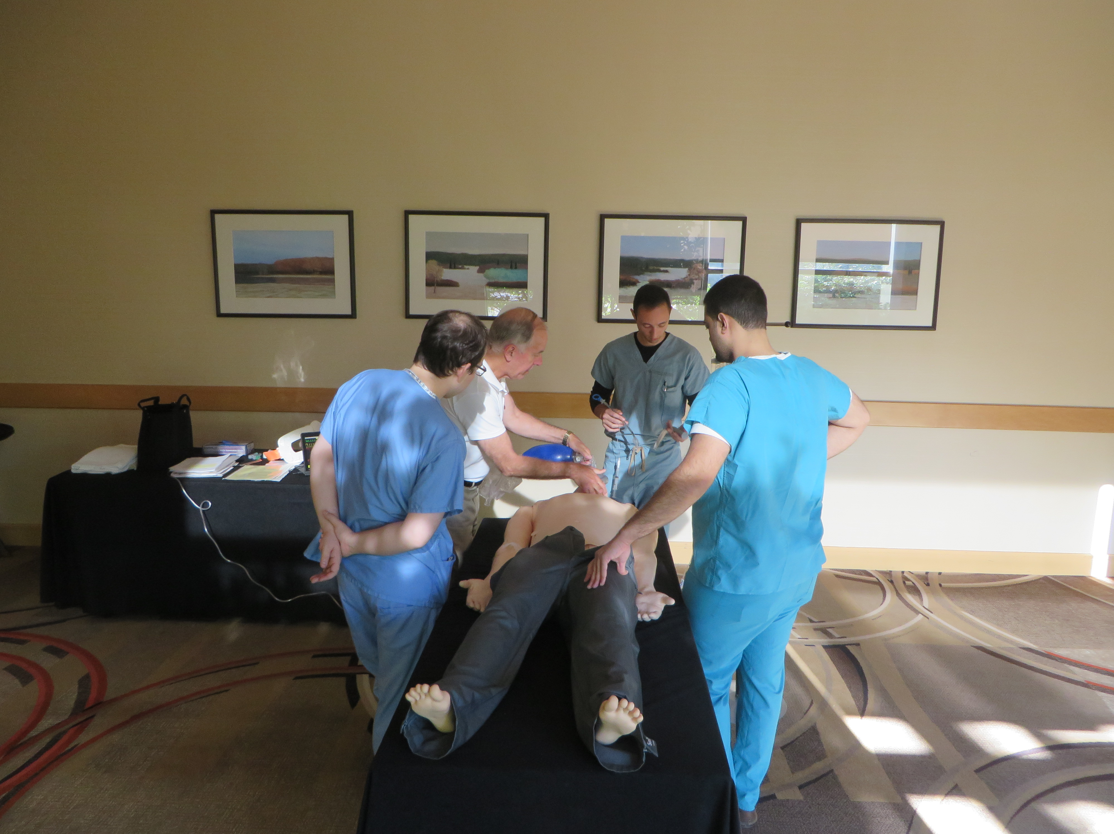
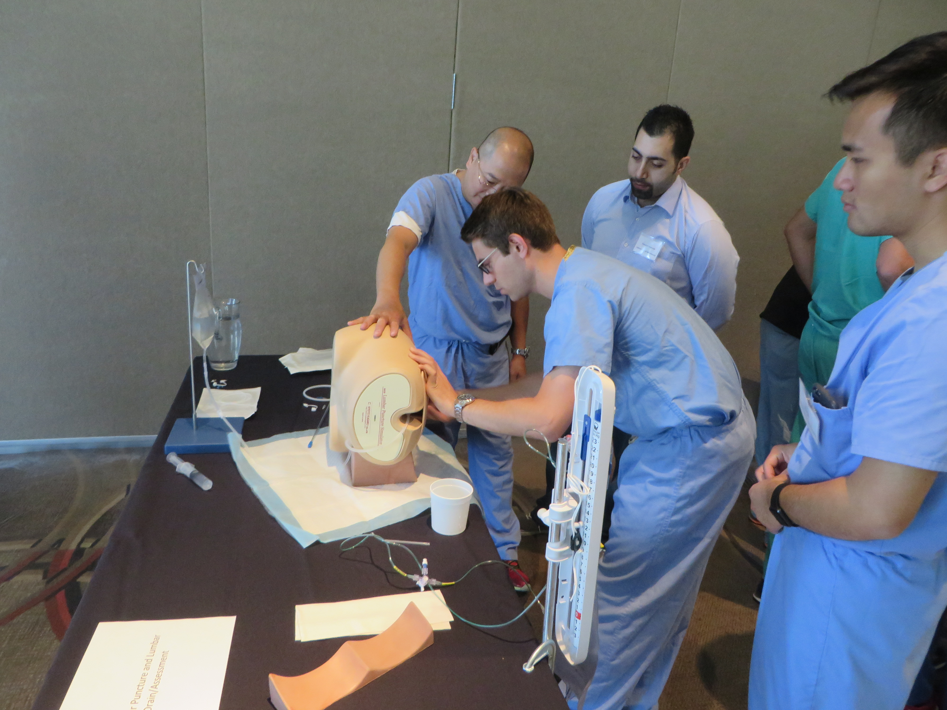

Slide 10
Intern Boot Camp Director: Ganesh Rao
July 6-7, 2018
Portland, OR; Directors: A. Dogan / R. Ellenbogen
Houston, TX; Directors: G. Rao / B. Ehni
July 13-14, 2018
Boston, MA; Directors: J. Wu / C. Heilman
Chicago, IL; Directors: R. Byrne / T. Origitano
July 20-21, 2018
Atlanta, GA; Directors: G. Pradilla / D. Barrow
Philadelphia, PA; Directors: A. Ozturk / S. Grady

Slide 11
Intern Boot Camp
2018
Expected attendance (223)
Near-universal participation at all six sites

Slide 12
Junior Resident Course
Goal
Help PGY2 residents in their transition from intern to neurosurgery junior resident
Focus on teaching skills / competencies that are difficult for individual programs to provide
Format
“Flipped classroom”
Pre-course study
Simulation-based training
Professionalism, leadership, communication

Slide 13
Junior Resident Course
Primary Industry Sponsors

Slide 14
Junior Resident Course Director: Scott Shapiro
March 1-2, 2018
UC San Diego; Directors: A. Khalessi / J. Ciacci
April 11-12, 2018
IU Indianapolis; Directors: S. Shapiro / D. Limbrick
June 14-15, 2018
Weill-Cornell NY; Director: M. Kaplitt

Slide 15
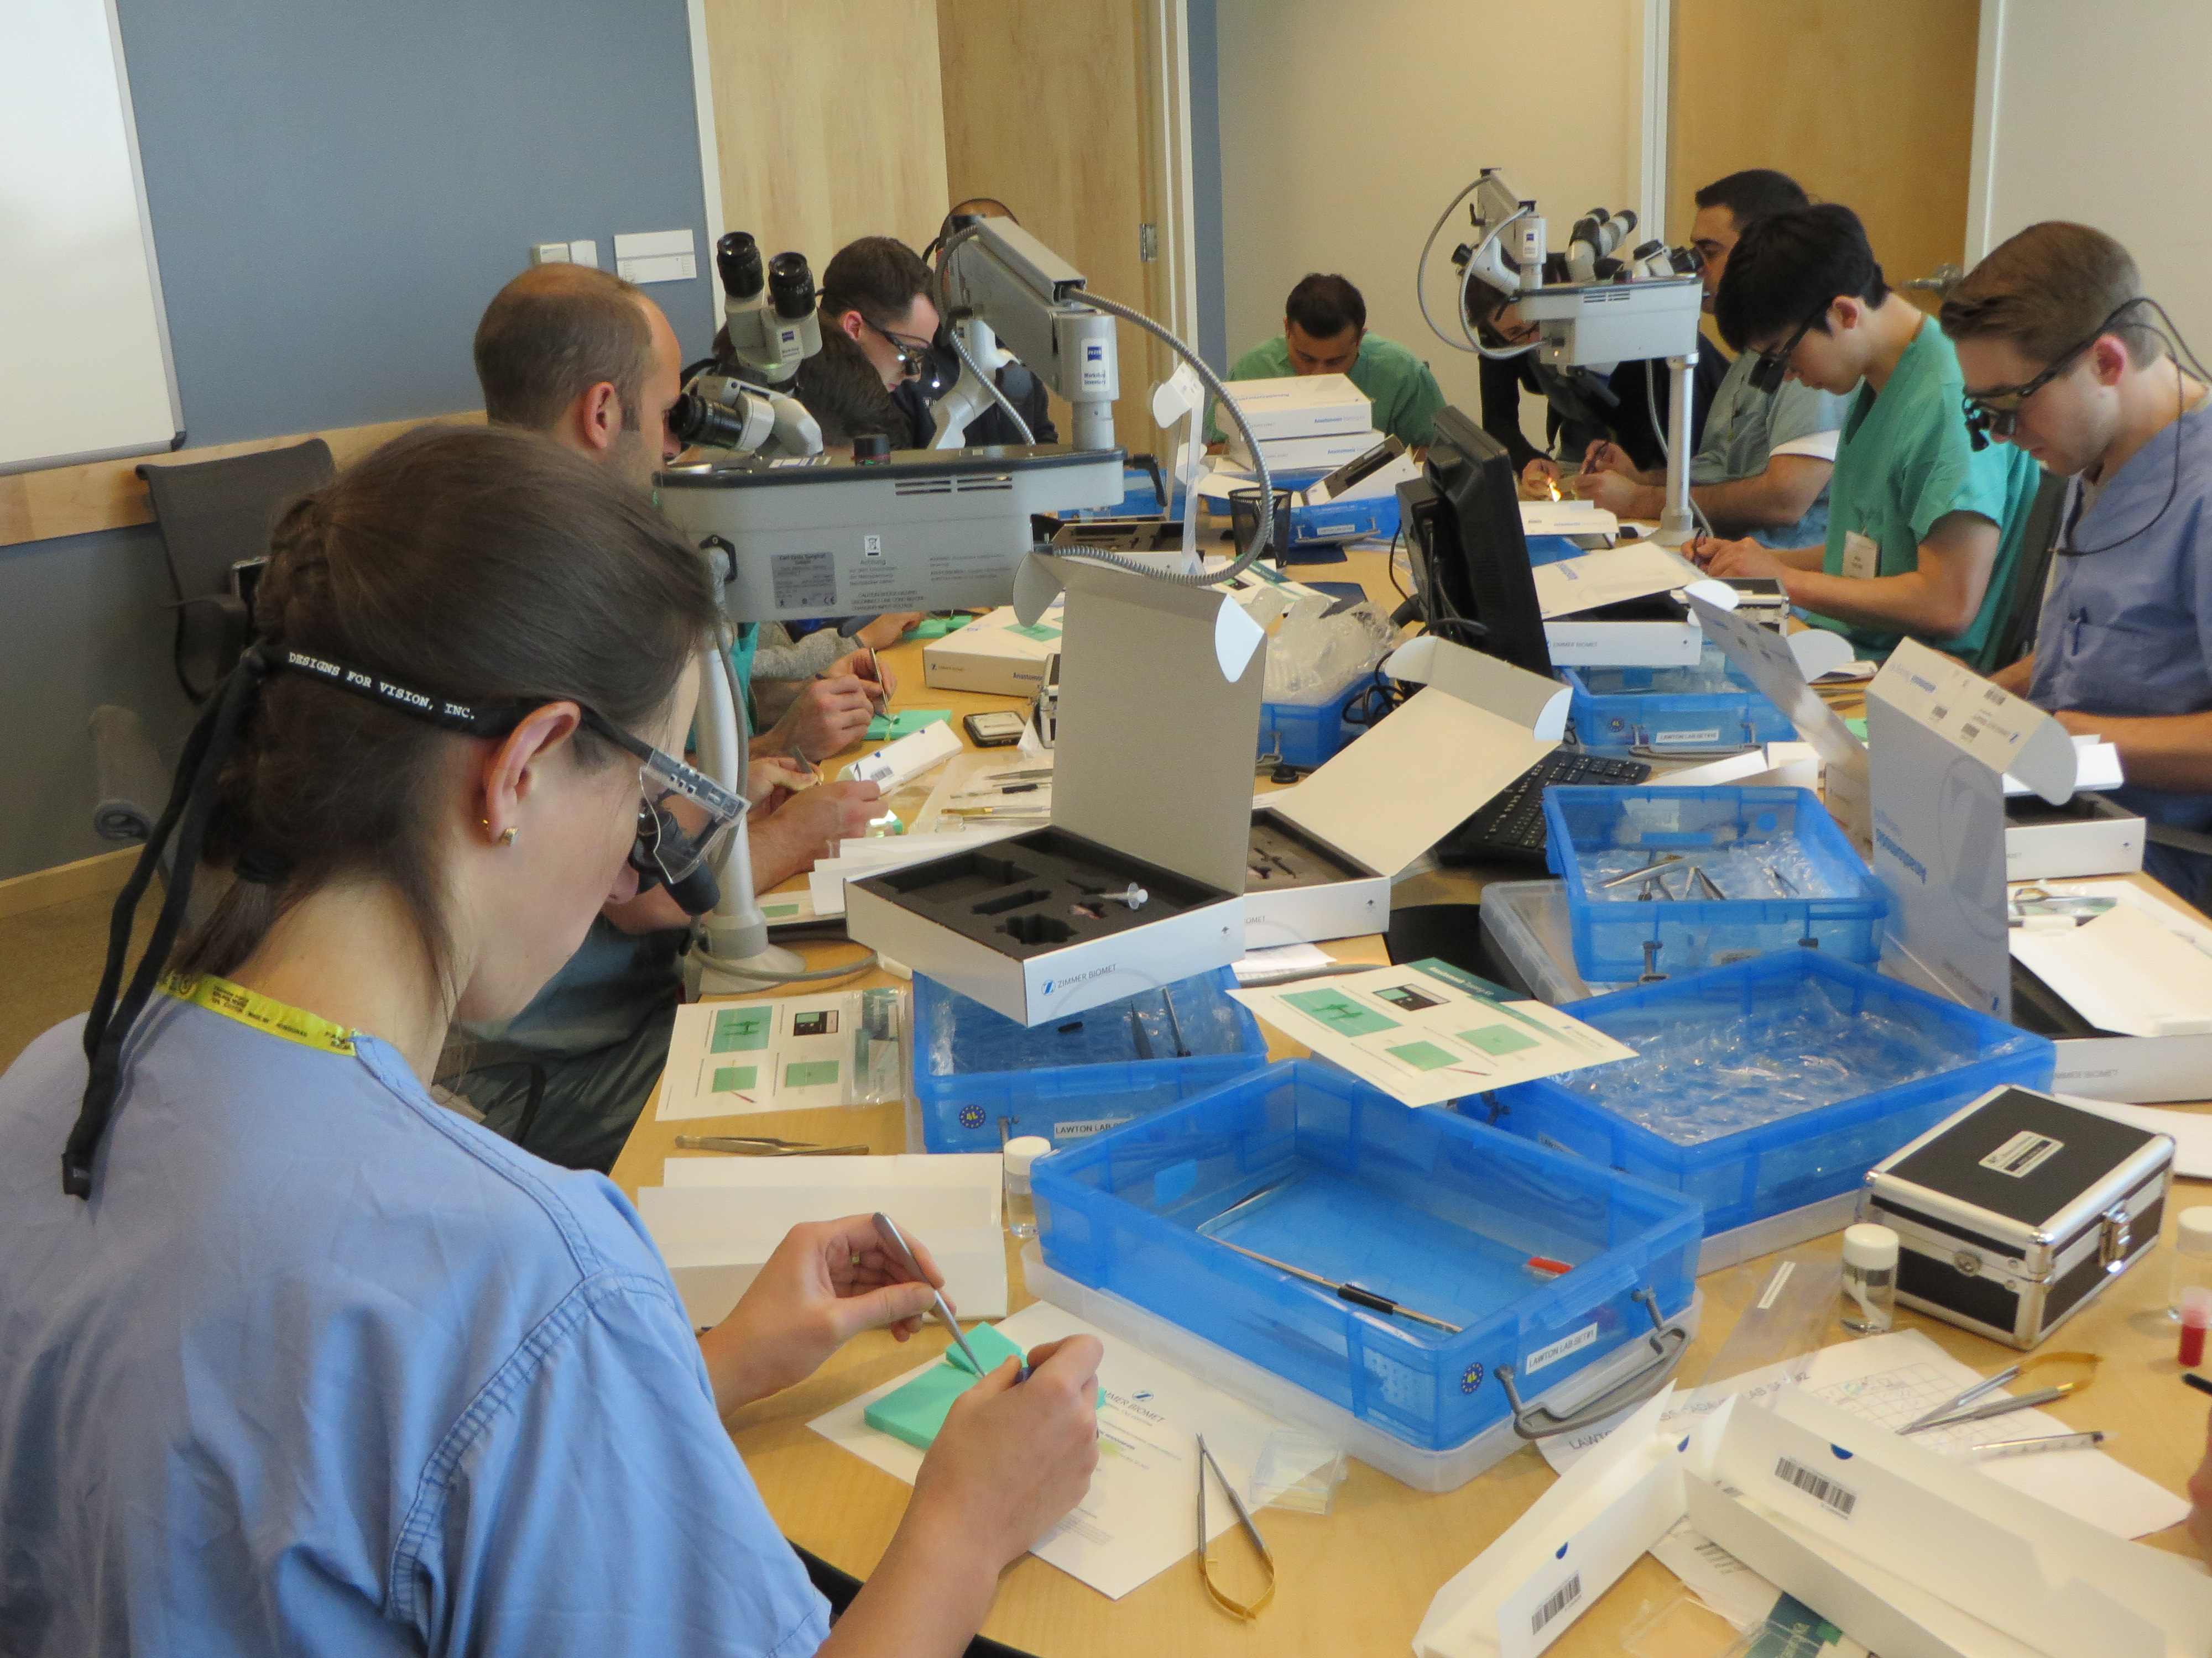
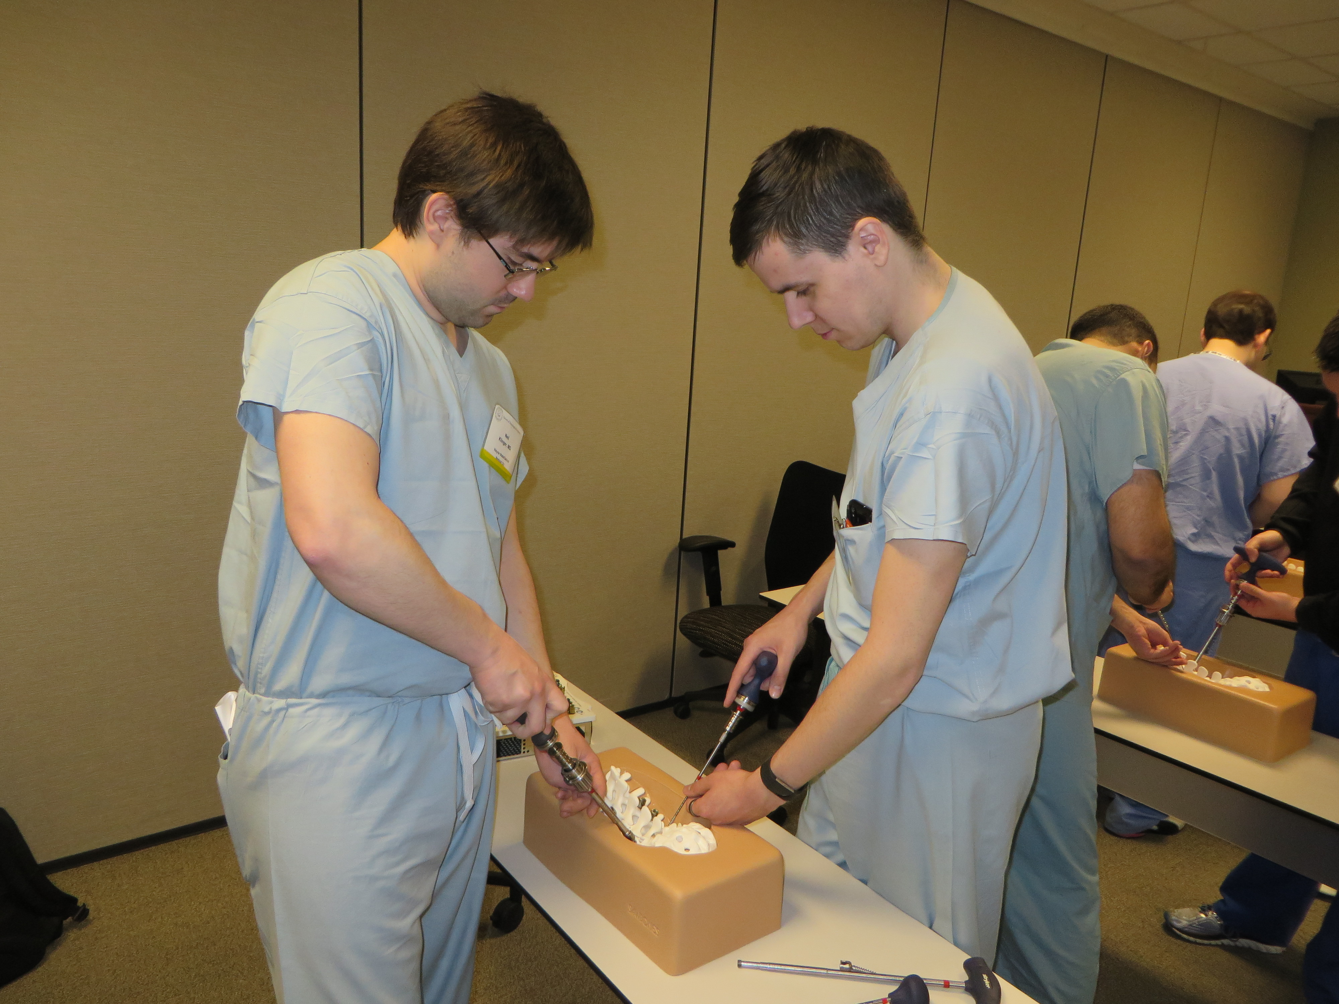
Junior Resident Course
Vessel Anastomosis
Spine Simulation

Slide 16
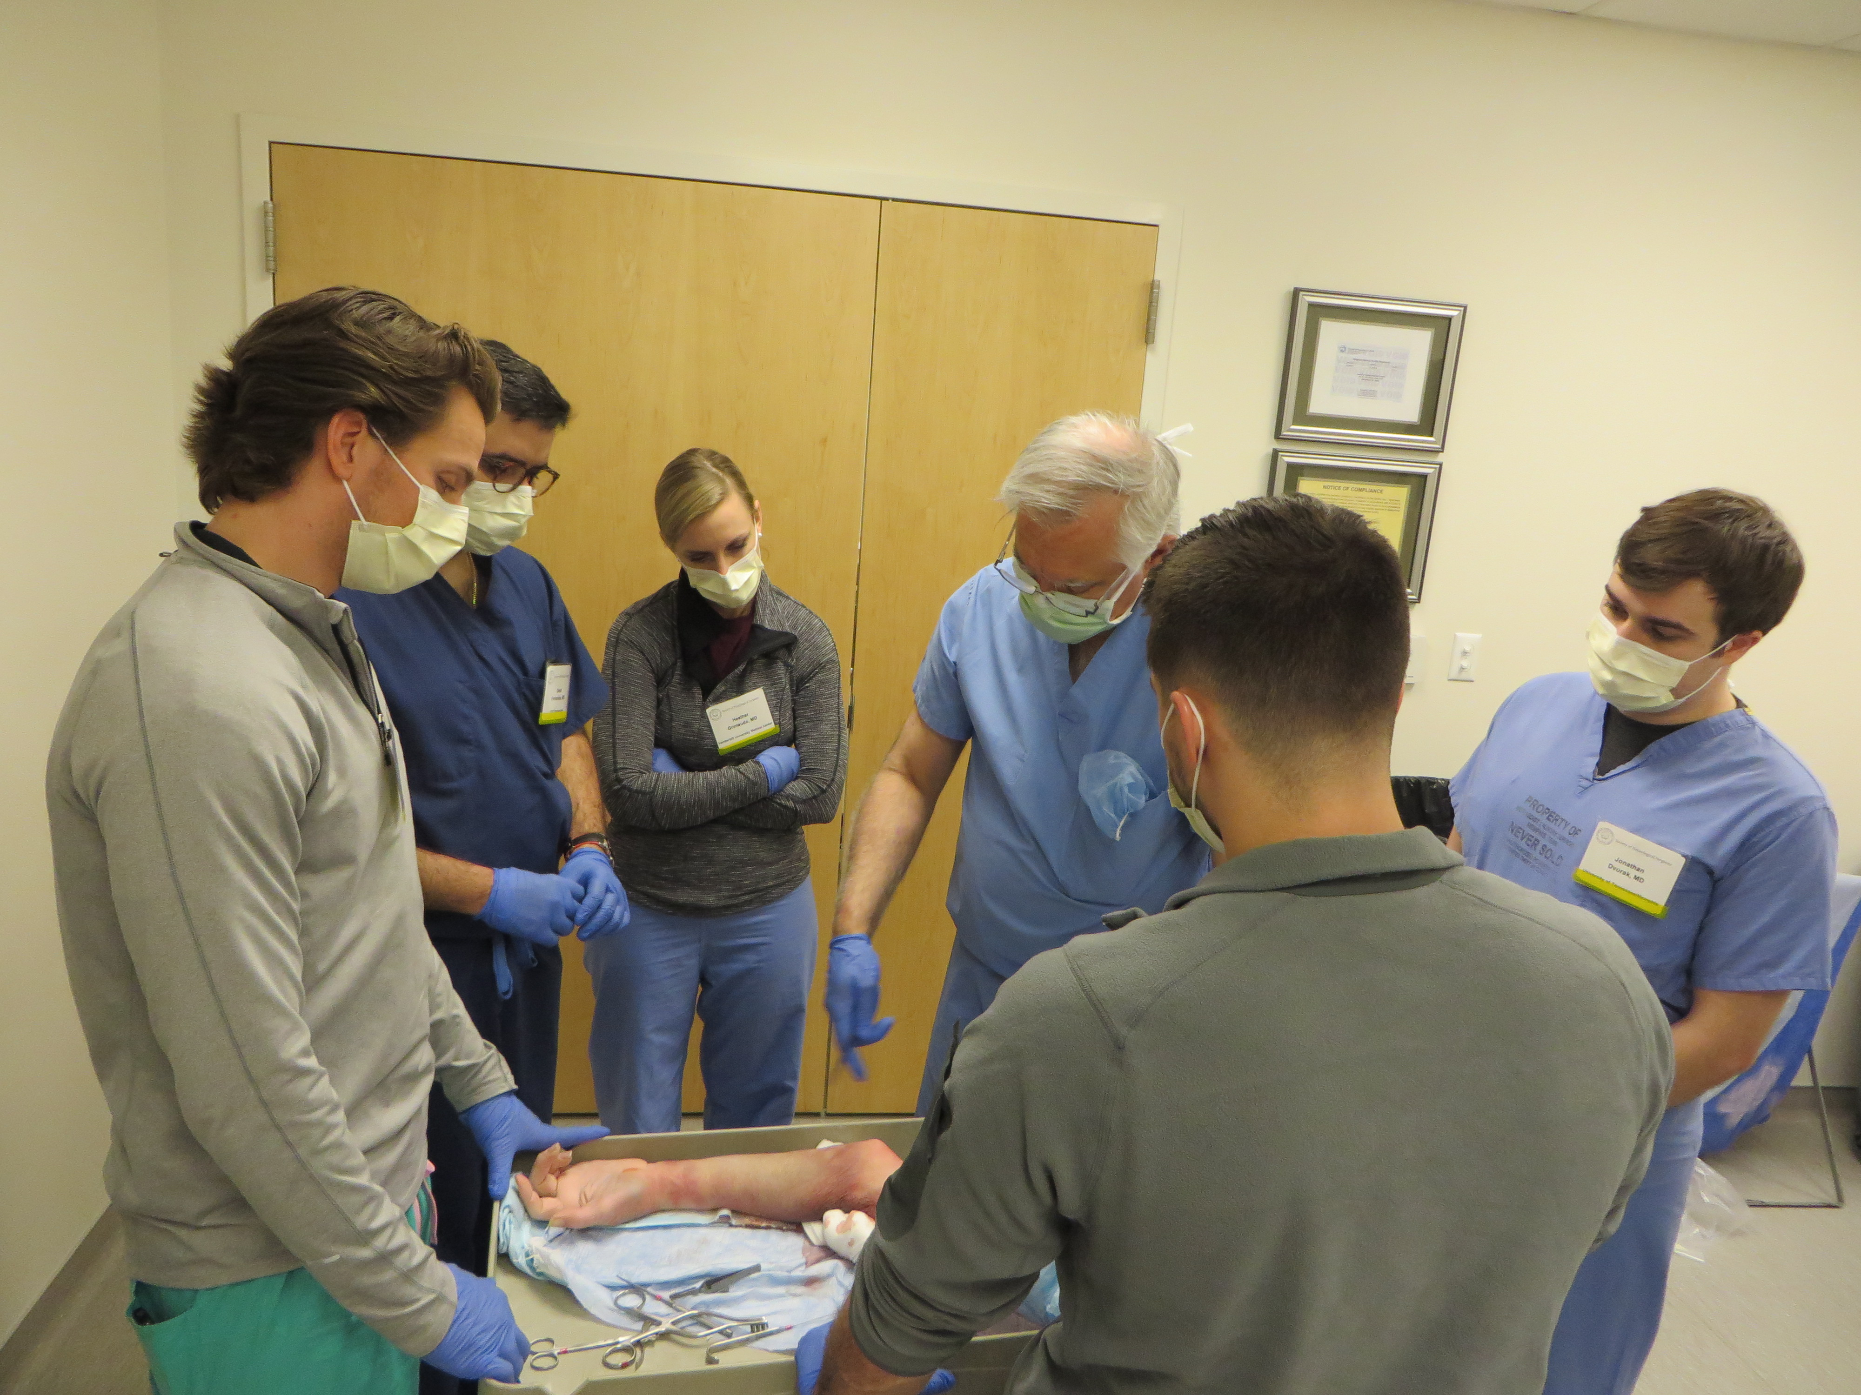
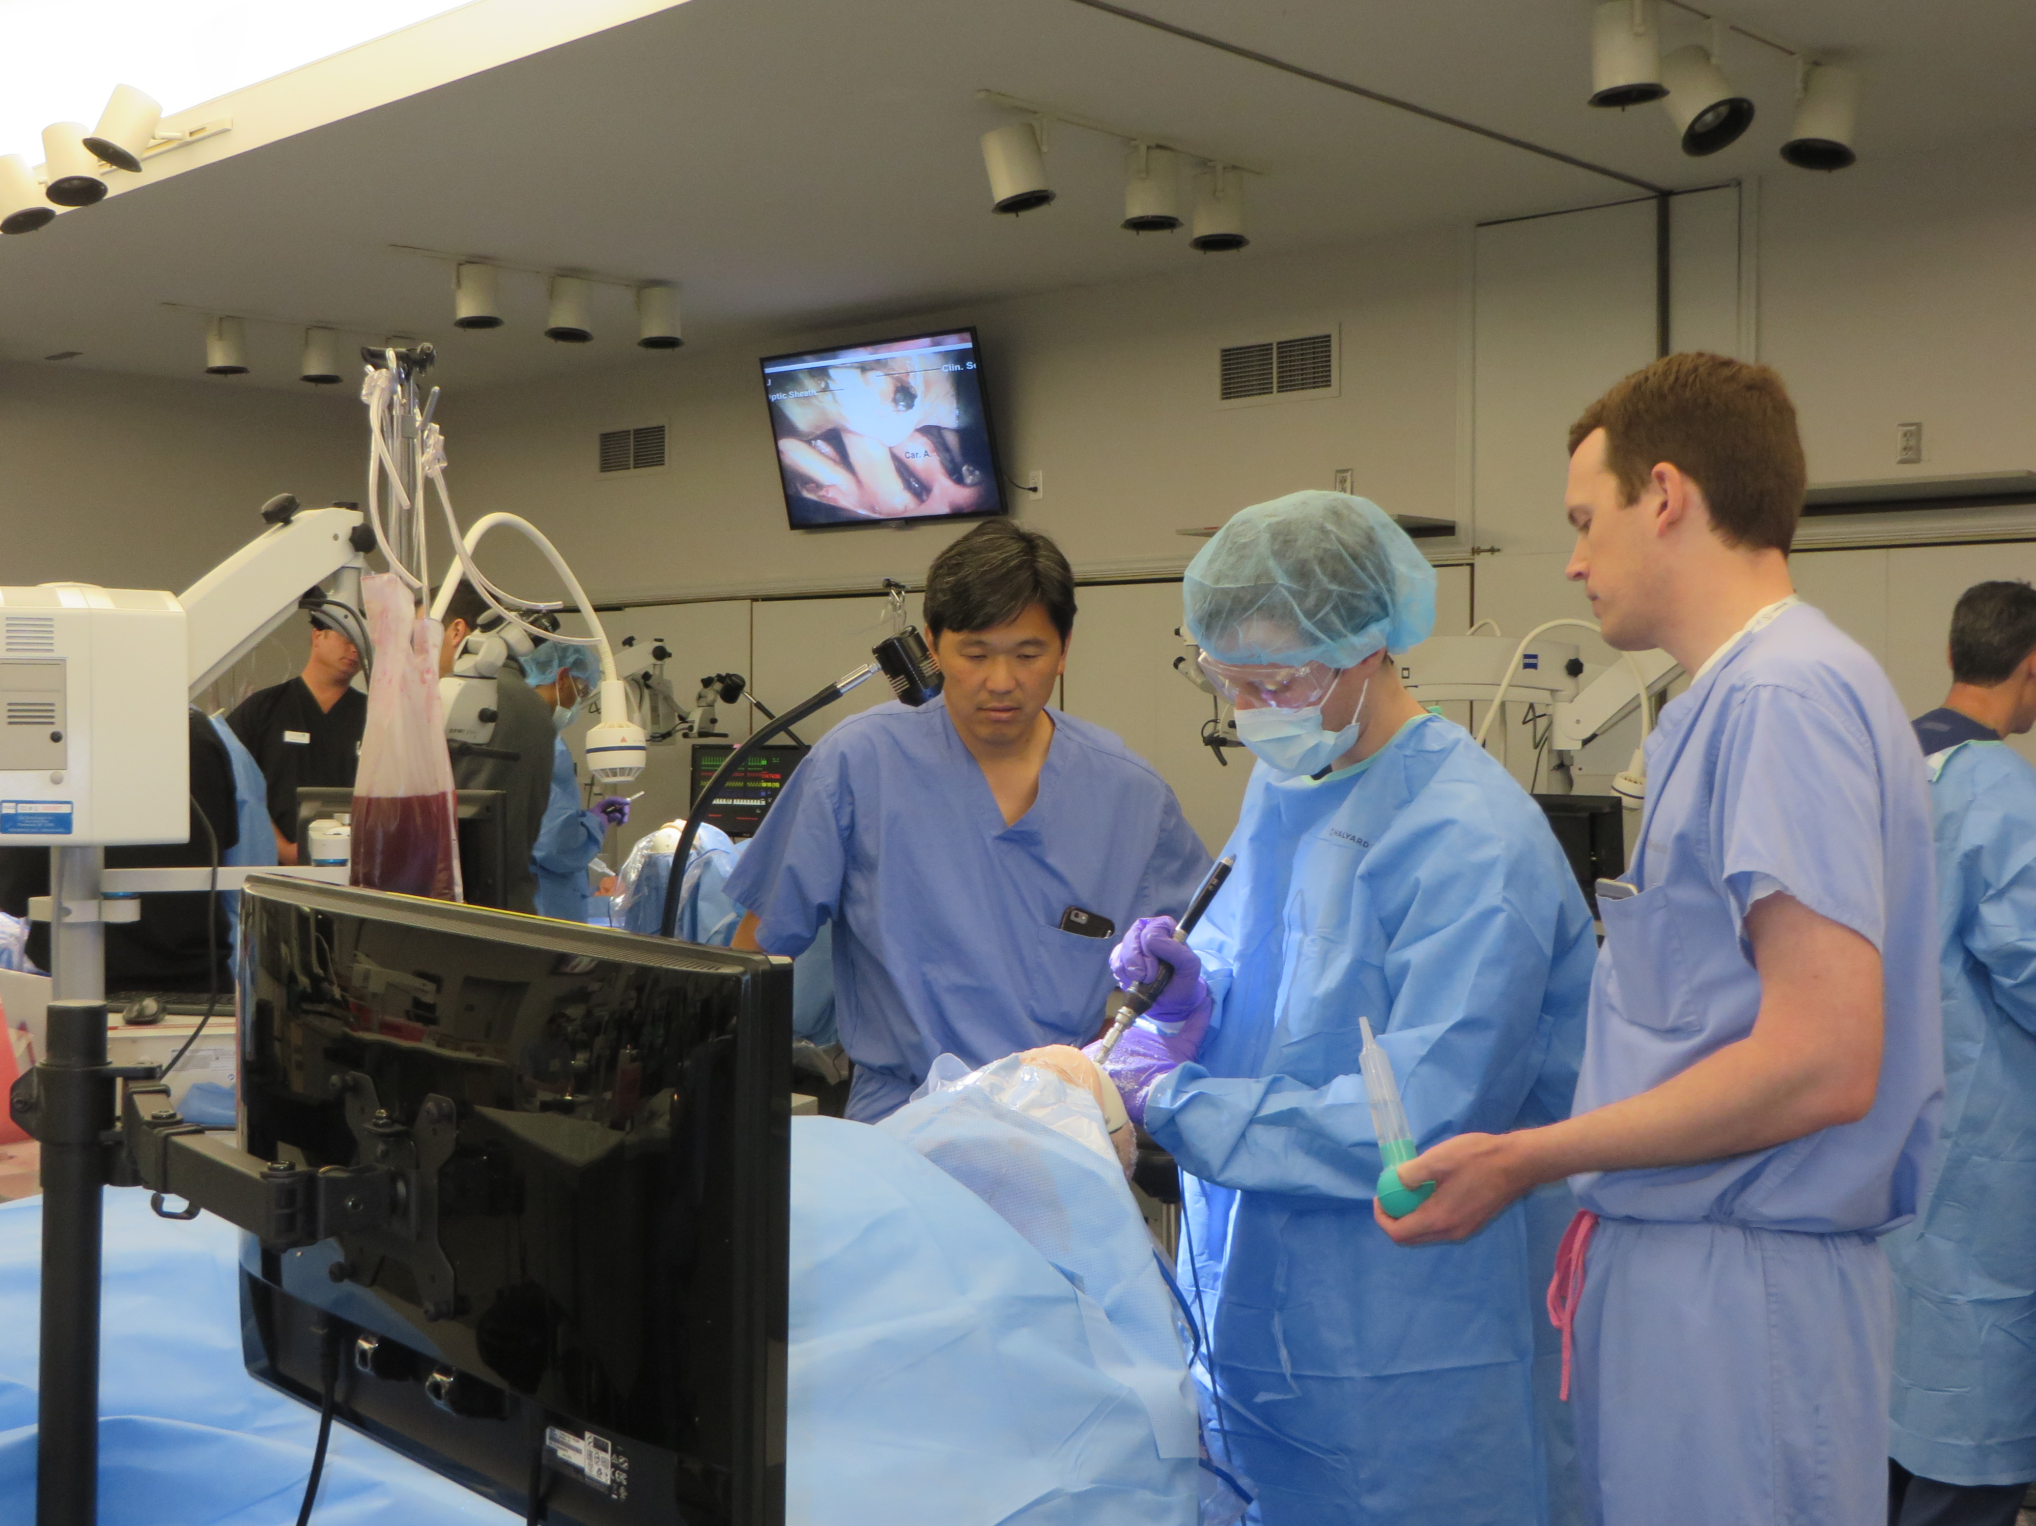
Junior Resident Course
Extremity Prosection
Intraoperative Catastrophe

Slide 17
Junior Resident Course
2018 – Attendance
Strong attendance at West Coast / Midwest courses
Projected attendance at East Coast course slightly decreased due to conflicts with mid-June date

Slide 18
Junior Resident Course
2018 - Evaluations (to date)
Faculty, curriculum, and simulations well-rated
Highest rated simulations
Sagittal sinus injury
Endovascular
Vessel anastomosis
New stations well-received
Spine simulation station
Extremity prosection

Slide 19
Junior Resident Course
2018
Suggestions from participants / faculty
Expand hands-on training like vessel anastomosis and sagittal sinus injury simulations
Expand spine simulations
Add session on resident wellness
Bring back cadavers

Slide 20
Senior Resident Course April 29, 2018 AANS Directors Bill Couldwell & Aaron Cohen-Gadol
Introduction Aaron Cohen-Gadol / William Couldwell
Where Will You Work? Judy Rosman / Ann Stroink / Deb Benzil
Hospital/Academics/Privademics
Fundamentals of Medical Billing John Ratliff
Building a Neurosurgical Team- William Couldwell / Erol Veznedaroglu
Community and Academic Settings
Incorporating APPs into your Practice
Contemporary Spine – Michael Wang / Charlie Branch
Case-based discussion
Managing Outpatient Practices Zoher Ghogawala
Economics of SurgiCenters Joseph Cheng
NERVES Derek Cantrell
Staying out of Trouble in Practice/ Deborah Benzil
Work Life Balance
Personal Finance and Investment Alan Scarrow
Regulatory and Malpractice Primer Michael Chabraja
Cranial Nuance – Aaron Cohen-Gadol
Case-based discussion
Final comments Aaron Cohen-Gadol / William Couldwell

Slide 21
Resident Courses in Summary
Present
Attendance at PGY-1 / PGY-2 courses very strong
Faculty participation / evaluations strong
Financial position improved, but remains reliant on industry partnership
Future
Engage additional industry sponsors (spine)
Expand / improve simulations
Modify curriculum to align with Milestones 2.0

Slide 22
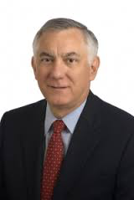
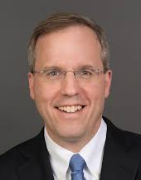
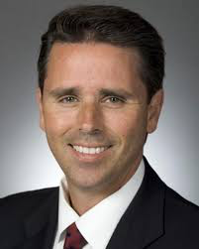
Thank-you!
President
Secretary
CoRE, Chair
Program Directors / Coordinators
Joni Shulman – SNS Resident Course Director
Sophie Church / Gretchen Blow / Michelle Ernst – WashU

