Slide 1
Will Academic Medicine Falter Or Lead?
Darrell G. Kirch, MD
President and CEO, AAMC
May 22, 2018
2018 Society of Neurological Surgeons Meeting
Hershey, PA
Notes:
NOTE: This is the concluding session of the meeting.
About the Society of Neurological Surgeons:
The Society of Neurological Surgeons (the "Senior Society") is the American society of leaders in neurosurgical residency education, and is the oldest neurosurgical society in the world. Academic department chairman, residency program directors, and other key individuals comprise the active membership of the Society. The membership is limited to 200 active members, while senior, inactive and honorary members fill out the remainder of the Society.
In accordance with Article II of the Constitution and Bylaws of the Society, the purpose of the Society in carrying on the traditions of the founding members will be:
The continuing development of the field of neurological surgery including graduate and post-graduate education.
To bestow recognition upon persons of outstanding ability and excellence in their work and teaching. Such recognition may be bestowed by appointment to membership or by appearance on the programs at appropriate times.
To enhance the role and stature of neurosurgical units in academic medical centers
To insure that patients with nervous system disease received the highest quality of care.
To encourage and support research in neurosciences.

Slide 2
The “Stockdale Paradox”
“
Retain the faith that you will prevail in the end, regardless of the difficulties, and at the same time, confront the most brutal facts of your current reality, whatever they may be.
”
Retired Admiral James B. Stockdale
Notes:
The Stockdale Paradox, according to Jim Collins, describes the mental strategy retired Admiral James Stockdale used to survive eight years of torture as a prisoner of war at the Hanoi Hilton.
The key is confronting the reality in front of you, while maintaining optimism. If your optimism is based on false hope, you will be continually disappointed and won’t be able to maintain faith.
With that in mind, I want to examine with clear eyes some of the great challenges facing health care today.
The Stockdale Paradox: Retain the faith that you will prevail in the end, regardless of the difficulties and at the same time, confront the most brutal facts of your current reality, whatever they may be.

Slide 3
Our Challenges Create Leadership Imperatives
Notes:
We cannot depend on people or institutions outside of health care—insurance providers, government policymakers—to solve all of the challenges we face.
We must ourselves exert the leadership needed to transform our system.
With the Stockdale Paradox in mind, I want to examine with clear eyes some of the great challenges facing health care today, and our imperatives to solve them.

Slide 4
Great Challenge: An Era of Uncertainty in Health Care
Notes:
First: an era of uncertainty in health care.
NOTE: Eric J. Strucko, Associate Vice President for Finance and Business and controller for Penn State College of Medicine, delivered a keynote on Sunday afternoon titled “The role of the academic medical center in a health system”

Slide 5
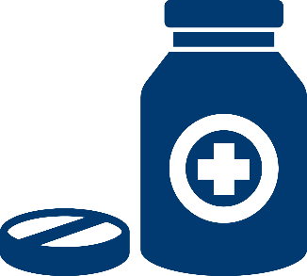
Rising Pressure On Health Care…
Increasing Pharmaceutical, Labor, and Supply Costs
New Clinical Partnerships
Congressional and Executive Action
Changing Demographics
Tightening Reimbursement
Notes:
Disruption in health care is something that each of you know and experience first hand.
We are in an era of great uncertainty due to a variety of factors.
Polarized political climate and uncertain future of health care legislation
Rising pharmaceutical, supply and labor expenses
Difficult payer environments in which commercial payers in some cases steer members toward free-standing imaging and urgent-care centers, contributing to the ongoing issue of flat volumes at some hospitals.
Changing demographics (aging population, urban migration, loss of health insurance protections, etc.)
Implementation of expensive technology (e.g. EHRs, robotics, etc.)
Due to these pressures on the entire hospital industry, Moody’s downgraded 41 not-for-profit hospitals and upgraded 12 in 2017, a ratio of 3.4 to 1. More than 60% of the 2017 downgrades were among small to medium-sized hospitals and health systems with less than $1 billion in operating revenue, suggesting that larger systems are better positioned to weather industry challenges.
In December, Moody’s downgraded the not-for-profit and public healthcare sector from stable to negative for 2018.
Source: http://www.modernhealthcare.com/article/20171204/NEWS/171209962
More recent article: http://www.modernhealthcare.com/article/20180306/NEWS/180309935

Slide 6
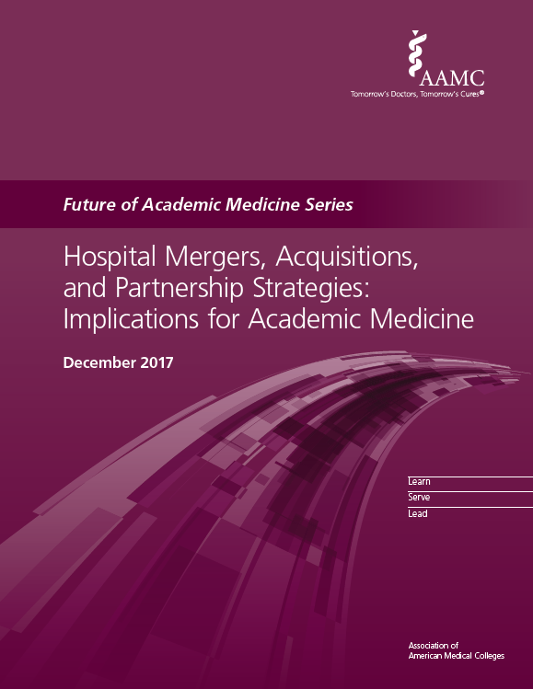
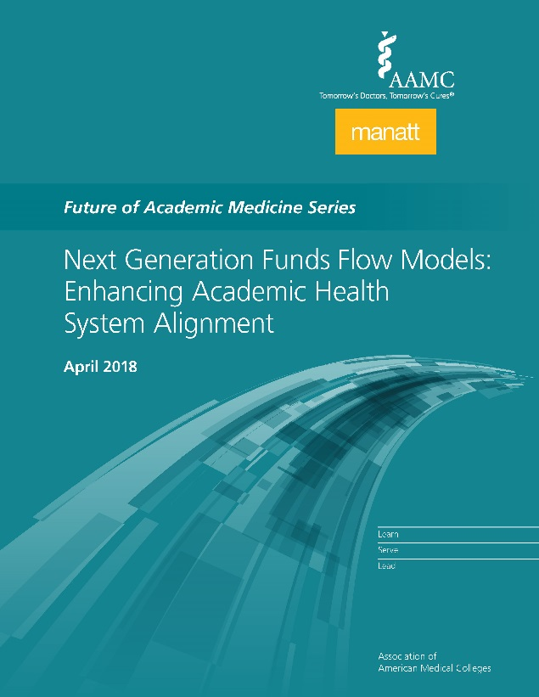
… Requires Renewed Focus on Preserving Our Academic Missions
Coming Soon
Notes:
All of these changes, especially mergers and acquisitions, are threatening our academic missions.
With many of these changes driven by economic forces, medical educators face the special challenge of maintaining strong clinical learning environments to prepare the next generation of physicians to acquire the competencies needed to keep up with ongoing changes in medicine and practice.
Likewise, our researchers are under pressure to maintain the research mission at our institutions, so our scientists can keep discovering new treatments and cures.
Two new reports really highlight these issues (M&A and Mannatt).
The funds flow report highlights how we are challenged to find new ways to support health research and medical education in consolidated systems
We must double down on our efforts to preserve our academic missions, which our essential to maintaining progress in health care amid our many changes.
If we maintain this focus, we can foster thriving and sustainable health systems that can guarantee ongoing, robust support to our missions of education, research, and clinical care.

Slide 7
Great Challenge: Science in a Post-Truth Era
Notes:
Our second challenge is maintaining the voice of science.
There is a notion, heard frequently in politics and the media, that we have entered a “post-truth” era.

Slide 8
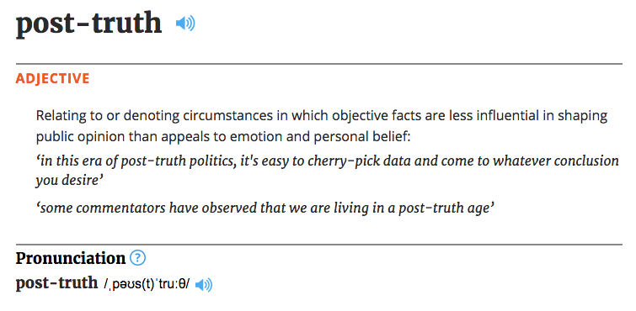
The Rise of Public Misinformation…
Notes:
The challenge to truth has been building for some time. It transcends political party affiliation and our current political leadership.
In 2016, The Oxford English Dictionary even made “post-truth” its word of the year, defining it as “relating to or denoting circumstances in which objective facts are less influential in shaping public opinion than appeals to emotion and personal belief.”
We are seeing a troubling national trend of basing decisions in emotion and personal belief, rather than in fact.
And when this becomes widespread in our culture and across our media landscape, policy can be hijacked, and partisanship can be used to push for agendas that are based in personal beliefs, rather than in evidence.
This is an issue that undermines what we as a community believe and the role we in academic medicine can and should play in society.

Slide 9
…Requires Leaders to Strengthen the Voice of Science
Notes:
In this environment, it is critical that scientists be a voice for science and for governmental support for research.
I see clear and encouraging signs that collectively we are reasserting the authority of science in our national debates.
In April 2017, more than one million people in 600 cities around the world marched for science.
Since then, the global grassroots movement has evolved into year-round advocacy for science and for evidence-based policies by government officials
In September 2017, hundreds walked the halls of the Capitol in Washington as part of the “Rally for Medical Research Hill Day” to support National Institutes of Health (NIH) funding.
It is that kind of passionate defense of science and evidence that will carry the day.

Slide 10
Great Challenge: The New Realities of Learning and Assessment
Notes:
The challenge in education is less related to what’s happening in government or the public sphere.
Instead, we’re being challenged by the explosion in medical knowledge and the expectations of our learners.

Slide 11
The Growing Complexity of Medical Knowledge…
Notes:
Fact accumulation is not a sustainable measurement of medical students today – nor is it an ideal approach to train the doctors of tomorrow.
New “deep learning” artificial intelligence (AI) algorithms are showing promise in performing medical work which until recently was thought only capable of being done by humans.
People are increasingly suggesting that this technology may soon replace physicians.
These algorithms have shown success in radiology, pathology, ophthalmology, and cardiology – with machines’ abilities to detect disease (or even predict it) performing better than human experts.
For example: UK researchers gave data on 295,000 patients to machine learning algorithms to allow them to correlate medical history with rates of heart attacks. Then the algorithms were given 82,000 patient records and asked to predict who would have heart attacks (these patients subsequent history of heart attacks were already known). The algorithms’ results were compared to the predictions based on current “best practice” American College of Cardiology/ American Heart Association (ACC/AHA) guidelines. All four AI methods performed significantly better than the ACC/AHA guidelines. The best algorithm correctly predicted 7.6% more events than the ACC/AHA method, and raised 1.6% fewer false alarms. In the test sample, that’s 355 more patients whose lives could have been saved.
Source: https://www.forbes.com/sites/paulhsieh/2017/04/30/ai-in-medicine-rise-of-the-machines/#52f0bfc3abb0

Slide 12
…Requires Competency-Based Medical Education…
Learning
Competencies!
Premedical
Medical
School
Residency and
Fellowships
Practice
Assessment
Notes:
But in fact, advances in AI are making medical educators think beyond simple facts, which Watson is great at, to other necessary competencies for physicians.
Which is why we are shifting our focus from an accumulation of facts to competencies. When our students graduate, we want to be assured that they are competent physicians, capable of practicing throughout many changes over time.
This is especially important as our profession becomes more specialized—we need to ensure that all physicians have foundational core competencies, and that individual specialties identify core competencies within each field.
As educators, we must focus on creating well-rounded physicians who are prepared for the complexity of medicine tomorrow and in the coming decades.

Slide 13
…In Eight Competency Domains…
Patient Care
Interpersonal and Communication Skills
Medical Knowledge
Inter-professional Collaboration
Professionalism
Health Care
Provider
Practice-based Learning and Improvement
Personal and Professional Development
Systems-based Practice
Source: Englander R, Cameron T, Ballard AJ, Dodge J, Bull J, Aschenbrener CA. 2013. “Toward a Common Taxonomy of Competency Domains for the Health Professions and Competencies for Physicians.” Acad Med 88(8): 1088-1094.
Notes:
Medical knowledge is only one of 8 domains.
Of the other 8, I don’t see Watson replacing them.
Watson is a machine, not a team player. It can’t convey empathy or compassion.
These are the 8 domains identified by Englander et al that make a complete health care provider:
Patient Care
Medical Knowledge
Interprofessional Collaboration
Personal and Professional development
Systems-based practices
Practice-based learning and improvement
Professionalism
Interpersonal and communication skills
These eight domains expand upon the current 6 domains used by ACGME/ABMS.
Source: Englander R, Cameron T, Ballard AJ, Dodge J, Bull J, Aschenbrener CA. 2013. “Toward a Common Taxonomy of Competency Domains for the Health Professions and Competencies for Physicians.” Acad Med 88(8): 1088-1094.

Slide 14
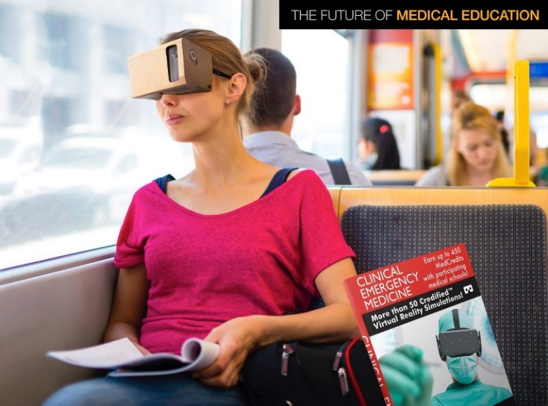
…To Keep Pace With Learners
Notes:
Learners are now more easily able to access and share information that they may have traditionally received in lectures.
Our learners are no longer satisfied with us sitting them down in a lecture hall and forcing them to listen to a sage on a stage.
They want to learn when it suits them and by whatever mode suits them.
New models of learner interaction are emerging to question traditional models for teaching and learning medicine. These new models include MOOCs, IPE, case-based learning, distance technology, virtual reality, and more.
If we are truly going to embrace competency-based learning to produce well-prepared physicians, we must examine every part of the current curriculum for opportunities to train in the competencies.

Slide 15
Great Challenge: Inequity, Division, and Injustice
Notes:
Social inequities and ongoing division are also major challenges to health in the United States.

Slide 16
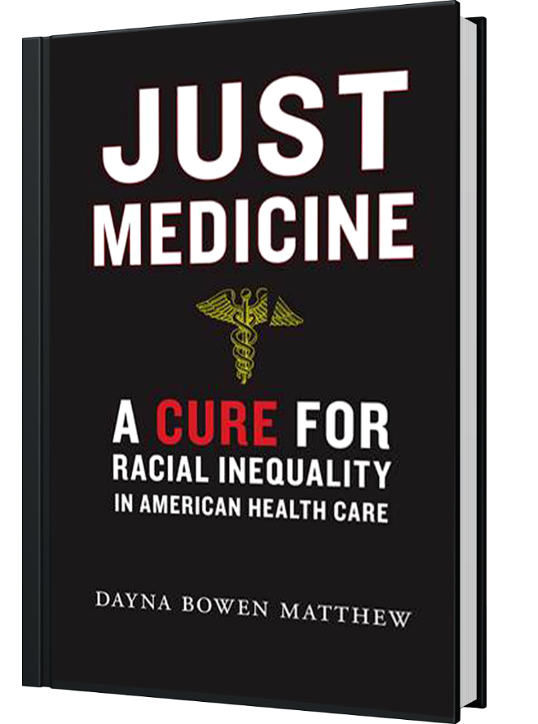
Today’s Inequity, Division, and Injustice…
“
The most tragic proof that racial and ethnic injustice is alive and well is the phenomenon we politely call “health disparities.”
”
Dayna Bowen Matthew
Notes:
Despite how much we spend on health care, we have profound health disparities, which align with income and educational disparities in America.
Equity is central to quality care, and academic medicine needs to lead in the search for equity—not because of any political ideology, but because of the clear evidence that equitable access to care helps us fulfill our commitments to our patients.

Slide 17
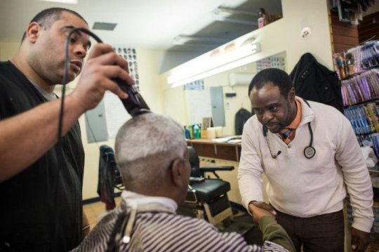
…Require Our Institutions to Be Exemplars of Diversity and Inclusion…
Notes:
(Photos, clockwise from upper left: Hospital food service staff, community health outreach in an African-American barbershop , diverse physicians, interfaith chapel at Penn State Children’s Hospital in Hershey)
At a time when those gaps are widening, academic institutions are the shining exemplars of places that embrace diversity and inclusion.
Academic medicine is a big tent. Academic medical centers are arguably the institutions that are – and must be – the most open, inclusive, culturally diverse, and economically diverse in our country.
AMCs include some of the lowest and highest paid people working in the same organization—from the hospital CEO to food service employees.
Moreover, the outreach taking place at our institutions helps meet members of the community where they are, in places like black barbershops and other community centers.
You can argue that AMCs are temples to science, but I’m always struck that if you happen to walk by the chapel or meditation room, it’s inclusive or ecumenical. It has to be. It must embrace everybody.
I have a deep seated belief, affirmed by my visits to our institutions, that academic health centers are unique, extraordinary places in so many ways. But we can continue to get better.

Slide 18
…To Help Solve Our Most Pressing Challenges
6.3 Million Jobs
are supported by academic medicine in the U.S.
Notes:
Our institutions are both economic anchors and microcosms of their communities.
Increasingly, we’re the source of opportunity for people in our communities through the jobs we create.
An AAMC study conducted in 2017 found that academic medicine supports 6.3M jobs in the U.S. (2.7M direct, 3.7M indirect). Appropriate attention to diversity and inclusion at our institutions can have a significant effect on the community.
However, the case for diversity is not just about improving numerical representation. Diversity plays an essential role in solving big challenges.
When diverse perspectives are brought to bear on our challenges, more ideas are brought to the table. Ultimately, diverse teams and organizations find more creative and innovative solutions.
Building diverse and inclusive organizations is necessary to solve the tough problems we face today, and those that lie ahead.
Dr. Page has published five books—including The Diversity Bonus (2017) and The Difference: How the Power of Diversity Creates Better Groups, Firms, Schools, and Societies (2007).
His research focuses on diversity, complexity, incentives, and institutions. He is particularly interested in the effects of diversity and variation within complex systems.
Add’l background on Dr. Page: In addition to his departmental appointment, Scott Page, PhD, holds a position as a senior research scientist at the Institute for Social Research at the University of Michigan. He also directs or helps direct three large projects at the University of Michigan, including director of Project Diversity, an interdisciplinary effort to understand the theoretical implications of diversity that is funded by the James S. McDonnell Foundation and the Center for Research on Learning and Teaching. Scott belongs to several research teams, including the MacArthur Foundation’s working group on economic inequality and social interactions

Slide 19
Great Challenge: Burnout Among Health Professionals
Notes:
Dr. Shapiro discussed this at length in his “Assessing Burnout and Fostering Resilience” keynote on Monday afternoon.
Thankfully, we are finally discussing the problem of physician burnout more openly.

Slide 20
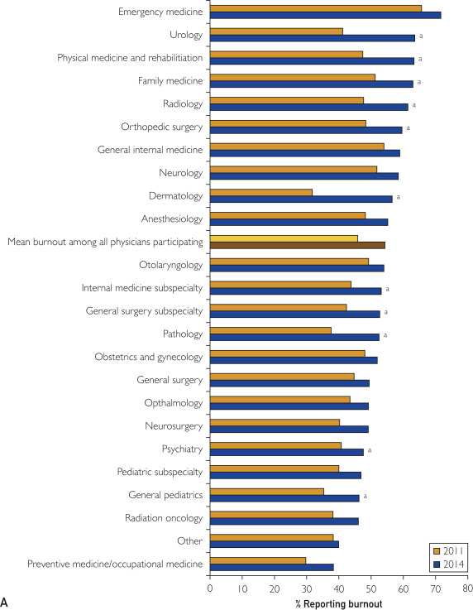
Burnout Is Prevalent Among Clinicians…
54.4% of physicians show symptoms of burnout*
*As Reported in 2014. Source: Mayo Clinic Proceedings 2015 90, 1600-1613DOI: (10.1016/j.mayocp.2015.08.023)
Copyright © 2015 Mayo Foundation for Medical Education and Research
Notes:
The data are alarming:
2014 Shanafelt numbers:
Burnout: 54.4% (rise of nearly 10% in just 3 years)
Depression: 39.8%
Suicidal Ideation: 6.4%
When compared with 2011, rates of burnout among physicians were higher (54.4% vs 45.5%; P<.001) in 2014 and satisfaction with work-life balance was lower (40.9% vs 48.5%; P<.001). In contrast, minimal differences were observed in the proportion of physicians reporting symptoms of depression (39.8% vs 38.2%; P=.04) and no difference in the rates of suicidal ideation was observed (6.4% vs 6.4%; P=.98).
As in 2011, substantial variation in the prevalence of burnout was observed by specialty. Compared with 2011, the prevalence of burnout was higher for all specialty disciplines in 2014. Family medicine (51.3% vs 63.0; P<.001), general pediatrics (35.3% vs 46.3%; P=.005), urology (41.2% vs 63.6%; P<.001), orthopedic surgery (48.3% vs 59.6%; P=.01), dermatology (31.8% vs 56.5%; P<.001), physical medicine and rehabilitation (47.4% vs 63.3%; P=.01), pathology (37.6% vs 52.5%; P=.006), radiology (47.7% vs 61.4%; P=.003), and general surgery subspecialties (42.4% vs 52.7%; P=.005) each experienced a more than 10% increase in burnout.
Nearly half of neurosurgeons show symptoms of burnout. And like most other specialties, the problem worsened from 2014 to 2011.
Regarding neurosurgery, a separate study in the Journal of Neurosurgery published in 2015 conducted a survey of 783 neurosurgeons and found the rate of burnout to be 62.9 percent among nonacademic neurosurgeons and 47.7 percent for academic neurosurgeons. Poor work life balance, anxiety over future earnings and health care reform were cited as major factors contributing to burnout and career satisfaction.
About the Chart: Burnout by specialty 2014 vs 2011. Specialty discipline is shown on the y axis and burnout (A) is shown on the x axis. GIM = general internal medicine; OBGYN = obstetrics and gynecology; PM&R = physical medicine and rehabilitation; Prev = Preventive medicine, occupational medicine, or environmental medicine; WLB = work-life balance. ªP<.05 from comparison 2014 to 2011.
Source of Neurosurgery Article: McAbee JH, Ragel BT, McCartney S, Jones GM, Michael LM 2nd, DeCuypere M, Cheng JS, Boop FA, Klimo P Jr. Factors associated with career satisfaction and burnout among US neurosurgeons: Results of a nationwide survey. J Neurosurg. 2015 Jul;123(1):161-73. doi: 10.3171/2014.12.JNS141348. Epub 2015 Feb 13. PubMed PMID: 25679276.

Slide 21
…Including Neurosurgery Residents
Notes:
These problems exist in your own specialty, as well.
In a nationwide study of neurological surgery residents in 2015 (published in 2018), the overall burnout rate was 67%, despite the fact that 81% indicated they were satisfied with their career choice (while 41% acknowledged they had given serious thought to quitting at some point).
Notable factors associated with burnout included:
inadequate operating room exposure
hostile faculty, and
social stressors outside of work.
Meaningful mentorship was protective against burnout.
Rates of burnout and career satisfaction are paradoxically high among neurosurgery trainees. While several factors were predictive of burnout, including inadequate operative exposure and social stressors, meaningful mentorship proved to be protective against burnout. The documented negative effects of burnout on patient care and health care economics necessitate further studies for potential solutions to curb its rise.
Note: response rate with completed surveys was 21% (346/1643).
Source: J Neurosurg. 2018 Feb 9:1-15. doi: 10.3171/2017.9.JNS17996. [Epub ahead of print] Factors associated with burnout among US neurosurgery residents: a nationwide survey. Attenello FJ¹, Buchanan IA¹, Wen T¹, Donoho DA¹, McCartney S², Cen SY¹, Khalessi AA³, Cohen-Gadol AA⁴, Cheng JS⁵, Mack WJ¹, Schirmer CM⁶, Swartz KR⁷, Prall JA⁸, Stroink AR⁹, Giannotta SL¹, Klimo P Jr.¹⁰.

Slide 22
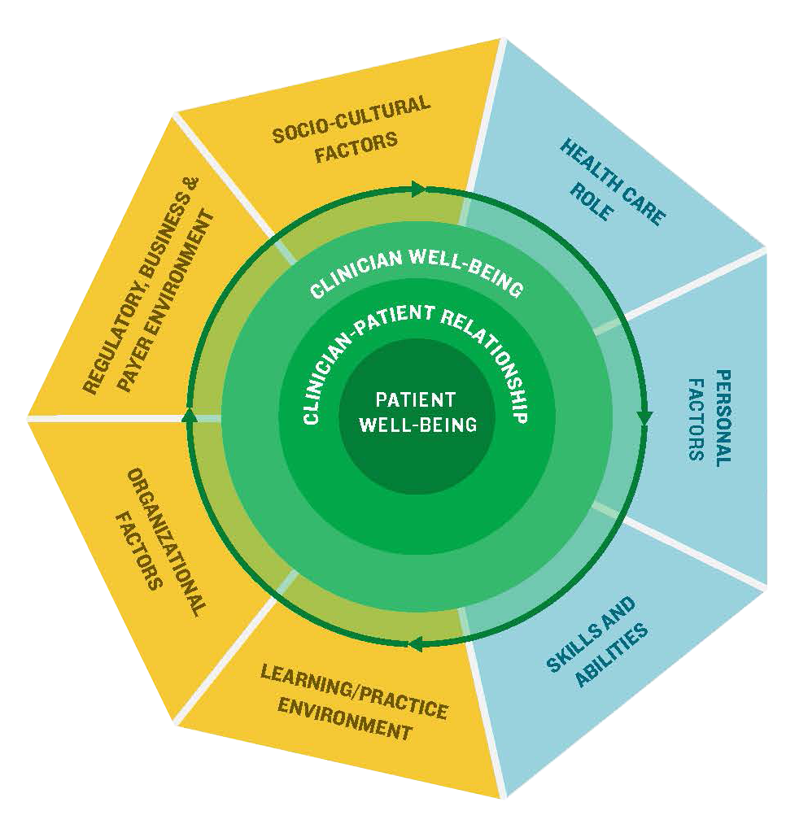
This Multi-Faceted Problem…
SOCIO-CULTURAL
FACTORS
HEALTH CARE ROLE
REGULATORY, BUSINESS & PAYER ENVIRONMENT
PERSONAL
FACTORS
ORGANIZATIONAL FACTORS
SKILLS AND
ABILITIES
LEARNING/PRACTICE ENVIRONMENT
Notes:
I co-chair the National Academy of Medicine’s Action Collaborative on Clinician Resilience and Well-Being, which focuses on this issue.
When we started, everybody wanted to focus on one problem—for many is was EHR. For some it was duty hours. For others it was admin paperwork.
But what we’ve realized is how multi-dimensional the problem is, encompassing personal and individual factors and organizational factors.
If you go to NAM website, within each of the domains shown here there are 80 individual factors that contribute to burnout.
Solutions to this problem must account for this complexity.

Slide 23
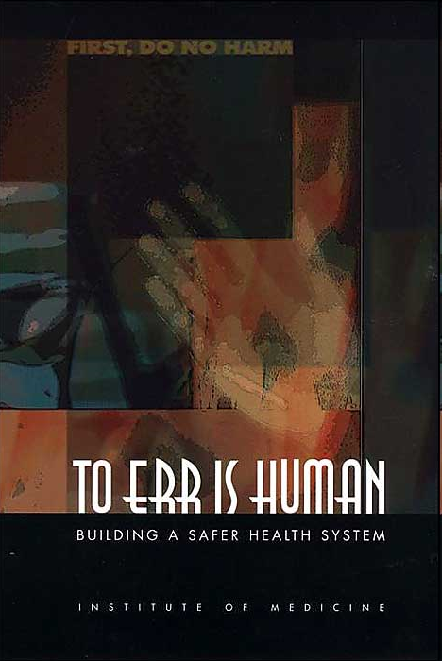
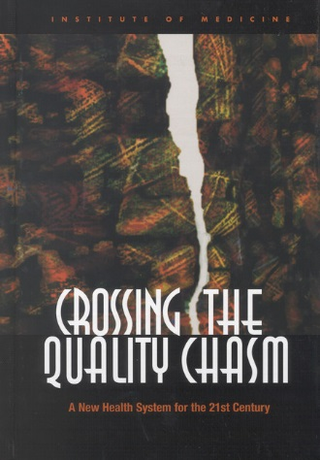
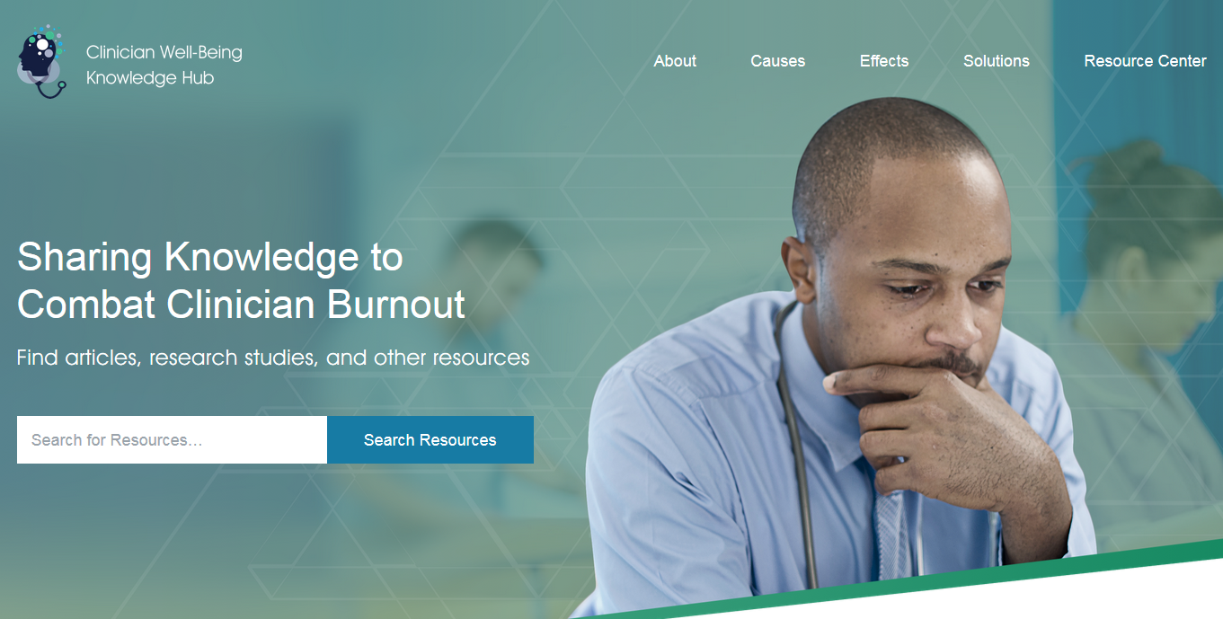
…Requires A Systematic Approach That Adapts Lessons From Our Past
nam.edu/clinicianwellbeing
Notes:
There’s no simple solution, but we can learn from the past.
20 years ago, we thought the quality and safety of American health care as good as it could possibly be.
However, the early 2000s also saw wake up calls about quality and safety, highlighted by two Institute of Medicine reports—To Err is Human and Crossing the Quality Chasm—showing lapses in quality and safety in health care.
Now, we’re coming out of denial about burnout, and we are taking the same approach with the National Academy of Medicine’s Action Collaborative on Clinician Resilience and Well-Being, which I co-chair with Tom Nasca and chair Victor Dzau.
We’ve shown the data and now we’re working to develop the road map. A study will begin this summer, which should be completed in 18 months. We hope it will provide a roadmap to combating burnout in the same way.
But you cannot change culture with the flip of a switch. Just as our changes in quality and safety took years, reforming health care to address the issue of burnout will be a long road.
To Err is Human
44,000 – 98,000 annual hospital deaths in US as a result of errors in health care (Data released Nov. 2009, full report published 2000)
Exceeds deaths from car accidents, breast cancer, or AIDS
35% of physicians and 42% of public report errors in their own or family members’ care; 18% of physicians and 24% of public report serious consequences—death, long-term disability, and severe pain.
Originally published November 1999
Crossing the Quality Chasm
"Crossing the Quality Chasm" gave our nation a clear blueprint for improving the quality of health care in this country.
The report focused on six key pillars: efficiency, effectiveness, safety, timeliness, patient-centeredness, and equity.
Originally published July 19, 2001

Slide 24
Great Challenge: A Leadership Deficit
Notes:
NOTE: Several speakers, including Dr. Alan Cohen, Dr. Shelly Timmons, and Dr. Lacquement Jr, and Ms. Melissa Doberstein, led sessions and discussion on leadership development on Sunday afternoon of the meeting.

Slide 25
Our Biggest Deficit!
$3.7T
Notes:
Lastly, I think our greatest challenge is not financial.
I believe that $3.7 trillion is more than enough to take care of the health of our nation. Our biggest deficit is not financial.
I believe our biggest deficit is that we do not have the leaders we need to succeed in this changing environment.

Slide 26
Notes:
All too often, when organizations are looking for a new leader, they are looking for one who is an expert and comes with a set of prescribed answers to all their problems – they are looking for Moses.

Slide 27
Embracing A New Model…
“
Multipliers are leaders who look beyond their own genius and focus their energy on extracting and extending the genius of others.
”
Liz Wiseman
Notes:
Liz Wiseman and Doug McKeown propose a new model of leadership: “Multipliers.”
Multipliers do not rely solely on their own genius: they look for ways to amplify intelligence, produce better outcomes, and foster talent in their colleagues.
We need to embrace this model of leadership. We need leaders who can mobilize teams and maximize the genius of others to solve our problems locally and nationally.

Slide 28
…Guided By Our Ethics
Beneficence
Non-maleficence
Autonomy
Social Justice
Notes:
When it comes to leading in challenging times, what we as medical professionals always have to guide us is our ethics: beneficence, non-maleficence, autonomy, and social justice.
Especially in these difficult times, we can must guard against allowing bias and fear to inform our decisions in policy, research, clinical care, and education by approaching our biggest challenges from a foundation of science and adherence to academic medicine’s core values.
If you can be a multiplier and you can stay in touch with your four principles, you can be the kind of leader we need in health care today.

