Slide 1


DEVELOPING A
NEUROSCIENCE INSTITUTE
What To Do and What Not To Do
Marc Mayberg, MD

Slide 2
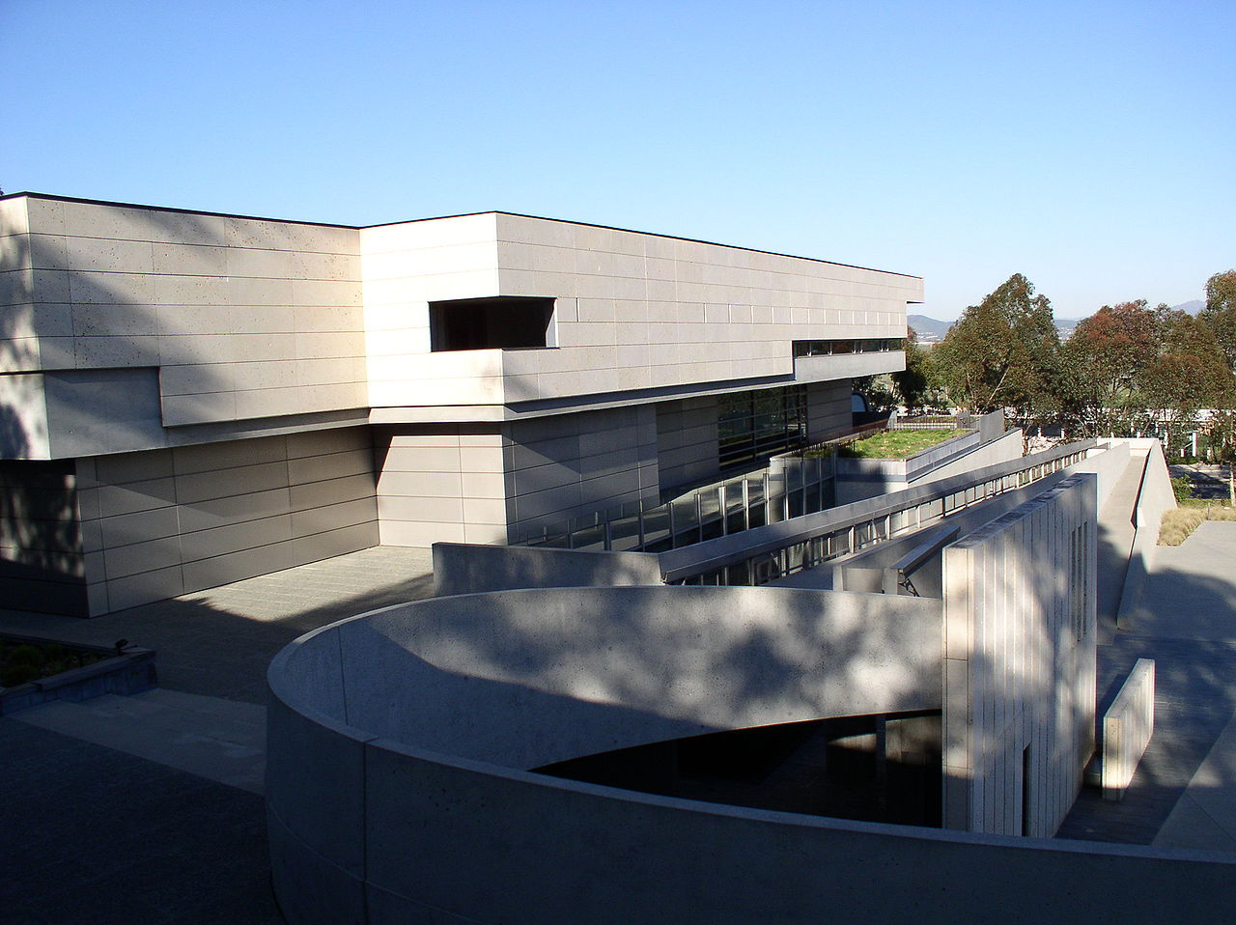

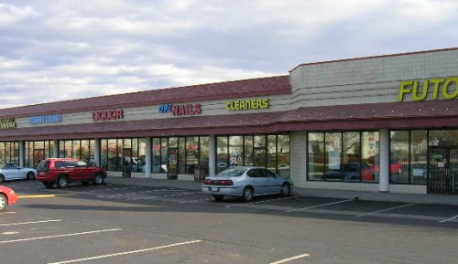
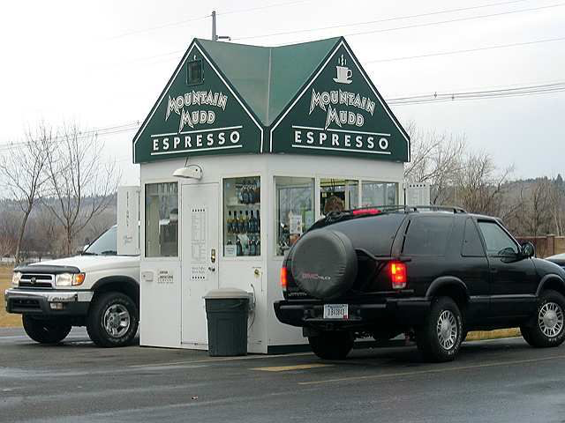

evolution OF NEUROSCIENCE INSTITUTES
2019
2013
1998
Distribution
1993
Elaboration
Diversification
Inception
NEUROSCIENCE
INSTITUTE
DRIVE-THRU
•ESPRESSO•
Neuroscience
Institute
•1962 Gerald Edelman organizes NSI working group at Rockefeller University
•1993 Moves to Scripps in San Diego
•2012 Assumed by Scripps Research Institute after financial decline
•2000s Proliferation of Neuroscience Institutes

Slide 3
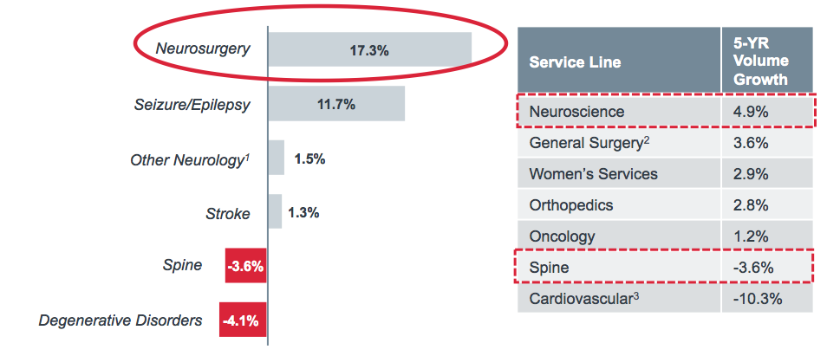

WHAT IS DRIVING HOSPITALS TO PROMOTE NEUROSCIENCE INSTITUTES?
NEUROSCIENCES ARE THE FASTEST GROWING SERVICE LINE FOR INPATIENT ADMISSIONS 2016-2021
CRANIAL SURGERY AND SPINE ARE AMONG THE HIGHEST AVERAGE PER-CASE CONTRIBUTION MARGIN
Neuroscience Per-Case Financials
Inpatient, National Medicare Averages
Low Profitability,
High Volume
Medical Spine¹
Medical Stroke²
Degenerative Disorders³
Brain Surgery⁴
Spinal Fusion
ESPECIALLY NEUROSURGERY
MS-DRGs 52-53, 551-552.
MS-DRGs 61-69.
MS-DRGs 56-57.
MS-DRGs 20-27, 31-33, 614-615.
Advisory Board 2018

Slide 4
EVOLvIng MODELS FOR PATIENT CARE
Traditional NEUROSURGICAL Academic Model
PATHOLOGY
PEDIATRICS
ORTHOPEDICS
NEUROSURGERY
MEDICINE
RADIOLOGY
NEUROLOGY

Slide 5
NEUROSURGERY Subspecialty Model
INTEGRATED PRACTICE Model
COMPLEX SPINE
ENDOVASCULAR
NEUROSURGERY
HYBRIDS
SURGICAL
EPILEPSY
HYBRIDS
HYBRIDS
PEDIATRIC
NEUROSCIENCES
BRAIN TUMOR
INSTITUTE
HYBRIDS
FUNCTIONAL &
RESTORATIVE
HYBRIDS
HYBRIDS

Slide 6
PROMOTING HYBRID PRACICES IN NEUROSURGERY
AANS NEUROENDOVASCULAR TASK FORCE - 1997
• Establish term “Neuroendovascular Surgery”
• Neurosurgery program directors;
  Appoint INR faculty to Neurosurgery departments
  Required NS resident training in angiography
  Allow infolded Neuroendovascular fellowships
  Distribute procedure income across specialties
• Promote ACGME Neuroendovascular accreditation
• Courses in Neuroendovascular techniques
• Invite ASITN members to join CV Section
• Promote Stroke Center Development
• Develop marketing programs
• Develop multi-specialty guidelines
Framework for Neurosurgery involvement with neuroendovascular procedures and multi-disciplinary stroke care
1997

Slide 7
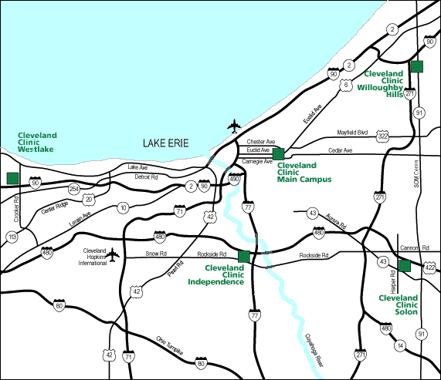

Establishment of CLEVELAND CLINIC Integrated Multi-Specialty CV Center (2001)
• MULTI-DISCIPLINARY UNIT
• HYBRID PROVIDERS ACROSS SPECIALTIES
REGIONAL STROKE CARE ALGORITHM
Neurology
Cardiology
Neurology
Cardiology
Tony
Furlan
Jay
Yadev
Tony
Furlan
Jay
Yadev
Irene
Katzen
Irene
Katzen
Hillcrest
Hospital
Derk Krieger
Derk Krieger
Cathy
Sila
Neuroendovascular
Surgery
Cathy
Sila
Lakewood
Hospital
Surgery
Henry Woo
John
Perl
Neuro
-Intensive Care
Peter
Rasmussen
Neuro
-Intensive Care
Peter
Rasmussen
John
Andrefsky
Tom
Masaryk
John
Andrefsky
Tom
Masaryk
Mike
DeGeorgia
Microsurgery
Microsurgery
Radiosurgery
Henry Woo
Radiosurgery
Peter
Rasmussen
Gene Barnett
Peter
Rasmussen
Gene Barnett
Marc Mayberg
Marc Mayberg
Marc Mayberg
Marc Mayberg
John
John
Suh
Suh

Slide 8
CCF ENDOVASCULAR CENTER
INTEGRATED PROVIDER GROUP BENEFITS
GROUP AND INDIVIDUAL PRODUCTIVITY
REVENUE and PROFITABILITY
CLINICAL VOLUME
2000
1500
1000
500
0
2000
2000
2001
2001
2002
2002
2003
2003
2001
2002
2003
Neuro Diagnostic
Neuro Therapeutic
Gross Revenue
Work RVU/ Physician
TOTAL Work RVU's
Net Revenue

Slide 9
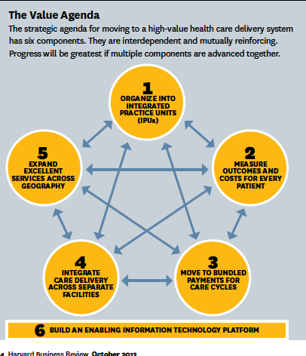
INTEGRATED PRACTICE UNITS - 2013
Organized around a single medical condition
  Dedicated, multidisciplinary team of subspecialty clinicians
Responsibility for the full cycle of care
  Outpatient / Inpatient / Rehabilitation / Outpatient
Single administrative and scheduling structure
Co-located in dedicated facilities
Measurement + Joint accountability
  Outcomes
  Costs
  Processes
Coordinated regional care
Porter and Lee Harvard Business Review. Oct 2013

Slide 10
Swedish Neuroscience Institute
INTEGRATED PRACTICE UNITS
PROCEDURAL
NON-PROCEDURAL
Brain Tumor
Complex Spine
MIS Spine
Stroke
Epilepsy
Movement Disorder / DBS
Neuroendocrine
Skull Base
Hearing Restoration
MS Center
General Neurology
Inpatient Neurology
Headache
Sleep
Neuropsychiatry
Neurocritical Care
Memory Disorders
Pain

Slide 11
Integrated Practice Units and Clinical Transformation
Porter ,M.H. and Lee, T.H. Harvard Business Review. Oct 2013

Slide 12
DETERMINING FINANCIAL PERFORMANCE BY PROGRAM
NEUROSCIENCE INSTITUTE
CLINICAL PROGRAMS
Clinical
Administrators
Integration
Councils
System Support
Campus
Departments
Neuro-
vascular
Cranial
Surgery
Neuroscience Spine
Neuro-medical
SMG Professional Services
System
TOTAL
Impact (MM) | 2012 | 2017 | 2012 | 2017 | 2012 | 2017 | 2012 | 2017
Facility Contr. Margin | $13.4 | $21.9 | $20.9 | $33.7 | $59.1 | $69.6 | $26.2 | $31.9
Investment | (1.6) | (2.9) | (3.8) | (6.7) | (5.9) | (10.5) | (5.1) | (8.8)
Marketing | (0.1) | (0.3) | (0.1) | (0.3) | (0.1) | (0.3) | (0.1) | (0.3)
Contribution Margin | $11.7 | $18.9 | $17.1 | $27.2 | $53.1 | $59.5 | $21.1 | $23.2
Depreciation | - | (1.3) | - | (3.2) | - | (2.8) | - | (0.5)
Net Contrib. Margin | $11.7 | $17.5 | $17.1 | $23.6 | $53.1 | $56.1 | $21.1 | $22.4
2012 | 2017
$119.6 | $157.2
(17.3) | (25.0)
(0.3) | (1.6)
$101.9 | $131.6
- | (7.8)
$101.9 | $122.8
Marketing/
Business Dev
Emergency Department
Cerebrovascular Center
Ivy Brain Tumor Center
Comprehensive Spine Center
Epilepsy Center
Clinic Operations
Physician Relations
Neuroscience Nursing Units
Primary
Stroke Center
Seattle Pituitary Center
Same Day Spine Surgery Center
MS Center
Revenue Cycle
Memory Disorders Center
Recruitment
Finance
Decision Support
Radiology
Angiography
Comprehensive
Stroke Center
Skull Base Surgery
Center
Complex Spine Surgery Center
Movement Disorders Center
Foundation/ Development
Surgery
Neuromodulation Center
Rehabilitation
Pain Center
Center for Hearing
Neurorehab Center
SRS Center
Sleep Center

Slide 13
NEUROSCIENCE INSTITUTES
POTENTIAL STRENGTHS
Integrated Practice Units - Quality of Care
  Multi-disciplinary
  Sub-specialty
  Evidence-Based Treatment Algorithms
  Care Continuum from Clinic/Hospital/Outpatient
  High Volume – Better Outcomes
Patient Satisfaction
Outcome Tracking and Quality Improvement
Financial Accountability by Practice Unit
Inter-disciplinary Knowledge Exchange
Structured Incentives for Providers
More Influence on Healthcare System Expenditures
Regional Care Coordination
Center Of Excellence in Consolidated System
Adaptability to Changes in Healthcare

Slide 14

NEUROSCIENCE INSTITUTES
POTENTIAL DETRIMENTS
OPERATIONAL
Prioritizing the Mission
Significant Up-Front Investment
Regional Responsibilities
Care Coordination at a Distance
FINANCIAL
Stimulates Turf Wars
Impact Upon Community Practices
Compensation Transparency Among Providers
Greed

Slide 15
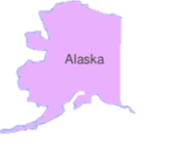
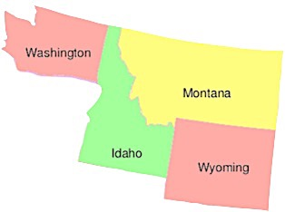
UNIVERSITY OF WASHINGTON AND WWAMI
REGIONAL CARE - STRENGTH
W
ashington
yoming
laska
ontana
daho
W
A
M
I

Slide 16
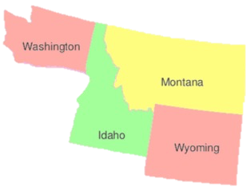
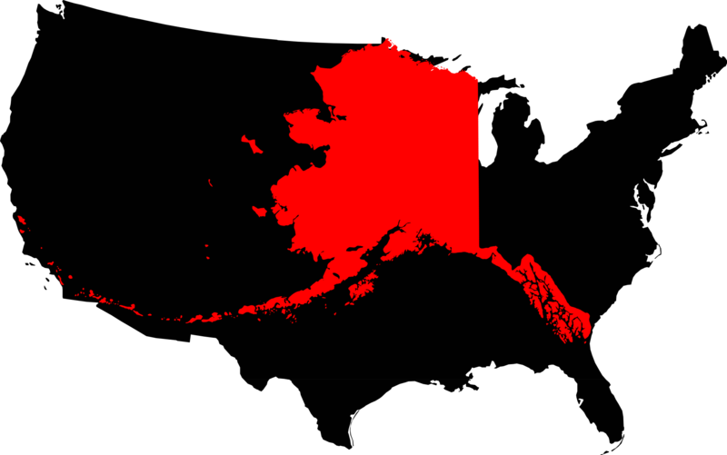
UNIVERSITY OF WASHINGTON AND WWAMI
REGIONAL CARE - CHALLENGE
Alaska

Slide 17
NEUROSCIENCE INSTITUTES requirements
Summary/Conclusions
  Unwavering Institutional Commitment
  Integrating Multi-Disciplinary Care
  Overcoming Detriment from Turf/Competition
  • Defining the Mission
COMPREHENSIVE REGIONAL QUALITY PATIENT CARE

