Slide 1
Society of Neurological Surgeons
Medical Student Teaching Award
2018

Slide 2
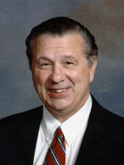
David Kline

Slide 3
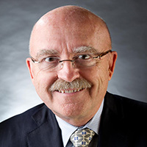
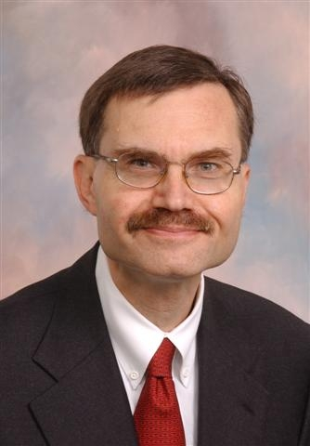
SNS Medical Student Teaching Award
Don Quest 2016
Allan Friedman 2017
2018
Notes:
Don Quest, Allan Friedman, Robert Dempsey

Slide 4
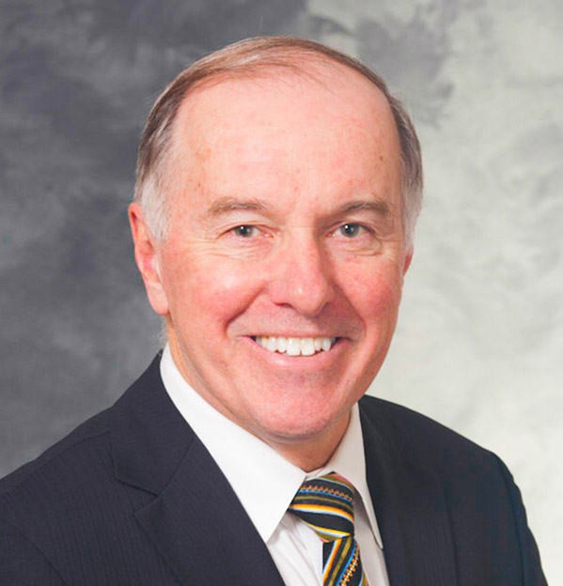
Robert Dempsey
Third Recipient of the American Academy of Neurological Surgeons Medical Student Teaching Award
Notes:
Robert J. Dempsey, is the Manucher Javid Professor and Chairman of the Department of Neurosurgery at the University of Wisconsin. Bob has had a decades long history of dedication to our specialty at all levels.

Slide 5
RUNN Course
Notes:
He has been integral in the development and stewardship of the annual RUNN course.

Slide 6
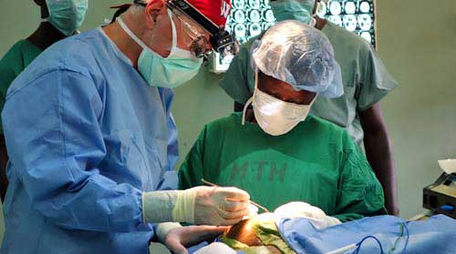
Leadership
Notes:
He is past-president of the Society of Neurological Surgeons and a long time leader of the Foundation for International Education in Neurological Surgery.
Through FIENS, he has established and supported over 20 training programs in developing countries—Asia, Central America, South America, and Africa.

Slide 7
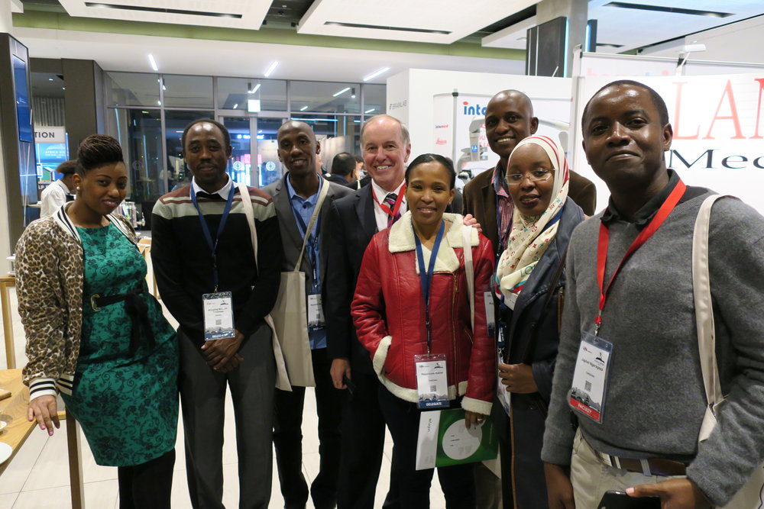
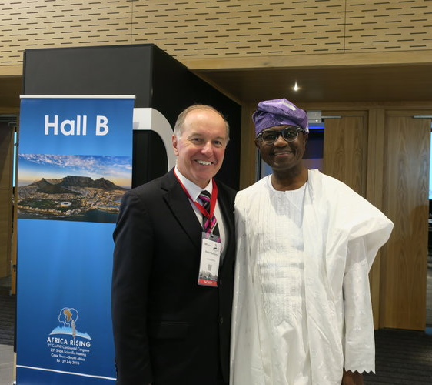
International Contributions
Notes:
Dr. Dempsey’s humanitarian projects have been active for over 25 years. With a philosophy of service through education, he is committed to training a generation of physicians in the developing world.

Slide 8
Research
Notes:
With over 30 years of NIH funding, Dr. Dempsey has multiple research projects with a focus on cerebral ischemia, vascular cognitive decline, and repair of the injured brain with 240 refereed publications and over 80 research grants.

Slide 9
Award Winning Educator
Notes:
Dr. Dempsey is an award winning educator and mentor, training a generation of students, residents, and faculty worldwide. He is a three-time winner of Clinical Teaching Awards as voted by the students. He has been inducted into the Gold Humanism Honor Society in 2014 and in 2015 was named the “Best Clinical Teacher Across the State” for outstanding teaching and mentorship for UW students. It should be noted this award is system wide and the fact that a subspecialist was even considered for this award is quite remarkable. The fact that a neurosurgeon won the award by a vote of the medical school classes is a testament to Dr. Dempsey’s dedication to medical students.

Slide 10
2013 Graduation Speaker

Slide 11
Notes:
He has received the Humanitarian Award from the AANS and the Distinguished Service Award from the SNS, noting a lifetime commitment to service and education nationally and internationally.

Slide 12
Robert J. Dempsey, MD
Notes:
In addition to his daily mentoring activities with the students on service, Bob has biweekly teaching rounds with the medical students, he takes hours out of his schedule teach week to sit down with the students, sometimes in the hallway, sometimes over coffee, sometimes in his office and discuss basic clinical neuroanatomy, neuro imaging, ethical issues facing patients on this service and coaching students with regard to career choice. He has steered numerous students towards careers in clinical neurosciences and just as importantly, has steered numerous students on to other paths for which they are better suited.

Slide 13
SNS Medical Student Teaching Award
Notes:
Don Quest, Allan Friedman, Robert Dempsey

