Slide 1
Academic Medical Centers: Role in a Health System
Evolution of Approaches & Organizational Structures
May 2018
Eric Strucko
Associate Vice President for Finance & Business, Penn State University
Controller, Penn State College of Medicine
Treasurer, Milton S. Hershey Medical Center & Penn State Health

Slide 2
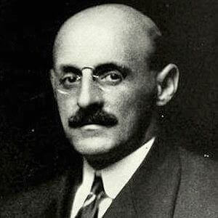
Ideal Form
Carnegie Foundation & Johns Hopkins University
Abraham Flexner (1910):
…the only medical educational model involves the tripartite mission of:
research,
instruction, &
clinical care…
…universities & the medical school need a hospital (ownership or access).

Slide 3
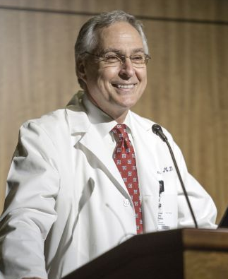
Research, Instruction, & Clinical Care
“…three different lines of endeavor that act synergistically to advance a unified purpose – that of a healthier future for all.”
Daniel W. Rahn, MD.
Chancellor of the University of Arkansas for Medical Sciences
Rahn, Daniel W. (2015). Preface. In Steven A. Wartman (Ed.), The transformation of academic health centers: Meeting the challenges of healthcare’s changing landscape (pp. xv). London: Academic Press.

Slide 4
Research, Instruction, & Clinical Care: “Act(ing) Synergistically”
The platform for advancing the three-part mission is the patient care enterprise, which is the largest classroom:
Model the best in patient care for the next generation of providers.
Point the way to innovations in how to approach health & disease.
Patients:
Receive state of the art care.
Partners in education & research.
Rahn (2015).

Slide 5
Research, Instruction, & Clinical Care: the University Business Model
Integration among the 3 mission areas & the sources & uses of funds.
Vigilance in research & instruction dependent on continuous patient care enterprise growth & the associated patient care revenue.
Biomedical & health science research capital intensive.
Physician-faculty research exceeds salary caps.
Cost of medical education high.
Grants, contracts, tuition, gifts, & endowments require supplemental clinical funding.
Growing the patient care enterprise relies on biomedical & health science research, & the clinical expertise honed through teaching.

Slide 6
Economic Argument for Integration: the Virtuous Cycle
AHS Hospitals & physician practices invest in research & instruction.
Growth in patient referrals, demand for care, & revenues.
Technology transfer, new protocols, instructional excellence.
Stature, reputation, & brand value for hospitals & physician practices.
Wartman, Steven A. (2015). Preface. In Steven A. Wartman (Ed.), The transformation of academic health centers: Meeting the challenges of healthcare’s changing landscape (pp. xix). London: Academic Press.

Slide 7
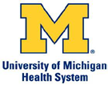
Models for Integration: Traditional AHS Corporate Structures
Loose Affiliation Full Integration
University/Medical School
University/Medical School
University/Medical School
Faculty /Physician Group Practice
Hospital(s)
Hospital(s)
University/Medical School
Hospital(s)
Faculty /Physician Group Practice
Hospital(s)
Faculty /Physician Group Practice
Faculty /Physician Group Practice
Faculty /Physician Group Practice
Hospital(s)
University/Medical School
Barrett, Douglas J. (2008). The evolving organizational structure of academic health centers: The case of the University of Florida. Academic Medicine, 83(9), 804-808. Jay K. Levine, ECG Management Consultants to AAMC, August 2001.

Slide 8
Faculty/Physician Effort Across Three Missions
Decreased ability for clinical earnings to cross-subsidize research & instruction at a time that funding for academics is shrinking (Rahn, 2015). Triple threat faculty now dual threat or pure clinicians or researchers?

Slide 9
Industry Changes Require Academic Health System Organizational & Effort Adaptations
Curriculum changes: patient/family centered team based care models; integration of health information systems into routine practice; longitudinal clerkships & training.
Research changes: multiple PI interdisciplinary, emphasis on translation, greater reliance on internal institutional support ($0.52 for every $1.00 in grants, AAMC, 2015), increased competition for public sponsorship.
Practice changes: population health, movement away from only high impact interventions for patients with serious disease, provider consolidation, payer consolidation, provider-payer integrations, value-based & shared risk reimbursements.
Rahn (2015).

Slide 10
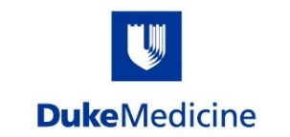
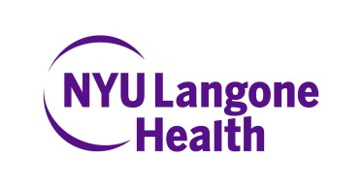
Maintain Clinical Margins: Evolving Strategies
Regional & National Specialty Programs
Managing Comprehensive Health Needs of a Population
Provide the Differential Value of Academic Medicine
The Chartis Group (2017).

Slide 11
Maintain Clinical Margins: Various Structures
Integrated delivery system with community network
Medical center hub with distributed physician network
Private practice hospital
Hospital spin-off
…managing comprehensive health needs of a population.
The Chartis Group (2017).

Slide 12
Penn State Health
“Are we facing market forces & economic realities requiring us to adopt a more private practice orientation? Yes. Are we a university owned clinical enterprise dedicated to biomedical & health science research & education? Yes.”
Eric Barron, President, Penn State University
(Penn State Health Board of Directors Meeting, February 2018).

Slide 13
Penn State Health
A viable clinical enterprise, committed financially & operationally to the university & biomedical & health science research & education, serves & fulfills the academic missions.
Viability: market competitive, liquidity, access to capital, & effective corporate structure.
Commitment to academic mission: unfettered access for faculty & students, clinical trials & translational research, protected time for faculty, sustainable funds flows.

Slide 14
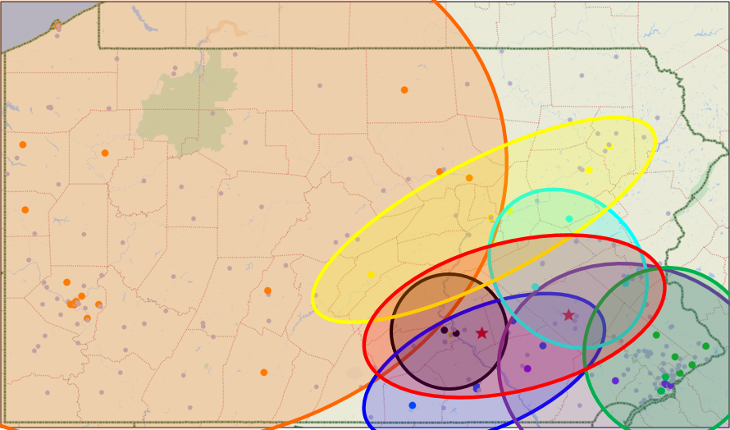
Market Competition: 2016-2017
Penn State
Penn Medicine
WellSpan
UPMC
Jefferson Health
PinnacleHealth
Geisinger
Lehigh Valley

Slide 15
Penn State Health Strategy Reorientation
Change in strategic direction
Traditional strategy:
Draw volume via high specialization, acute patient condition, & brand.
Scope of clinical services in alignment with the academic mission.
Laboratory based research & investigator initiated clinical trials.
Integrated system strategy:
Form vertically integrated delivery system (align with payer – population & value).
Grow network of community care assets (convenience to population, market scale); spread cost structure over broader health system network.
Improve as an accessible referral center.
Tom Stoessel, Senior Vice President & Chief Strategy Officer, Penn State Health; Eric Strucko.

Slide 16
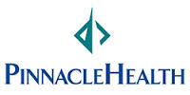
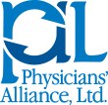
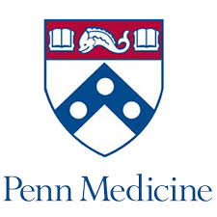
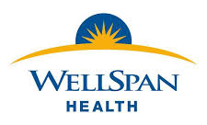
Market Movements Verifying the Strategy
1. FTC & Federal Courts halt PSH-Pinnacle merger
2. Pinnacle buys 4 CHS hospitals in York/Lancaster
3. PHS Acquires PAL, referral physicians in Lancaster
4. Pinnacle: capital pressure, no referral physicians in Lancaster, merges with UPMC
5. UPMC: insurer–provider services to mid-PA, pushes Highmark-PSH together
Highmark capital partner with PSH:
$ millions to PSH, 20% of Board seats
$25M to Cancer Institute
Other providers in the market:

Slide 17
Community Health Network Strategy
10 Minutes to Primary Care | 20 Minutes to Specialty & Ambulatory | 30 Minutes to Hospital
Legend
Penn State Health Hospital
Current Ambulatory Sites
Potential Future Ambulatory Sites
Bed Strategy Needed
Tom Stoessel, Senior Vice President & Chief Strategy Officer, Penn State Health.

Slide 18
Community Health Network Strategy
Surrounding Ten-County Market – Hershey Medical Center Serves Region as Preferred Hub
Legend
Core Community Competitive Market
Secondary Referral Competitive Market
Tom Stoessel, Senior Vice President & Chief Strategy Officer, Penn State Health.

Slide 19
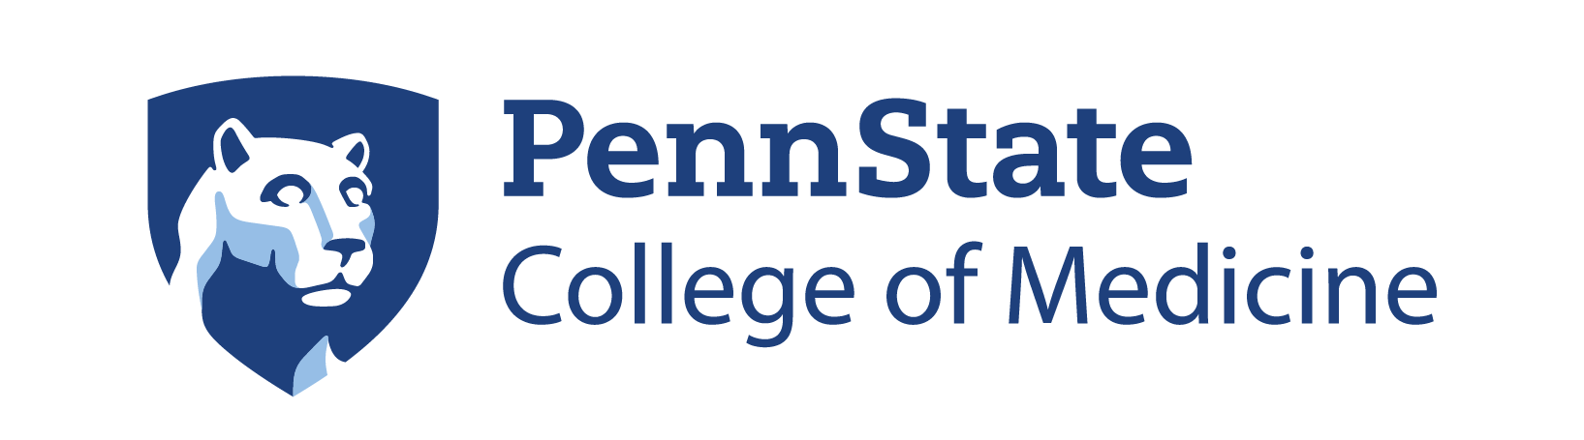
Penn State Health Corporate Structure
Health Plan
Highmark Inc.
(commercial insurance)
20% capital partner with Penn State Health
Community Hospitals
Community Medical Group
Former private practice groups. No faculty appointments.
Corporate Services
Finance, IT, HR, Revenue Cycle, etc.
Tertiary Quaternary Hospital
&
Faculty Medical Group
(19 clinical science departments)
19 Clinical Science Departments
8 Basic Science Departments
Research & Teaching Centers & Institutes
Academic Administration
Community health oriented.
Academic health oriented.

Slide 20
Financial Trends: Penn State
= Concern
= Positive
Penn State Health (PSH) [$ in millions] | FY2016 | FY2017
Revenue:
Net patient service revenue | $1,873.4 | $1,952.7
Other operating revenue | 114.6 | 110.5
Total operating revenue | 1,988.0 | 2,063.2
Expenses:
Salaries and benefits | (1,027.0) | (1,123.4)
Medical supplies | (329.5) | (334.1)
Depreciation & amortization | (76.2) | (82.7)
Other | (348.5) | (311.0)
Total operating expenses | (1,781.2) | (1,851.2)
Operating income | 206.8 | $212.0
Operating margin | 10.4% | 10.3%
Non-operating activity | 5.5 | 14.3
Academic support to College | (58.2) | (63.2)
Adjusted income | $154.1 | $147.9
Adjusted margin | 7.8% | 7.2%
Penn State College of Medicine [$ in millions] | FY2016 | FY2017
Sources of funds:
Tuition & fees | $42.0 | $40.2
Grants & contracts (spend & indirect) | 90.0 | 83.9
State government & university support | 26.8 | 24.2
Gift spend funds | 11.8 | 16.8
Endowment Income | 16.3 | 17.6
Purchased services from Penn State Health | 19.8 | 26.5
New gifts & other income | 29.4 | 22.5
Academic support from PSH | 58.2 | 63.2
Total sources of funds | 294.3 | 294.9
Uses of funds | (285.3) | (287.2)
Surplus/(deficit) | $9.0 | $7.7
Margin | 3.1% | 2.6%

Slide 21
Funds Flow
Penn State Health [Clinical Operations] | FY2017 [$ in Millions]
Revenues | $2,063.2
Expenses | $1,851.2
Margin of 10.3% | $212.0
To The College of Medicine
Research | $44.2
Education | $19.0
Total | $63.2
To Patient Care Operations
Capital | $100.0
Cash (6 days) | $24.0
Long-term Reserves | $24.8
Total | $148.8
Methodology:
Fixed commitment amount.
Growth: percentage of clinical revenue.
Shared risk/reward percent of margin.
Total investment < 30% clinical cash margin.

Slide 22
Role of Academic Medical Center in the System
Even 118 years since Flexner, advance biomedical & health science research & education.
Serve as the best & largest classroom (residents, fellows, clerkships).
Serve as the location for health & disease treatment innovations.
Provide effective academic time to faculty physicians.
Adapt strategies & organizational structures to changing industry, market, & regulatory conditions:
Maintain high acuity care focus.
Accommodate & support complementary population health initiatives & operations (value/risk based reimbursements necessitate this).
Expand primary & secondary care reach & facilities (vertical integrations with physician practices, community hospitals & health plans).
Develop symbiotic financial frameworks between the clinical & academic enterprises.
Corporate goals of growing funds flows to the medical school ($0.53 for every $1.00 of grant sponsorship).
Maximize funds flows while keeping clinical enterprise operationally & strategically viable (liquidity & capital requirements).

