Slide 1
Review Committee Update
Pamela L Derstine PhD, MHPE Executive Director
Neurosurgery Program Director Annual Meeting
May 18, 2019
Seattle Washington

Slide 2
Disclosure
No conflicts of interest to report

Slide 3
Discussion Topics
Review Committee Members and Staff
Accreditation and Program Statistics
Annual Accreditation Update
Common Program Requirements Update
Case Log Update

Slide 4
Review Committee Members and Staff

Slide 5
Review Committee Membership
Nominating Organizations
9 voting members
2 members (ABNS)
2 members (ACS)
2 members (AMA)
1 resident member (at large/SNS)
2 non-voting Ex-Officio
Carl Heilman, MD, ABNS
Patrice Blair, MPH, ACS
1 member (AOA)
1 public member (at large)

Slide 6
Review Committee Membership: Current
Nicholas M Barbaro, MD, Chair
Griffith R Harsh IV, MD, Vice Chair
Sepideh Amin-Hanjani, MD
Nickalus Kahn, MD, Resident Member
Karin Muraszko, MD
Harry Rosenbluth MBA, Public Member
Christopher Shaffrey MD
Gregory Smith, DO
Robert Harbaugh, MD

Slide 7
New Members Effective 7/1/2019
Richard G Ellenbogen MD
University of Washington
Jacob H Bagley MD (resident member)
Oregon Health & Science University

Slide 8
Accreditation and Program Statistics

Slide 9
Accreditation Statistics: Current
Total Current Accredited Programs
 | # Core | 115
 | # ESN Fellowship | 2
Pending Applications
 | # Core allopathic | 2
 | # Core osteopathic | 0

Slide 10
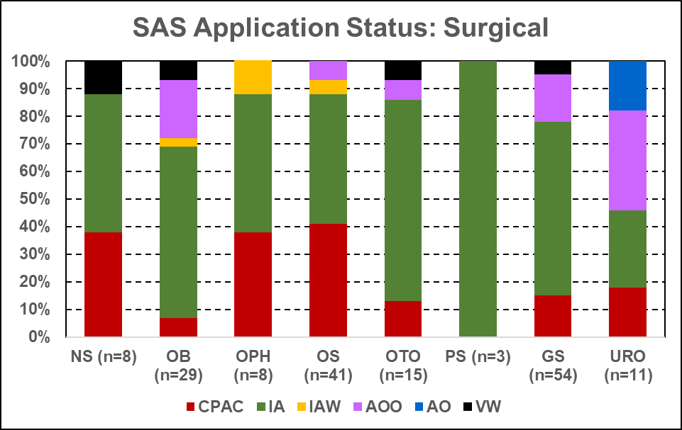
As of 5/1/2019

Slide 11
Accreditation Statistics: Current
Core Program Accreditation Status
Status | # Programs
Continued Accreditation | 98
Continued Accreditation w/o Outcomes | 4
Continued Accreditation w/ Warning | 1
Initial Accreditation | 10
Probationary Accreditation | 2
Continued Pre-Accreditation | 3
Voluntary Withdrawal (osteopathic) | 1

Slide 12
Other Meeting Decisions
Requests (2018 - 2019)
Permanent Increase # Requested / # Approved | 12/5
Temporary Increase # Requested / # Approved | 0/0
Participating Site # Requested / # Approved | 9/7
Focused/Full Site Visit | 2/3
Progress Report | 2
Clarifying Information | 2
Work Hour Exception # Requested / # Approved | 6/5

Slide 13
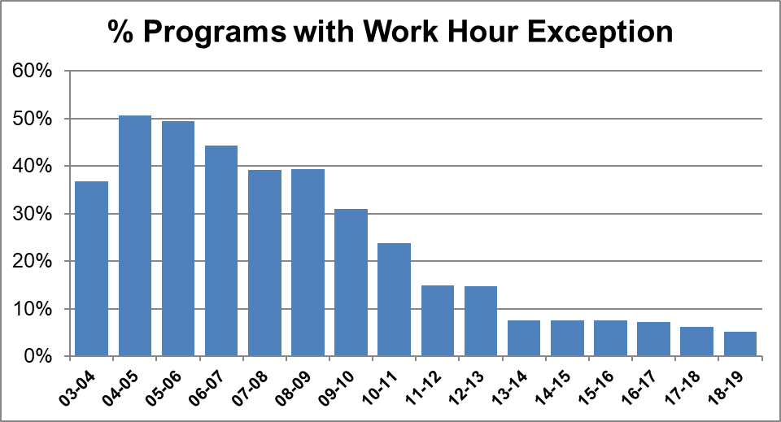

Slide 14
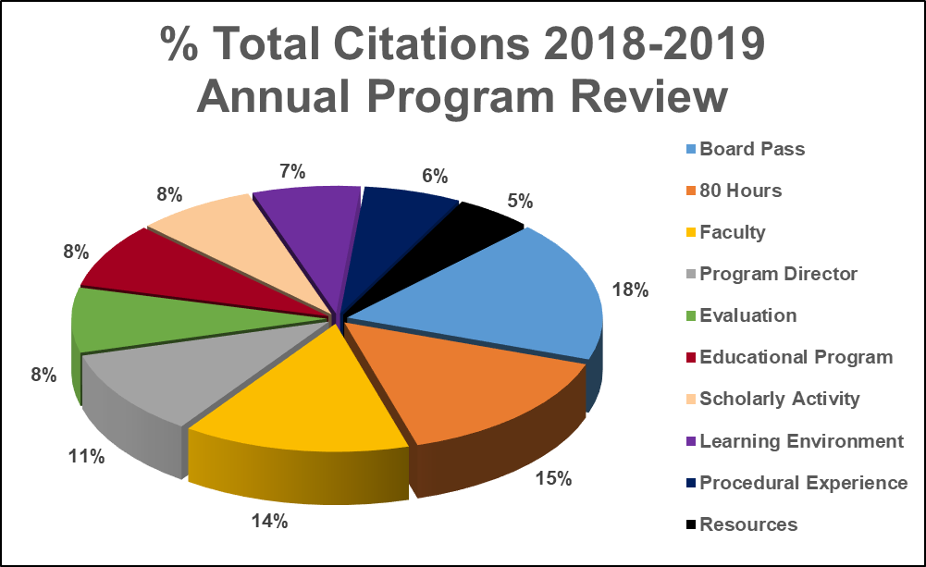
© 2019 ACGME

Slide 15
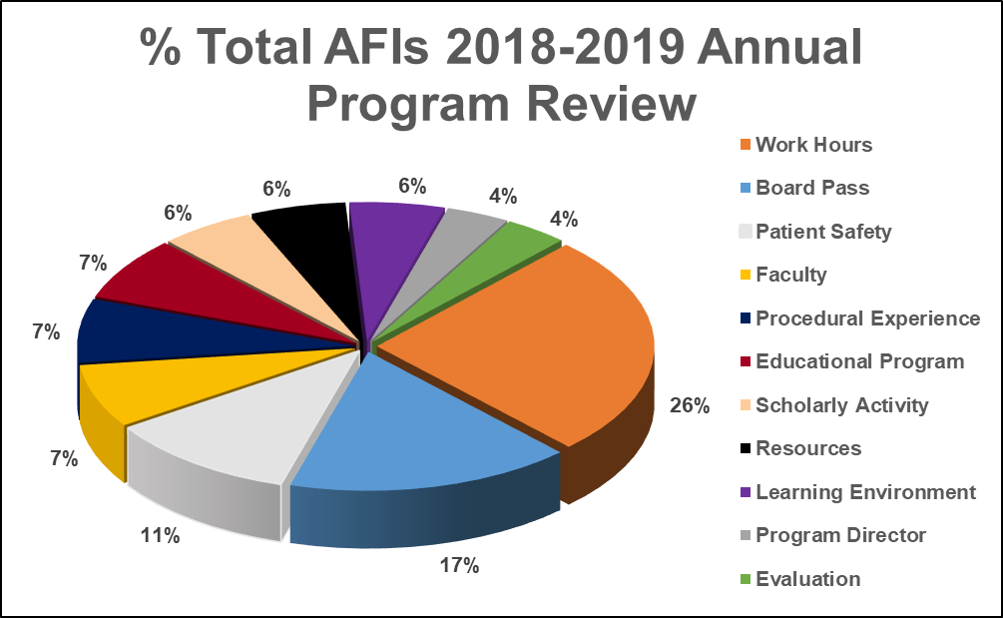
© 2019 ACGME

Slide 16
Annual Accreditation Update

Slide 17
Upcoming Review Committee Meetings
August 23, 2019
Agenda close: July 12, 2019
January 3-4, 2020
Agenda close: October 25, 2019
March 20-21, 2020
Agenda close: February 7, 2020

Slide 18
Requests that must be reviewed at RC meeting
All permanent increase requests
Most temporary increase requests
New sites for required rotations
New sites to establish a standing elective
Request to establish a standing international rotation
Work hour exception
Other requests as deemed appropriate
© 2019 ACGME

Slide 19
Requests that may have an interim review
Program director change
One-time elective request with new site
One-time international rotation
Temp increase due to CCC decision for remediation
Other requests as deemed appropriate
© 2019 ACGME

Slide 20
Request Guidelines
All required materials must be received as one PDF email attachment by RC meeting agenda close date.
See Neurological Surgery RC webpage for guidelines
Guidelines for Participating Site Change Requests
International Rotation Application Process
Requests for Changes in Resident Complement
Work Hour Exception Request
Program Director Change Guidelines will be sent when change is made in ADS
Sites must be added in ADS for RC review. Residents must not rotate to a new site until it has been approved.

Slide 21
2018-19 Annual Program Review: 2020 RC Meeting
Clinical Experience – Case Logs
Minimum Number reports for 2018-2019 program graduates
Graduates expected to comply with current minimum number requirements for all categories

Slide 22
2018-19 Annual Program Review: 2020 RC Meeting
Board Scores: new CPR
First-time takers only during the most recent three years reported by ABNS to Data Dept.
Bottom 5th percentile nationally for the specialty AND
Subject to citation if <80% pass rate

Slide 23
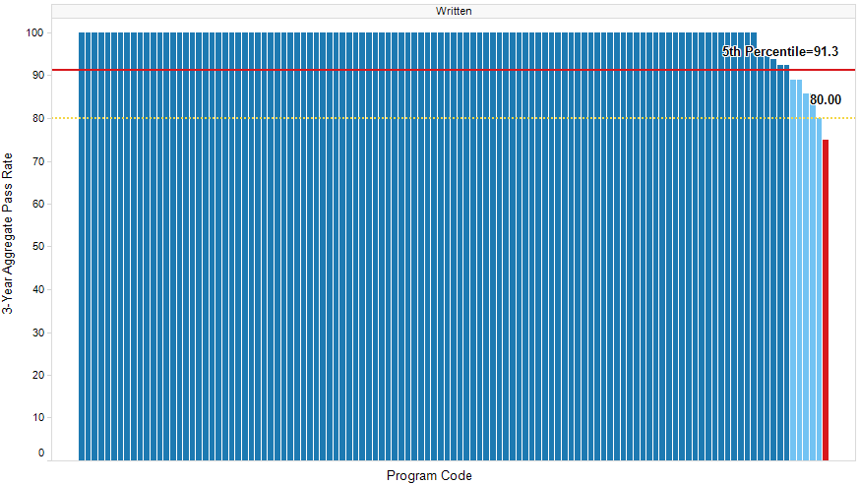
Example:
5th Percentile = 91.3% Example 2: Program 3-Year Aggregate Pass Rate = 85%
Program pass rate is NOT greater than the 5th percentile, BUT the pass rate is >=80%
Program Pass Rate = 85%
Program Pass Rate = 75%

Slide 24
2018-19 Annual Program Review: 2020 RC Meeting
ABNS reports data to ACGME twice a year: June and December
January 2020 review will include data reported December 2016 – June 2019

Slide 25
2018-19 Annual Program Review: 2020 RC Meeting
Resident and Faculty Surveys from Spring 2019 (no change)
NOTE: Survey items will change for the 2019-2020 surveys, consistent with new CPRs (reviewed January 2021)

Slide 26
2018-19 Annual Program Review: 2020 RC Meeting
Resident and Faculty Scholarly Activity reported Fall 2018
Scholarly Activity Completed 2017-2018
No Change from Current
Scholarly Activity reported in fall 2019 Annual Update will change (TBD)
Reviewed January 2021

Slide 27
Other ADS Changes for 2019-20 Annual Update
Participating Sites
Identify Site Director
PLA Effective Date
Faculty Roster
Identify core faculty via checkbox
Enter certification expiration date (not recert. date)
New Questions in Annual Update re: new CPRs
Program Mission Statement (CPR I.C)
Program aims guided by mission statement (CPR IV.A.1)
Other TBD

Slide 28
Self-Study/10 Year Visit Update
9 programs completed the self-study/10 year visit process
32 additional programs have submitted a self study
10 year visit will be about 36 months after submission date
Programs with self-study submission dates of June 2019 have been updated to June 2020 (not yet in ADS)
Programs with self-study dates of January 2020 and beyond will have their self-study dates moved forward into the future
New self study dates based on most recent site visit date
New dates will be communicated this summer
© 2019 ACGME

Slide 29
Common Program Requirements Update

Slide 30
Implementation of CPRs
The following are effective 7/1/2020
I.D.2.c) Lactation facilities
I.D.2.e) Accommodation for resident disabilities
II.A.4.a).(2) Design and conduct program consistent with community needs, mission
II.B.2.g) (1-4) Faculty development specifics
All other CPRs, including ALL CPRs in section VI, are effective 7/1/2019
See https://www.acgme.org/Portals/0/PFAssets/ProgramRequirements/CPRResidencyImplementationTable.pdf
© 2019 ACGME

Slide 31
Specialty-Specific Requirements
Current requirements updated for new CPRs posted by July 1, 2019
Deleted, renumbered, and edited PRs shown with track changes
Effective 7/1/2019

Slide 32
Specialty-Specific Requirements Focused Revisions
RCs must further specify the following
IV.C.1: The curriculum must be structured to optimize resident educational experiences, the length of these experiences, and supervisory continuity. ^{(Core)}
Other focused revisions under consideration
Public comment period this summer
Effective date: 7/1/2020

Slide 33
Implementation of CPRs
Program Director Guide to the Common Program Requirements is under development

Slide 34
Case Log Update

Slide 35
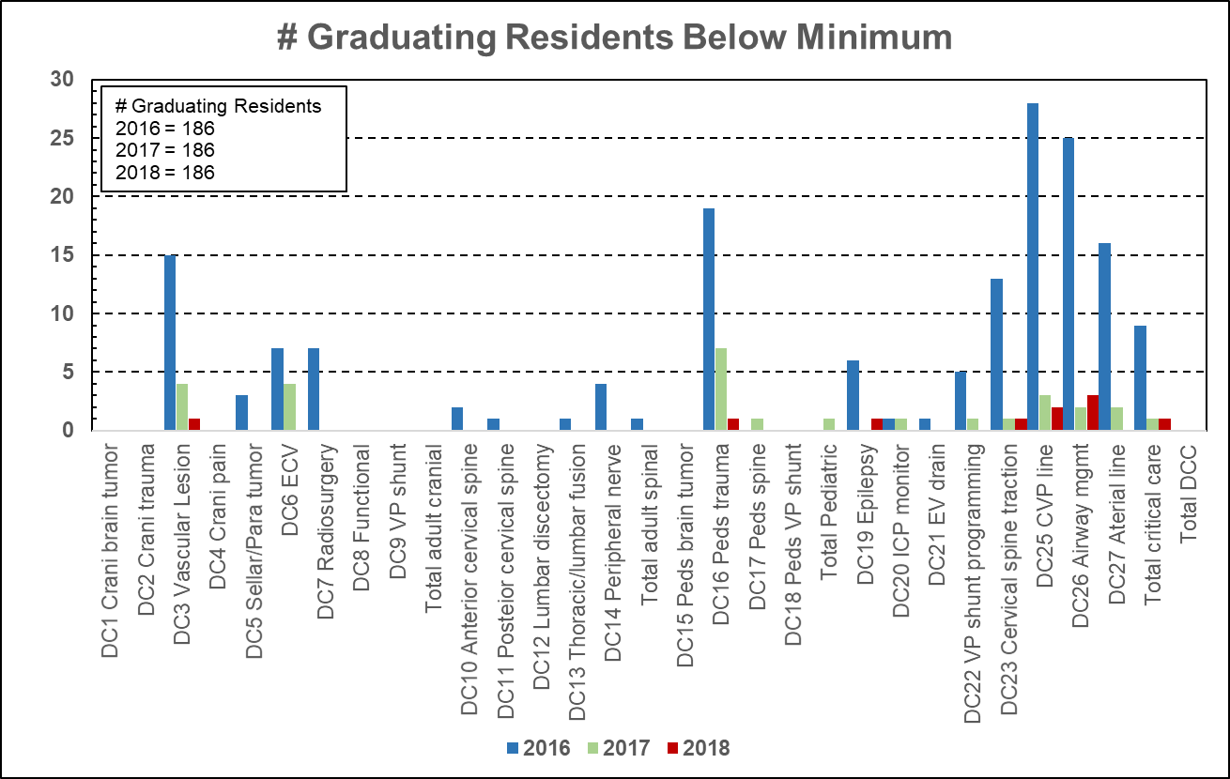

Slide 36
No DCC has a failure rate of >2%

Slide 37
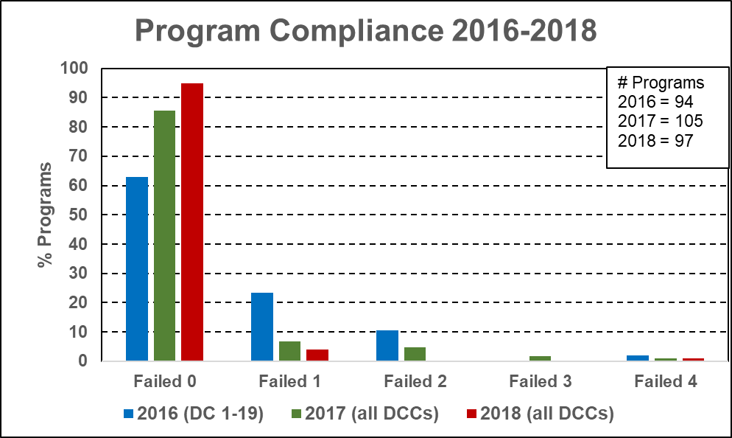

Slide 38
Case Log Change Highlights
Increase in overall total and major category total case minimums
Revised minimums for Senior + Lead
New minimums for Lead only
New requirement for microdissection
Only one lead and one senior per case
No limit to assistant role per case
Must report case ID

Slide 39
Case Log Change Timeline
Changes made summer 2019
No change for 2019 graduates (reviewed under current criteria)
Reviewed January 2020
All other currently logged cases moved into new system
No citations for 2020 graduates
Reviewed January 2021
Potential citations begin with 2021 graduates
Reviewed January 2022

