Slide 1
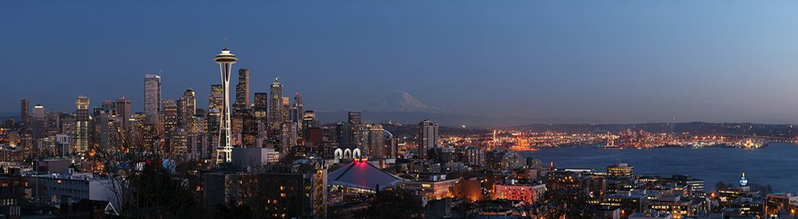
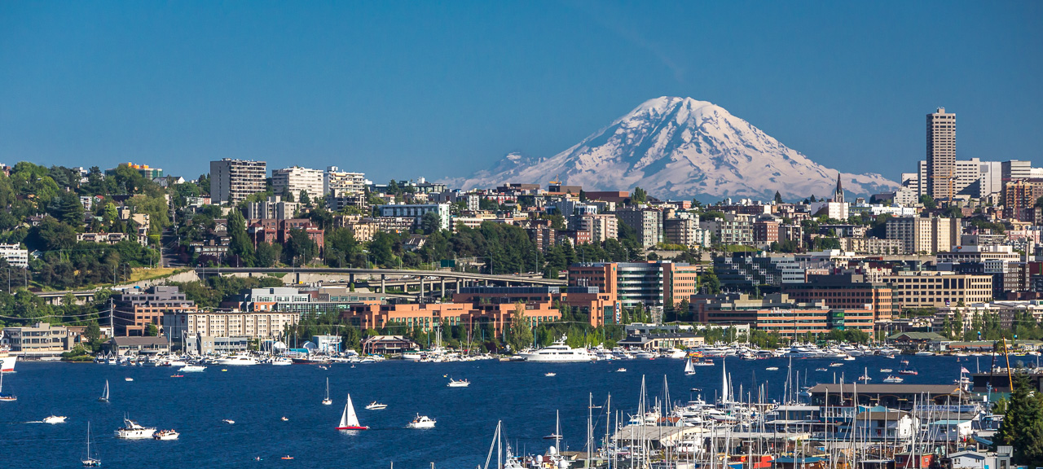
HARBORVIEW:
A County Hospital with a Split Personality
Louis Kim, MD
Professor & Vice-Chair
Chief of Neurosurgery, HMC

Slide 2




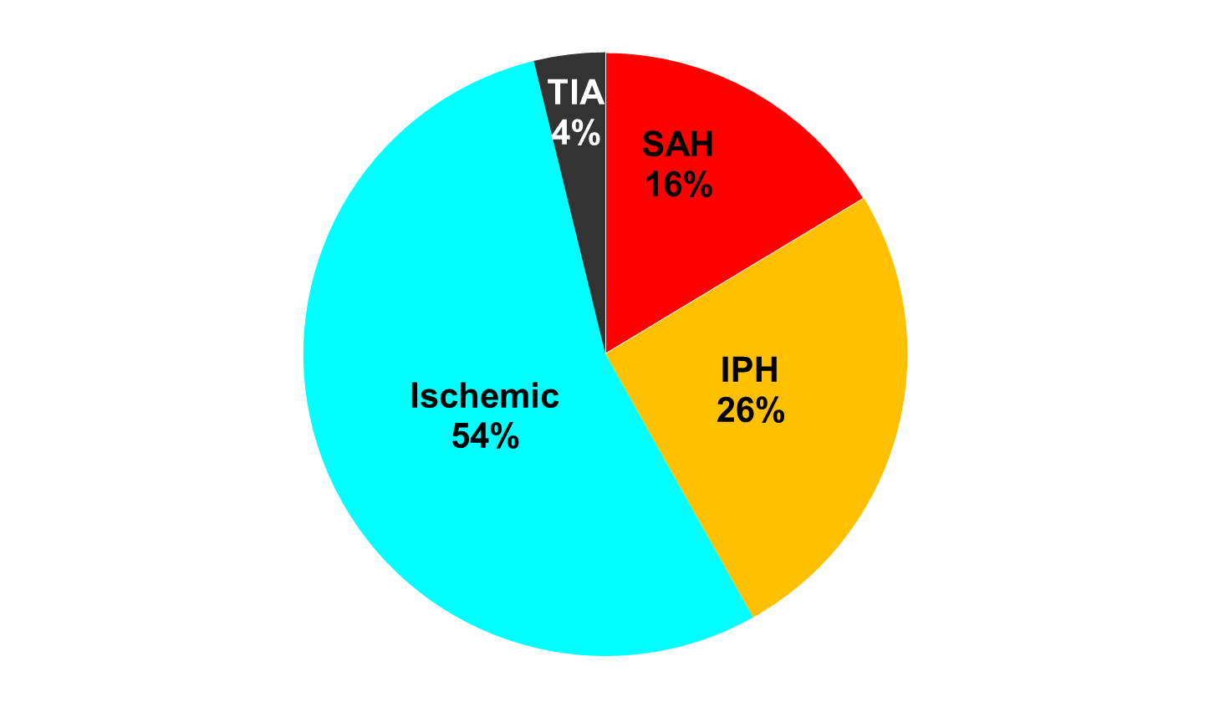



Harborview Facts
100%
27%
Of U.S.
Land Mass
Serviced
6+
Full-time
Faculty
59k
ED visits
Per year
2530 neurotraumas
1st CSC in PNW
Only Lvl 1 Trauma Center
413 Bed Hospital
20 to 50 “borders” daily
Comprehensive Stroke Center
N=1,193
But hat does it all mean?
Resident
Training
1,803 Operative cases
1,074 Endovascular
143 Thrombectomies
215 GKS
FY18
Flagship
>3200
Notes:
59k ED visits 1400 cranial trauma, 1100 spinal trauma, >6000Lvl1Traumas
Resident training: 9 Residents, 4 Fellows: 2spine, endovascular, skullbase
Services: Trauma/Spine, CV, Chiefs
6+ means 6 fulltime at hmc plus rge, Ojemann, ko, and virtually all adult faculty contribute to call coverage or elective/urgent cases onsite

Slide 3
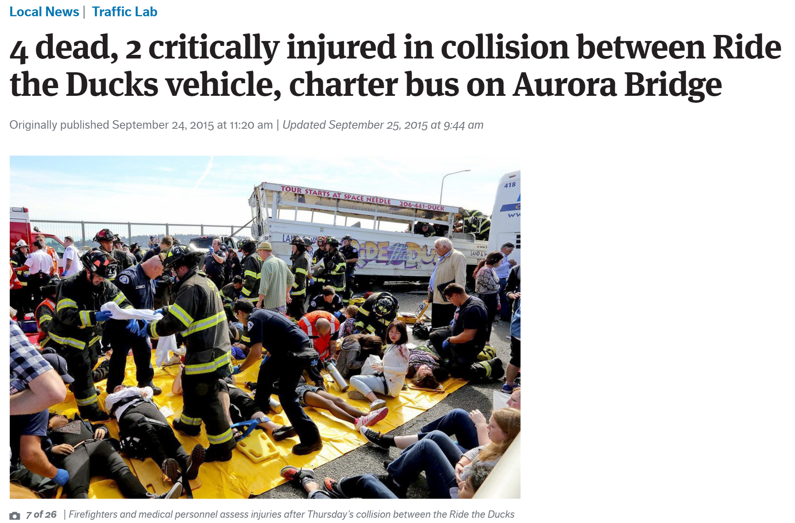
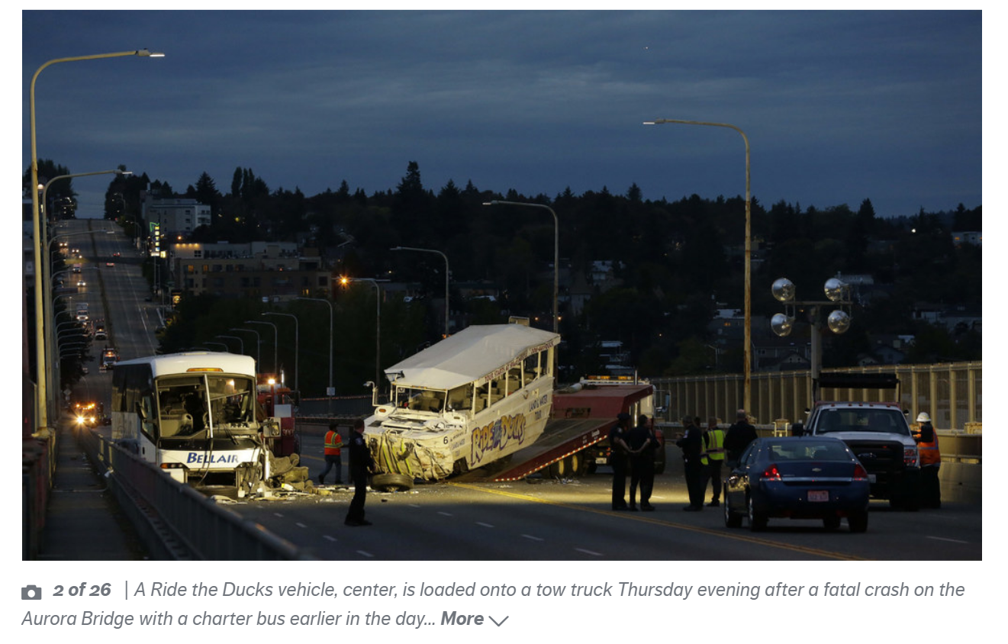
Emergent vs. Elective
Notes:
This is the first of a set of DICHOTOMIES that is what Harborview represents to our system and our community:
Emergent: LVL1 Trauma, CSC, Safety Net Hosptial: neurotrauma, stroke interventions, SAH, spine trauma; Ducks disaster 69 of 70 patients taken to HMC and the 70th guy was transferred to us the next day.
ED visits, >6000 Level 1 trauma visits,
Hopefully Rich didn’t put the “ride the ducks” on the things to do itinerary for S.O.’s!

Slide 4
Emergent vs elective
49% Elective
Notes:
41% of operative cases are ELECTIVE (744/1803)
Add on top of that elective vascular/endovascular, spine, neurooncology, functional, epilepsy and GKS

Slide 5
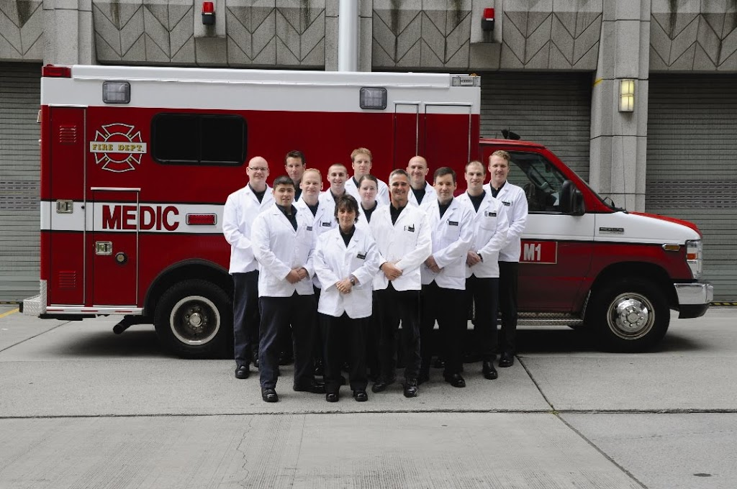
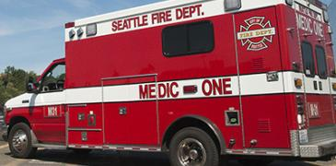
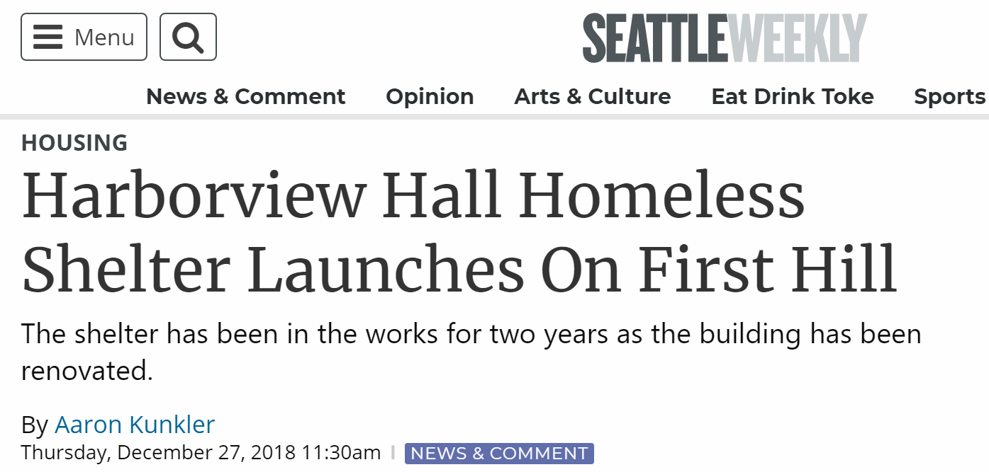
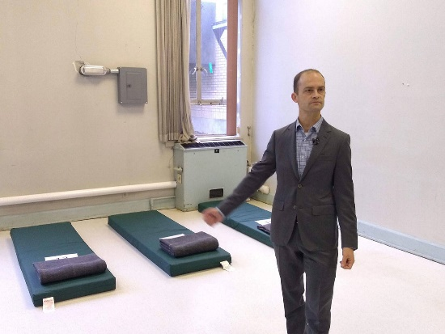
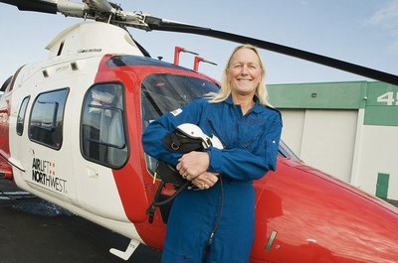
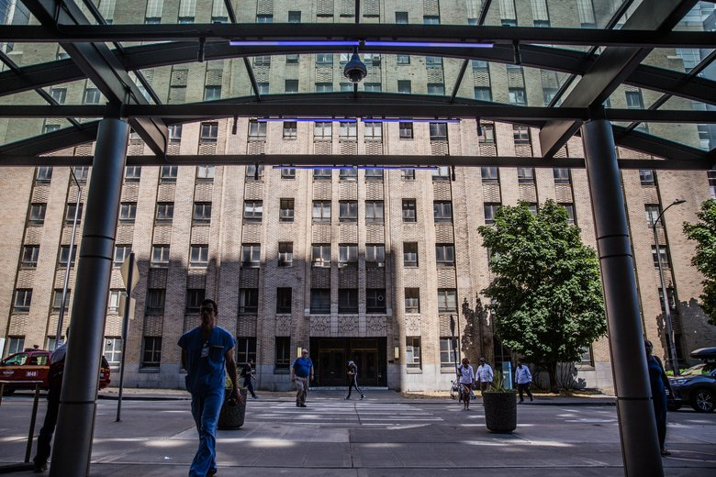
CounTy vs Cutting edge
Airlift Northwest
MEDIC ONE
Notes:
Another DICHOTOMY: County vs Cutting Edge. For County: 50% of room have 2 beds per room; primary for the King county jail system, indigent care, opioid crisis, homeless problem in Seattle
BUT…Being in the “county” isn’t all BAD…..
Medic one started in 1976 one of 2 EMS systems in place in King County/City of Seattle and based at HMC.
Airlift NW our regional medical airflight transport system is part of the UW Medicine conglomerate with heavy presence at HMC.
Chris Martin our head of ANW pictured.

Slide 6
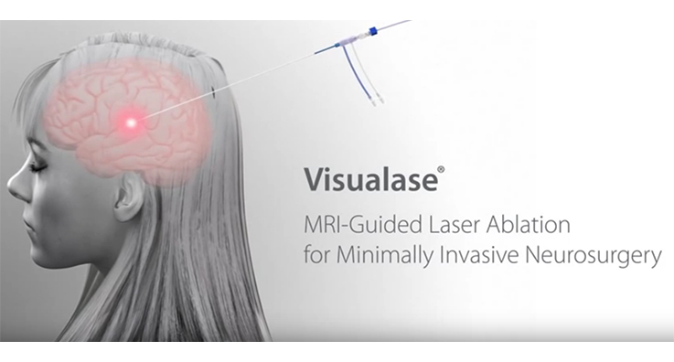
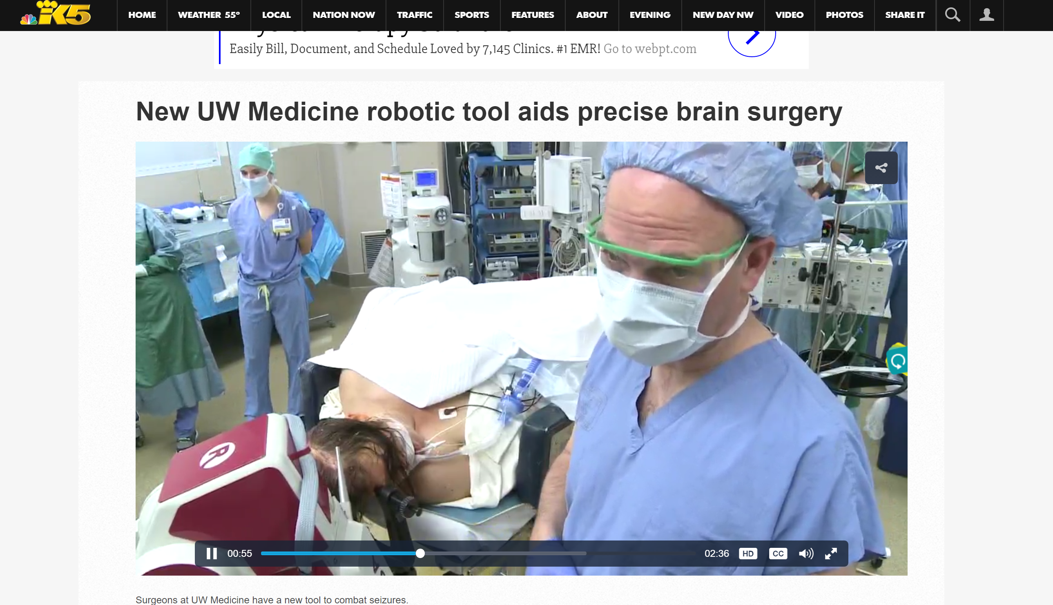
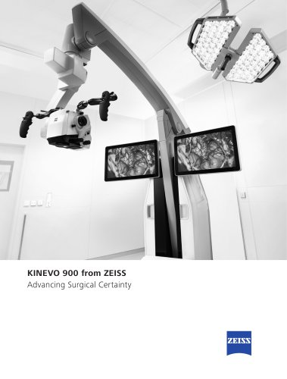
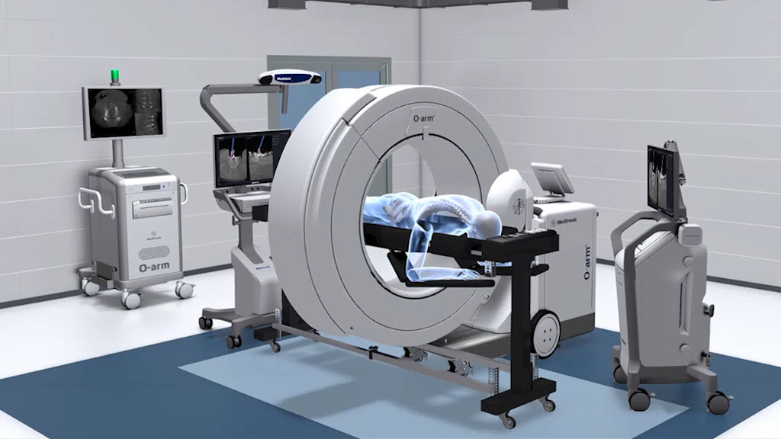
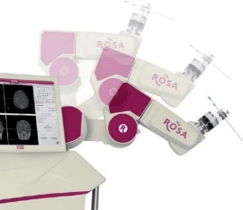
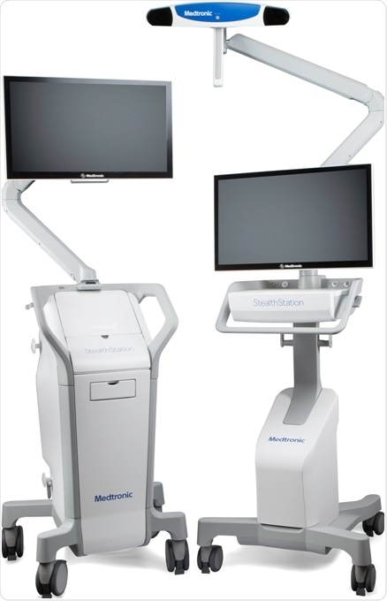
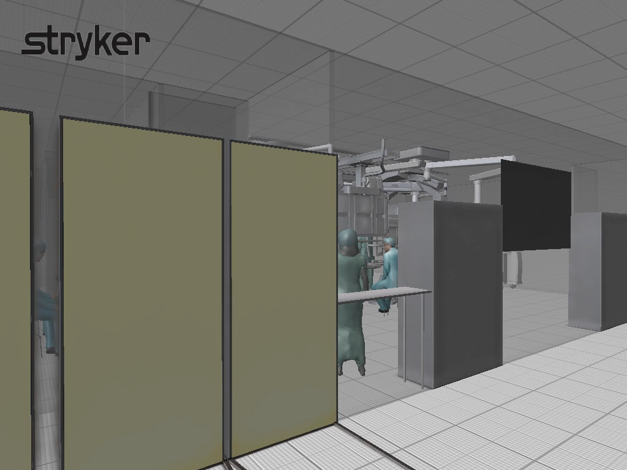
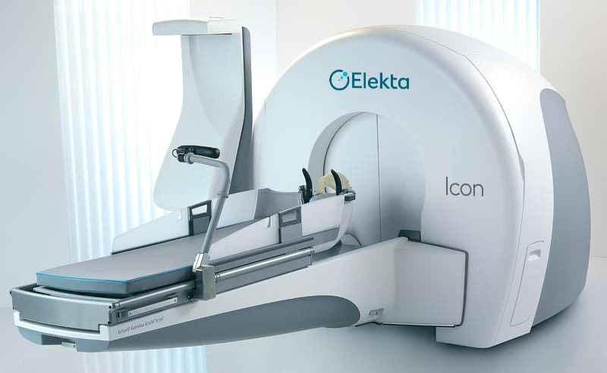
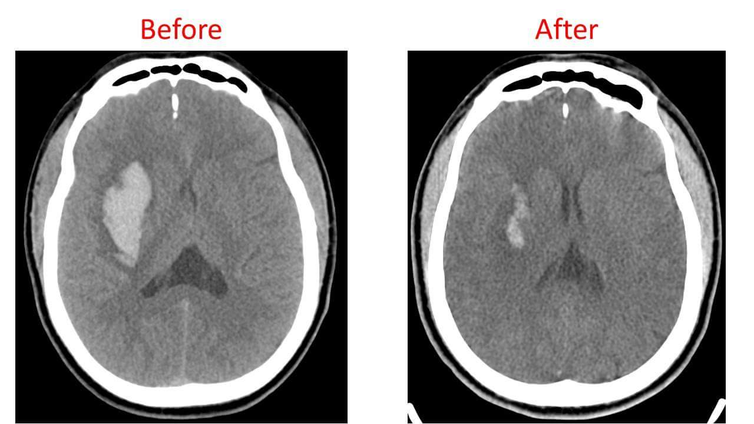
County vs cutting edge
Judicious tech investments that play to our strengths
Notes:
Biplane hybrid OR: 1200 sqft footprint for serious use as an open and endovasc room break ground June, opening Jan2020
Rosa Robot & Visualase Laser ablation technology: technology that has galvanized our functional/epilepsy service lineVOLUME has quadrupled in the past 5 years
Minimally invasive endoscopic ICH evacuation systems (Apollo, Archimedes)
GKS at HMC: ICON upgrade in 2016 and first installed in April 2000.
The usual accoutrements of state of the art NS: image guidance S8 steath, Kinevo scopes, O-arm spinal nav integration.

Slide 7
Mission vs margin
63%
FY19
0.8% margin
~$8M
Notes:
Another DICHOTOMY: Mission(of care for all, aka poorly insured, WWAMI safety net patients, ) and Margin (fiscal responsibility)
Our annual fiscal budget exceeds $1B with labor cost accounting for 60% THE MISSION is a POSITIVE!: feels good to take care of all at the highest quality without financial
Not coincidentally, the rising population in the Seattle Metro Area correlates well with our increasing budget heading toward a resource LIMIT
Payor MIX: how would you like to have these numbers at your institution?!? Over 63% medicare/Medicaid, modest 32% commercial payors
Total Margins: Living on razor thin margins year in and out: 2015 point out---Obamacare; payments didn’t persist and costs continued to rise….
This year at a 0.8% margin, RAZOR THIN. Remember, no payments from Olympia or King County, in fact we pay the county $5M/year for rent.

Slide 8
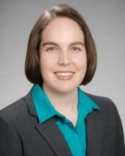
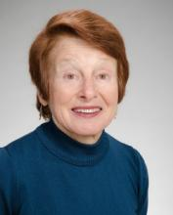
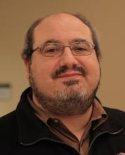
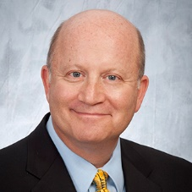
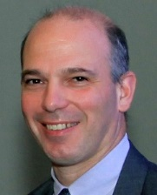
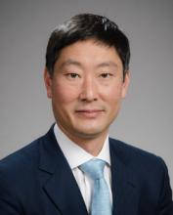
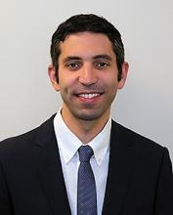
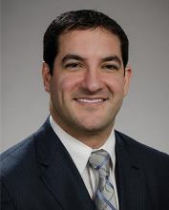
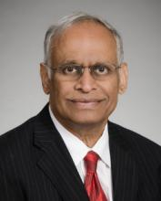
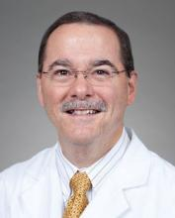
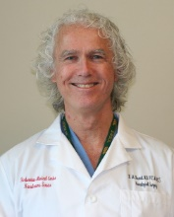
Research AND CLINICAL
HMC Research Faculty
  3 NIH/NINDS R01
  2 DoD R01 equivalents
  1 Private Foundation grant
HMC Clinician-Scientists:
  U01TRACK-TBI
  3 NIH R01 Principal Investigators
  1 NASA Human Research Division Grant
  1 NSF (UW/HMC)
  2 R25 Neuroscience Training Grant (UW/HMC)
  AHA Career Development Grant
  Amazon Catalyst Grant
  3 Private/WA state grants
$4,971,109 in FY19
Notes:
Finally, DICHOTOMY of Research and Clinical existing seamlessly side by side.
Academic means: resident teaching, research R&T building; clinical trials, triple digit peer reviewed papers and stellar grantsmanship
YET still maintaining our Productivity: We are 1 of 4 services that generate positive net income for the hospital to maintain operations across all clinical services. Highest contribution margins, net revenue, operating margins.
“as we go, so does the hospital go…”
Sekh: $100k
RS: 100k WASCIC +$150k vertex
ML: 432k total
LK: 338k
RC: 517k
JO: 130k NSF grant
MW: ?$amt for NASA

Slide 9
Swot aNALYSIS
“Can Do” Culture
Careful Investment in Technology
3° and 4° Powerhouse
Integrated research and innovation
Small size
Razor thin margins
Lack of county or state funding
“Parkland and Parnassus” Problem
Bond for growth capital
Alliances with UW affiliated and partner hospitals
Parkland and Parnassus” Problem
Level 1 and CSC expansion in WA state
Market Consolidation
Unified System Strategy for Neurosciences
S
W
O
T
Strengths
Weaknesses
Opportunities
Threats
Notes:
S: 1. Peter Thiel: you don’t create a culture, you are a culture. CAN DO.;
2. The story of NS is the story of technology—we are fortunate that inspite of resource limits HMC understands this
3. Inertia can be your ally, as long as we don’t take it for granted and earn it one patient at at time
4. This is the feed forward piece that drives excellence in clinical care
W: 1. need more capacity
2. byproduct of mission, emergency care staffing costs, safety population
3. Politics—what can you say?
4. Emergent vs. Elective problem trying to provide 2 conflicting priorities under 1 roof
O: 1. Adv of a county facility perhaps. Never had a bond for HMC fail 2/3 popular vote
2. Opportunities for
Messages to get out there
We are busy
We are good
We are competing and winning!
Providence, Swedish, VM, with ourselves(!)
We are living at the margin, hence need to be agile
Value based care and living at the margin
Will it truly account for the medically complex and severely ill subgroups
Overlapping/concurrent surgeries
How will productivity be affected at our academic institution?
Without the ability to consolidate hospital systems at scale, how can we compete in the future?
Our assets
#1 is the Harborview culture: “CAN DO!”
UW physician group
UW medicine brand
Research and innovation
Our liabilities
Multisite institutions, individual governances: County, Univ, Private SCH, VAH
A political landscape nightmare!
Expanding costs
Labor: Increased dependence on Health care specialist; Labor unions
Device, equipment, pharma
Tele-NS & Robotic telestroke interventions with affiliates and partner

Slide 10
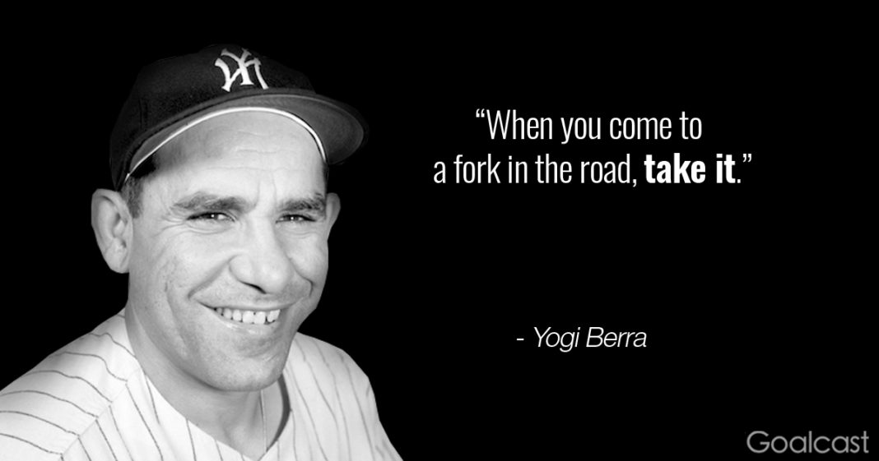
Key initiatives next 1-3 years
Efficiency & Cost
  Case turnover time
  LOS
  Overlapping surgeries
  Labor capacity
Increase capacity
  Infrastructure growth
  Utilize all affiliate centers
Integration of our multihospital system
  Mission critical: technology-based communication & logistics management
Notes:
Integration of multihospital systems
redundancy of services, cost
We must get creative to survive and thrive
OR turnover time (efficiency, somehow!)
New patient referral process (lifeblood of neurosurgery)
Alliances with affiliated and unaffiliated hospitals
Telemedicine, Tele-neurology
Physician engagement in cost accounting, strategy development
Technology: rosa robot, biplane hybrid or, laser ablation for epilepsy, GKS, minimally invasive pituitary/skull base surgery,

Slide 11

Conclusions
Harborview’s “split personality” is a double-edged sword
Our future:
  Judicious technology and research investments
  Revenue/Cost/Efficiency
  Infrastructure growth
  Preserve our culture of innovation and excellence over purely fiscal incentive
Notes:
Case turnover time, LOS, Overlapping surgeries, flexible Labor capacity
We need to get creative to survive and thrive

