Slide 1
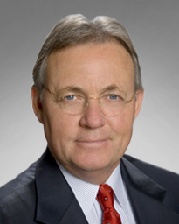
Arthur L. Day, M.D.
Distinguished Service Award
Society of Neurological Surgeons
Notes:
It is a great honor and privilege to introduce the recipient of the Distinguished Service Award of the Society of Neurological Surgeons, Dr. Arthur L. Day.

Slide 2
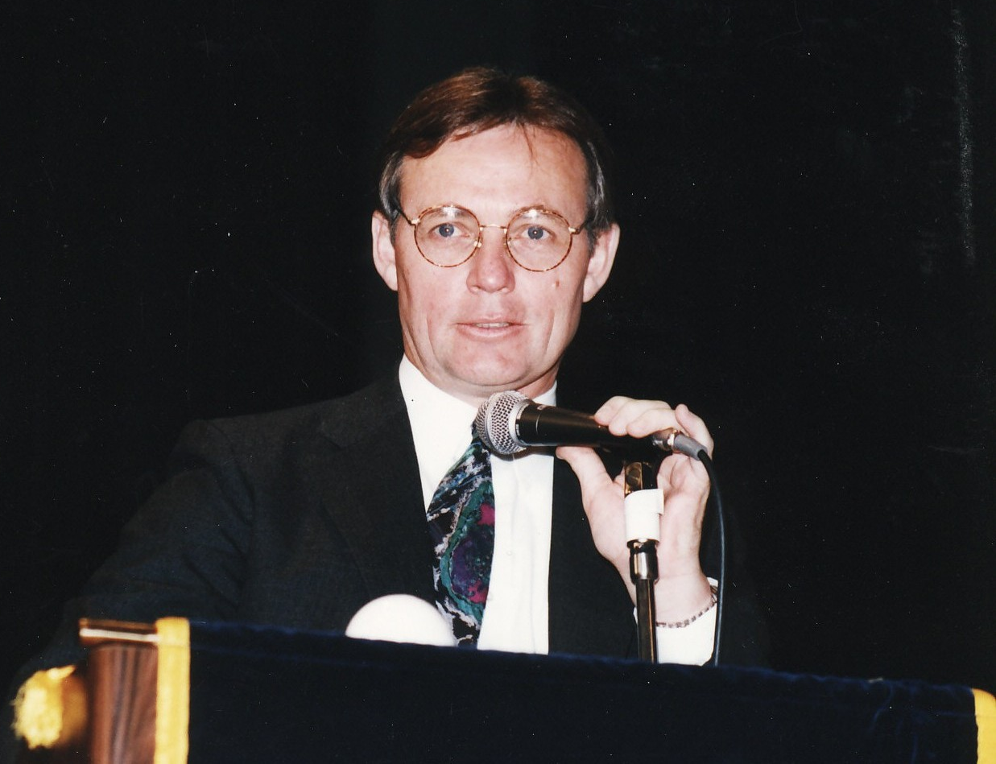
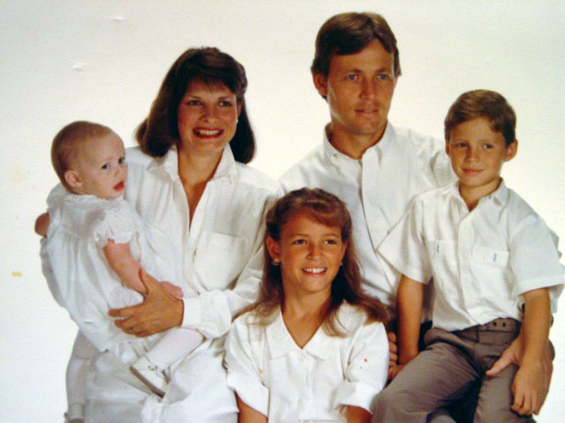
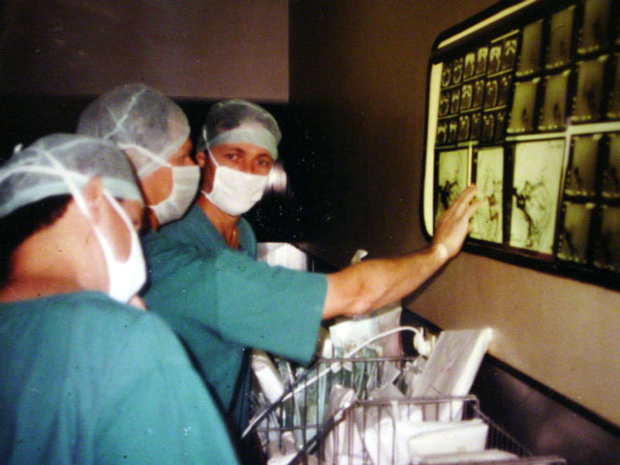
Notes:
Art Day is a unique individual who has unconsciously created an enviable legacy. He is a paragon of patience, compassion, tolerance and charity; characteristics that have earned him an assembly of close friends. He has a zeal for athletics, both on the field and in his pioneering developments for the care of injured athletes. Most importantly, his epitaph will one day assert that he was a man of great integrity and honesty who did the right thing even when it was unpopular.

Slide 3
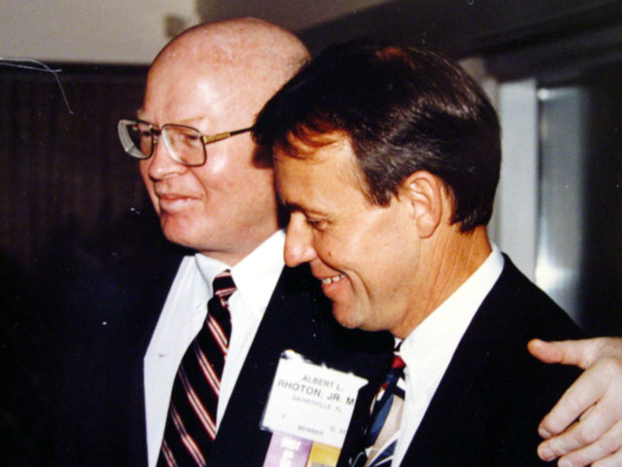
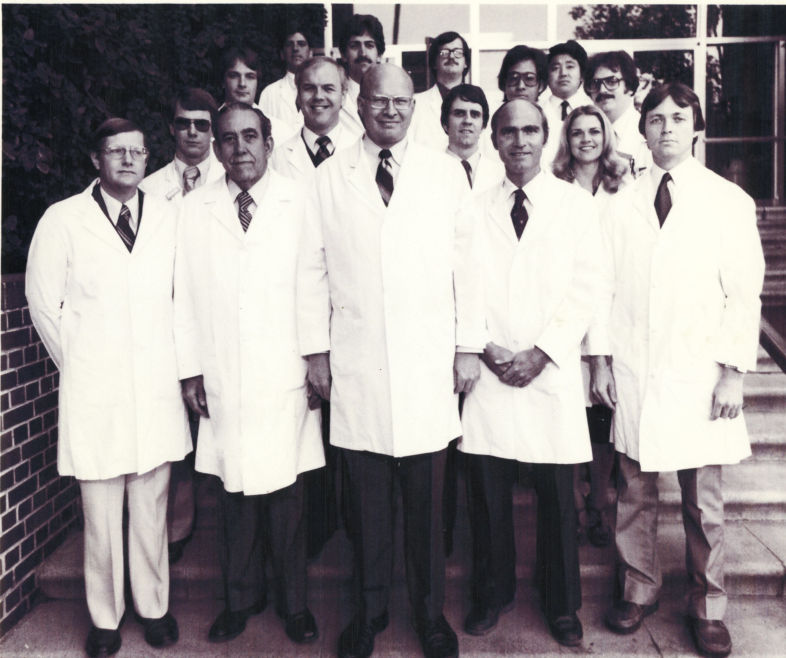
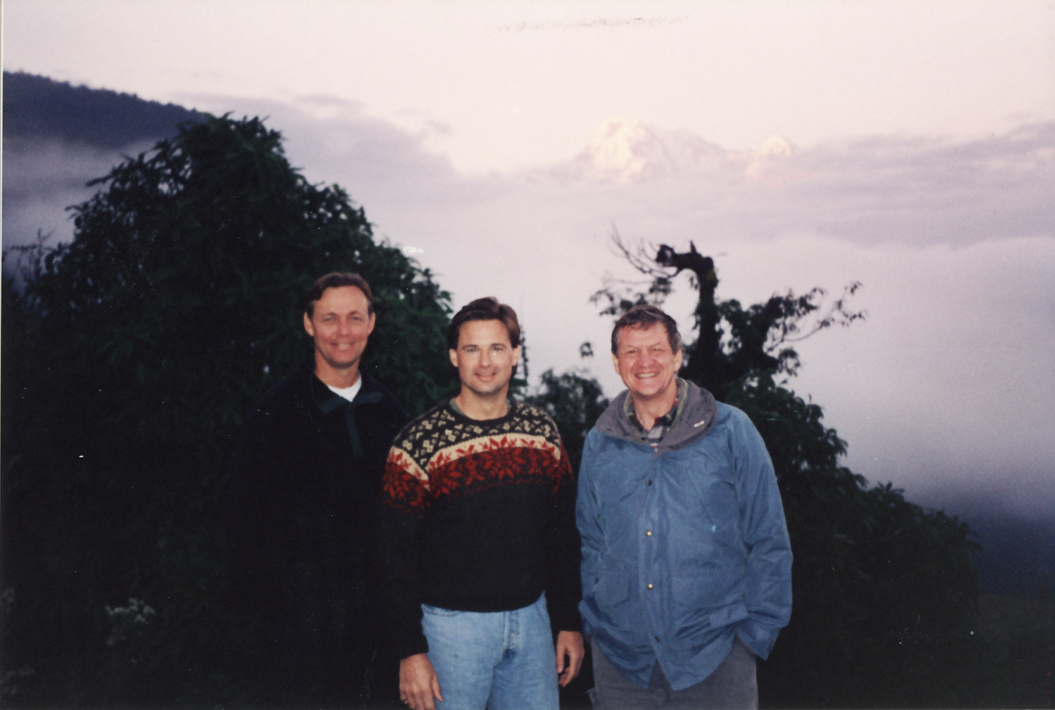
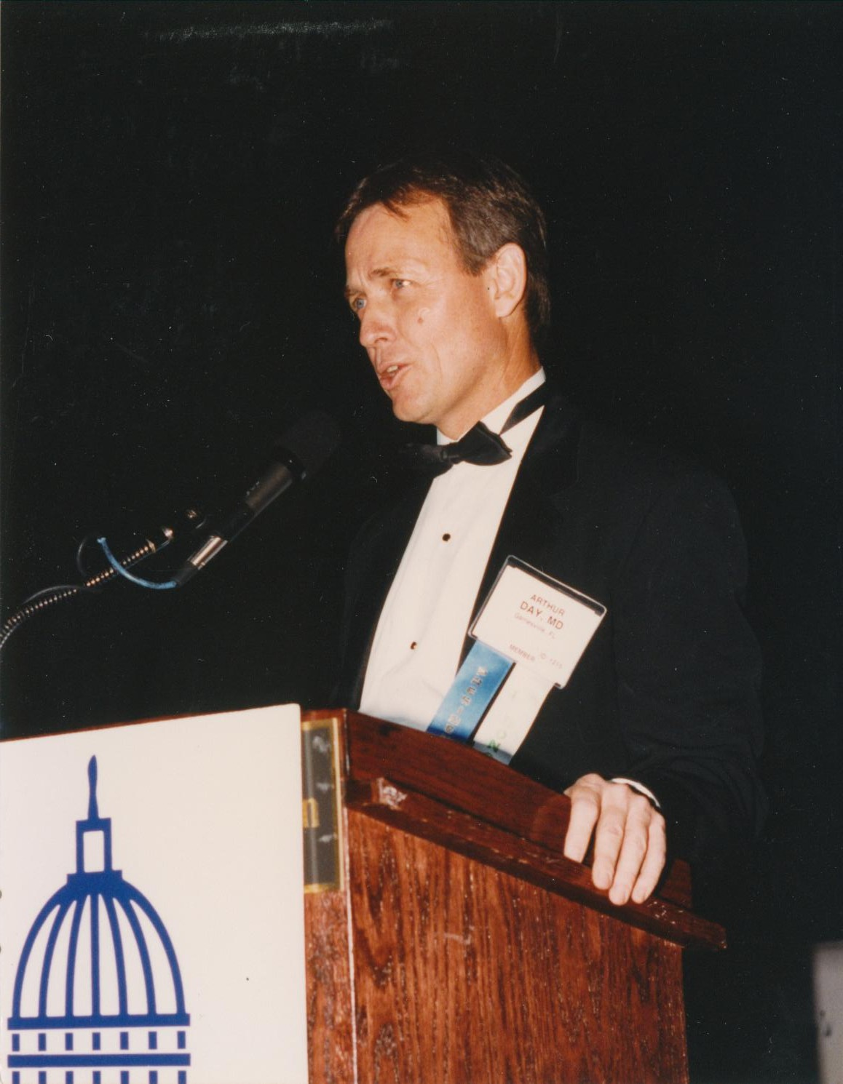
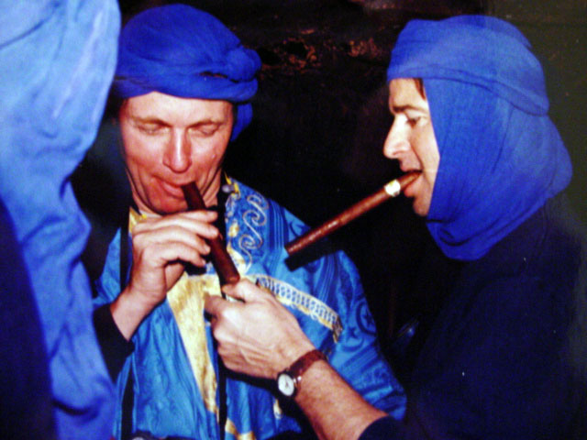
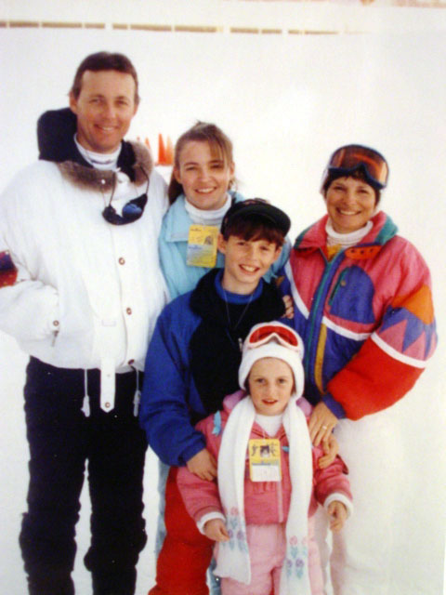
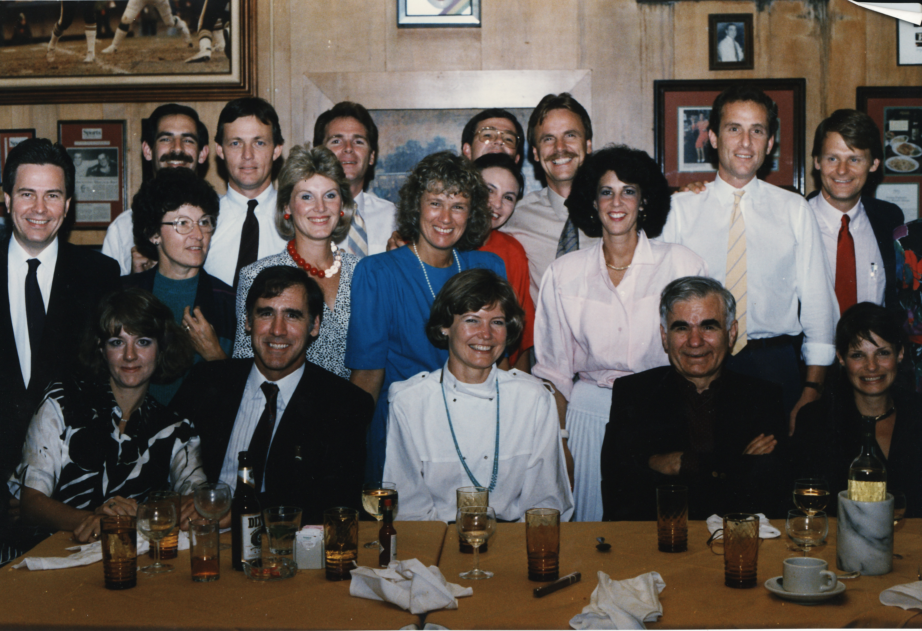
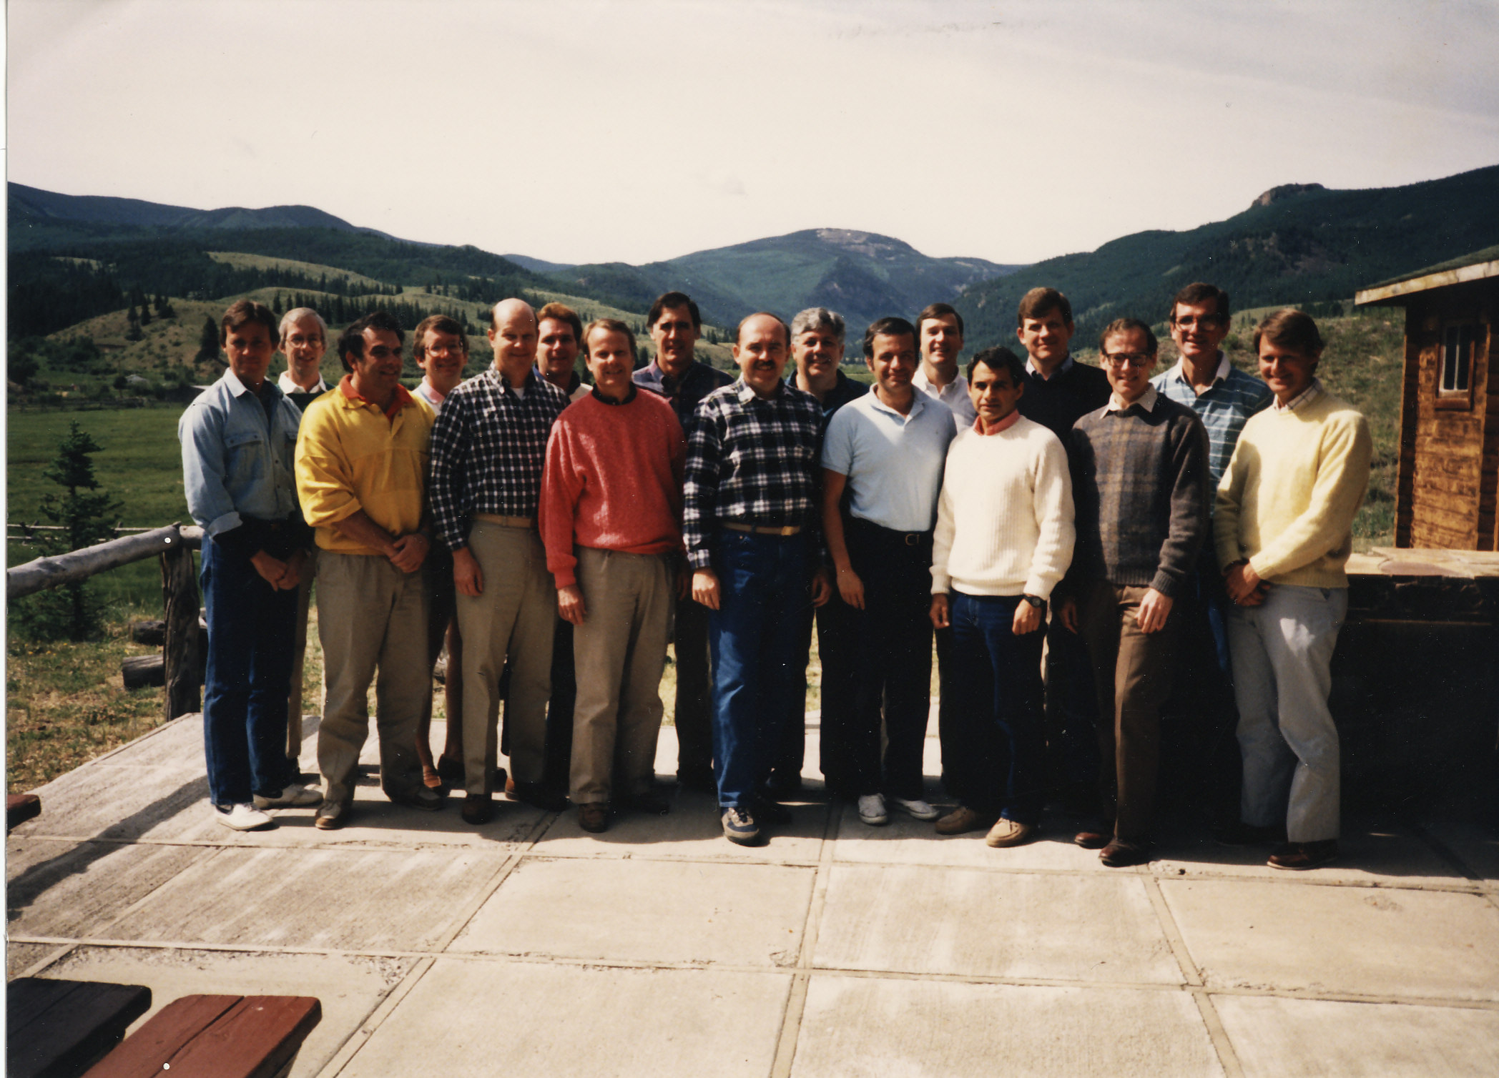
Notes:
What is the essence of Art Day? As with most legacies it has been the combined influence of family, friends and role models who have molded his life… and education, the great equalizer. But one of the major factors strengthening Art Day’s legacy is his ability to learn from all experiences, from the agreeable to the inauspicious, to carefully analyze what went well and what went sour and use those experiences to help himself as well as those fortunate enough to know him. From his unpromising beginnings to this very day, Art has continuously matured to make the most out of his every frustration as well as his opportunities.

Slide 4
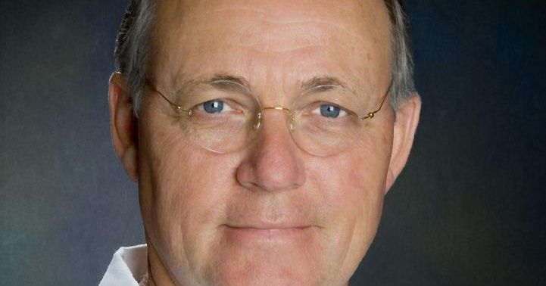
Master Clinician
Notes:
Art Day is a master clinician, gifted technical neurosurgeon, and compassionate physician.
Practicing near Art’s former institution just south of me, I have had the opportunity over the years to see many of Art’s former patients. I recently saw one who could still walk and talk. Art had not operated on him. He had a fusiform aneurysm of the vertebrobasilar system.

Slide 5
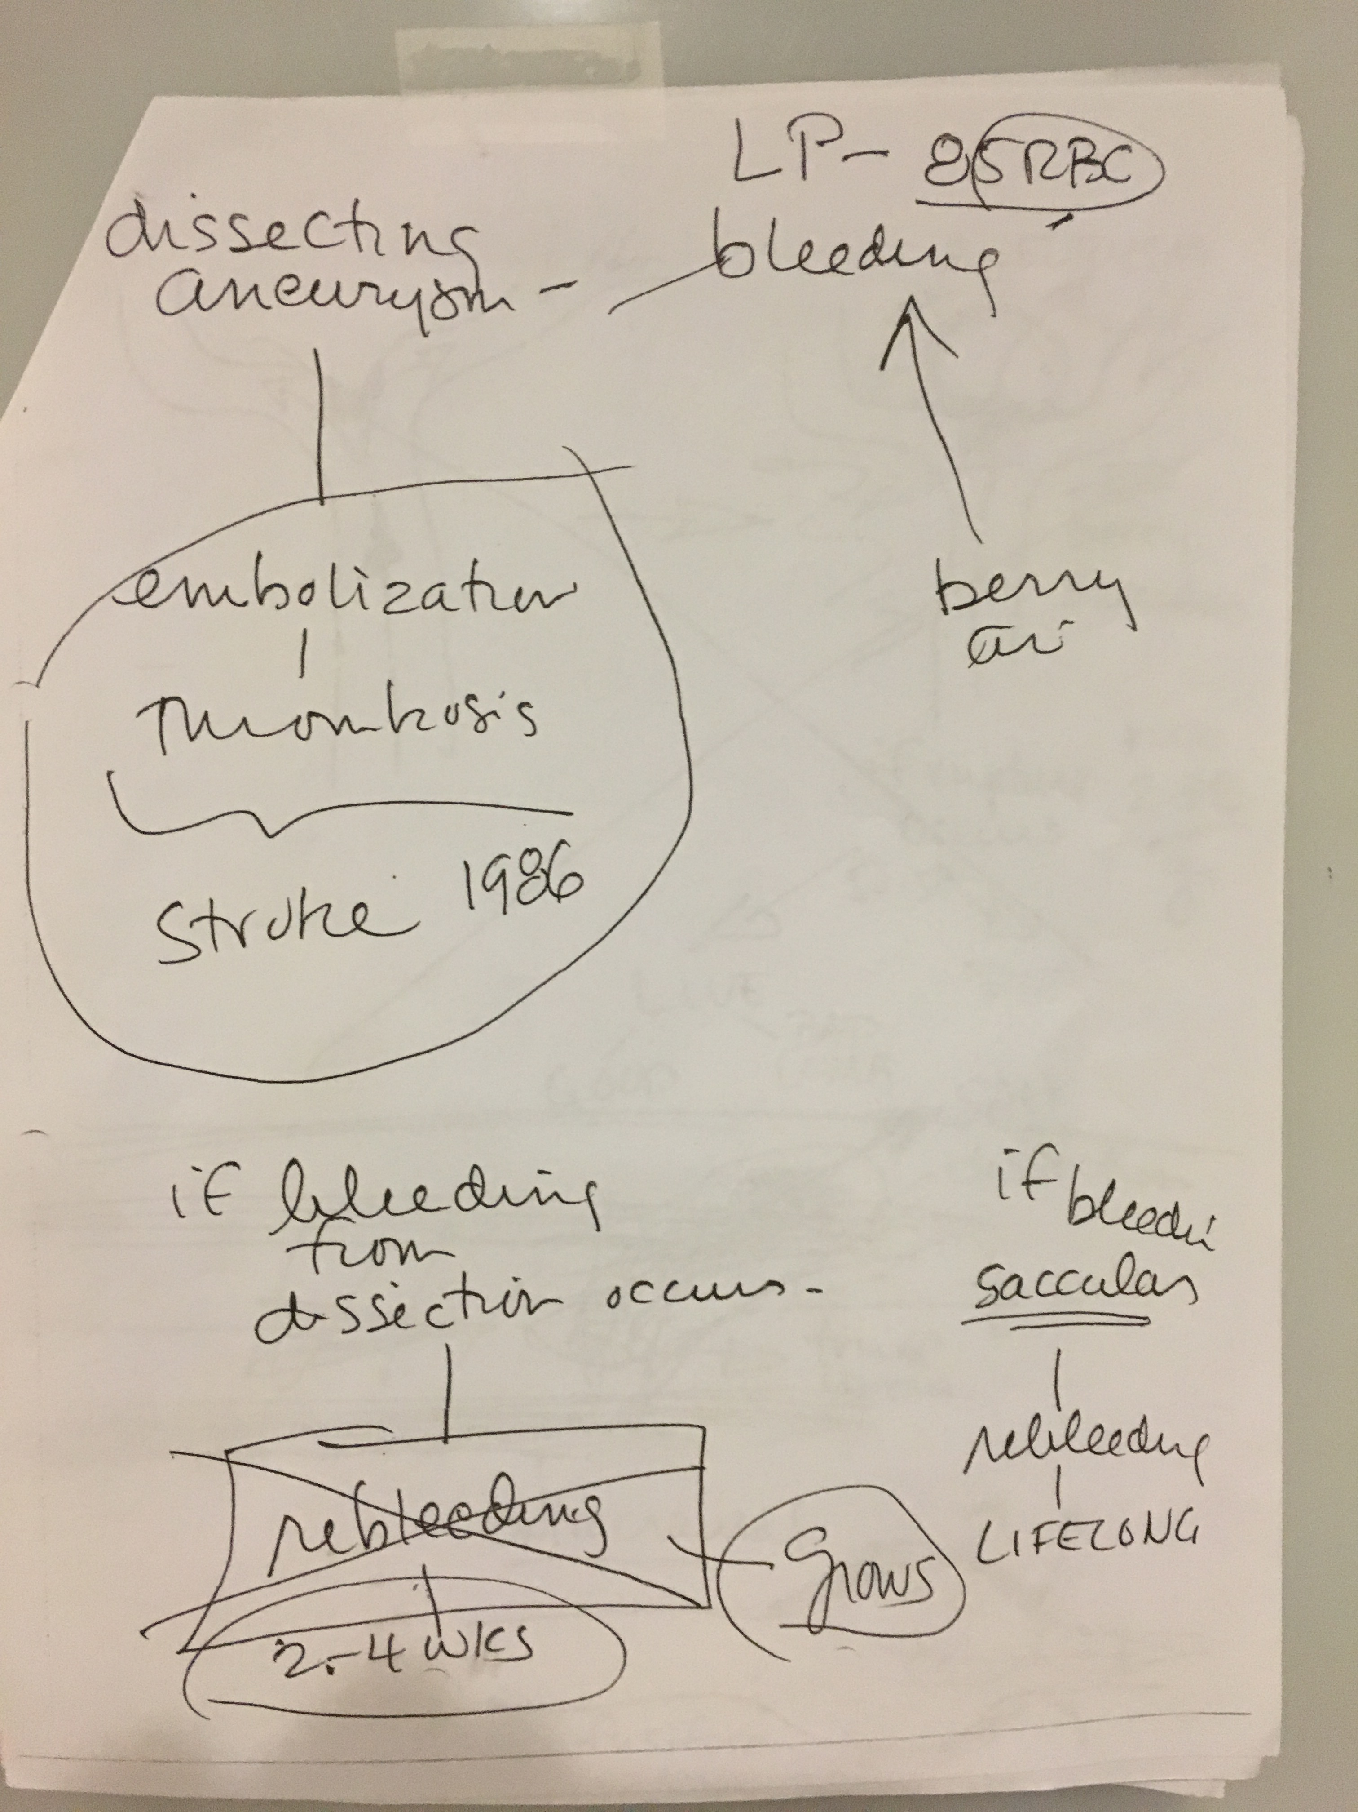
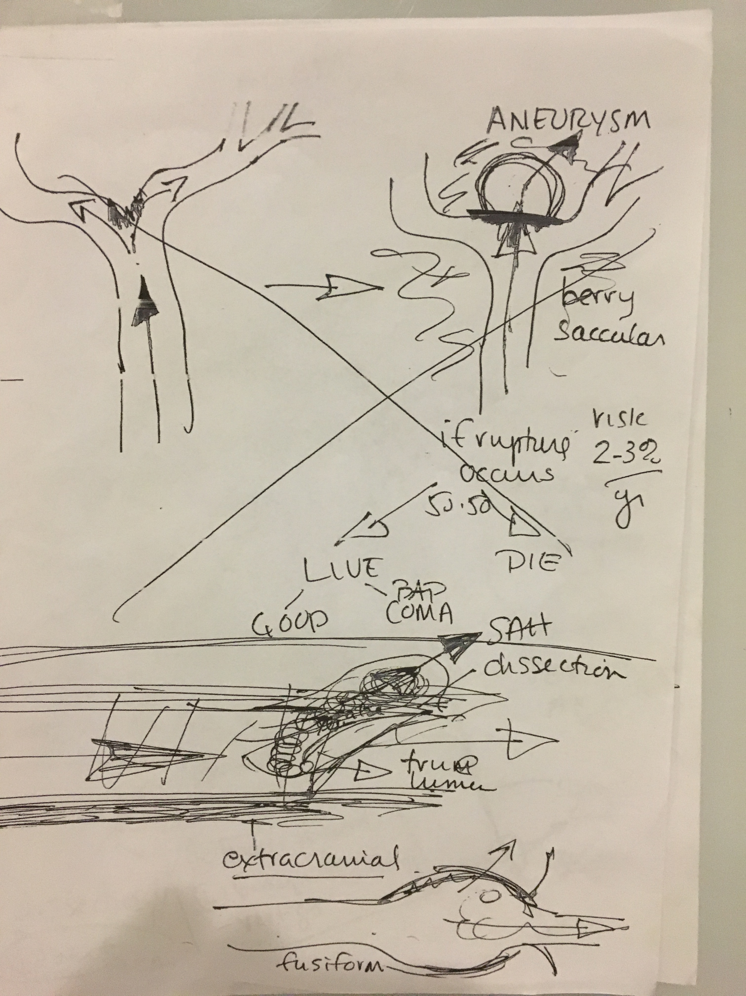
Notes:
Over 30 years earlier

Slide 6
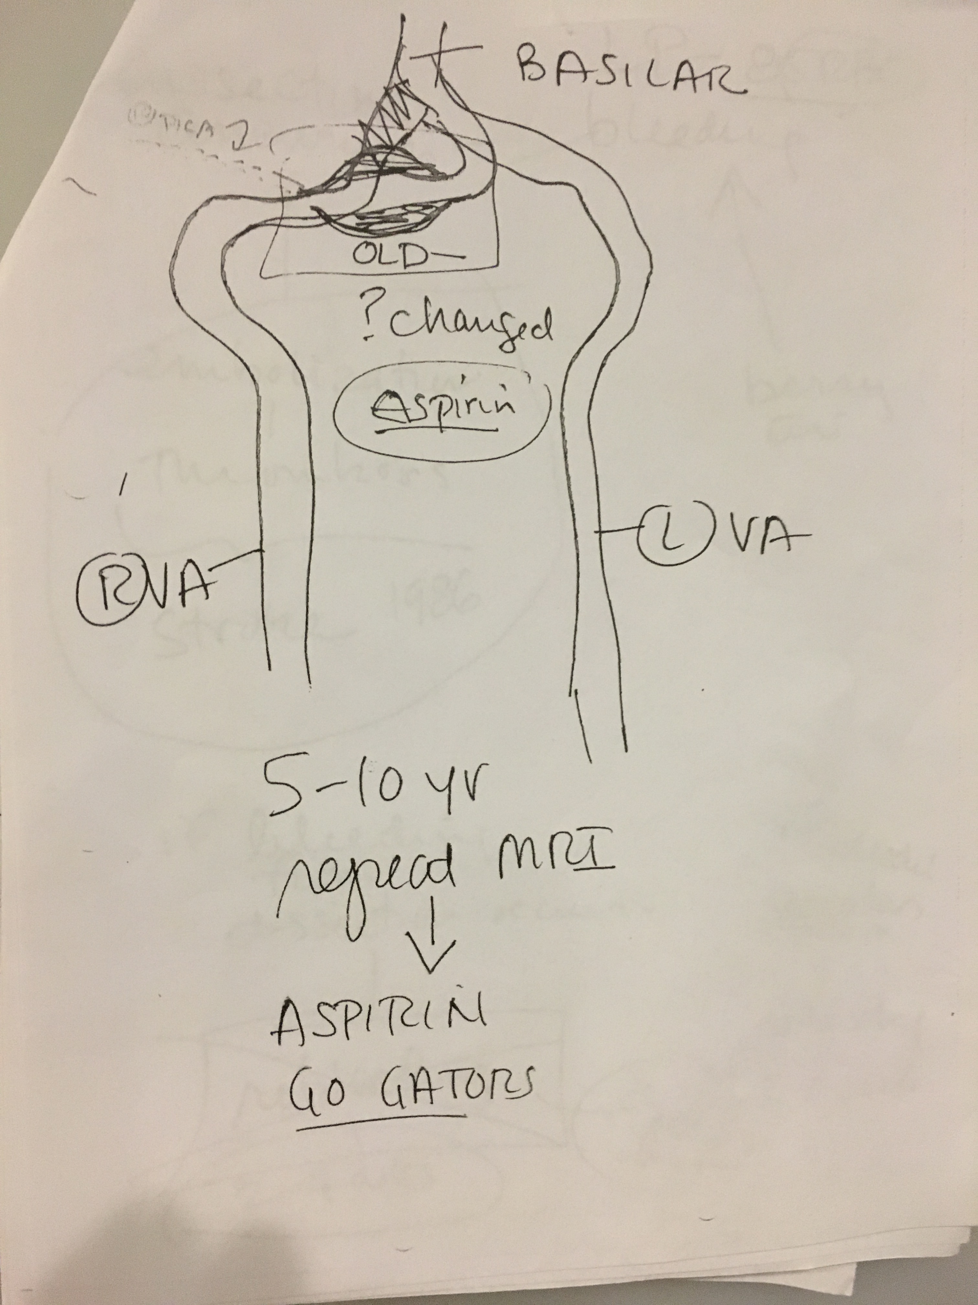

Slide 7
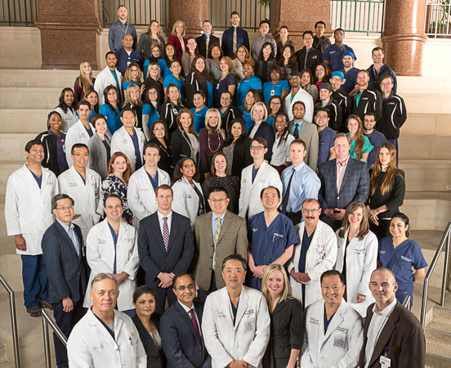
Colleague
Notes:
He is the ideal colleague… selfless, collegial, and entertaining.

Slide 8
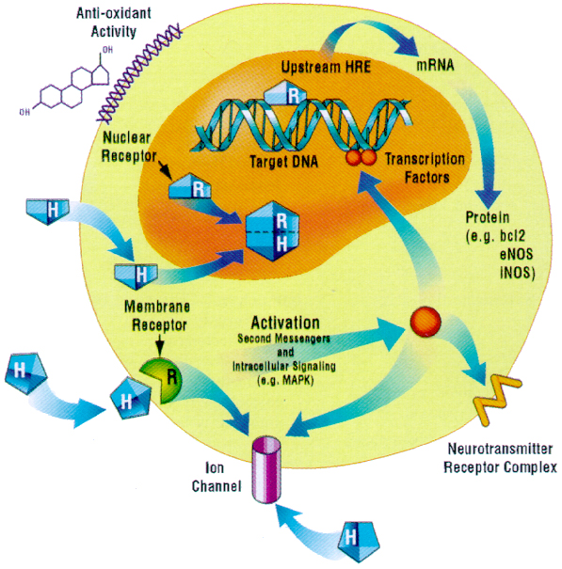
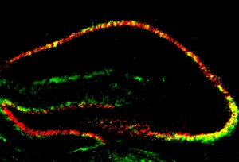
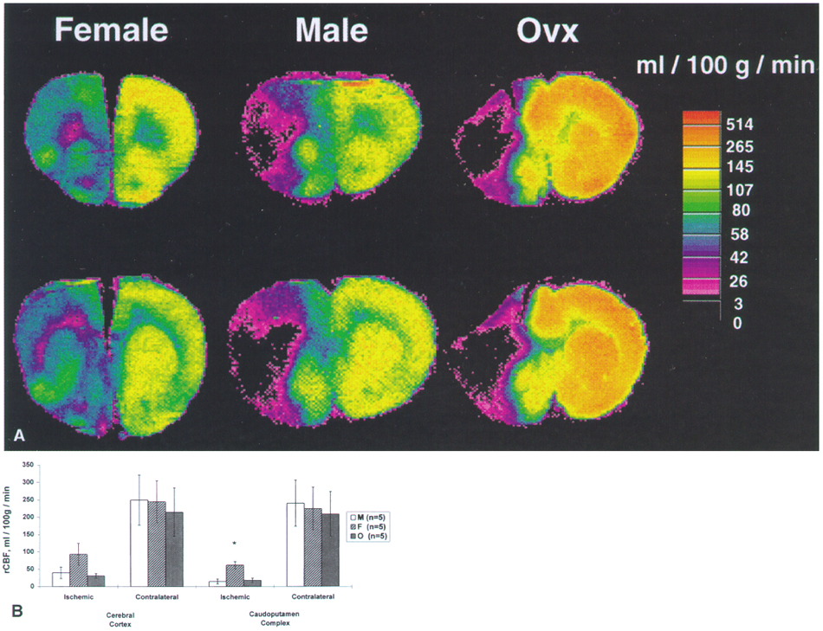
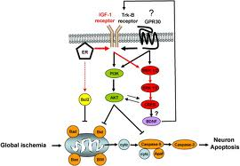
Scientist
Notes:
Despite his demanding clinical service, Art also found time to devote his energy to basic research where he investigated the neuroprotective effect of estrogens against focal and global cerebral ischemia as well as programmed cell death in animal models.

Slide 9
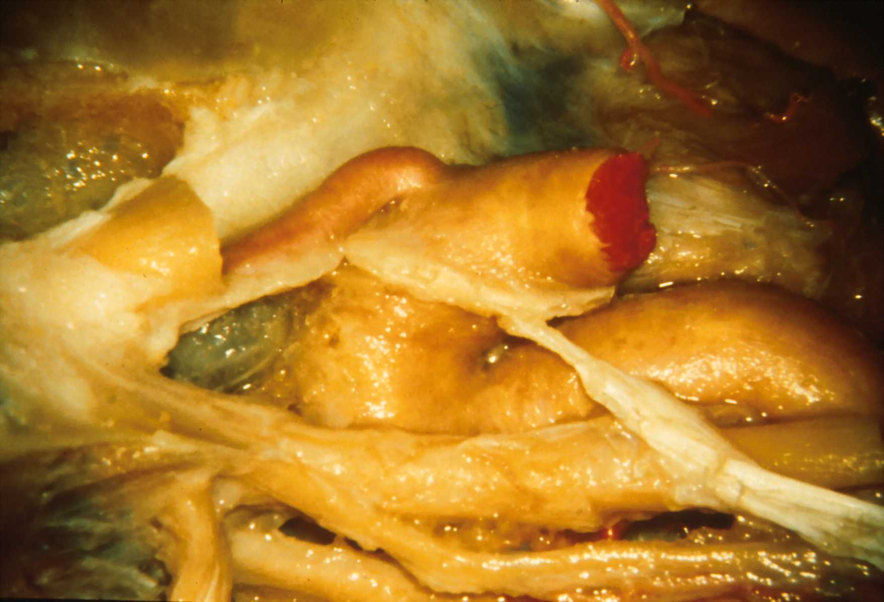
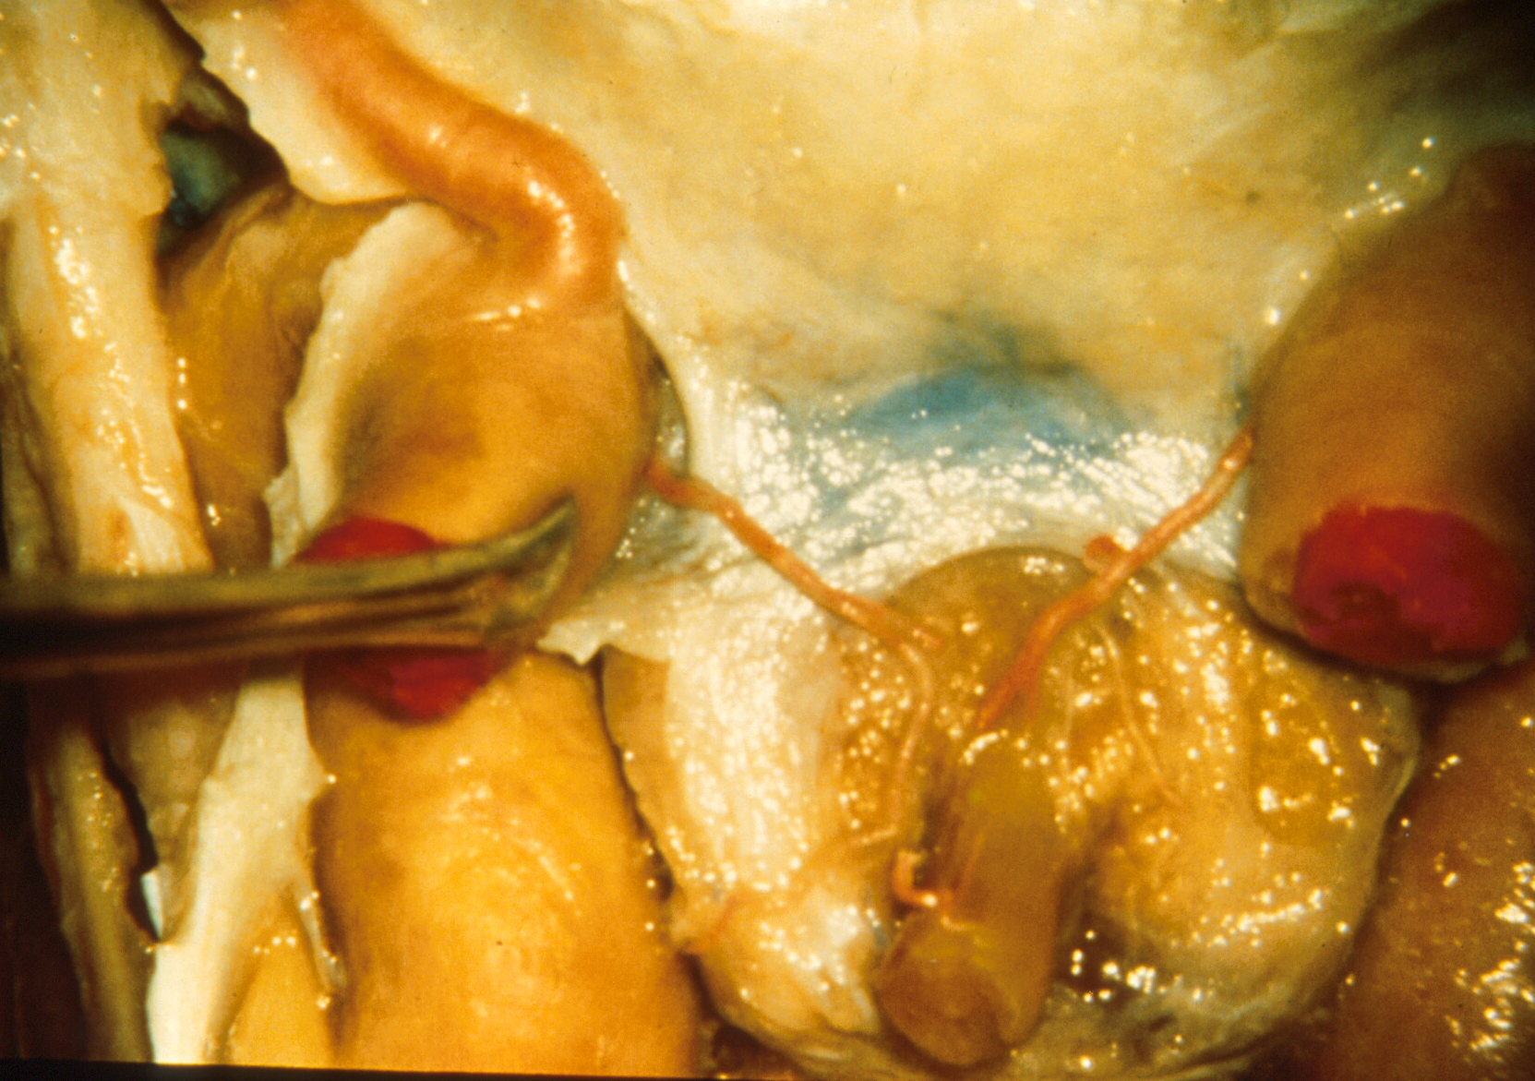
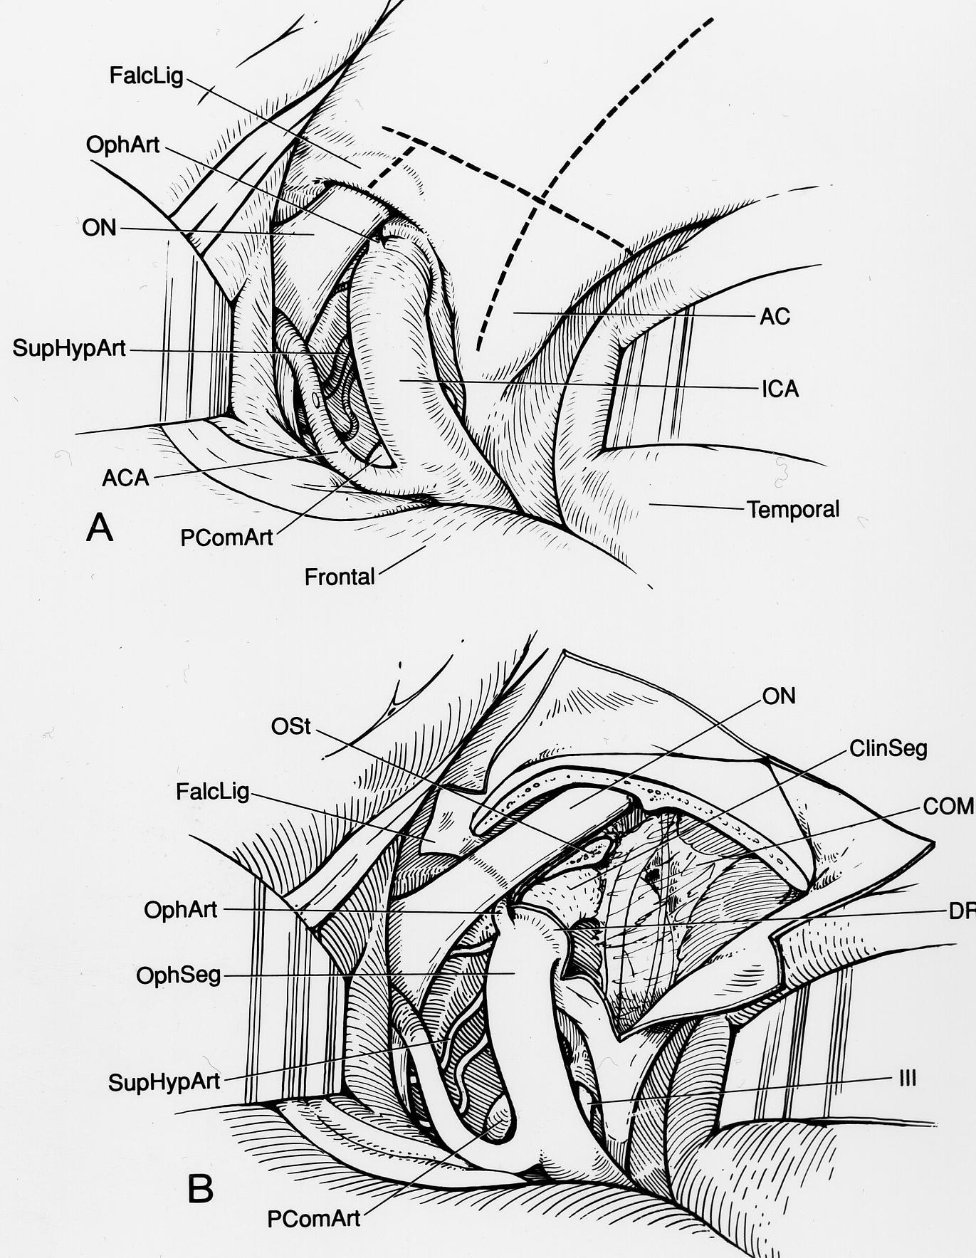
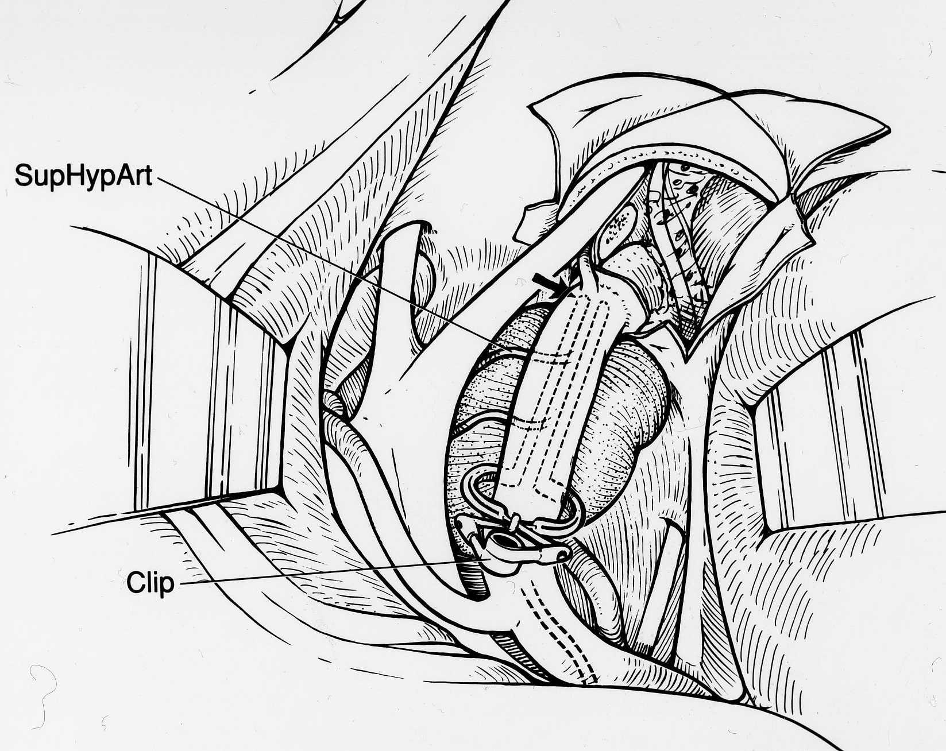
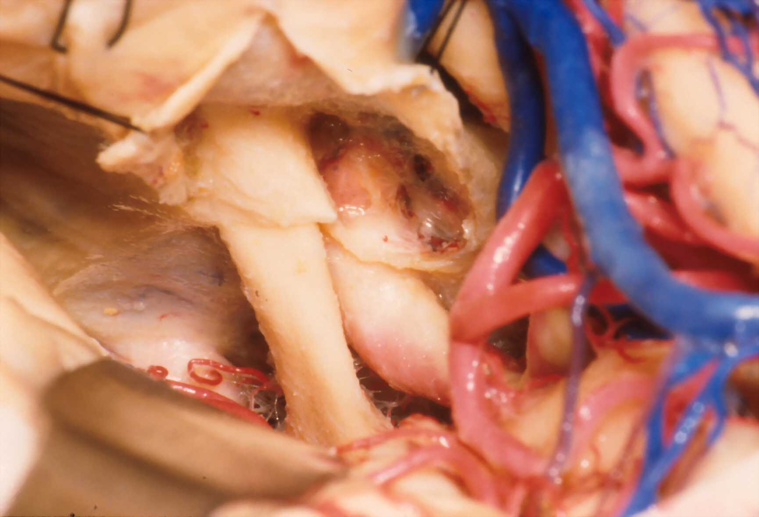
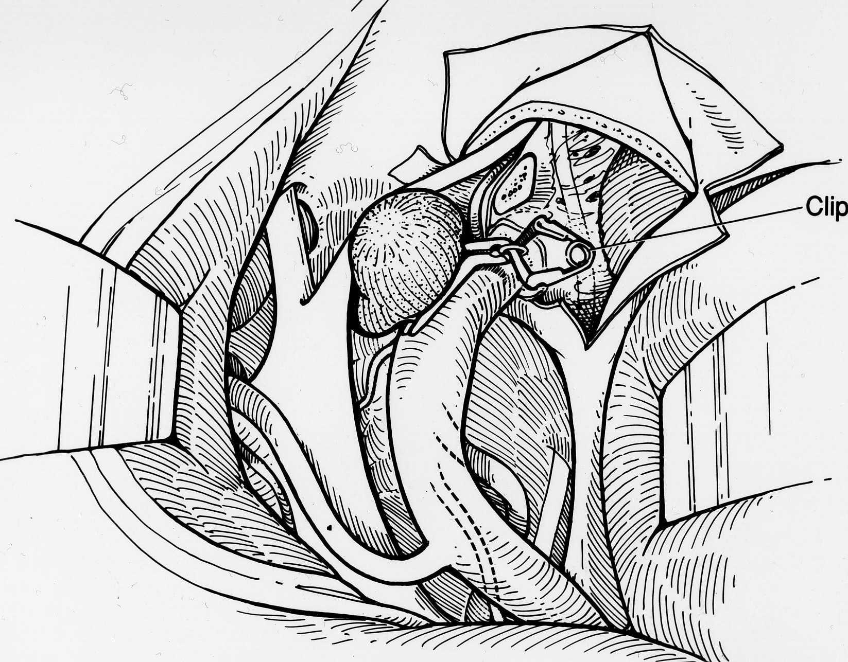
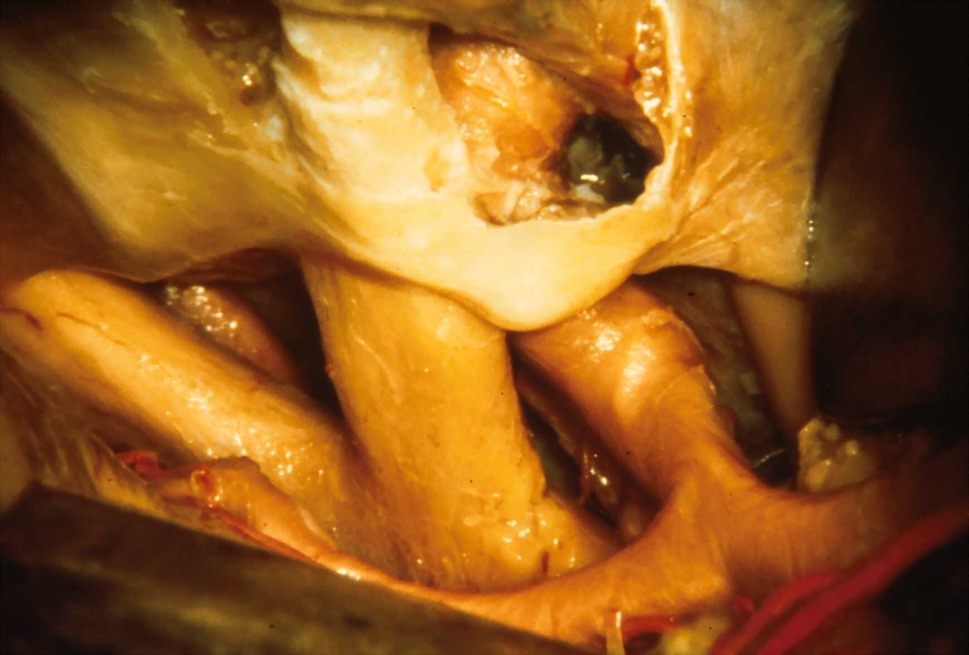
Anatomist
Notes:
His seminal work on the anatomy of the proximal carotid artery provided a clearer understanding of the anatomy of the clinoidal segment of the internal carotid artery and the complex bony and dural anatomy surrounding this small but important anatomical region.

Slide 10
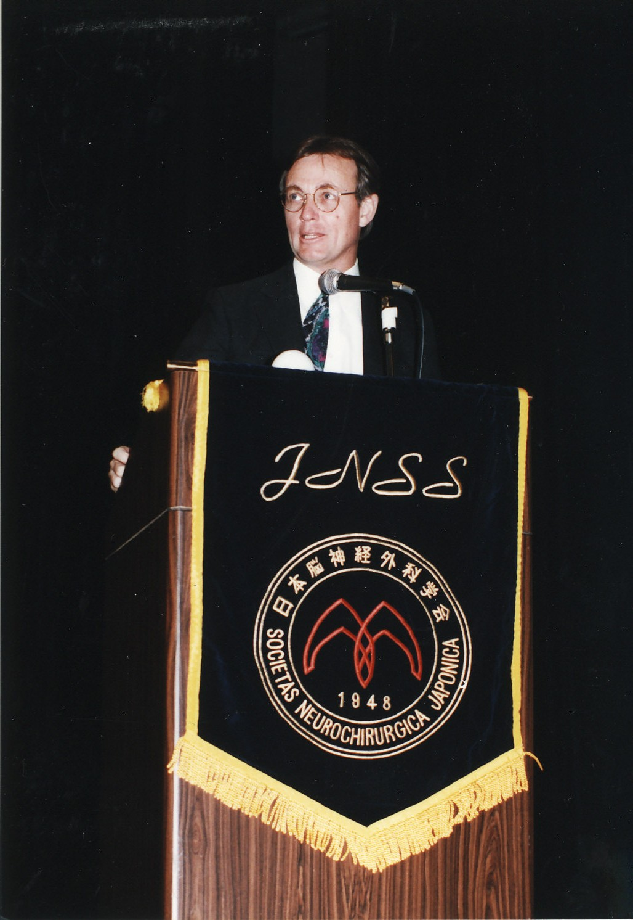
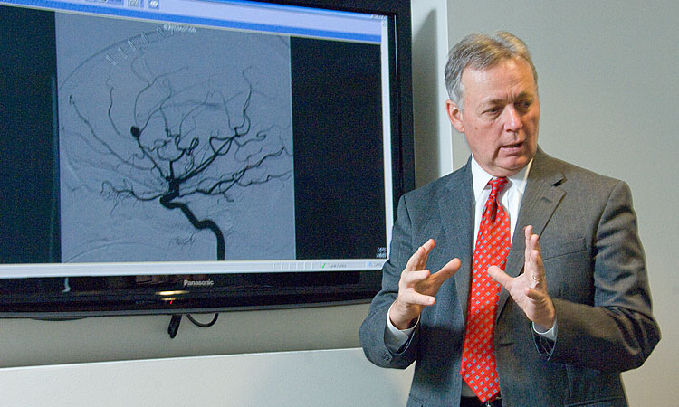
Educator
Notes:
Perhaps the greatest and most unsung accomplishments have been Art Day’s contributions to education. As Program Director at the University of Florida, he devised an educational program to encourage knowledge and a scholarly atmosphere. Once in place, board scores uniformly soared and reached the highest levels for all residents. He taught a weekly cerebrovascular conference which was attended by all the neurosurgery residents along with multiple students, residents and faculty from neurology, orthopedics and anesthesia. He lectured to first-year medical students on cerebrovascular anatomy, to the second-year class on brain tumors and the third and fourth year students on stroke and its surgical treatment.
At Brigham & Women’s, he served as the Program Director for 8 years. At Brigham, Art found an institution with a grand history but with an educational program that was in dire need of leadership. He made major educational changes and during his tenure his residents board scores soared to the highest percentile nationally, and grant funding dramatically improved.
He again worked his magic and has been instrumental in leading the development of a new residency program at the University of Texas with Dong Kim.

Slide 11
Leader
Alachua County Medical Society
President
American Association of Neurological Surgeons
Annual Meeting Chairman
Treasurer
Vice President
President-Elect
American Academy of Neurological Surgery
Vice President
American Board of Neurological Surgery
Director
Treasurer
Chairman
American College of Surgery
Governor
Congress of Neurological Surgeons
Scientific Program Chairman
Annual Meeting Chairman
Treasurer
President
Founder’s Laurel
AANS/CNS Joint Sections
President CV Section
President Sports Medicine Section
Florida Neurosurgical Society
President
Residency Review Committee
Society of Neurological Surgeons
Treasurer
President
Chairman CAST
Medal of Honor NSA
Notes:
Art Day has held major positions in every important neurosurgical organization. In each of these positions he has provided wisdom, leadership, and demonstrated a unique ability to resolve conflict. All of these organizations and those individuals with whom he collaborated have benefited immensely from his sage advice and calm demeanor in dealing with challenging issues and problems.
(*) Member of the SNS since 1993

Slide 13
End

