Slide 1
Medical Student Mentorship for the Neurosciences
through Focused Interest Groups
Jeffrey Bruce, MD
Dept. Neurosurgery
Columbia University Medical Center
New York, NY
Notes:
Fill out pages of paperwork, conflict of interest with yourself, family distant relatives, whether or not you colluded with anyone – so I never know what to say

Slide 2
CONCLUSIONS: Focused Interest Groups for Medical Students What’s not to like?
Good for students
Good for residents
Good for residency program
Good for AANS and organized neurosurgery

Slide 3
AANS
For
Medical Students

Slide 4
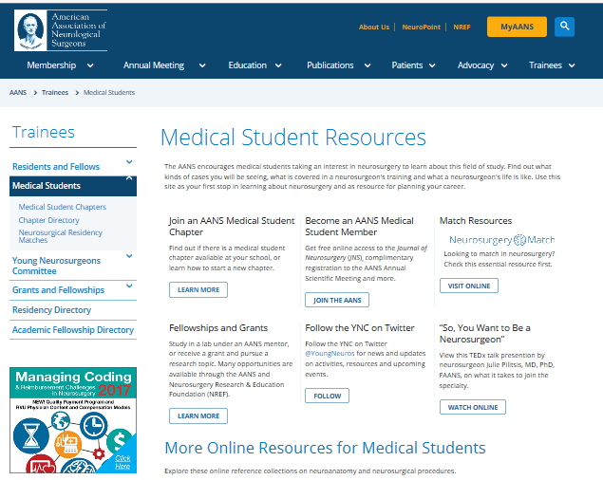
AANS for Medical Students
Access through:
Trainees /
Medical Students
on AANS.org

Slide 5
Medical Student Chapter
Benefits:
Access to AANS faculty member liaison
Access to AANS educational and career guidance resources
Ability to promote neurosurgery to medical school, community, and patients
Access to AANS YNC newsletter and twitter to promote your group’s events
Early involvement in AANS Young Neurosurgeons Committee leadership opportunities, meetings and projects
Access to other medical student chapter programs and events
Grants will be available for educational programs
All student chapter members will receive automatic AANS student membership status
Notes:
Benefits:
Access to AANS faculty member liaison
Access to AANS educational and career guidance resources
Ability to promote neurosurgery to medical school, community, and patients
Access to AANS YNC newsletter and twitter to promote your group’s events
Early involvement in AANS Young Neurosurgeons Committee leadership opportunities, meetings and projects
Access to other medical student chapter programs and events
Grants will be available for educational programs
All student chapter members will receive automatic AANS student membership status

Slide 6
AANS for Medical Students
If your school
does not have
a Medical Chapter
you can apply for
Individual
Membership
Currently = 101 chapters
Notes:
Joining Medical Student Chapter automatically enrolls you as a medical student member.
But if you do not have chapter at your institution you can still be a member.
Membership eligibility in AANS Medical Student Chapters will be limited to student sat accredited allopathic medical schools in the United States, Mexico and Canada.

Slide 7
AANS for Medical Students
Member Benefits:
Access to AANS opportunities, events and AANS Medical Student membership
Access to AANS educational and career guidance resources
Discounted registration to Annual AANS Meeting ($50 medical student member registration; $150 non-member medical student registration)
Assistance in developing relationships with local AANS members
Early involvement in the AANS Mentorship program and invitation to the mentorship sessions and social events at the annual meeting
Early involvement in AANS Young Neurosurgeons Committee leadership opportunities, meetings and projects
Availability of AANS-sponsored information pertaining to neurosurgery as a career, residency training programs, research opportunities, awards, etc.
Grants will be available for educational programs
Free online subscription to Journal of Neurosurgery (including Spine and Pediatrics)
Member discount on AANS publication purchases
Notes:
Member Benefits:
Access to AANS opportunities, events and AANS Medical Student membership for chapter members
Access to AANS educational and career guidance resources
Free registration to Annual AANS Meeting
Assistance in developing relationships with local AANS members
Early involvement in the AANS Mentorship program and invitation to the mentorship sessions and social events at the annual meeting
Early involvement in AANS Young Neurosurgeons Committee leadership opportunities, meetings and projects
Availability of AANS-sponsored information pertaining to neurosurgery as a career, residency training programs, research opportunities, awards, etc.
Grants will be available for educational programs
Free online subscription to Journal of Neurosurgery (including Spine and Pediatrics)
Member discount on AANS publication purchases

Slide 8
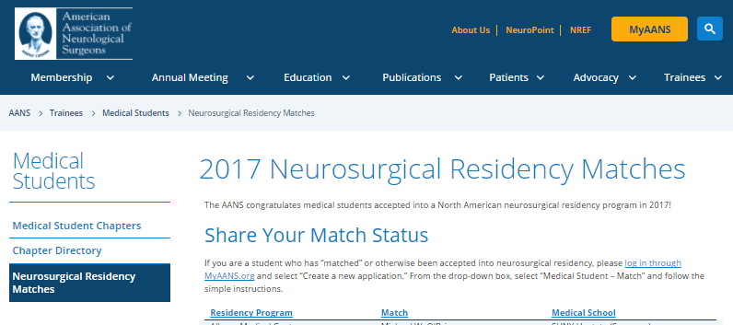
Residency Match
Notes:
The YNC website on AANS allows access to medicals to see where their colleagues have matched as well as where prior students have matched.

Slide 9
Residency Match
Notes:
Neurosurgery continues to be a difficult specialty to apply, however recent numbers have shown that medical students applying have an 82% chance of matching.

Slide 10
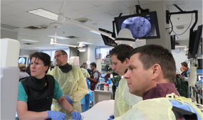
Medical Student Mentoring
How do I prepare for residency?
How do I balance my personal life with the demands of a career in neurosurgery?
What are the pros and cons of academic versus private practice?
What are effective ways to network before and during residency?
Go to MyAANS.org and log in.
Select My Applications / Mentor Program
Notes:
To assist with applying, career guidance and preparedness we are beginning a medical student mentoring program.
This will expand our already present Resident Mentoring Program. This program now has had more than 650 mentors and nearly 200 residents participate. This unique program allows residents access to neurosurgeons practicing in the field, helping them better understand the specialty and guiding them as they explore new areas and subspecialties.
The AANS is working on an automated matching program that will help this program reach medical students

Slide 11
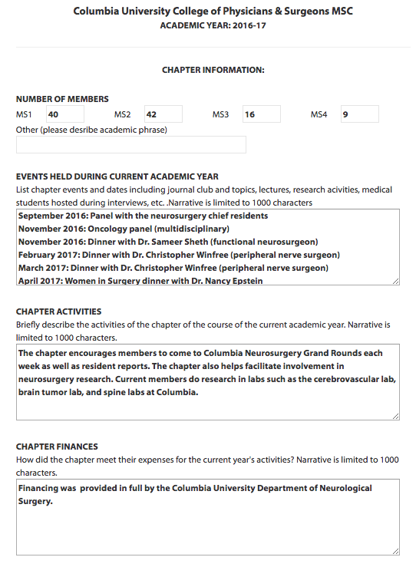

Slide 12
Columbia Neurosurgery Interest Group Activities
Facilitate attendance at all Neurosurgery teaching events
Monthly dinner talks
Variety of clinical topics
Informal setting
Weekly case conferences – with resident or 4th yr medical student
Basic fundamentals – imaging, path anatomy
4th year medical students important for residency information (most knowledgeable because just through process)
Strong mandate to pay it forward
Find mentors
Members: MS1–40; MS2-42; MS3-16; MS4-9
Financed by Dept. of Neurosurgery

Slide 13
Mentors
Every practicing neurosurgeon at one point in time had a mentor and very likely, still does
You can go to them with questions about research, the match process, sub-I’s, your application, lifestyle, etc.
Ideally, you get to know mentors in both the clinic and research setting
Will write your letters of recommendation
Consider: AANS Mentoring Program if none at your institution

Slide 14
Focused Interest Group Advantages for Medical Students
Immersion in field of neurosurgery
Information on residency application
Insight into life as a neurosurgeon
Could decide it’s not for you
Establish formal and informal contacts
Bonding with other medical students interested in neurosurgery
Navigate neurosurgical politics
Establish leadership skills

Slide 15
Focused Interest Group Advantages for Program Directors
Informational conduit for future neurosurgeons
Identify promising (and not so promising) students
Get to know students well
See how they interact with peers
Informal interactions
Facilitate resident-student interactions
Help students get into best program possible
Enhance the specialty at your institution

Slide 16
CONCLUSIONS What’s not to like?
Good for students
Good for residents
Good for residency program
Good for AANS and organized neurosurgery

Slide 17
Acknowledgements
Pranav Nanda
Jack McNulty
Anadjeet Khahera

