Slide 1
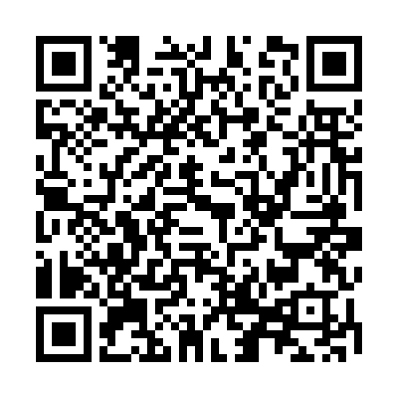

What We Learned from Milestones 1.0:
Realizing the Promise of
Competency-Based Medical Education
Stanley J. Hamstra, Ph.D.
VP, Milestones Research and Evaluation
@stanhamstra

Slide 2
Construct of Interest
What do they know? (Medical Knowledge)
What can they do? (Patient Care)

Slide 3
Construct of Interest is Multi-Dimensional
What do they know? (Medical Knowledge)
What can they do? (Patient Care)
How do they conduct themselves? (Interpersonal and Communication Skills, Professionalism)
Are they critical and reflective? (Practice-based Learning and Improvement, Systems-based Practice)

Slide 4

From:
William Iobst MD and Kelly Caverzagie MD

Slide 5
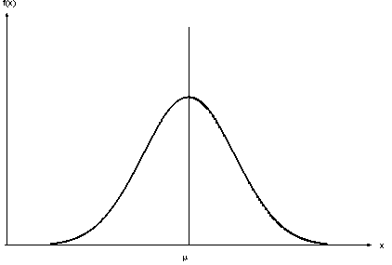
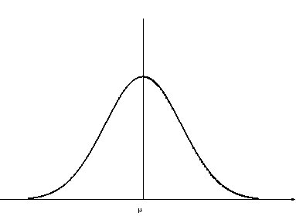
Making the Right Decision…
competent
residents
proportion
observed competence

Slide 6
Uncertainty
Certainty

Slide 7
Epistemology
Methods to ascertain truth statements
  authority
  consensual validation
  triangulation
  hypothesis testing
  scientific method

Slide 8
Milestones in Formal Terms:
M = t + σ_{CI} + ε
where:
    M -represents the resident’s Milestones achievement score as reported to the ACGME by the Clinical Competency Committee (CCC),
    t -represents the resident’s “true” ability,
    σ_{CI} -represents measurable variance due to factors irrelevant to the primary construct of interest, and
    ε -represents any additional residual variance otherwise unaccounted for

Slide 9
Sources of Construct-Irrelevant Variance
Relatively under-developed assessment tools
  Need a good survey of what they community is currently using
How can the ACGME toolbox help? What would you like to see there?

Slide 10
Making the Right Decision…
“pre-competent”
residents
competent
residents
proportion
observed competence

Slide 11
Making the Right Decision…
“pre-competent”
residents
competent
residents
proportion
observed competence

Slide 12
Residents Attaining Level 4 or Higher for
PC Sub-Competencies (June 2016) – Neurological Surgery
PC02 PC08 | Critical Care Traumatic Brain Injury
PC01 | Brain Tumor
PC06 | Spinal Neurosurgery
PC05 | Pediatric Neurological Surgery
PC07 | Vascular Neurosurgery
PC04 | Pain and Peripheral Nerves
PC03 | Surgical Treatment of Epilepsy and Movement Disorders

Slide 13
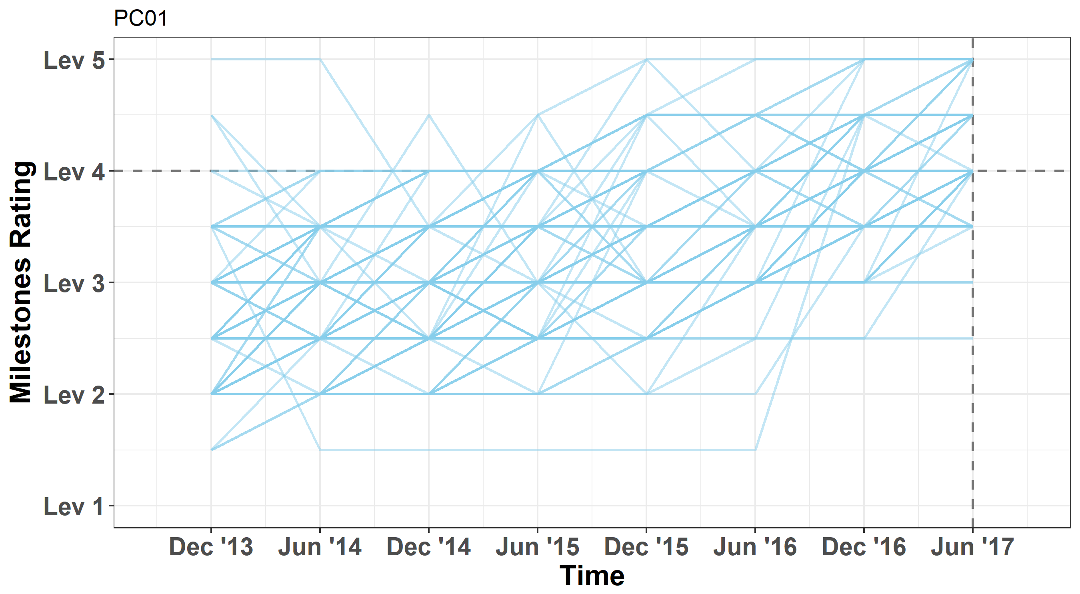
    PC01:
    Brain Tumor
Residents’ Milestones trajectories over time (e.g., PC01)
N=144

Slide 14
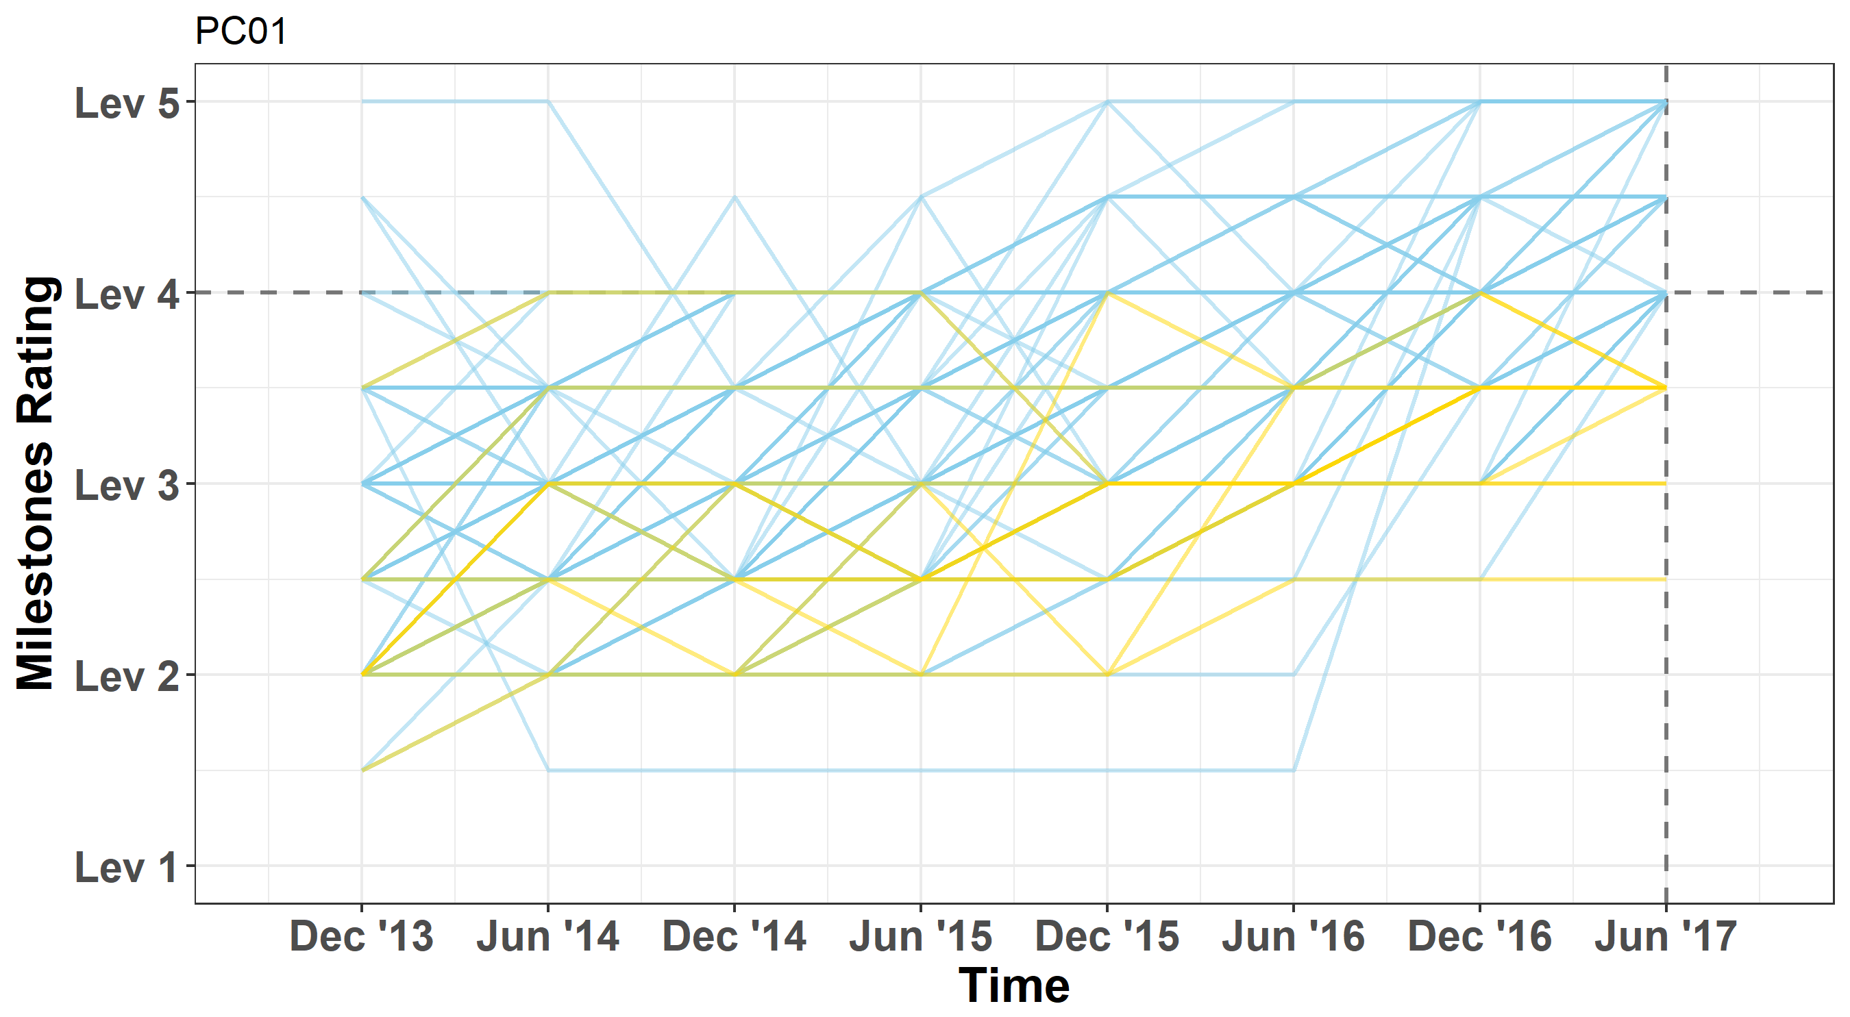
    PC01:
    Brain Tumor
Milestones trajectories for residents who attained Level 4 and those who did not
n = 130
(90%)
N=144
n = 14
(10%)

Slide 15
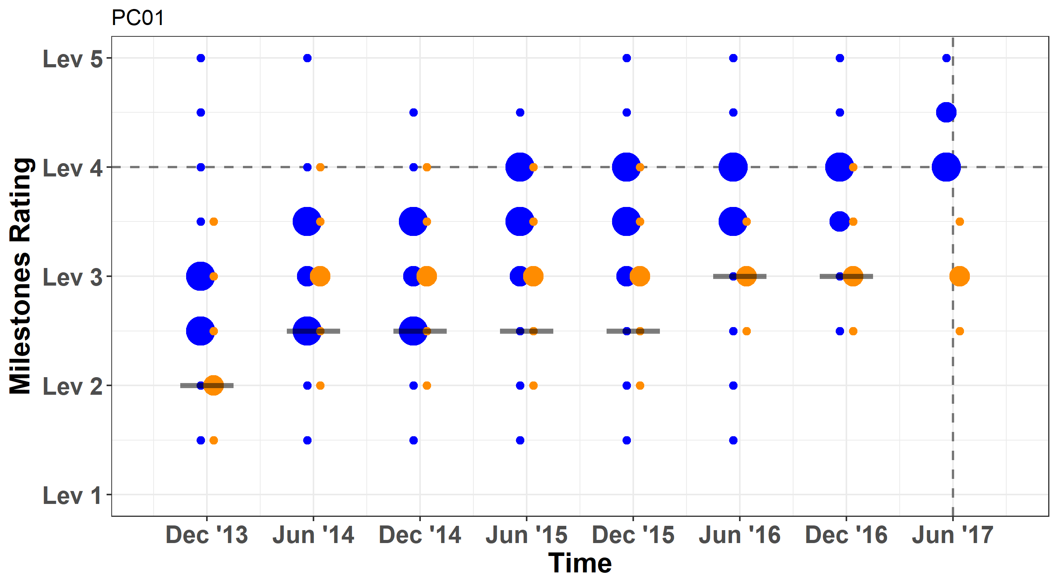
    PC01:
    Brain Tumor
Odds Ratio for residents not attaining Level 4 under the threshold over time
OR=5.80
(0.77, 43.44)
OR=2.70
(0.40, 18.38)
OR=5.35
(0.73, 39.24)
OR=4.07
(0.37, 44.53)
OR=6.70
(0.53, 84.74)
OR=4.63
(0.68, 31.58)
OR=2.15
(0.28, 16.67)
Notes:
Note: B-correction was applied for the CI to contain the experiment-wise type I error at p=0.05.

Slide 16
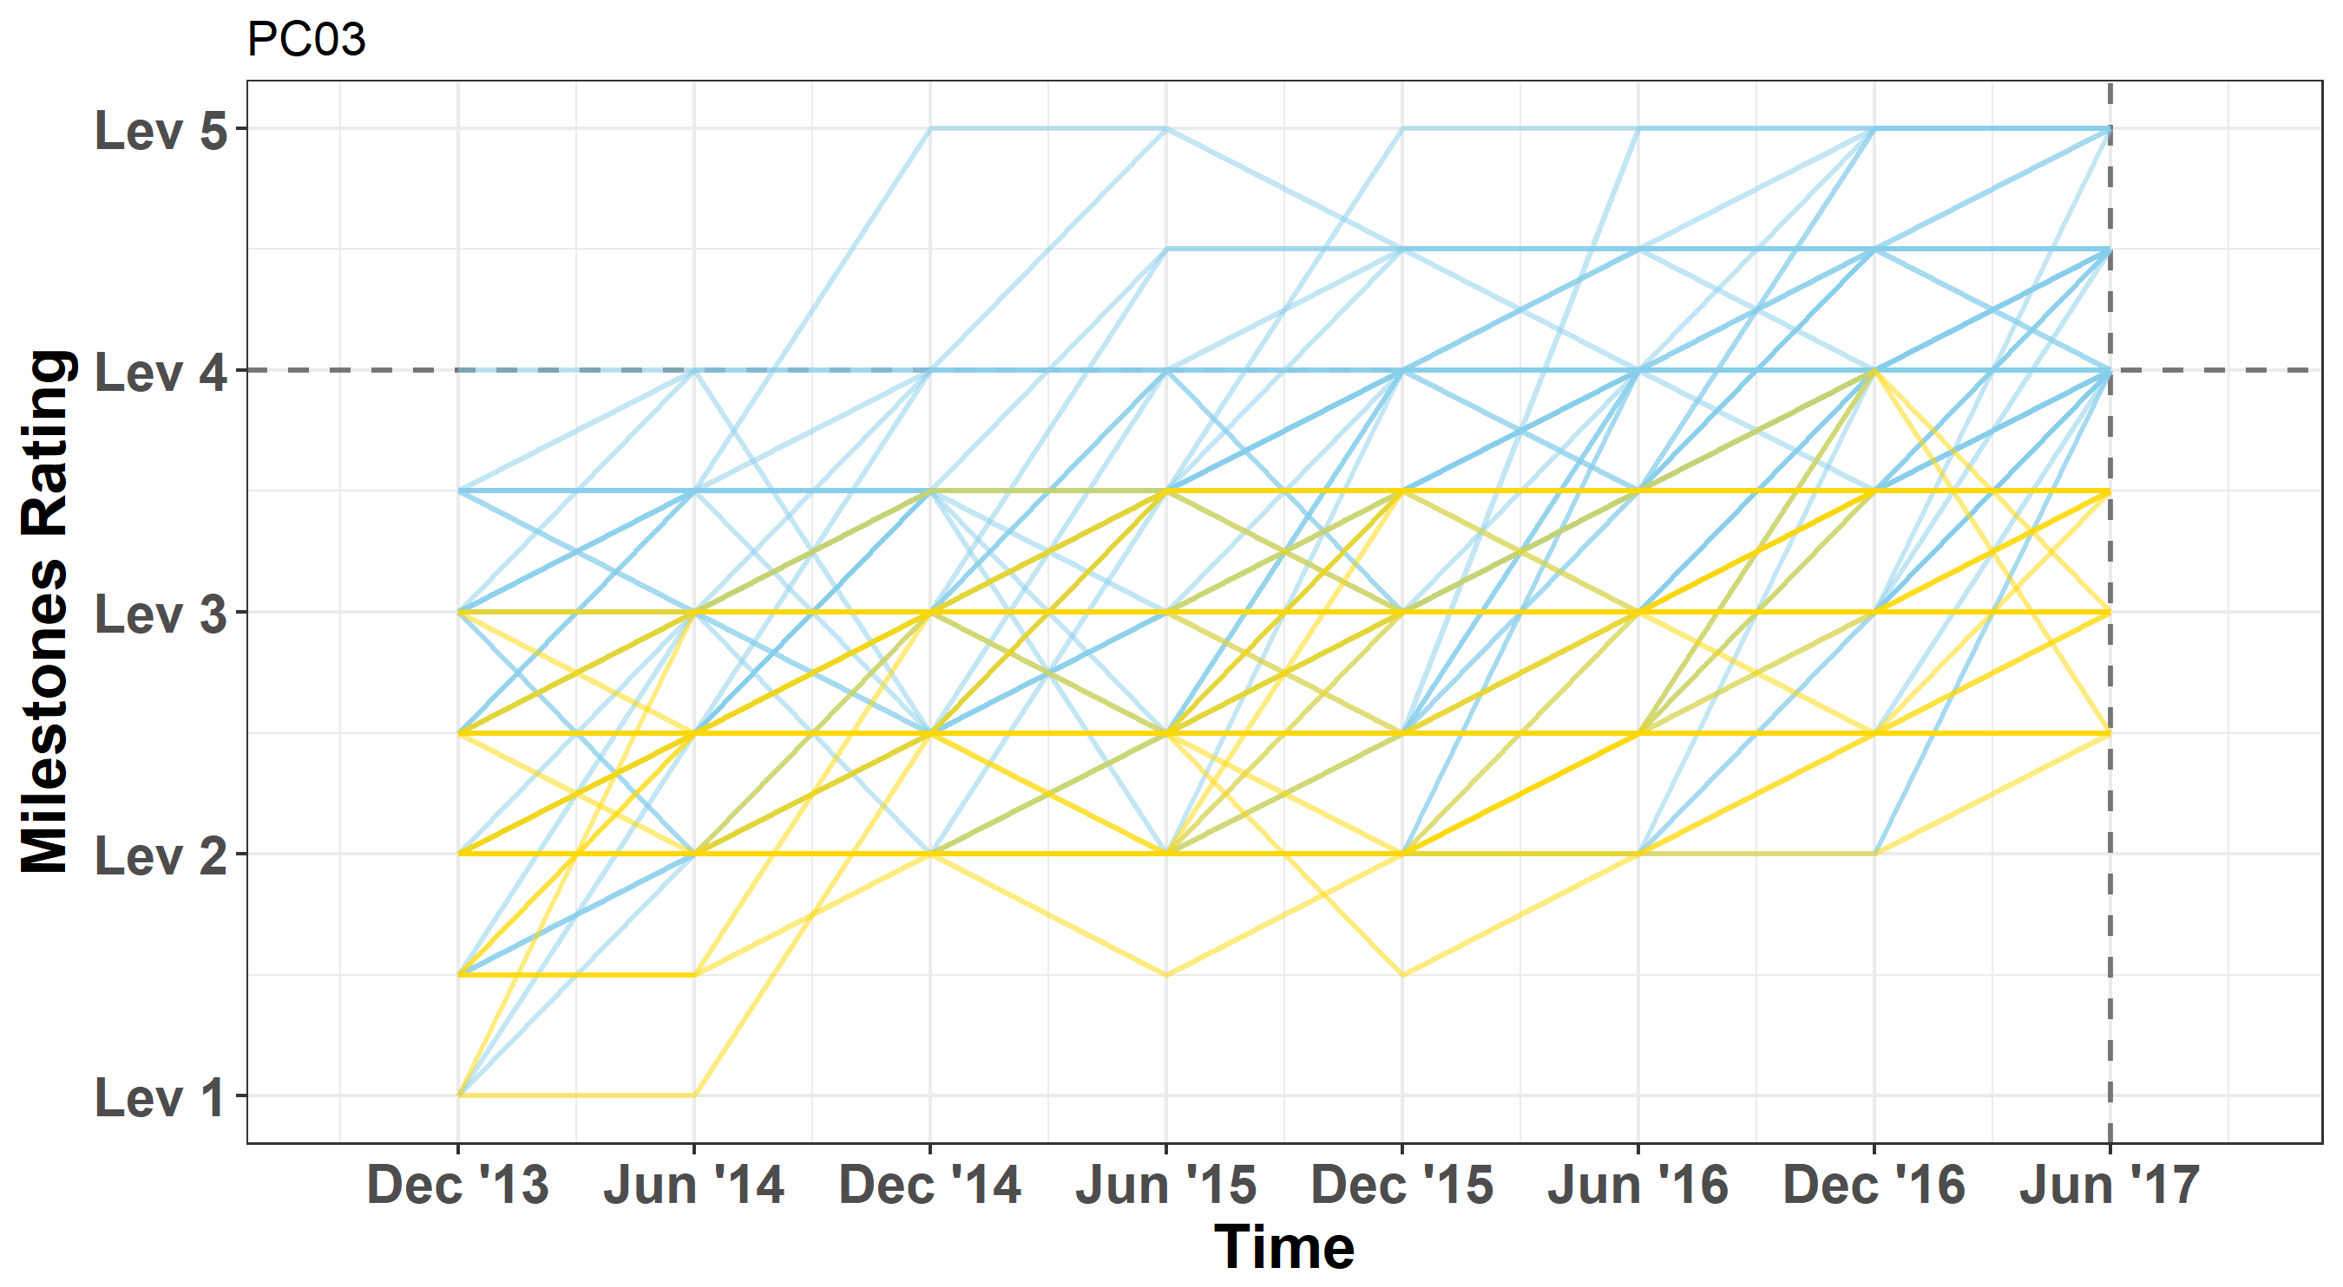
PC03:
Surgical Treatment of Epilepsy and Movement Disorders
Milestones trajectories for residents who attained Level 4 and those who did not
n = 113
(78%)
N=144
n = 31
(22%)

Slide 17
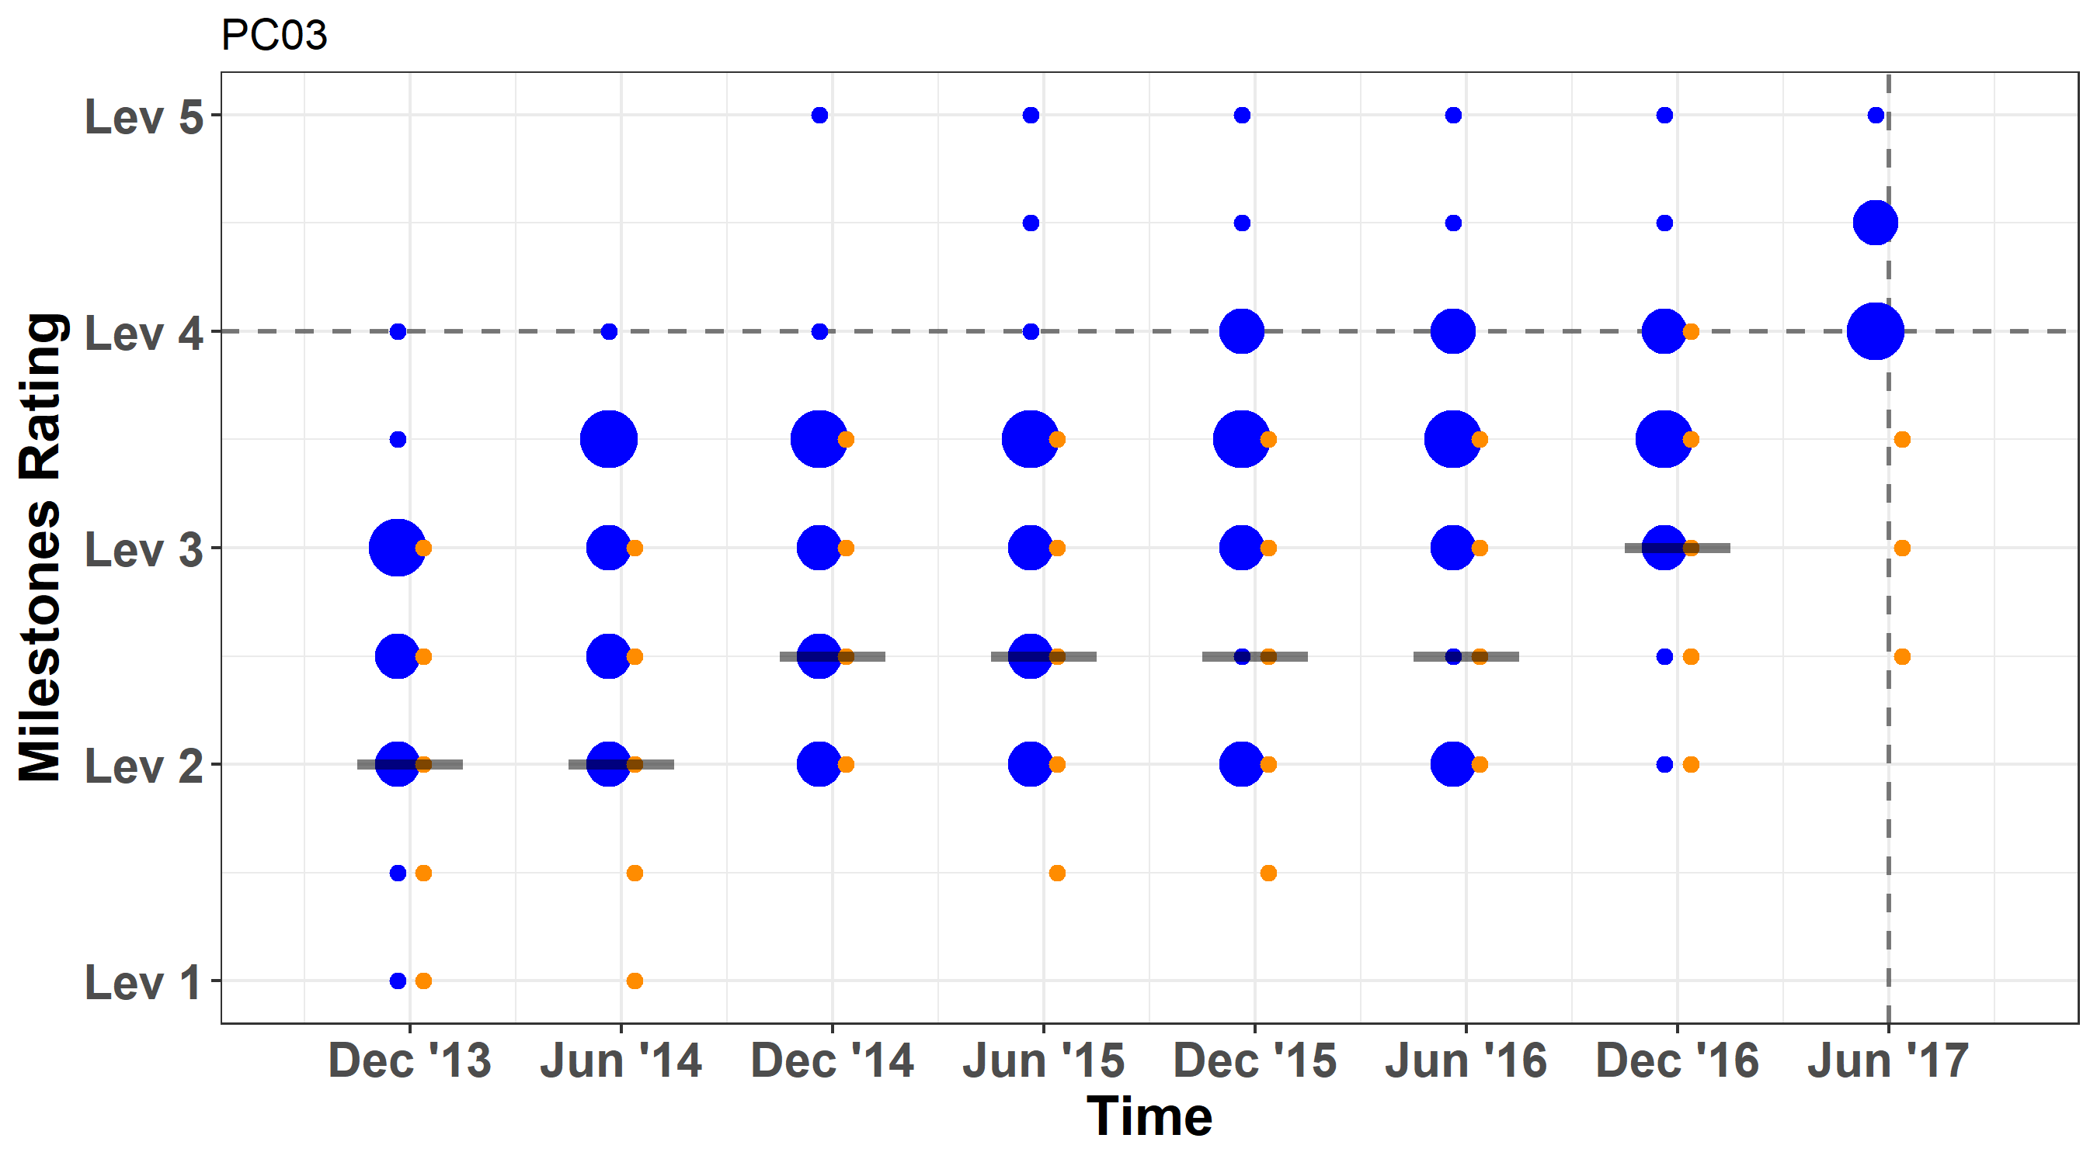
PC03:
Surgical Treatment of Epilepsy and Movement Disorders
Odds Ratio for residents not attaining Level 4 under the threshold over time
OR=7.91*
(1.47, 42.58)
OR=2.13
(0.48, 9.51)
OR=2.42
(0.54, 10.88)
OR=2.57
(0.53, 12.52)
OR=3.60
(0.50, 26.01)
OR=2.61
(0.81, 8.32)
OR=1.89
(0.43, 8.26)
*p < .007
Notes:
Note: B-correction was applied for the CI to contain the experiment-wise type I error at p=0.05.

Slide 18
Why Milestones 2.0?
Reduce uncertainty in your professional judgments about residents’ competence
  esp. the Milestones language really needed an overhaul – to improve “content validity”

Slide 19
Milestone Resources
Clinical Competency Committee Guidebook (v2)
http://www.acgme.org/Portals/0/ACGMEClinicalCompetencyCommitteeGuidebook.pdf
Milestones Guidebook
http://www.acgme.org/Portals/0/MilestonesGuidebook.pdf
Milestone Guidebook for Residents/Fellows (NEW!!)
http://www.acgme.org/Portals/0/PDFs/Milestones/MilestonesGuidebookforResidentsFellows.pdf
Milestones Annual Report 2017
http://www.acgme.org/Portals/0/PDFs/Milestones/MilestonesAnnualReport2017.pdf

Slide 20
Milestone Resources
Faculty Development in Assessment
    Three courses in Chicago each year
    First “refresher” course in 2018
Regional Faculty Development hubs
    Three sites up and successfully running
        Vanderbilt, UCLA, Cleveland Clinic
    More sites have signed on:
        Philadelphia consortium (2018)
        MSU OPTI (in development)

Slide 21
Questions?
@stanhamstra
Background and Context
  CBME and the ACGME
Entrustability and the Assessment Process
  Making the Right Decisions
Assessment Data for Educational CQI
  The Quest for Validity:
    Developing a Framework for Testing Validity
shamstra@acgme.org

Slide 22
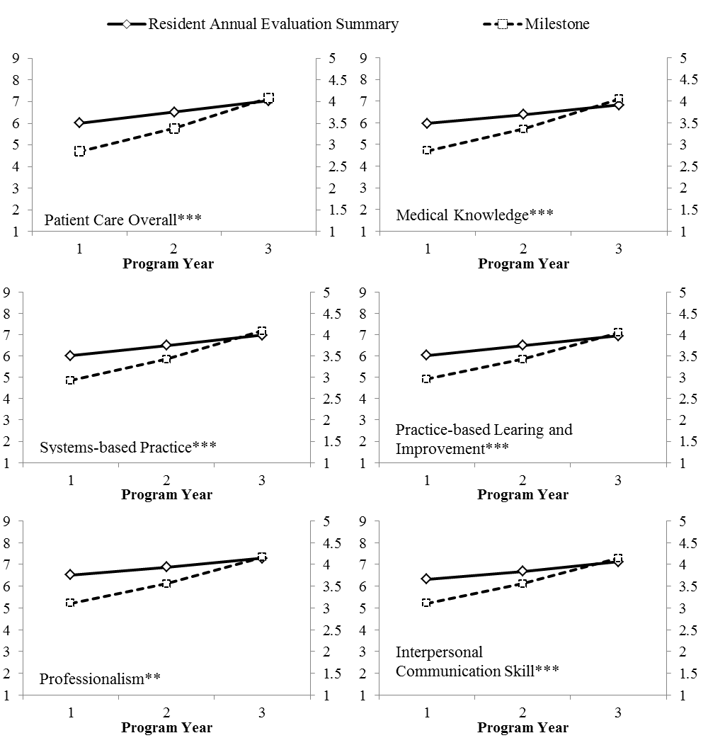
Milestones vs Old Form: More inter-year variation

Slide 23
Sources of Validity Evidence
Content – expert group creates the content
Internal Structure – reliability; how many dimensions?
Response Process – tools constructed with rater in mind; well-accepted; feasible; scoring processes
Relation with other Variables – does the tool correlate with other variables in an expected manner?
Consequences – how do scores impact the system?

Slide 24
Sources of Validity Evidence
Content – expert group creates the content
Internal Structure – reliability; how many dimensions?
Response Process – tools constructed with rater in mind; well-accepted; feasible; scoring processes
Relation with other Variables – does the tool correlate with other variables in an expected manner?
Consequences – how do scores impact the system?

Slide 25
The Evaluation Form
Diagnosis (PC1)
N Not observed | 0 Unable to perform an accurate H+P | 1 Performs a focused, efficient and accurate H+P of all patients including critically ill patients | 2 Accurately diagnoses many common conditions and initiates management for some | 3 Accurately diagnoses and initiates management for most common conditions | 4 Recognizes atypical presentations of a large number of conditions
Post-op care (PC2)
N Not observed | 0 Does not recognize or manage common post op problems | 1 Manages common post op problems with a senior physically present | 2 Manages common post op problems with a senior available by phone | 3 Manages common and complex post op problems independently | 4 Supervises junior residents managing common and complex postoperative problems
Technical skills (PC3)
N Not observed | 0 Lacks basic surgical skills (e.g. knot tying, NG tube, foley, I+D, art line) | 1 Has basic surgical skills (e.g. knot tying, NG tube, foley, I+D, art line) | 2 Has respect for tissue and developing instrument handling | 3 Proficient at most instrument handling and exhibits efficiency | 4 Proficiency in use of all instruments and equipment for essential operations
Knowledge about diseases (MK1)
N Not observed | 0 Lacks basic knowledge expected of a medical student | 1 Understands signs, symptoms and treatment of some common conditions | 2 Basic knowledge and recognizes variations in presentation of many common conditions | 3 Significant knowledge of many common conditions | 4 Comprehensive knowledge of common conditions and basic knowledge of advanced conditions
Knowledge about operations (MK2)
N Not observed | 0 Does not know steps of common operations | 1 Basic knowledge of steps of common operations | 2 Basic knowledge of steps and perioperative care for many common operations | 3 Significant knowledge of most common operations, basic knowledge of some complex operations | 4 Comprehensive knowledge of common operations, basic knowledge of many complex operations

Slide 26
The Evaluation Form
Diagnosis (PC1)
N Not observed | 0 Unable to perform an accurate H+P | 1 Performs a focused, efficient and accurate H+P of all patients including critically ill patients | 2 Accurately diagnoses many common conditions and initiates management for some | 3 Accurately diagnoses and initiates management for most common conditions | 4 Recognizes atypical presentations of a large number of conditions
Post-op care (PC2)
N Not observed | 0 Does not recognize or manage common post op problems | 1 Manages common post op problems with a senior physically present | 2 Manages common post op problems with a senior available by phone | 3 Manages common and complex post op problems independently | 4 Supervises junior residents managing common and complex postoperative problems
Technical skills (PC3)
N Not observed | 0 Lacks basic surgical skills (e.g. knot tying, NG tube, foley, I+D, art line) | 1 Has basic surgical skills (e.g. knot tying, NG tube, foley, I+D, art line) | 2 Has respect for tissue and developing instrument handling | 3 Proficient at most instrument handling and exhibits efficiency | 4 Proficiency in use of all instruments and equipment for essential operations
Knowledge about diseases (MK1)
N Not observed | 0 Lacks basic knowledge expected of a medical student | 1 Understands signs, symptoms and treatment of some common conditions | 2 Basic knowledge and recognizes variations in presentation of many common conditions | 3 Significant knowledge of many common conditions | 4 Comprehensive knowledge of common conditions and basic knowledge of advanced conditions
Knowledge about operations (MK2)
N Not observed | 0 Does not know steps of common operations | 1 Basic knowledge of steps of common operations | 2 Basic knowledge of steps and perioperative care for many common operations | 3 Significant knowledge of most common operations, basic knowledge of some complex operations | 4 Comprehensive knowledge of common operations, basic knowledge of many complex operations

Slide 27
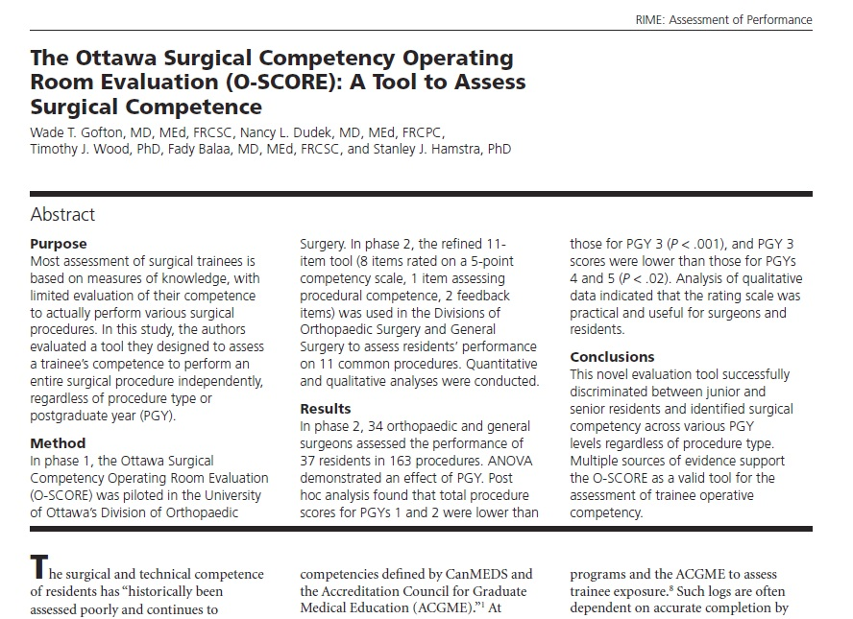
Gofton WT et al. Acad Med. 2012; 87:1401-7.

Slide 28
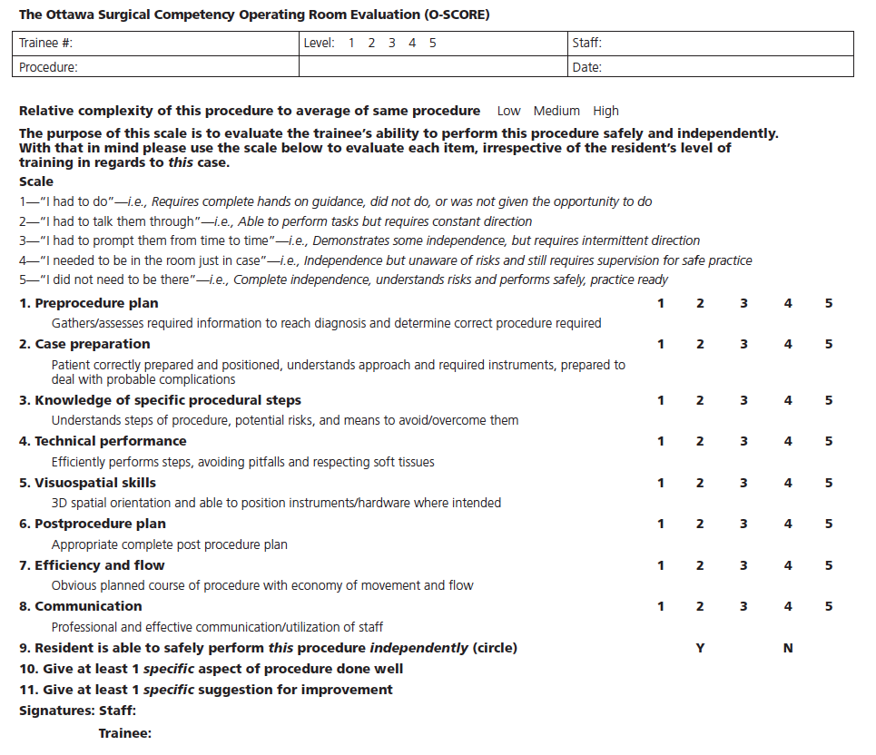

Slide 29
Notes:
Ratings are coloquial in nature and based on how a surgeon often considers a trainees competence. There are some criteria to provide raters direction if required
The scale develops an external reference criteria avoiding the comparison of a trainee to their year of training.
There are 8 questions based on key aspects of a surgical procedure. Experts consider these important features of a successful case, and they help demonstrate to trainees what are considered key aspects of a procedure and aids in ‘blueprinting’ desired behavior

Slide 30
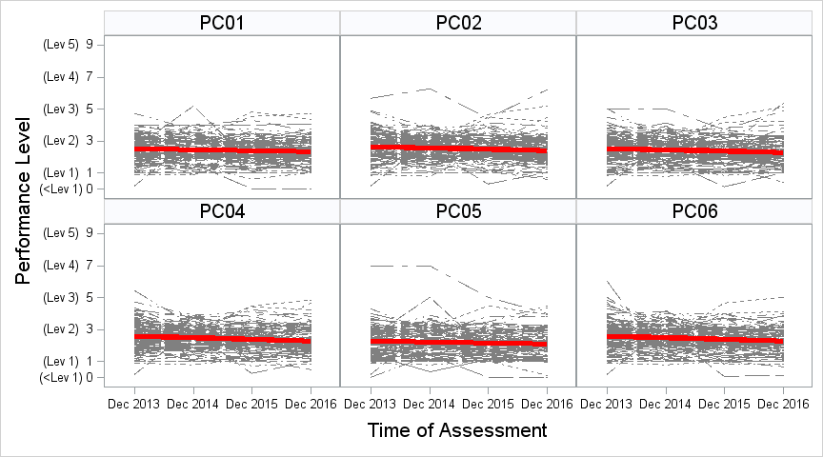
Stringency Study: Emergency Medicine
Y = -0.07x+2.50
Y = -0.08x+2.64
Y = -0.08x+2.53
Y = -0.10x+2.58
Y = -0.06x+2.29
Y = -0.11x+2.59
Programmatic average for the first year residents

Slide 31
Residents Attaining Level 4 or Higher

Slide 32
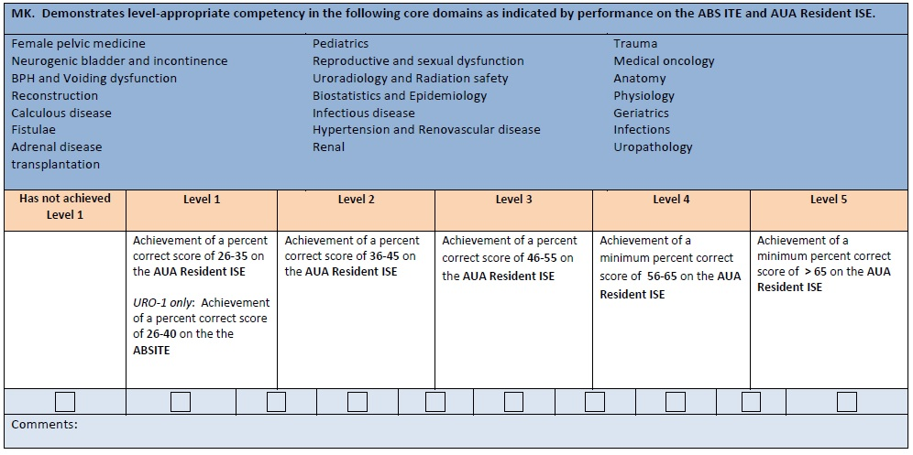
Urology MK

Slide 33
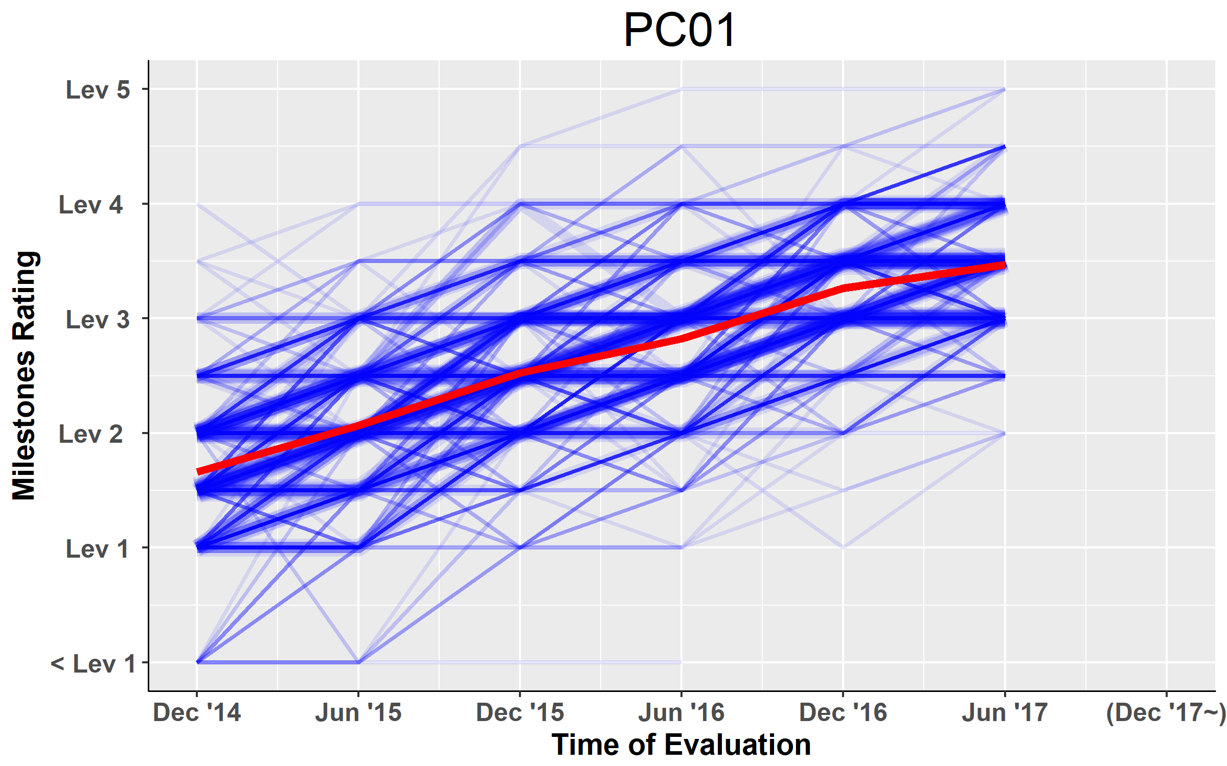
Resident-Level Trajectories of Milestones Ratings - Pathology
Notes:
Done

Slide 34
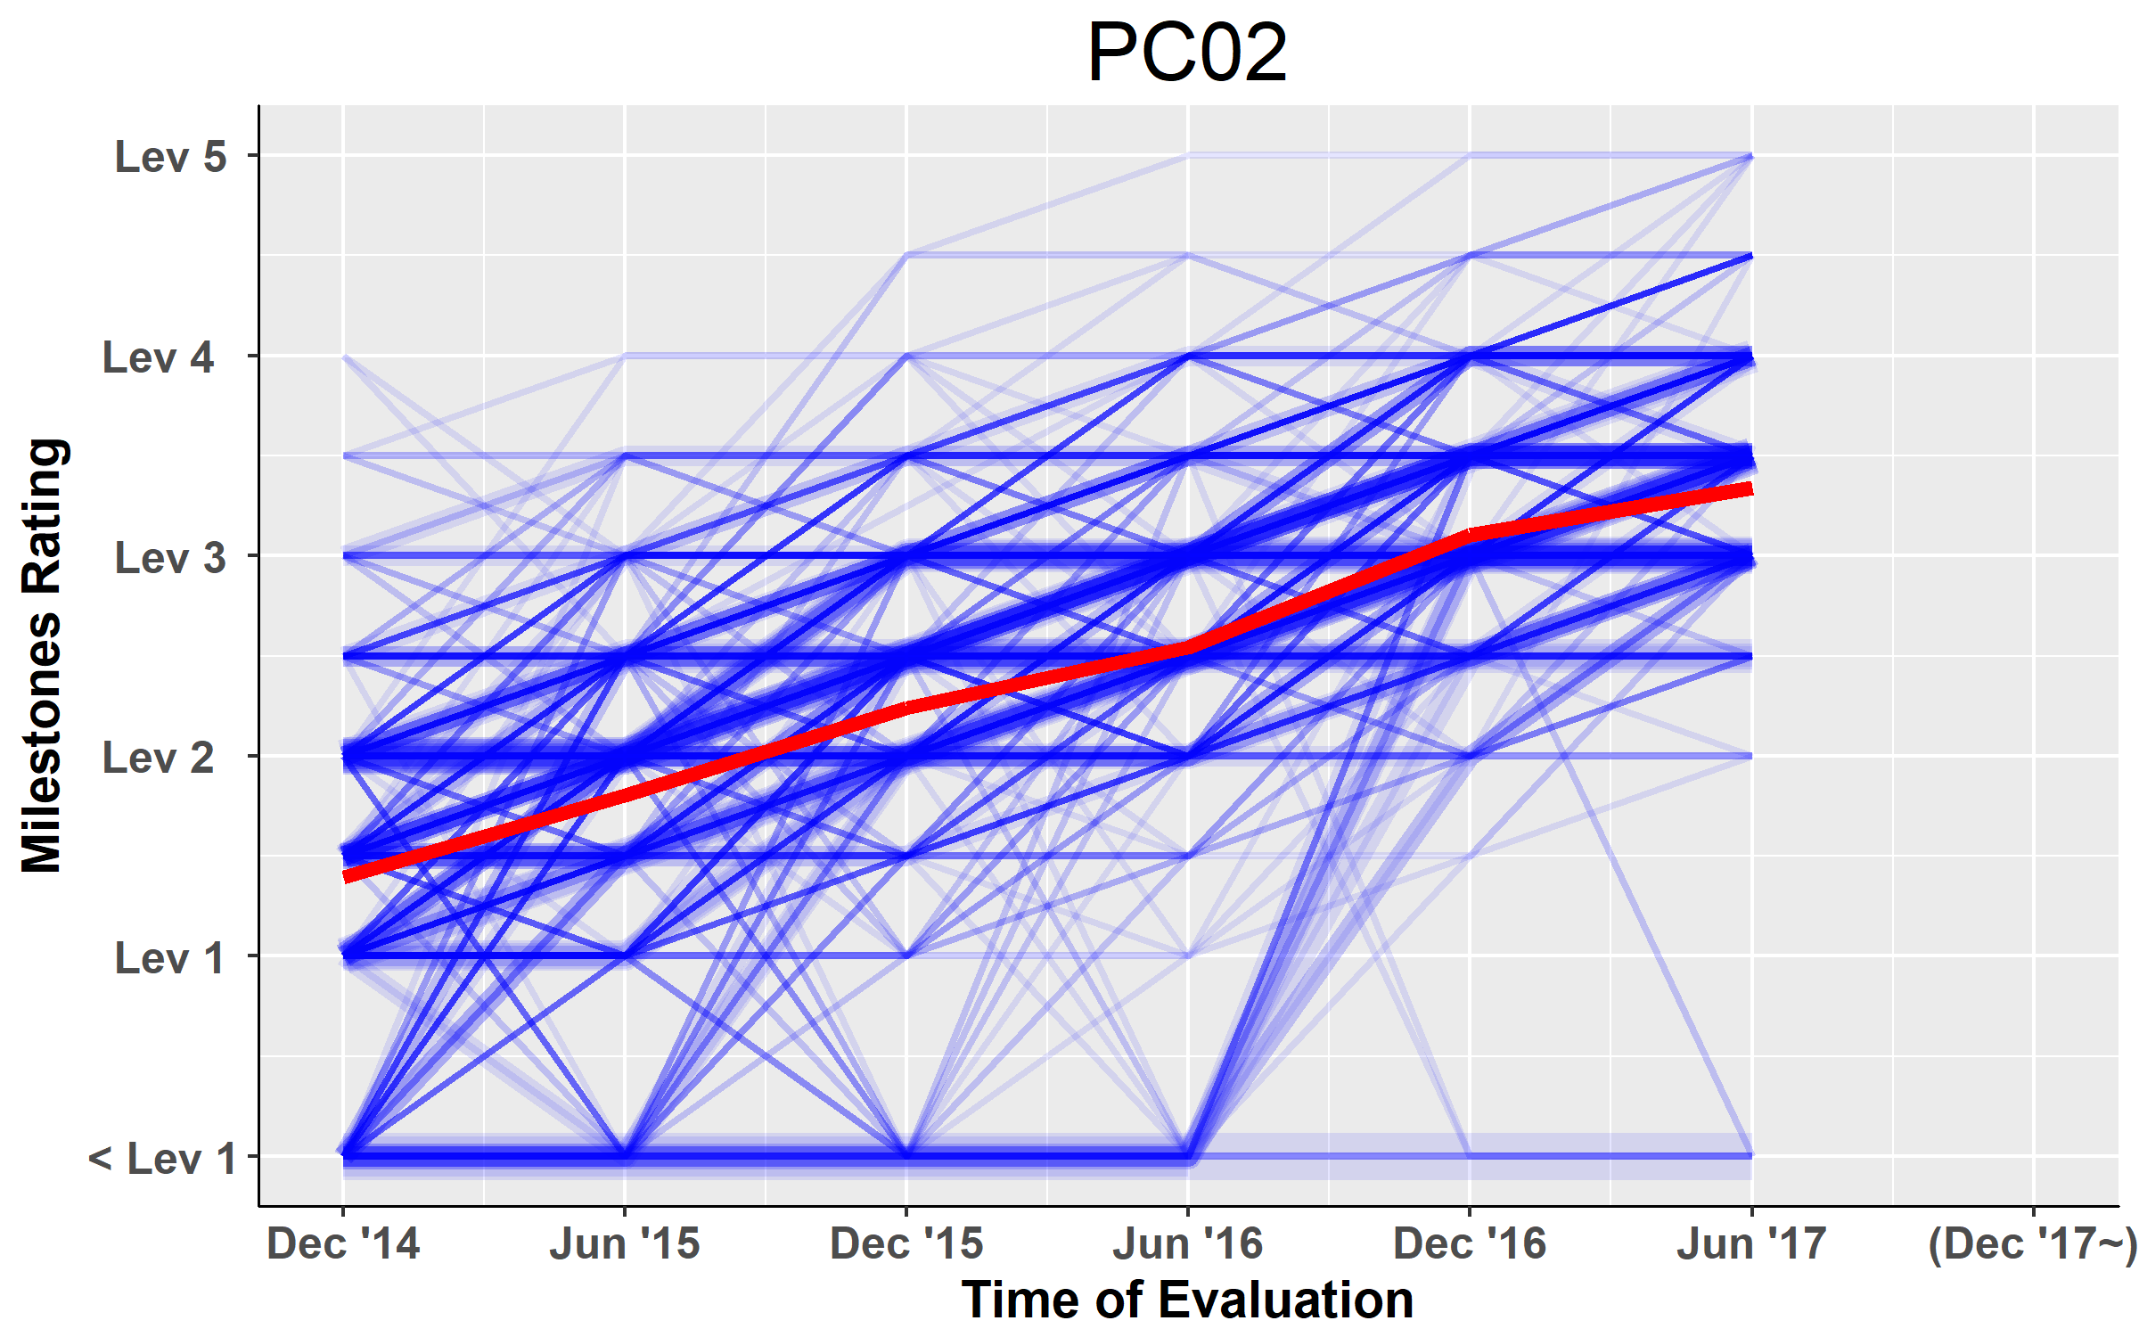
Resident-Level Trajectories of Milestones Ratings - Pathology
Notes:
Done

Slide 35
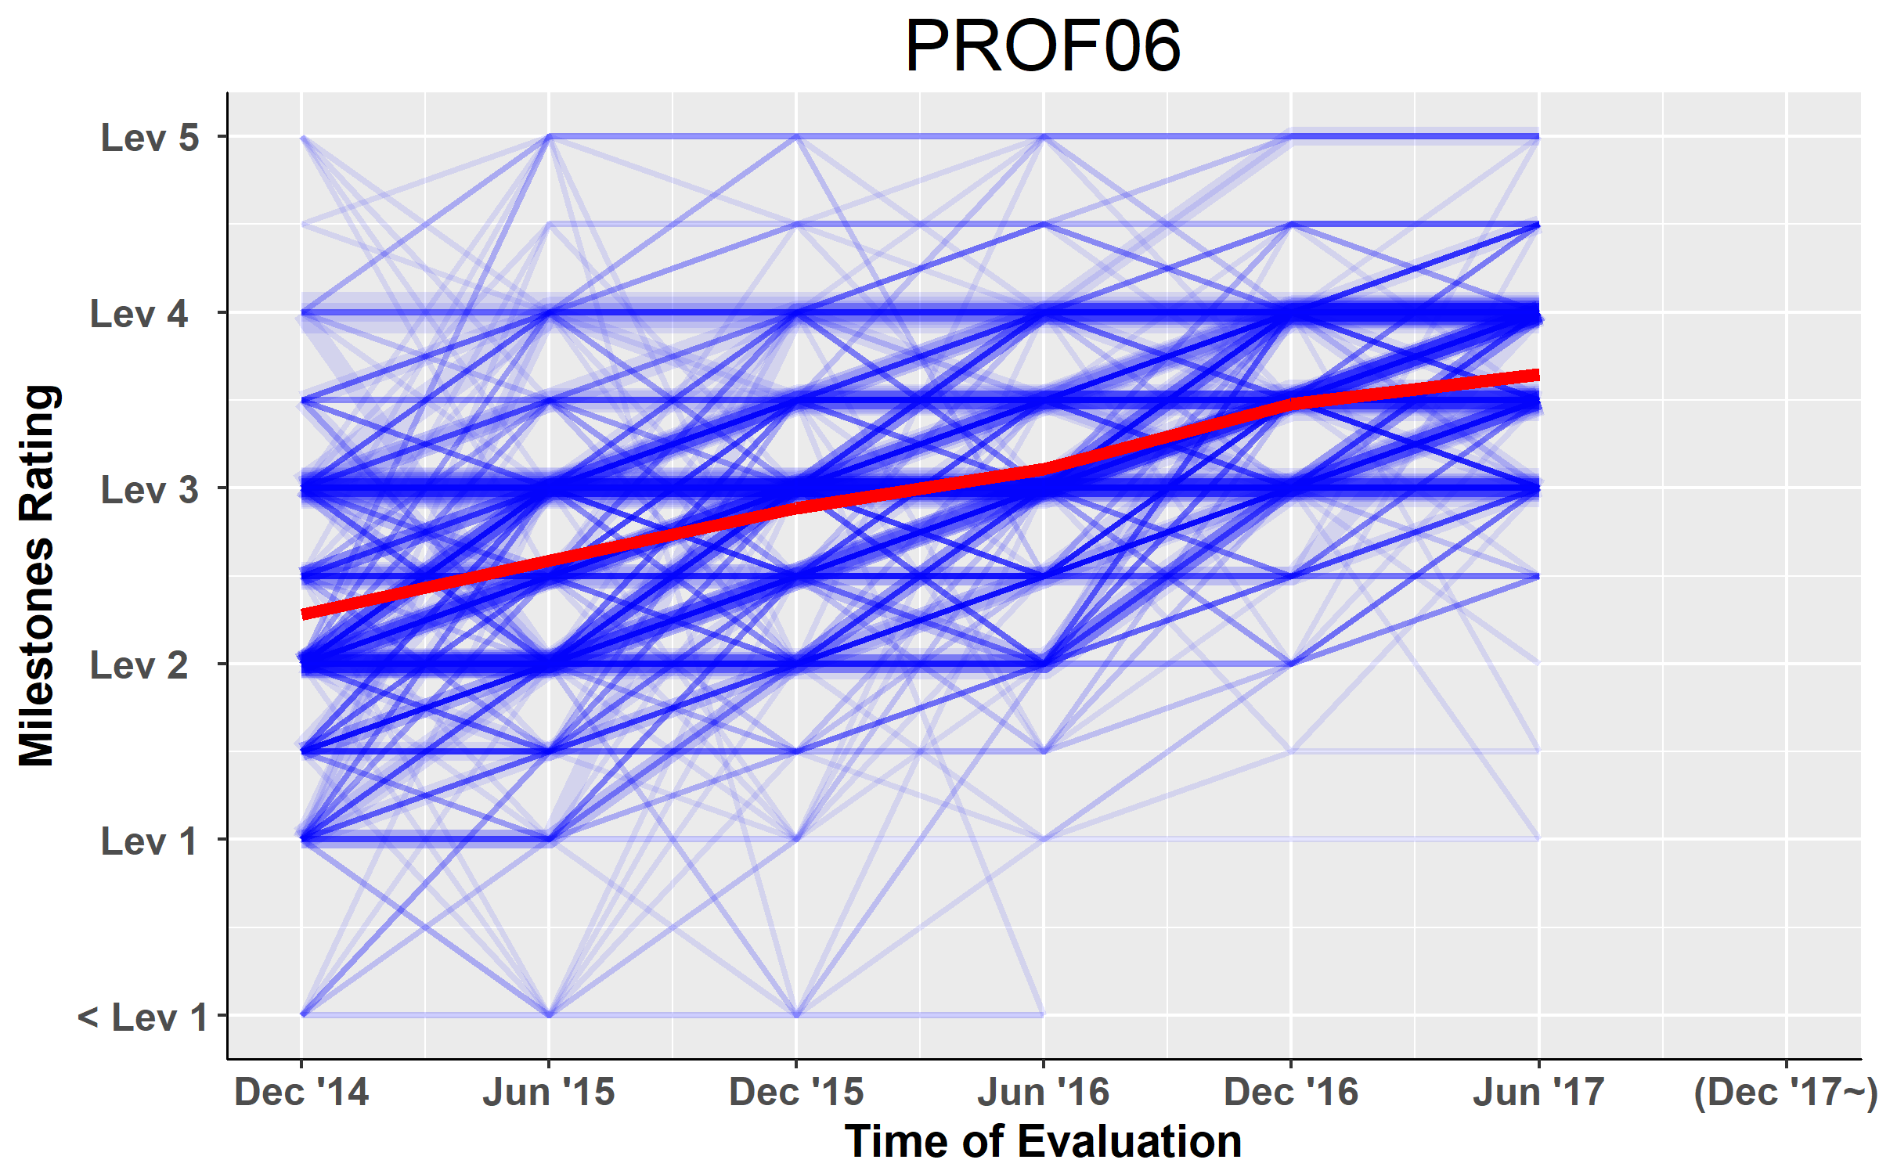
Resident-Level Trajectories of Milestones Ratings - Pathology
Notes:
Done

Slide 36
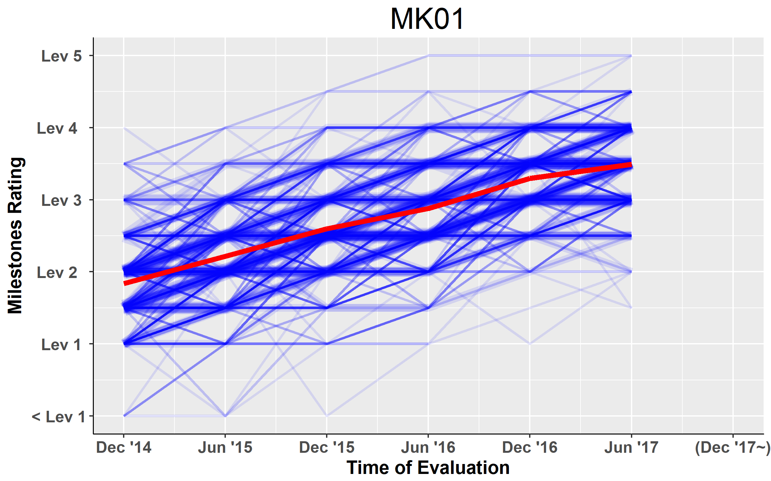
Resident-Level Trajectories of Milestones Ratings - Pathology
Notes:
Done

Slide 37
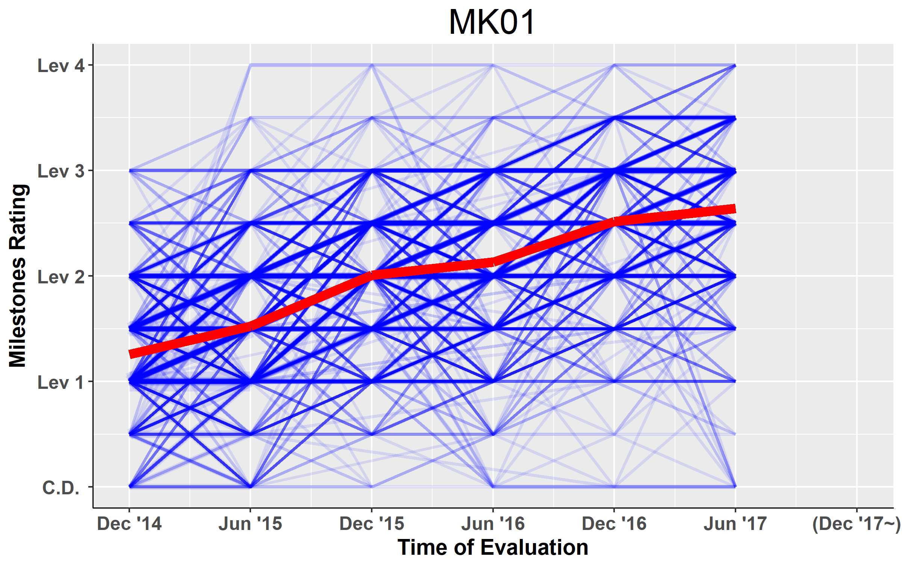
Resident-Level Trajectories of Milestones Ratings – Surgery
Notes:
Done

Slide 38
Interpretation:
The observed variation in attainment of competencies may reflect:
  Residents’ underlying ability
  Variation in exposure to certain sub-competencies
  Incomplete specification of underlying construct
    content validity
  Variation in scoring by raters
    training/orientation (shared mental model)
    engagement/buy-in
  Curriculum factors/resources
  Other unwanted sources of error
    i.e. “construct-irrelevant variance”

Slide 39
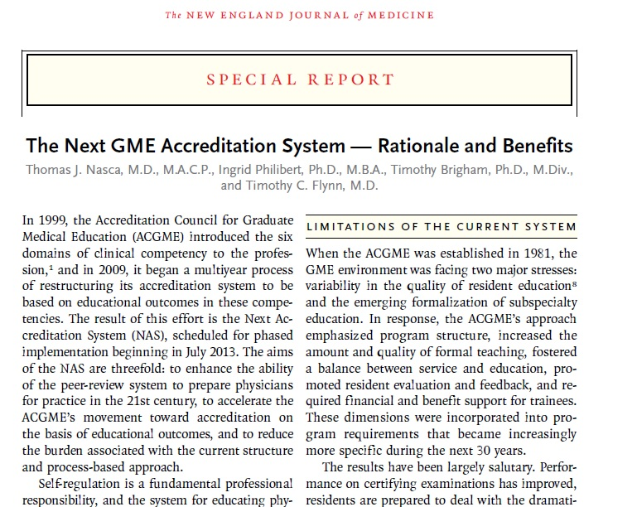
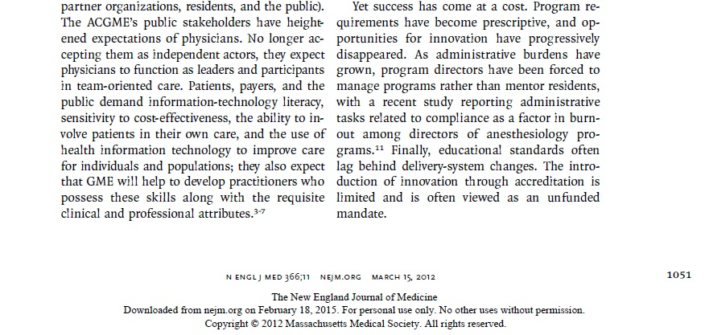
N Engl J Med, 366:1051-6;2012.

Slide 40
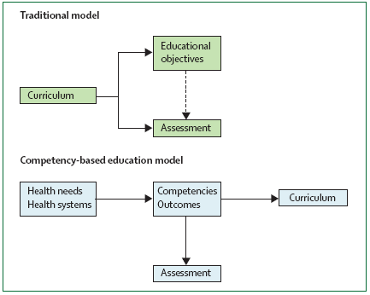
The Role of Assessment in CBME
40
Frenk J. Health professionals for a new century: transforming education to strengthen health systems in an interdependent world. Lancet. 2010

Slide 41
Vision: Public Trust
Boards
ACGME
RRC’s
Milestones
CLER
Individual Certification

Slide 42
Vision: Public Trust
ACGME
Program Accreditation via RRC’s
ACGME
Program Improvement via Milestones
Boards
Individual Certification

Slide 43
“Entrustability”
Can we develop a system to ensure residents and fellows are ready for unsupervised practice by graduation?
Notes:
Has anybody here ever been to a specialist? How do you know they were good? Why do you trust them? ACGME is the machine behind that seal of approval...

Slide 44
Major Dimensions of Competence
Medical Knowledge
Patient Care
Communication
Professionalism
Systems-Based Practice
Practice-Based Learning and Improvement

Slide 45
Major Dimensions of Competence
Medical Knowledge
Patient Care
Communication
Professionalism
Systems-Based Practice
Practice-Based Learning and Improvement

Slide 46
Benefit to the Program Director
  Changes in the remediation process
    Catching struggling residents earlier
    Targeted improvements for individual learners
    Identifying gaps in otherwise high performers
  Structuring of learning goals
  Making defensible decisions
    Milestones provide “built-in” documentation
Conforti et al. The effect and use of Milestones in the assessment of neurological
surgery residents and residency programs. J Surg Educ. 2017; Jun 21 [Epub
ahead of print].

Slide 47
A Validity Framework

Slide 48
“Validity” as Defensibility
Validity consists of a defensible argument based on evidence from several sources
      Messick S. Validity of psychological assessment. Am Psych. 1995; 50:741–749.
      Kane MT. Validation. In: Brennan RL, ed. Educational Measurement. 4th ed. Westport, Conn: Praeger; 2006:17–64.

Slide 49

Primary “Construct” of Interest
    Resident’s Underlying Ability
  At any point in time, every resident has a “true score” of Milestone achievement in each competency that represents their underlying ability. This is the target construct which the Milestones data is designed to represent.
Notes:
Key Point: There is a (1) Construct of Interest and (2) Construct-Irrelevant Variance.
The rest of this talk is about a Method for tapping into this Construct of Interest. Relates to the larger vision of Public Trust and Defensibility.

Slide 50
Milestones in Formal Terms:
M = t + σ_{CI} + ε
where:
    M -represents the resident’s Milestones achievement score as reported to the ACGME by the Clinical Competency Committee (CCC),
    t -represents the resident’s “true” ability,
    σ_{CI} -represents measurable variance due to factors irrelevant to the primary construct of interest, and
    ε -represents any additional residual variance otherwise unaccounted for

Slide 51
Our job…
is to specify and reduce Construct-Irrelevant Variance (σ_{CI})
Construct-Irrelevant Variance
True Score
Time
Milestones CQI process

Slide 52


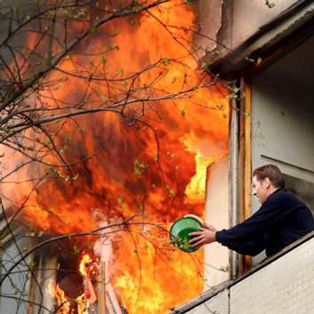
Don’t Get Overwhelmed

Slide 53


Slide 54

The CBME “System”
Residents
Institution and Program
Unit of Analysis:
Program
Assessments within Program:
Direct observations
Audit and performance data
Multi-source FB
Simulation
ITExam
Accreditation
Judgment and Synthesis:
Committee
Certification and Credentialing
Faculty, PDs and others
This is a
Human Process
Unit of Analysis:
Individual
Milestones as Guiding Framework and Blueprint

