Slide 1


Neurosurgical Workforce- is there a Shortage of Neurosurgeons in the USA?
William T. Couldwell, MD, PhD
Department of Neurosurgery
University of Utah
SNS Boston, June 10, 2013

Slide 2

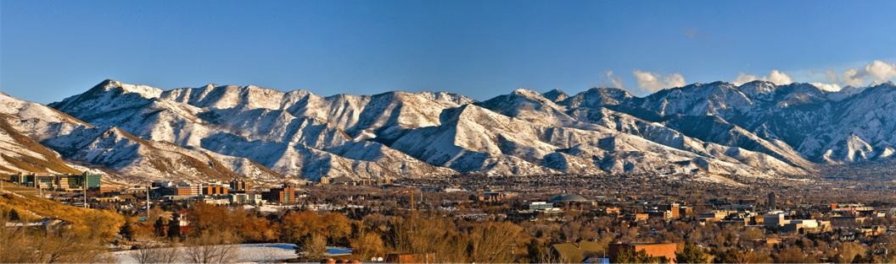
University of Utah Hospitals and Clinics:

Slide 3
Where are we?
Present status of workforce

Slide 4
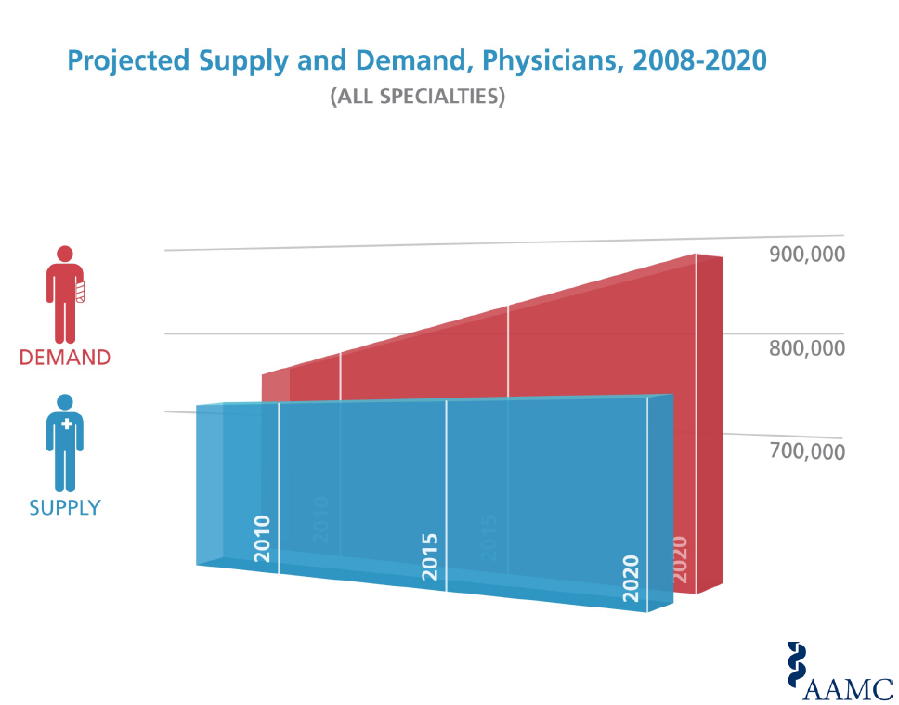
General Physician Shortages
Courtesy of Atul Grover, MD, PhD
Chief Public Policy Officer

Slide 5
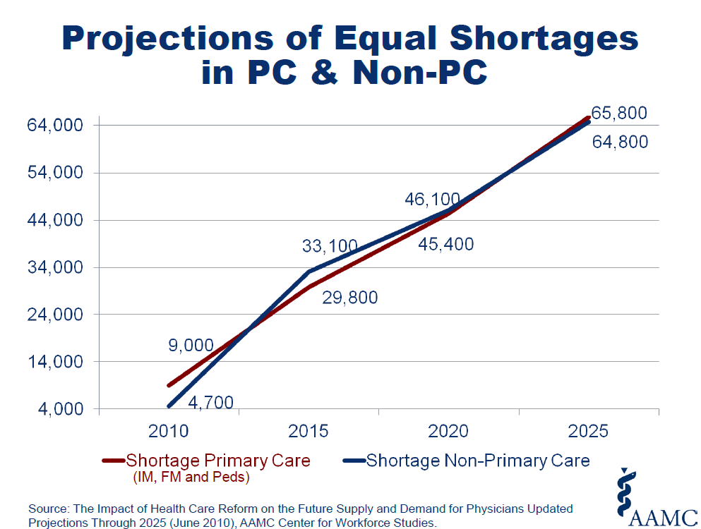

Slide 6
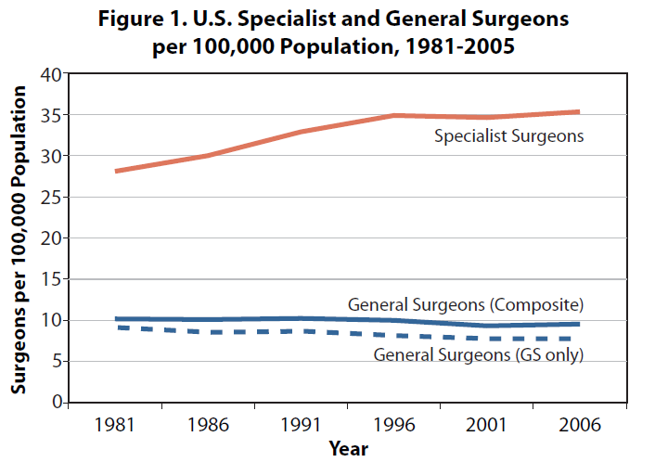
Specialist Surgeon Numbers Remain Relatively Static In Recent Years
From the American College of Surgeons Health Policy Research Institute, Longitudinal Trends in US Surgical Workforce, Issue 1; May 2009

Slide 7
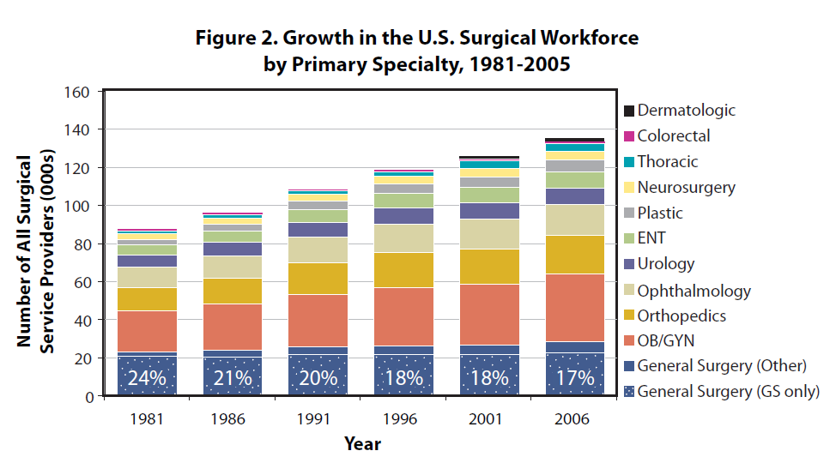
Neurosurgery Numbers Overall Show Slower Growth than Some Surgical Subspecialties
From the American College of Surgeons Health Policy Research Institute, Longitudinal Trends in US Surgical Workforce, Issue 1; May 2009

Slide 8
Practicing ABNS Certified Neurosurgeons
In January 2012, there were approximately 3,689 practicing board certified neurosurgeons for over 5,700 hospitals in the U.S.

Slide 9
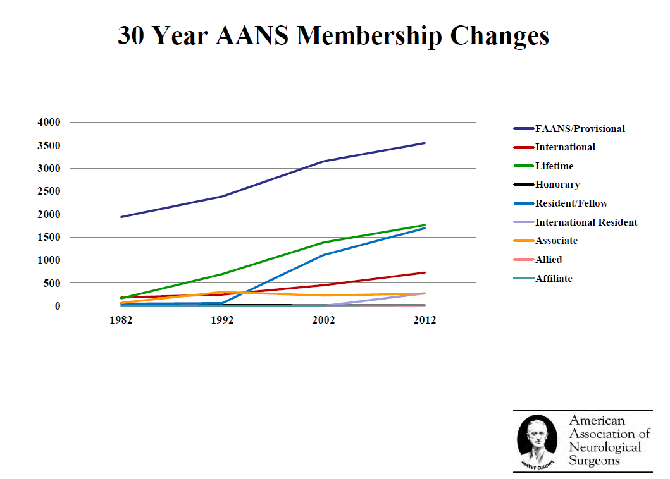

Slide 10
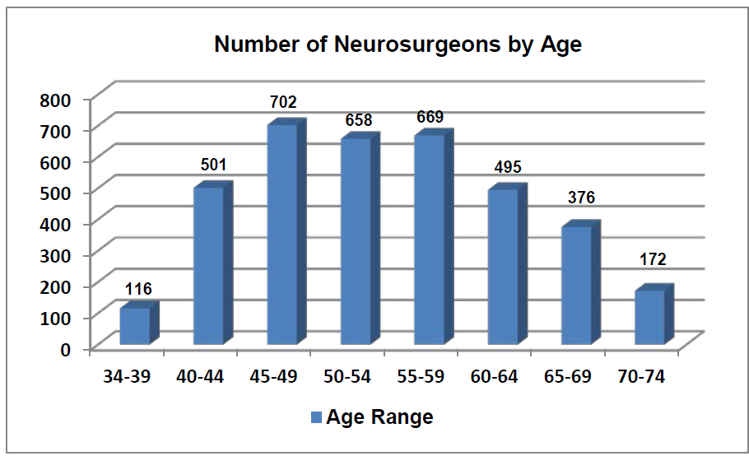
Nearly one-half of neurosurgeons over the age of 54

Slide 11
Challenge of Workforce Planning
Knowns
  Increased insurance coverage
  Growing population
  Aging population with higher per capita needs
  Expected decline in physicians per capita
  Medical advances increasing utilization over course of lifespan
Demand vs. utilization vs. need & current supply?
Assumptions about current vs. future system?

Slide 12
How do we define Shortage in Neurosurgery?
Both market-based and medical need question
Defined by:
  Demand for patient services (wait times, surgical volumes, call coverage)
  Market demand (recruitment by hospitals and groups)
  Manpower goal had been defined by “optimum” number of Neurosurgeons per capita- 1/100,000 (SOSSUS)

Slide 13
SOSSUS Report
Study on Surgical Services for the United States (SOSSUS) report completed in 1977
SOSSUS Study proposed to slow the growth of the neurosurgical workforce to produce a 20% reduction by the year 2000 based on three data points:
  study assumed that the U.S. population would grow to 250 million by 2000 (actually grew to 300 million).
  while acknowledging shortages in small, specific areas, it found no evidence pointing to generally poor care. The authors used the absence of a negative (shortages) to conclude the positive (oversupply)
  they used the ratio of neurosurgeons to population in other parts of the world as a basis of comparison, noting that the ratio was higher in the U.S. This ignored the fact that the practice of neurosurgery is far different in the U.S. than in other countries, especially with regards to spine
  In spite of the soft foundation and conclusions of the SOSSUS ratio, it has remained the standard against which community need in neurosurgery is assessed.

Slide 14
What is the current ratio?
In the 40 years since the SOSSUS report, has always been higher than 1/100,000
The AAMC* estimates the current ratio to be 1 per 61,293
Popp**, using FTE calculations, estimated the ratio to be 1 per 55,000 population.
Despite studies indicating that the average neurosurgeon-to-population ratio is higher than the SOSSUS-proposed ratio of 1:100,000 people, ample evidence exists to suggest that demand for neurosurgeons is far greater than supply.
* Association of American Medical Colleges, Center for Workforce Studies. (November, 2008). 2008 physician specialty data.
(www.aamc.org/meded/cfws/rcntwrkfce.pdf). Accessed January 7, 2012
**Popp, A.J. (Spring, 2000). Neurosurgical workforce: Examining the physician supply controversy. AANS Bulletin, 7-9.

Slide 15
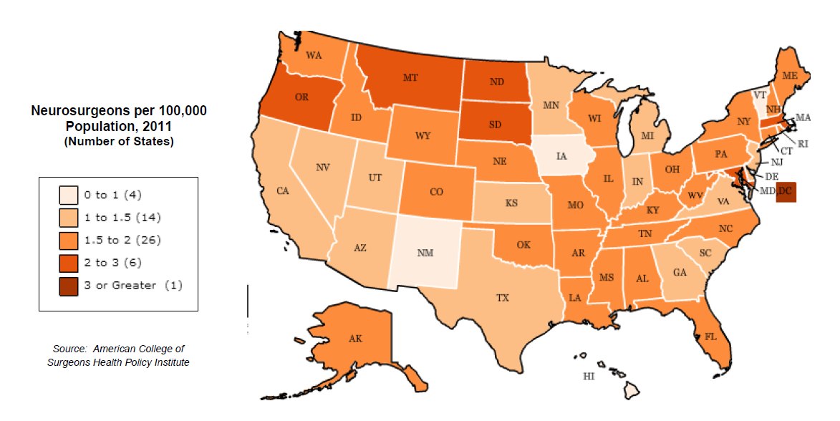
Source: American College of Surgeons Health Policy Research Institute

Slide 16
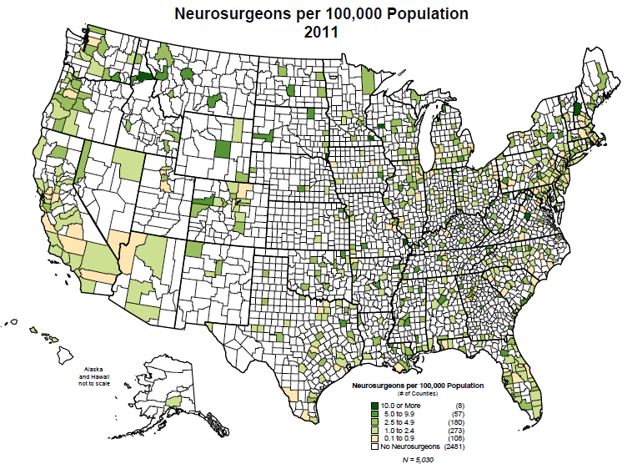
Source: American College of Surgeons Health Policy Research Institute

Slide 17
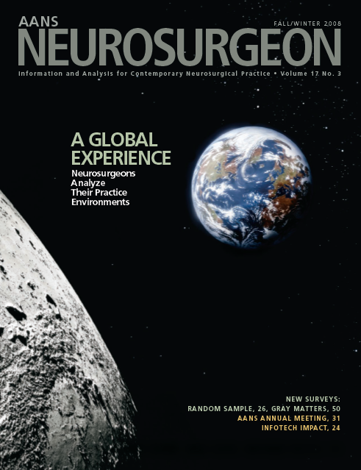
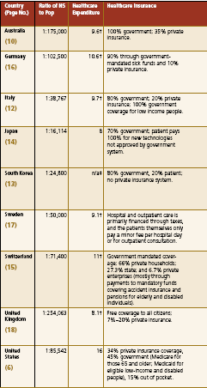
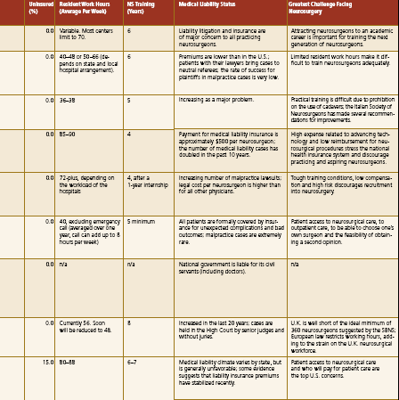

Slide 18
Market Demand for Neurosurgeons
“recruitment shortage” or “market shortage” does not necessarily indicate a shortage of neurosurgeons to satisfy patient demand for neurosurgical care:
  possibility of misallocation or inefficient use of neurosurgical resources in communities
  May result from differing priorities between hospitals and other hospitals, or between hospitals and the neurosurgeons who admit to them
However, reviewing the demand data is certainly a good start in finding evidence of a “shortage” or need

Slide 19
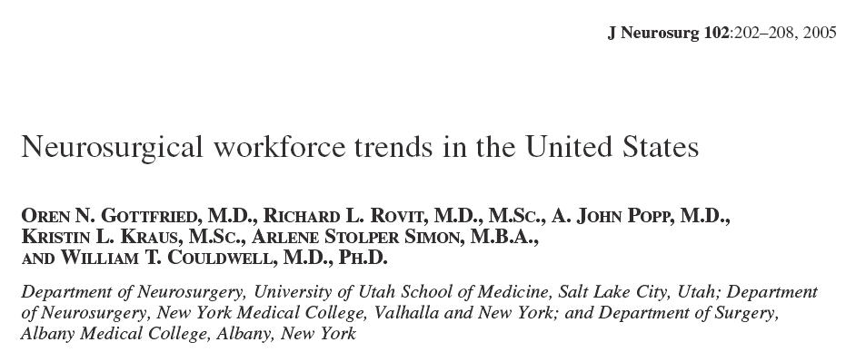
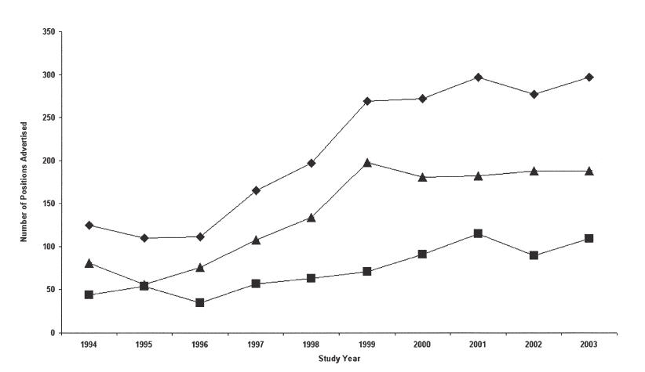
Advertisements as surrogate for “Market Demand”

Slide 20
What is the Demand?

Slide 21
Data Collection Sources
US Census Data
A survey assessing practice characteristics (e.g., neurosurgical subspecialty), workload (e.g., perceived workload, RVU’s, number of emergency rooms covered), and patient demand (e.g., wait time) was emailed to 3450 practicing U.S. neurosurgeons in the Fall/Winter of 2010-2011.
  obtained 462 partial and 362 complete surveys.
  sample appeared to include a good representation of geographic area, type of practice and subspecialty
Rosman Search Database
Web and Journal Advertisements

Slide 22
Survey of Practicing Neurosurgeons
Survey with the goal of determining a scientific metric for the “correct” number of neurosurgeons to population ratio. We combined the survey results with 2009 census data to address the following questions:
  What is the “ideal” number of neurosurgeons and is there currently an oversupply or undersupply?
  Does the demand for recruitment of neurosurgeons exceed the supply of available candidates for work?
  Do patients have sufficient and timely access to emergency and elective neurosurgical care in all areas of the United States?
  Does the market demand reflect true patient demand for neurosurgical services, or, or is at least a portion of the demand related to hospital-sponsored recruitment of neurosurgeons in communities where competition for elective cases is already present?
  Is patient demand for neurosurgical procedures likely to increase due to the increasing average age of the population?

Slide 23
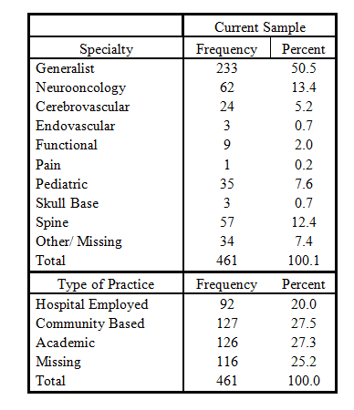
Specialties and practice types as reported by survey respondents

Slide 24
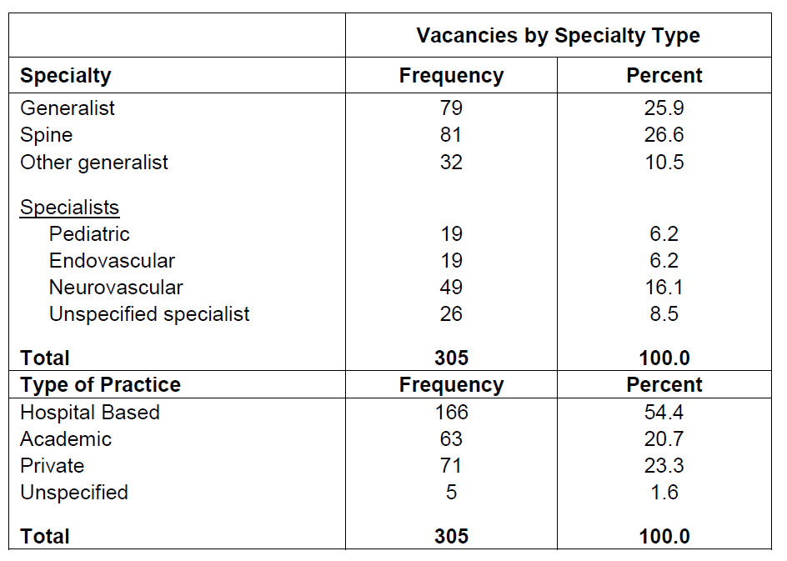
Job vacancies by specialty based on the advertisements in print journals and on the internet

Slide 25
Practice Type

Slide 26
Perceived Workload

Slide 27
Ratio of Neurosurgeons per population
Using the roster of practicing U.S. neurosurgeons and the most recent Census Bureau population estimates (2009)
  the current national ratio of neurosurgeons to population is computed to be 1:65,580
  Ratio varies dramatically by state; from a high in South Dakota (1:37,605) to a low in Puerto Rico (1:233,370). Similarly, in the 242 catchment areas, ratios varied from 1:14,588 (a portion of New Hampshire) to 1:728,014 (a portion of Puerto Rico).

Slide 28
Conclusions from Study
Study invalidates the current widespread use of the 1:100,000 ratio reflected in the SOSSUS report
The current study found the nationwide ratio of neurosurgeons to population to be 65,580
There are varying ratios that exist in various locales across the U.S.
24% of advertising practices indicated that they are recruiting only for emergency room coverage, and an additional 26% indicated that they might not be recruiting if not for the need for emergency coverage
Attempts to evaluate the relationships between estimates of neurosurgical workload, patient demand, type of practice, and vacancies on a regional basis did not provide a uniform basis for determining any ideal ratio

Slide 29
Personal Conclusions
Workforce demand is dependent upon how we measure the scope of a neurosurgical practice. We could definitely employ more neurosurgeons from analysis of market demand
Neurosurgeons per capita ratio is multifactorial; dependent upon geographical location (including COL), payer mix and legal considerations
“Fungible” subspecialties have developed due to limited bandwith in neurosurgery and competition from other specialties:
  Neurocritical Care, including Trauma
  Stroke and Endovascular
  Peripheral nerve
  Spine
  Pain

Slide 30
Implications of the Supply-Demand Mismatch in Fungible Subspecialties
?Ceding of potential neurosurgical practice opportunities to other specialties with capacity
  Endovascular (Neuroradiology and Neurology, Cardiology)
  Critical Care (Neurology)
  Pain (Anesthesia)
  Peripheral nerve (Plastics, Orthopedics)
  Spine (Orthopedics)

Slide 31

Blue Ocean Strategy
Blue Ocean vs. Red Ocean (2005)
Describe the Market Universe
  Red Ocean- markets that exist today
  Blue Ocean- unknown markets

Slide 32
1980, Montreal
Guy Laliberté toured Europe as a folk musician after quitting college. By the time he returned home to Canada in 1979, he had learned the art of fire breathing
In Montreal, located in the inner-city area of Saint-Michel, with his friend Gilles Ste-Croix, they started a performing troupe Les Échassiers, using talent from a youth hostel for performing artists named Le Balcon Vert. It was a financial failure.
Originally intended to only be a one-year project, Cirque du Soleil (Circus of the Sun) was scheduled to perform in 11 towns in Quebec over the course of 13 weeks running concurrent with the third La Fête Foraine. It performed at the Old Port of Montreal.

Slide 33



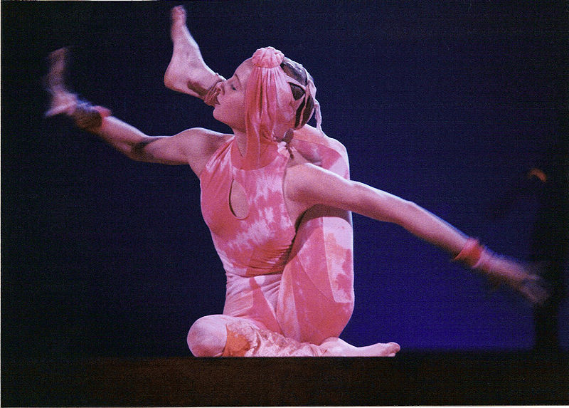
2010:
Worldwide
>5000 employees
1 Billion revenue
Creation of a new market
- Fusion of street performance, acrobatics, illusionists

Slide 34
Considerations for the Future
Neurosurgical Blue Ocean
  “Neurocritical Care” Units
  Functional Procedures (Movement Disorders, Mood Disorders, Obesity)
  Pain Procedures
  Nerve Transfers
  HIFU

Slide 35
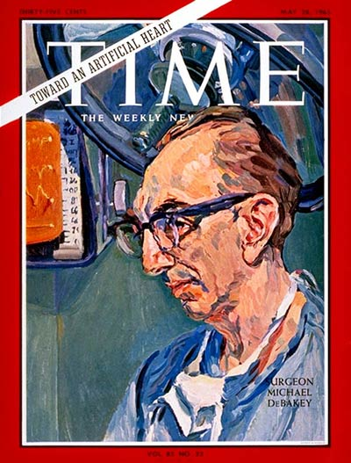
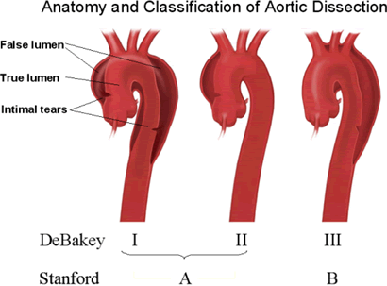

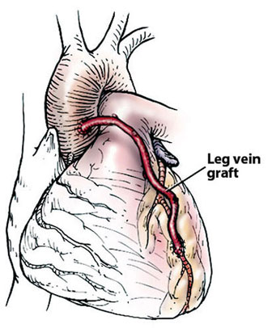
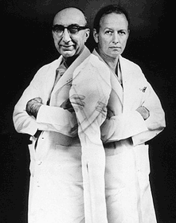

Slide 36
Future Considerations
An aging population that will double by 2030. Due to disease prevalence and comorbidity, the elderly use 130% more services and require more expensive interventions
An aging workforce with increased rates of retirement. One-third of the overall healthcare workforce is over 55 years; higher in neurosurgery
General population growth at higher than expected rates (approximately 25 million per decade)
Recent healthcare reform that may infuse 30-40 million new patients into the healthcare system
Changes in work culture reducing hours worked and work preferences

Slide 37
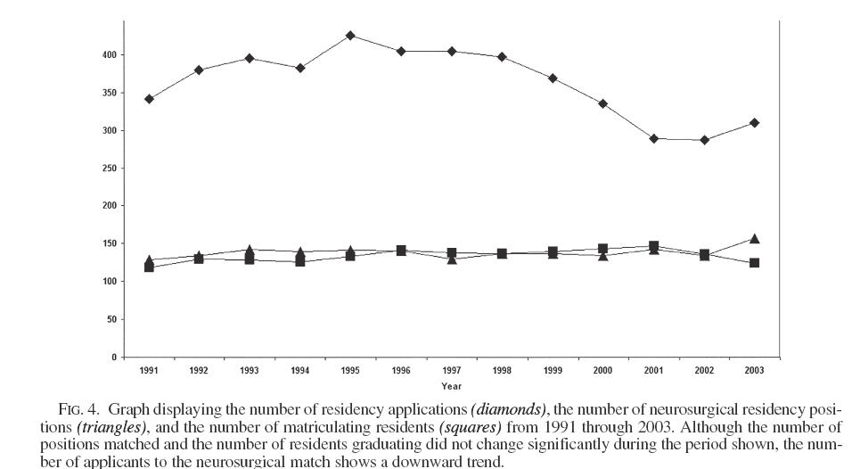
Static for almost 15 years
-Slow Growth
-Pipeline Effect (time to increase output)

Slide 38
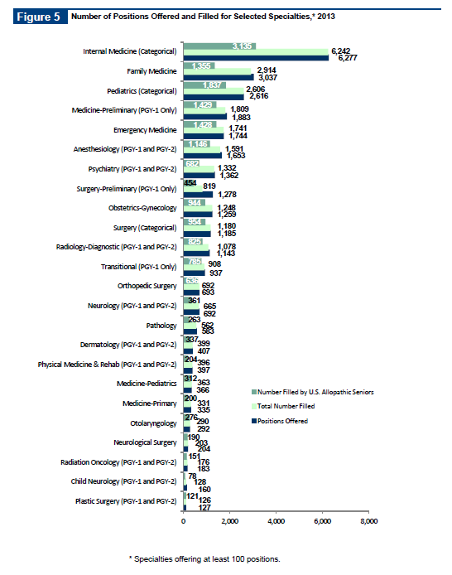
NRMP, 2013

Slide 39
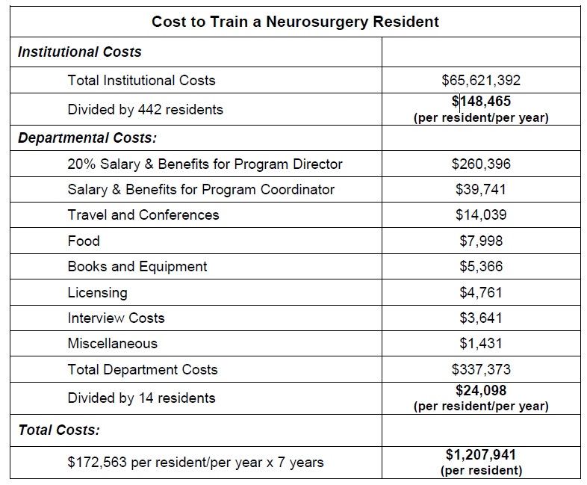
*academic medical center in the northeastern region of the U.S. Courtesy Ralph Dacey and Katie Orrico

Slide 40


Thank You!

