Slide 1
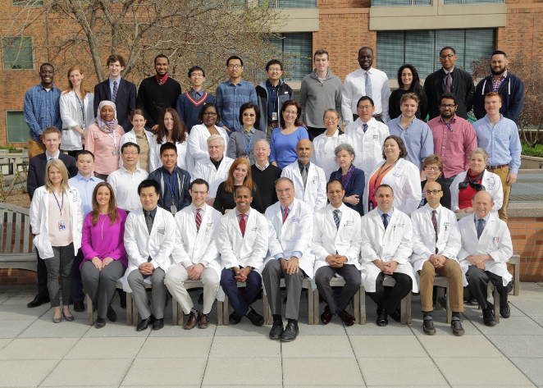
NIH Intramural Residency & Fellowship Training
John D. Heiss, M.D., SNB Chair

Slide 2
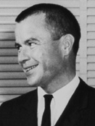
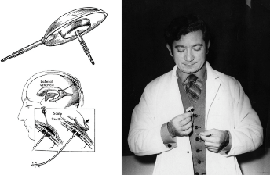
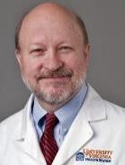
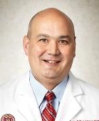
NEUROSURGICAL CARE, TRAINING, & RESEARCH, : Historical focus on functional, oncologic, & pituitary neurosurgery
1953-1970 Maitlyn Baldwin, M.D.: Pathophys. & surgical rx of epilepsy
1970-1974 John van Buren, M.D., PhD.: Thalamic atlas; epilepsy
1974-1979 Ayub Ommaya: Spinal angiography; Ommaya reservoir
1979-1986 Paul Kornblith, M.D.: Glioma immuno- & chemotherapy
1986-2007 Edward H. Oldfield, M.D.: Cushing’s disease rx., Convection- enhanced drug delivery for brain tumor rx., VHL-related tumors
2007-2012 Russell Lonser, M.D.: Convection-enhanced drug delivery; congenital CNS tumor syndromes (VHL; NF2)
Baldwin
Ommaya & his reservoir
Oldfield
Lonser
Photos from Mehta G, et al. World Neurosurg (2010) 74, 1:49-59

Slide 3
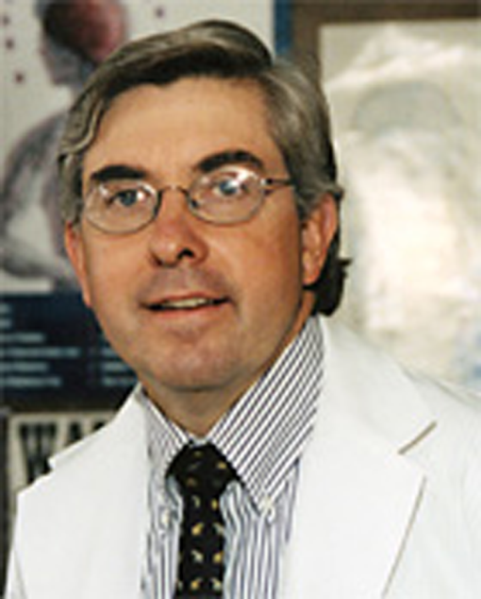
NINDS—Neurosurgery Research & Training
The Director manages the Intramural and Extramural Program
Extramural Program awards grants to applicants from around the U.S.—90% of Funding
Intramural Program includes scientists and clinical investigators on the NIH campus in Bethesda, Maryland—10% of Funding
NINDS leadership observed that only a relatively small group of neurosurgeons in the U.S. were successfully competing for NIH grants
Walter Koroshetz, M.D.
NINDS Director
http://www.ninds.nih.gov/

Slide 4
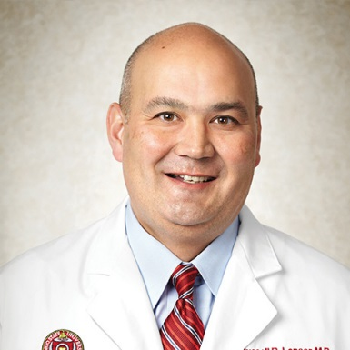
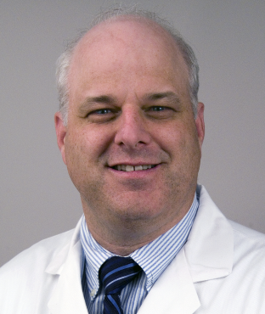
NIH/UVA Neurosurgery Residency Collaboration
Objective to train clinical and academic leaders in neurosurgery
Perform world-class neuroscience research
Develop skills as independent researchers
Able to successfully compete for research funding
Expand neurosurgery training to benefit the NIH and UVA
Partner site (UVA) supports areas in Common Program Requirements not present at the NIH Clinical Center
Trauma, Neurovascular surgery, Pediatrics, Neuro ICU, some ancillary residencies
Provides clinical and academic foundation for research interests

Slide 5
The Next GME Accreditation System — Rationale and Benefits
Thomas J. Nasca, M.D., M.A.C.P., Ingrid Philibert, Ph.D., M.B.A., Timothy Brigham, Ph.D., M.Div., and Timothy C. Flynn, M.D.
NEJM 366;11:1051-6, 2012
When the ACGME was established in 1981, the GME environment was facing two major stresses: variability in the quality of resident education⁸ and the emerging formalization of subspecialty education. In response, the ACGME’s approach emphasized program structure, increased the amount and quality of formal teaching, fostered a balance between service and education, promoted resident evaluation and feedback, and required financial and benefit support for trainees. These dimensions were incorporated into program requirements that became increasingly more specific during the next 30 years.
The results have been largely salutary. Performance on certifying examinations has improved, residents are prepared to deal with the dramatically increasing volume and complexity of information in their specialty, and graduates and academic institutions have contributed to clinical advances and innovation that the public enjoys today.^{9,10} In addition, the role of the program director has been established as an educational career path, and the formal teaching and assessment of residents and fellows have improved substantially.
Yet success has come at a cost. Program requirements have become prescriptive, and op- portunities for innovation have progressively disappeared. As administrative burdens have grown, program directors have been forced to manage programs rather than mentor residents, with a recent study reporting administrative tasks related to compliance as a factor in burn-out among directors of anesthesiology programs.¹¹ Finally, educational standards often lag behind delivery-system changes. The introduction of innovation through accreditation is limited and is often viewed as an unfunded mandate.

Slide 6
NIH Neurosurgery Residency/Fellowship Mission
Develop neurosurgeon-scientists with research grants & academic productivity
Recruitment
Enroll senior medical students/residents committed to a career combining neurosurgery and research
Training
Faculty committed to clinical training and research
Clinical skills; progressive development of autonomy
Research
NIH and UVA Mentors
Financial and manpower resources
Research committee presentation & evaluation every 6 months
Neurosurgeon-scientist development
Courses: RUNN, 1 yr. Clinical Research, & Grant Writing
National scientific and neurosurgical meetings
Publications
Planning and Preparation to Establish an Academic Career Post-Residency
Fellowship in chosen subspecialty
First academic position and grant

Slide 7
Innovation to Produce Neurosurgeon-Scientists
Recruitment
Early Research Productivity
Research
Training
Avoid
Attrition
Research
Productivity
Research
Commitment
Resident with high interest in research.
Adequate NINDS funding
NIH RO1:
“Physician-Scientist”
(50% Research;
50% Clinical)
Sustained NIH Funding: Career
Neurosurgeon-Scientist
++
++
++
++
+
++
Neurosurgery residency applicant
Resident with some interest in research. No NINDS funding.
+
+
Non-NINDS Funded Neurosurgeon (40% Research;
90% Clinical)
+
++
Key:
Productivity
++ Great
+ Some
+/- Little
None
+/-
-
-
Resident in privademic residency
+/-
Unfunded Neurosurgeon
(<10%Research Time
>90% Clinical Time)
+/-
Notes:
The ideal outcome of the NIH/UVA Residency Training Program is to produce neurosurgeons that are competent in neurosurgery, have research skills necessary to obtain NIH RO1 Grants, and have the motivation to become Career Neurosurgeon-Scientists.

Slide 8
Year | July to December | January to June
PGY-1 | General Neurosurgery and Neurotrauma— Univ. of Virginia | Pediatric Surgery – Univ. of Virginia (1 month) Trauma Surgery – Univ. of Virginia (1 month) Neuro-Ophthalmology – Univ. of Virginia (1 mo.) Neurology– Univ. of Virginia (3 mos.)
PGY-2 | Spine Rotation – Univ. of Virginia (4 mos.) Vascular Rotation – Univ. of Virginia (2 mos.) | Stereotactic/Functional Surgery – Univ. of Virginia (2 mos.) Pediatric Neurosurgery and Pituitary – Univ. of Virginia (2 mos.) Neuro-Oncology – Univ. of Virginia (2 mos.)
PGY-3 | Pediatric Neurosurgery– Univ. of Virginia (2 mos.) Spine Rotation – Univ. of Virginia (2 mos.) Vascular Rotation – Univ. of Virginia (2 mos.) | Research Rotation (80% Research time; 20% Clinical) National Institutes of Health
PGY-4 | Research Rotation (80% Research time; 20% Clinical), National Institutes of Health | Research Rotation (80% Research time; 20% Clinical), National Institutes of Health
PGY-5 | Research Rotation (80% Research time; 20% Clinical), National Institutes of Health | Junior Clinical Rotation (10% Research time; 90% Clinical), National Institutes of Health
PGY-6 | Senior Clinical Rotation (10% Research; 90% Clinical), National Institutes of Health | Senior Clinical Rotation (10% Research time; 90% Clinical), National Institutes of Health
PGY-7 | Chief Resident – Univ. of Virginia | Chief Resident – Univ. of Virginia

Slide 9
TRAINING: Neurosurgery Residency/Fellowship
Clinical Faculty
Basic Science Faculty
John D. Heiss, M.D. (1991)
Chair and Residency Training Program Director
Neurosurgery Research Fellowship
Clinical interests: intraoperative MRI, syringomyelia, Chiari I malformation, brain tumors
Research interests: Chiari I malformation, pathophysiology of syringomyelia, CNS drug delivery
Kareem A. Zaghloul, M.D., PhD. (2010)
Tenure Track Investigator
DBS and Epilepsy Fellowships
Chairman, Research Committee
Clinical interests: functional neurosurgery, brain & spinal tumors, epilepsy, deep brain stimulation
Research interests: cortical functional networks, neural mechanisms of cognitive function, brain machine interfaces, human neurophysiology
Prashant Chittiboina, M.D., M.P.H. (2012)
Assistant Clinical Investigator
Pituitary Surgery Fellowship
Clinical interests: pituitary tumors, brain tumors, skull base surgery, spinal tumors Research interests: von Hippel-Lindau disease clinical research; pituitary tumor research
Edjah Nduom, M.D. (2015)
Staff Clinician
Neuro-Oncology Fellowship, MD Anderson
Clinical interest: Surgical neuro-oncology
Research interest: Immunotherapy of primary brain tumors
Richard J. Youle, PhD.
Senior Investigator
Head, Biochemistry Section
Research interests: apoptosis, mitochondria, Parkinson's disease, brain tumors
Marsha J. Merrill, PhD.
Staff Scientist
Research interests: brain tumor biology, von Hippel-Lindau disease-associated hemangioblastoma, VEGF, blood-brain barrier
Zhengping Zhuang, M.D., PhD.
Head, Molecular Pathogenesis Unit (25% NINDS /75% NCI)
Research interests: small molecule inhibitor
treatment for brain tumors, pathogenesis of tumor predisposition syndromes
Residency Faculty--University of Virginia Dept. of Neurosurgery
Mark E. Shaffrey, M.D., Chair W. Jeffery Elias, M.D.
Gregory A. Helm, M.D., PhD. Jason Sheehan, M.D., PhD.
John Jane Jr., M.D. Ashok R. Asthagiri, M.D.
Christopher I. Shaffrey, M.D. Dennis Vollmer, M.D.
Justin Smith, M.D., PhD.

Slide 10
RESEARCH: Clinical Protocols in SNB
Prashant Chittiboina, M.D., M.P.H. (CNS tumor and pituitary neurosurgery)
CRH PET for tumor localization in Cushing’s disease:12-N-0007
Vorinostat (HDAC inhibitor) for VHL: 14-N-0067
NF2 prospective natural history study: 08-N-0044
Kareem Zaghloul, M.D., PhD. (Functional & CNS tumor neurosurgery)
Research study of specimens obtained during epilepsy surgery: 02-N-0014
Epilepsy surgery: 11-N-0051
DBS for movement disorders: 11-N-0211
DARPA multicenter brain recording and stimulation for memory: 15-N-0081
Tumor-related epilepsy: 16-N-0041
John Heiss, M.D. (Clinical Neurosurgery Unit)
VHL prospective study: 00-N-0140
Evaluation & treatment of neurosurgical disorders (training & tissue): 03-N-0164
AAV2-GDNF treatment of Parkinson’s disease (1st in man trial): 12-N-013
Intrathecal resiniferatoxin for cancer pain (1st in man trial): 09-N-0039
Genetic analysis of Chiari I malformation: 00-N-0089
Natural history of syringomyelia: 10-N-0143
Edjah Nduom (Neurosurgical Oncology)
Cytokine microdialysis for real time immune monitoring in glioblastoma patients undergoing checkpoint blockade: T-N-3735

Slide 11
SNB Research and Clinical Facilities

Slide 12
NIH Neurosurgery Residents—Future Neurosurgeon-Scientists
PGY1
Lionel Ampie, M.D.
M.D., Georgetown University
Immunotherapy Research for 2 years at Northwestern University
Jonathan Pomeraniec, M.D., MBA
M.D., University of Virginia; MBA, University of Virginia Darden School
Research for 3 years at Columbia Univ. Laboratory For Pediatric Brain Imaging and Developmental Neuroscience
PGY2
PGY3
Panagiotis (Panos) Mastorakos, M.D., Ph.D.
M.D., University of Athens
Ph.D. research: Univ. of Athens/Johns Hopkins University. Thesis: Brain penetrating CNS nanoparticles for the treatment of CNS diseases
PGY5
Dominic Maggio, M.D., MBA
B.S., Univ. of Miami in Neurobiology; M.B.A. Univ. of Miami
M.D., University of Miami Leonard M. Miller School of Medicine
Spinal cord injury research
Complex Spinal Surgery fellowship at Ohio State post-residency
PGY6
Alexander Ksendzovsky, M.D. (Zaghloul on PhD Thesis Committee)
B.S., Emory University in Neuroscience and Behavioral Biology; Philosophy
NIH Medical Research Training Program (MRSP)
M.D. with distinction in research, Chicago Medical School
Epilepsy Fellowship at Yale post-residency
PGY7
Sze Chun Winson Ho, M.D.
B.A., Cum Laude with Honors in Biology—Yale College
M.D., Yale School of Medicine; Genetics research
Pediatric Neurosurgery Fellowship at Univ. of Utah post-residency
Gautam U. Mehta, M.D.
B.A., University of California, Berkeley
NIH Medical Research Training Program (MRSP)
M.S. Biophysics, Georgetown University; M.D., Georgetown University
Skull Base Fellowship, M.D. Anderson Cancer Center
Graduate

Slide 13
NIH Neurosurgery Residents—TRAINING & DEVELOPMENT of Neurosurgeon-Scientists
Clinical Research
Basic/Translational Research
PGY1
Lionel Ampie, M.D.
Pituitary surgery
PGY2
Jonathan Pomeraniec, M.D., MBA
Intracranial sinus stenting; pituitary surgery
PGY3
Panagiotis (Panos) Mastorakos, M.D., Ph.D.
Endovascular mechanical thrombectomy; Chiari I malformation
Immune response to isolated injury of the cerebral vasculature in TBI and SAH
PGY5
Dominic Maggio, M.D., MBA
Hypoxia signaling in tumors; Protein-phosphatase inhibitors as adjuvants for glioblastoma immunotherapy
Von Hippel-Lindau disease; spinal cord tumor; spinal surgery
PGY6
Alexander Ksendzovsky, M.D.
Epilepsy; Von Hippel-Lindau disease; Chiari I malformation; visual system
Lactate dehydroxylase (LDH) isoforms and epilepsy; neural network connectivity changes in epilepsy
PGY7
Protein-phosphatase inhibitors as radio-and chemosensitizers & glioblastoma immunotherapy adjuvants
Sze Chun Winson Ho, M.D.
Blood-brain barrier in pediatric and metastatic CNS tumors
Graduate
Gautam U. Mehta, M.D.
Pituitary tumors: Carney complex; Cushing’s disease; radiotherapy. Schwannomatosis; VHL; melanoma metastasis immunotherapy
Development of a rodent model of glioblastoma immunotherapy

Slide 14
NIH Neurosurgery In-Residency Fellows
Clinical Research
Basic/Translational Research
John Lynes, M.D.
Georgetown University
Microdialysis of immune mediators in GBM immunotherapy pts
Murine model of GBM immunotherapy
2017-2018
Matthew Shepard, M.D.
University of Virginia
Novel agents to suppress VHL-related hemangioblastoma
CRISR model of VHL-related hemangioblastoma; IDH mutation of astrocytes with CRISPR
2016-2017
Michaela Lee, M.D.
George Washington University
Low-grade glioma and IDH1 downstream molecular effects; protein phosphatase 2A effects on glioma chemosensitivity
2013-2015
Raul Vasquez-Castellanos, M.D.
University of Florida
Mechanisms of hearing loss in NF2
Clonality of NF2-associated vestibular schwannomas; convection-enhanced delivery
2011-2012

Slide 15
TRAINING & DEVELOPMENT of Fellows/Faculty as Neurosurgeon-Scientists
Fellow & Staff Departures since 2007
Senior Staff Fellow—Graduate of Neurosurgical Residency (7 yrs. Post-MD)
1-2 yrs.
Complete Fellowship at NIH or Elsewhere
R. Yong, MD
Mt. Sinai, NYC
Staff Clinician
Perform 150 neurosurgical cases in 18 months to qualify for Oral Board Examination; establish research program; prepare for competitive search for ACI
2-3 yrs.
Germanwala,MD
Loyola Univ.
Edjah Nduom, M.D..
Assistant Clinical Investigator (ACI)
Asthagiri, MD
Univ. of Virginia.
Demonstrate promise for independent research; BSC review; international competitive search for Tenure Track position
3 yrs.
Prashant Chittiboina, M.D., M.P.H.
Park, MD, PhD
Cottage Hospital, UCSB
Tenure Track Investigator
Achieve Board Certification; productive independent PI; BSC confirmation as worthy of permanent position
6-8 yrs.
Kareem Zaghloul, M.D., PhD.
Lonser, MD, OSU
Oldfield, MD UVa
Tenured Principal Investigator

Slide 16
Anticipated Program Outcomes
Metrics to determine residency program success
1. 75% of graduating residents after 2017 will enter academic practice.
2. 85% of residents taking the ABNS written certifying board examination for credit for the first time during the most recent 7 year period must pass.
3. 80% of residents taking the ABNS oral certifying examination for the first time during the most recent 7 year period must pass.
4. 50% of graduates will obtain grant funding.
5. Graduates will present research results in peer-reviewed journals, and national meetings.
6. Graduates will have the ability to establish independent investigator status in their post-residency institution.
Proposed peer group for comparison: Top US research-oriented residency programs in neurological surgery (TBD)

Slide 17
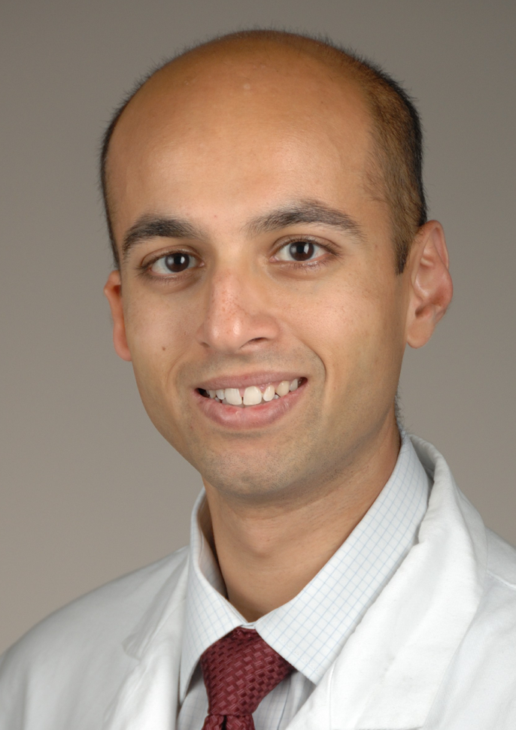
1st Residency Graduate
Gautam U. Mehta
20 First-Author Papers
Mehta GU; Malekzadeh P; Shelton T; White DE; Butman JA; James C. Yang JC; Kammula US; Goff SL; Rosenberg SA; Richard M. Sherry RM. Outcomes of Adoptive Cell Transfer With Tumor-infiltrating Lymphocytes for Metastatic Melanoma Patients With and Without Brain Metastases. Journal of Immunotherapy. 41(5):241–247, JUN 2018

Slide 18
1st Residency Graduate
Gautam U. Mehta
20 First-Author Papers
Sarkiss CA, et al. Academic Productivity of US Neurosurgery Residents as Measured by H-Index: Program Ranking with Correlation to Faculty Productivity. Neurosurgery 2017 Jun 1;80(6):975-984. The average resident published 2.9 first-author papers… The average h-index per resident is 2.47 ± 3.25…. Top-20 productivity and that of other programs (average h-index 4.2 vs 1.7, respectively, P < .001)

Slide 19
2nd Residency Graduate
Winson Ho
H-index
4

Slide 20
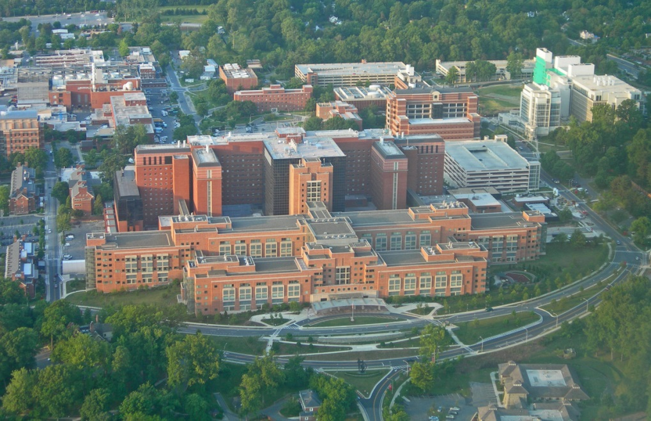
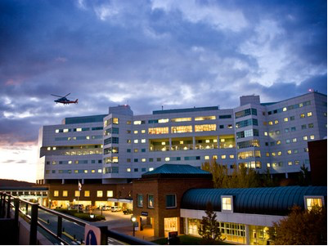
NIH/UVA Neurosurgery Residency Training Program
Innovating according to ACGME Next Accreditation System guidelines
Innovation is not reducing the quality of clinical education
Sponsoring institution provides the appropriate learning environment
Resident education stresses patient safety
Patient care at UVA (all neurosurgical subspecialties) & NIH
Research training at UVA & NIH
Graduating residents
Ready for independent practice now and in the future
Competent measured by ACGME Milestones
Careers assessed to monitor achievement of program goals
All residents have pursued post-residency subspecialty fellowships

