Slide 1
Penn State Department of Neurosurgery
Neurovascular Surgery Program
Kevin M Cockroft, MD, MSc

Slide 2
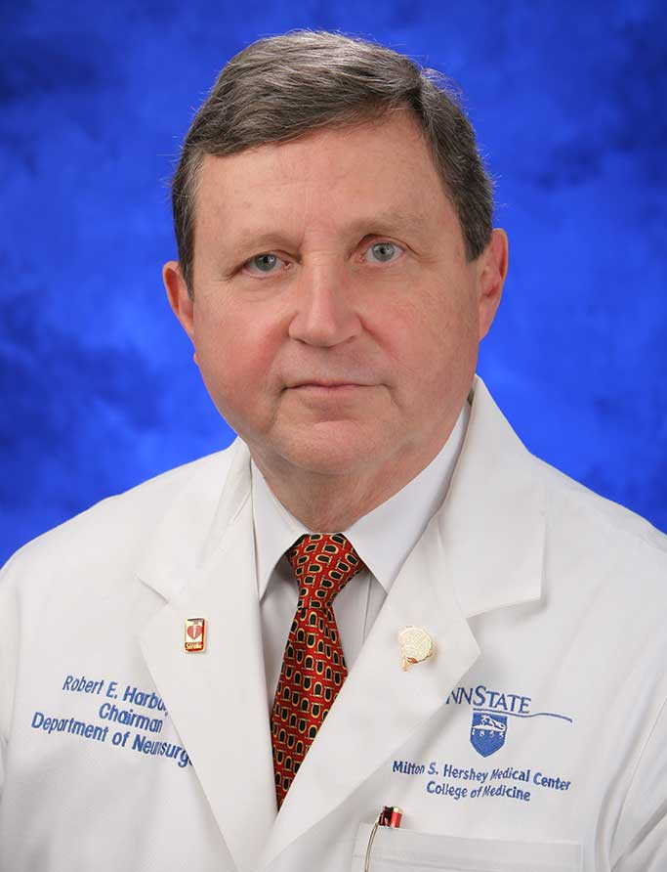
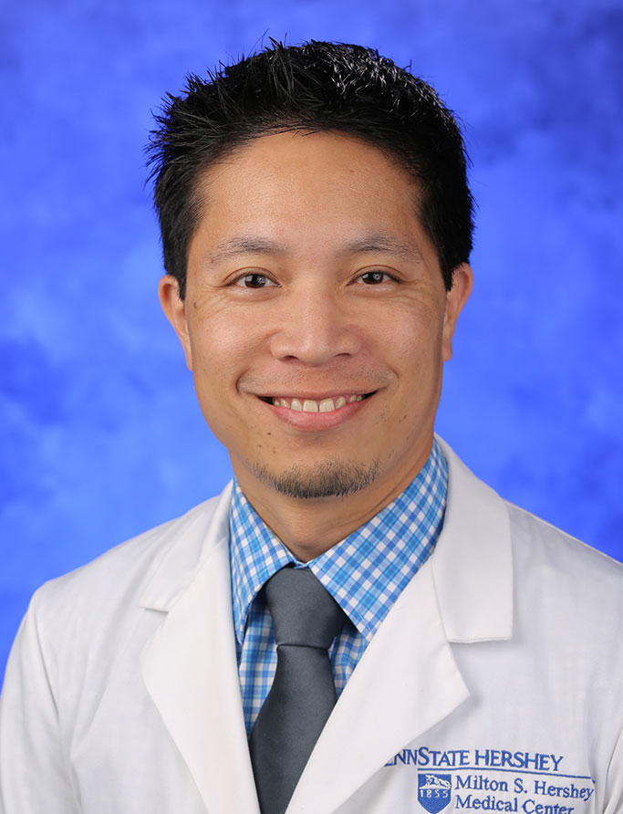
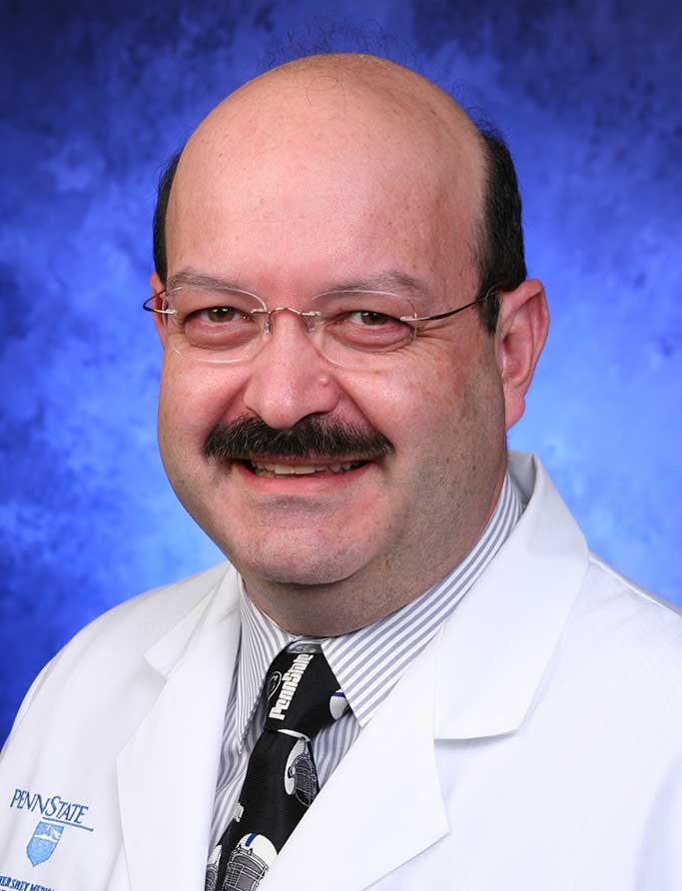
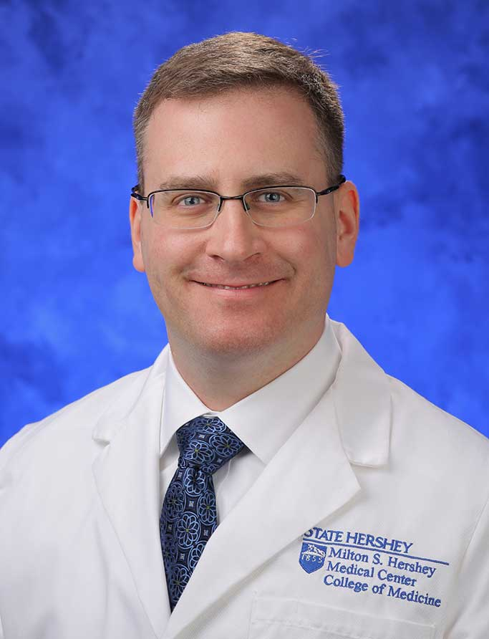
Cerebrovascular Faculty
Robert E. Harbaugh, MD
Kenneth C. Liu, MD
Paul Kalapos, MD
Scott D. Simon, MD

Slide 3
Neurovascular Patient Care
Part of a Joint Commission certified Comprehensive Stroke Center, with over 1000 stroke admissions in 2017

Slide 4
Neurovascular Patient Care
Open surgical procedures including microsurgical aneurysm clipping, AVM resection, carotid endarterectomy and EC-IC bypass.
Endovascular procedures including aneurysm embolization, flow diversion, AVM embolization, mechanical thrombectomy, extracranial and intracranial stenting, and venous sinus stenting.
Gamma Knife Radiosurgery for AVMs.

Slide 5
Neurovascular Patient Care
Open Vascular and Endovascular call schedule.
Endovascular call shared equally among 3 neurosurgeons and 1 interventional neuroradiologist.
Default therapy for ruptured aneurysms is endovascular embolization.
Neuroradiologist admits to the neurosurgery service.
Flexible/Open Neuroscience ICU staffed by neurosurgeons and a neuroanesthesiologist.
Anesthesia block time 5 days a week in neuro angiosuite.

Slide 6
Neurovascular Patient Care
Penn State Hershey Stroke Center
JC Certified, GWTG Gold-Plus.
Neurology and Neurosurgery Co-Directors
Program Manager, 2 Coordinators, Data Support Analyst, dedicated Research Nurse and 8 stroke neurologists.

Slide 7
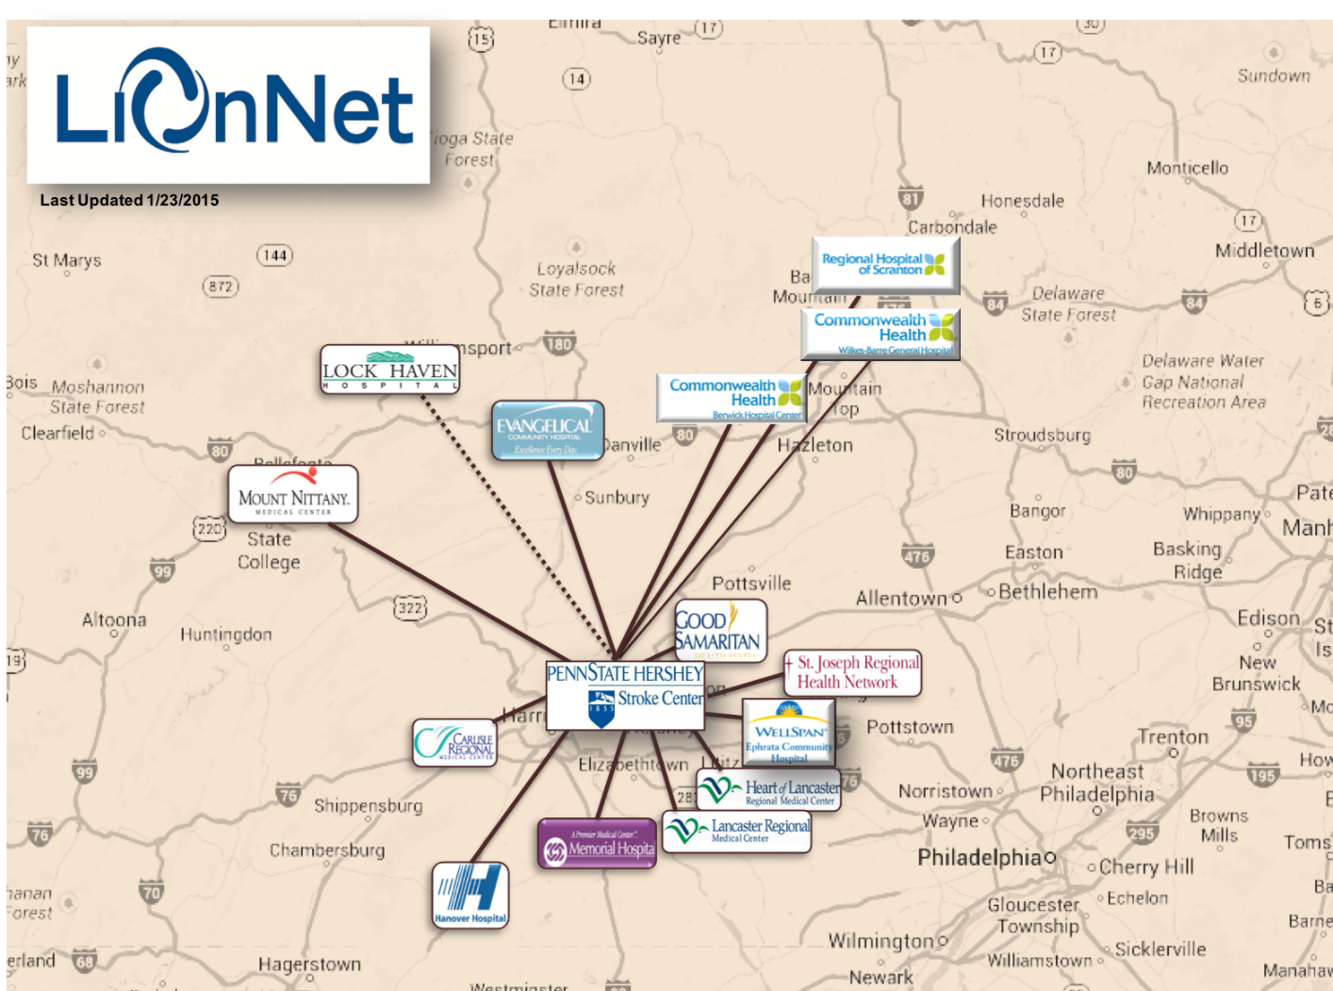
Neurovascular Patient Care
LionNet Telestroke
16 hospital network
Full-time Nurse Program Manager and Nurse Coordinator
REACH telemedicine system

Slide 8
Neurovascular Education
Full integration of Neuroendovascular training into residency
Disease based service line model – RED Service
Graduated responsibility
Angiography suite IS an operating room
CAST accredited fellowship in Neuroendovascular
Fellowship moved to PGY 7 year
Expectation that prospective fellows will complete 200 diagnostic angiograms prior to starting fellowship (or commit to two years of fellowship)

Slide 9
Neurovascular Education - CAST
7 fellows since 2005
Most recent fellow, Ephraim Church, completed fellowship during PGY5 year
Currently Chief Resident
Next year will be Cerebrovascular and Skull Base fellow at Stanford University
Case numbers as of February 2018
327 Diagnostic angiograms
280 Therapeutic procedures (133 aneurysms, 37 AVMs, 110 other)

Slide 10
Neurovascular Research
Clinical and translational (collaborative projects)
Utilization of a viral vector to achieve astrocyte to neuron conversion – Simon & Simpson (PSUCOM, Neural & Behavioral Sciences)
Neurovascular coupling in awake mice after SAH – Cockroft & Drew (PSU Main Campus, Engineering Science & Mechanics)
Current Clinical Trials
APOLLO, CREST II, ENRICH, INTREPID, SMART
Recent Clinical Trials
CLEAR III, IMS III, SENTIS

Slide 11
Neurovascular Research
2017 Publications
Farrell MB, Choi JY, Ziu E, Cockroft KM. Characteristics of Accredited Transcranial Doppler Ultrasound Laboratories in the United States. J Neuroimaging, 27(2):210-216, 2017. (Epub Dec 2016, doi: 10.1111/jon.12415)
Bogason ET, Morrison KJ, Zalatimo O, Ermak D, Lehman EB, Markley EN, Cockroft KM. Urinary Tract Infections in Hospitalized Ischemic Stroke Patients: Source and Impact on Outcome. Cureus, 9(2):e1014. doi: 10.7759/cureus.1014. Feb 6, 2017.
Lavine SD, Cockroft KM, Hoh B, Erratum to: Training guidelines for endovascular stroke intervention: an international multi-society consensus document. Neuroradiology. 2017 Jun 20. doi: 10.1007/s00234-017-1861-8. Lopez L, Farrell MB, Choi JY, Cockroft KM, et al. Accreditation is Perceived to Improve Echocardiography Laboratory Quality: Results of an Intersocietal Accreditation Commission (IAC) Survey. J Diagn Med Sonogr. 33:163-171, 2017. (doi:10.1177/8756479316687277)
Bambakidis N, Cockroft KM, Hu Y, Hirsch JA, et al. Stroke Systems of Care - Perspective of neurointerventional professional societies. Stroke, 48:2901-2904, 2017. (doi: 10.1161/STROKEAHA.117.016773)
Ilyas A, Buell TJ, Chen CJ, Ding D, Raper DMS, Taylor DG, Sokolowski JD, Liu KC. SMART coils for intracranial aneurysm embolization: Initial outcomes. Clin Neurol Neurosurg. 2017 Dec 2;164:87-91. doi: 10.1016/j.clineuro.2017.11.020. [Epub ahead of print]. PMID:29216501.
Buell TJ, Starke RM, Ding D, Hixson HR, Raper DMS, Chen CJ, Liu KC. Venous Sinus Stenting using Transcranial Access for the Treatment of Idiopathic Intracranial Hypertension in a Pediatric Patient. J Neurosci Rural Pract. 2017 Oct-Dec;8(4):672-675. doi: 10.4103/jnrp.jnrp_135_17. PMID:29204038.
Ding D, Buell TJ, Chen CJ, Raper DM, Liu KC, Vollmer DG. Staged Multimodality Treatment of a Large Ruptured Fusiform Supraclinoid Internal Carotid Artery Aneurysm: Microsurgical Clip-assisted Endovascular Coiling. J Neurosci Rural Pract. 2017 Oct-Dec;8(4):668-671. doi: 10.4103/jnrp.jnrp_293_17. PMID:29204037.
Pomeraniec IJ, Ding D, Starke RM, Liu KC, Mrachek EK, Lopes MB, Sheehan JP. Delayed cyst formation after stereotactic radiosurgery for brain arteriovenous malformations. J Neurosurg. 2017 Dec 1:1-10. doi: 10.3171/2017.6.JNS17559. [Epub ahead of print]. PMID:29192860.
Paisan GM, Ding D, Starke RM, Crowley RW, Liu KC. Shunt-Dependent Hydrocephalus After Aneurysmal Subarachnoid Hemorrhage: Predictors and Long-Term Functional Outcomes. Neurosurgery. 2017 Jul 31. doi: 10.1093/neuros/nyx393. [Epub ahead of print]. PMID:28973194.
Buell TJ, Raper DM, Ding D, Chen CJ, Liu KC. Development of an intracranial dural arteriovenous fistula after venous sinus stenting for idiopathic intracranial hypertension. BMJ Case Rep. 2017 Sep 26;2017. pii: bcr-2017-013282. doi: 10.1136/bcr-2017-013282. PMID:28951386.

Slide 12
Neurovascular Research
2017 Publications
11.Buell TJ, Raper DMS, Pomeraniec IJ, Ding D, Chen CJ, Taylor DG, Liu KC. Transient resolution of venous sinus stenosis after high-volume lumbar puncture in a patient with idiopathic intracranial hypertension. J Neurosurg. 2017 Aug 25:1-4. doi: 10.3171/2017.3.JNS163181. [Epub ahead of print]. PMID:28841117.
12.Raper D, Buell TJ, Ding D, Chen CJ, Starke RM, Liu KC. Pattern of pressure gradient alterations after venous sinus stenting for idiopathic intracranial hypertension predicts stent-adjacent stenosis: a proposed classification system. J Neurointerv Surg. 2017 Jun 21. pii: neurintsurg-2017-013135. doi: 10.1136/neurintsurg-2017-013135. [Epub ahead of print]. PMID:28637822.
13.Ding D, Starke RM, Crowley RW, Liu KC. Surgical Approaches for Symptomatic Cerebral Cavernous Malformations of the Thalamus and Brainstem. J Cerebrovasc Endovasc Neurosurg. 2017 Mar;19(1):19-35. doi: 10.7461/jcen.2017.19.1.19. Epub 2017 Mar 31. PMID:28503485.
14.Spiotta AM, Derdeyn CP, Tateshima S, Mocco J, Crowley RW, Liu KC, Jensen L, Ebersole K, Reeves A, Lopes DK, Hanel RA, Sauvageau E, Duckwiler G, Siddiqui A, Levy E, Puri A, Pride L, Novakovic R, Chaudry MI, Turner RD, Turk AS. Results of the ANSWER Trial Using the PulseRider for the Treatment of Broad-Necked, Bifurcation Aneurysms. Neurosurgery. 2017 Apr 25. doi: 10.1093/neuros/nyx085. [Epub ahead of print]. PMID:28449126.
15.Raper DMS, Ding D, Buell TJ, Crowley RW, Starke RM, Liu KC. Effect of Body Mass Index on Venous Sinus Pressures in Idiopathic Intracranial Hypertension Patients Before and After Endovascular Stenting. Neurosurgery. 2017 Apr 20. doi: 10.1093/neuros/nyx186. [Epub ahead of print]. PMID:28431144.
16.Raper DM, Buell TJ, Chen CJ, Ding D, Starke RM, Liu KC. Intracranial venous pressures under conscious sedation and general anesthesia. J Neurointerv Surg. 2017 Mar 30. pii: neurintsurg-2017-012984. doi: 10.1136/neurintsurg-2017-012984. [Epub ahead of print]. PMID:28360352.
17.Ilyas A, Chen CJ, Raper DM, Ding D, Buell T, Mastorakos P, Liu KC. Endovascular mechanical thrombectomy for cerebral venous sinus thrombosis: a systematic review. J Neurointerv Surg. 2017 Feb 17. pii: neurintsurg-2016-012938. doi: 10.1136/neurintsurg-2016-012938. [Epub ahead of print] Review. PMID:28213478.
18.Baum GR, Hooten KG, Lockney DT, Fargen KM, Turan N, Pradilla G, Murad GJ, Harbaugh RE, Glantz M, EVD Best Practice Team. External ventricular drain practice variations: results from a nationwide survey. J Neurosurg. 2017 Jan 13:1-8. doi: 10.3171/2016.9.JNS16367. [Epub ahead of print] PMID: 28084912, 2017.
19.Day A, Siddiqui A, Meyers P, Jovin T, Derdeyn C, Hoh B, Riina H, Linfante I, Zaidat O, Turk A, Howington J, Mocco J, Ringer A, Veznedaroglu E, Khalessi A, Levy E, Woo H, Harbaugh RE, Giannotta S. Training standards in neuroendovascular surgery: program accreditation and practitioner certification. Stroke 48: 2318-2325, 2017.
20.Abbott A, Silvestrini M, Topakian R, Golledge J, Brunser AM, de Borst GJ, Harbaugh RE, Doubal FN, Rundek T, Thapar A, Davies AH, Kam A, Wardlaw AM. Optimizing the definitions of stroke, TIA and infarction for research and application in clinical practice. Frontiers in Neurology, 8: Article 537, October 18, 2017.

Slide 13
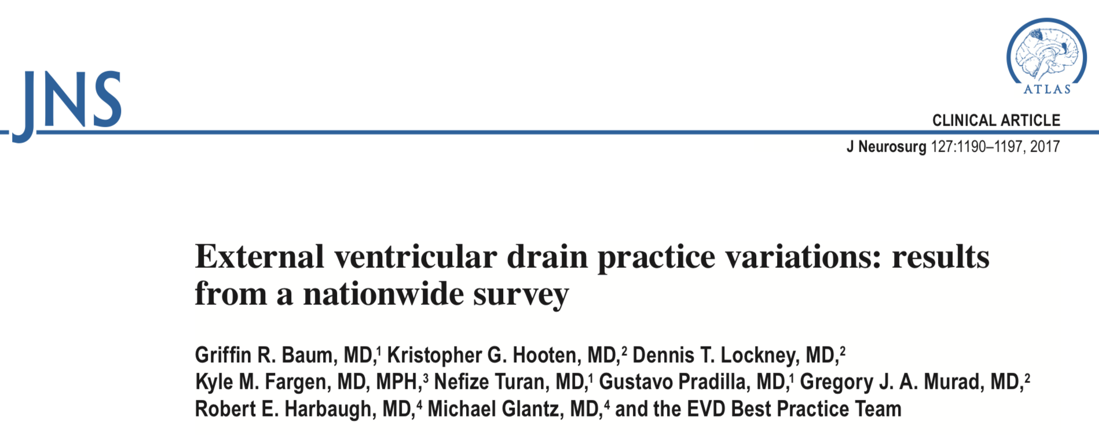
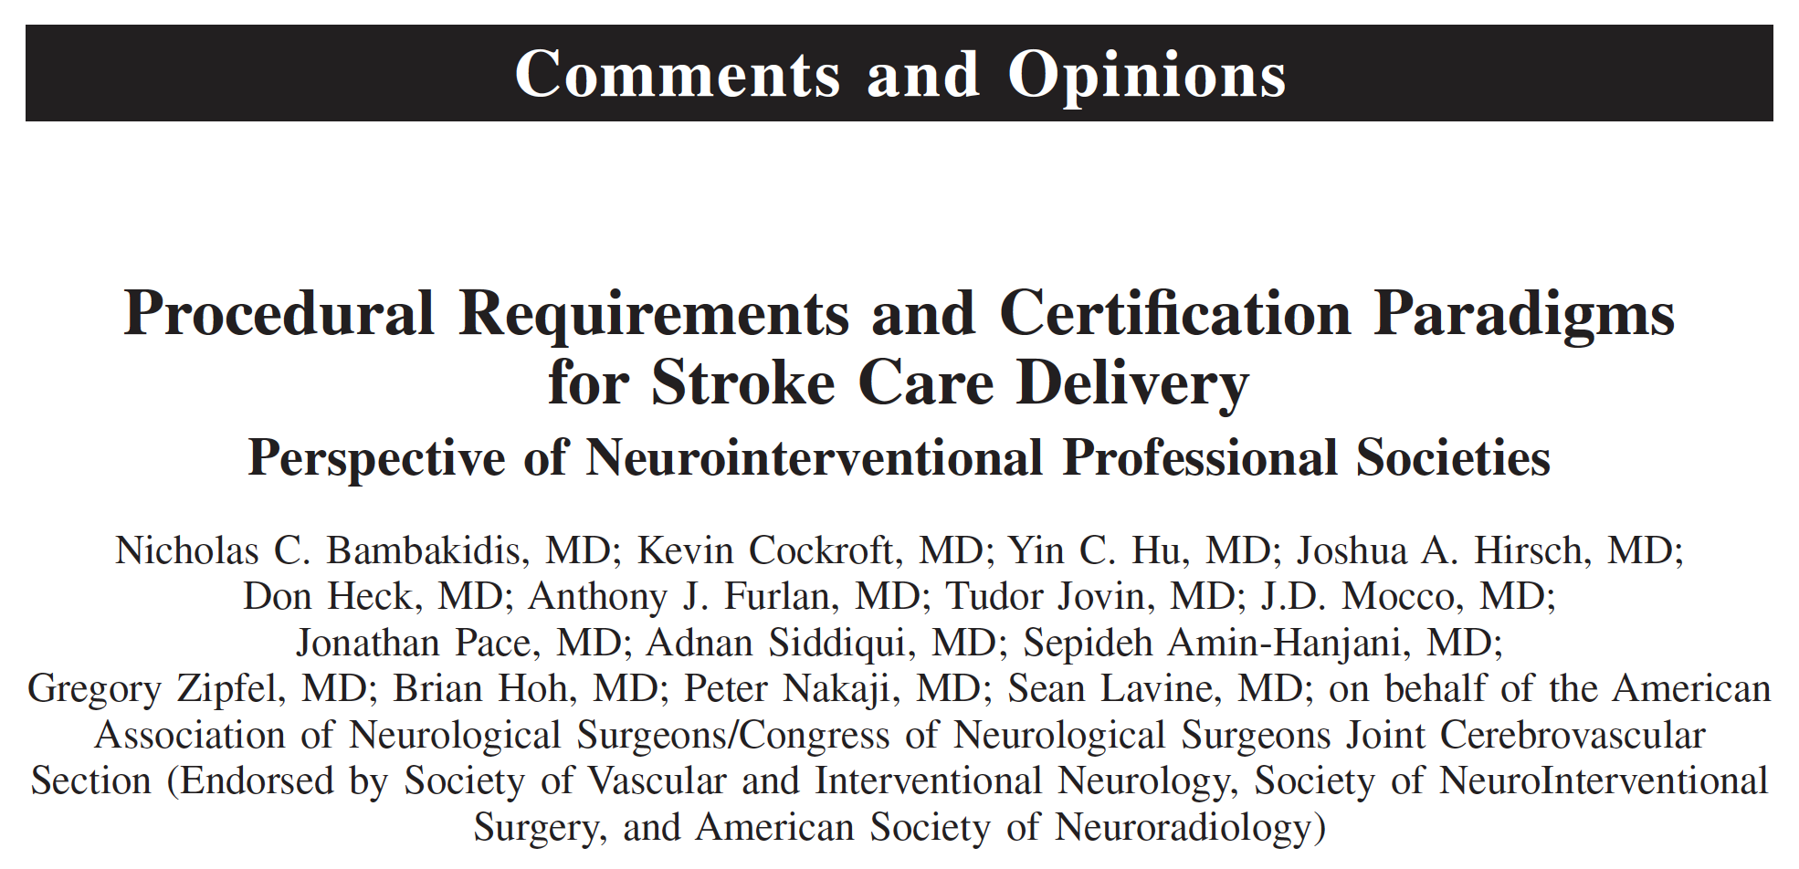
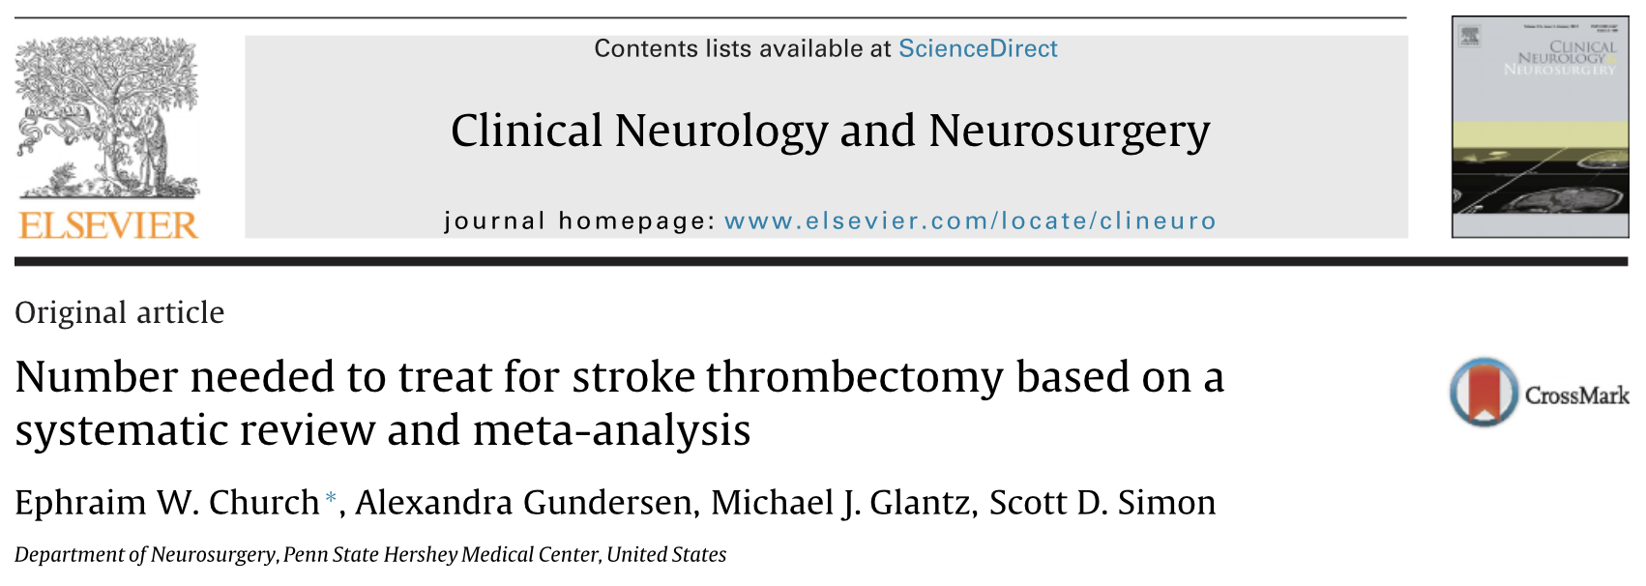
Neurovascular Research
2017 Publications
21. Sieg EP, Schlauderaff AC, Payne RA, Glantz MJ, Simon SD. Impact of an External Ventricular Drain Placement and Handling Protocol on Infection Rates: A Meta-Analysis and Single Institution Experience. World Neurosurg. 2018 Apr 2.
22. Davanzo JR, Simon SD: Temporal augmentation with polymethyl methacrylate at the time of autologous cranioplasty. British Journal of Neurosurgery, Published online 19 Dec 2017.
23. Tsay AJ, Langan S, Simon SD: Contrast Enhancement of Aneurysm Sac Post-Pipeline Treatment Interpreted as Recanalization. Cureus J Med Sci 9(9)e1732, published online Sept 29, 2017.
24. Church EW, Gundersen A, Glantz MJ, Simon SD. Number needed to treat for stroke thrombectomy based on a systematic review and meta-analysis. Clin Neurol Neurosurg. 2017;156:83-88.

Slide 14
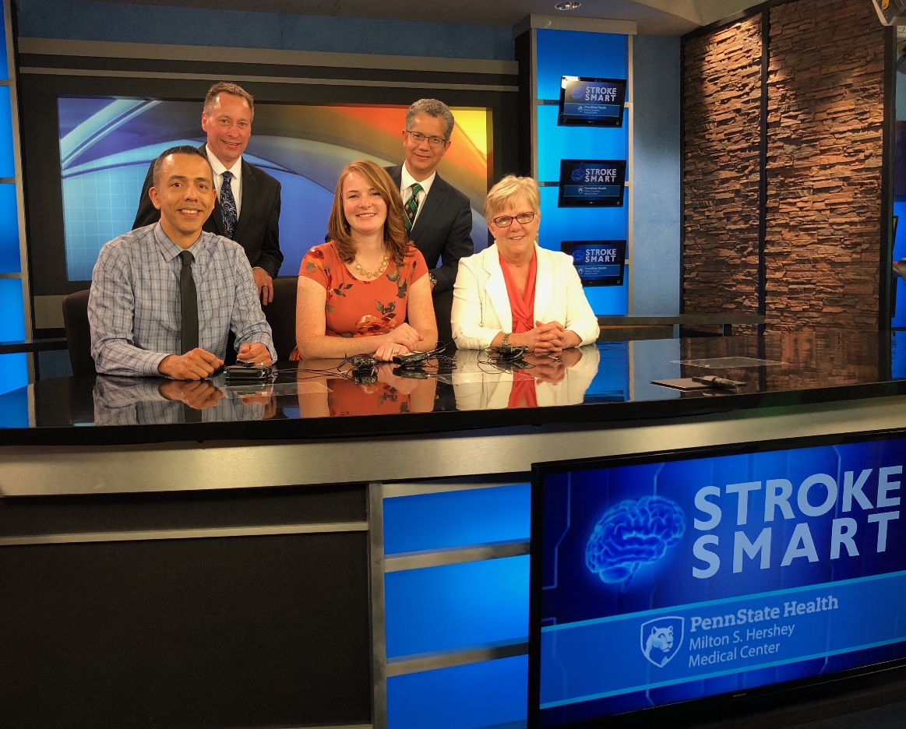
Neurovascular Outreach – Stroke Center
Stroke Support Group
Stroke awareness presentations at local business and schools
Stroke Detective Program
ABC27 Stroke Smart, WITF Smart Talk
Penumbra Quarterly
Stroke Referral Reports

Slide 15
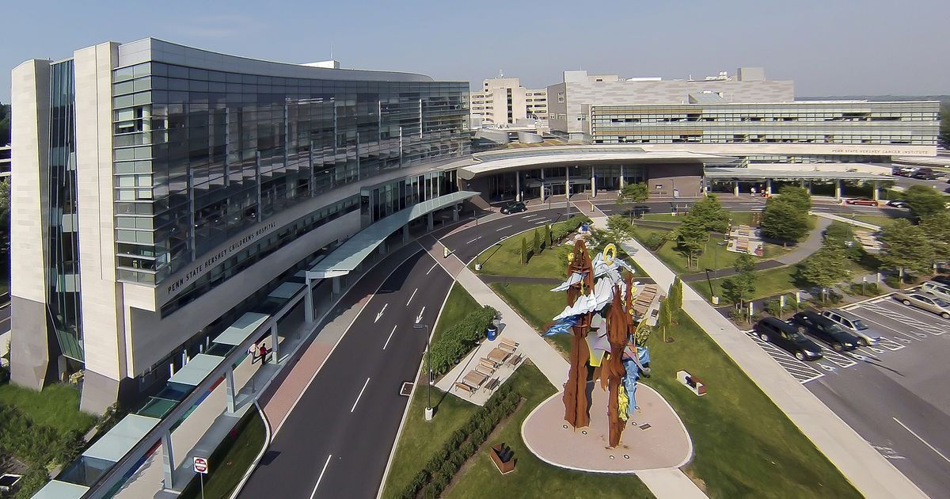
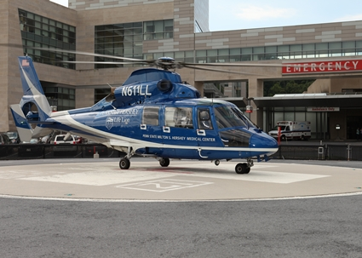
Thank You

